Slide 1
Domestic LFP Cell Manufacturing Overview May 2024 James D. Hodge, Ph.D.

Slide 2
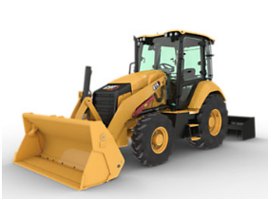
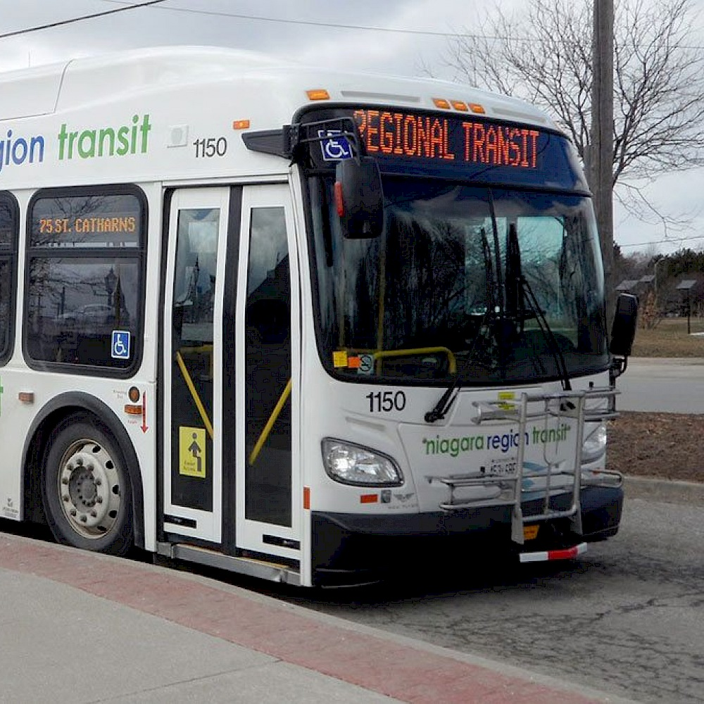
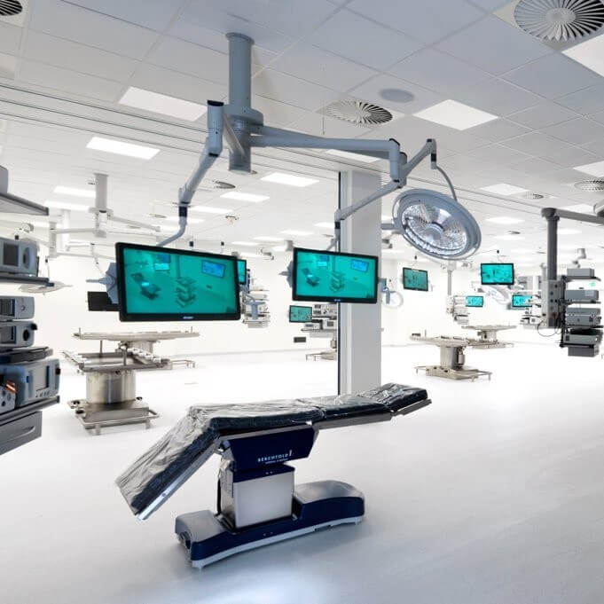
Lithion: Overview
585 employees
2 cell manufacturing facilities
100+ patents & licenses
4 module manufacturing facilities
400+ current customers
42 engineers and R&D staff
Chemistry
Cells
Modules
Systems
BMS
Integrated Approach to Solve Electrification Needs of Customers

Slide 3
Lithion: Established Presence
Calgary, AB 42,000 sq. ft. (cell manufacturing) 11,700 sq. ft. (pack manufacturing) 157 employees
Houston, TX Pack manufacturing 12,000 sq. ft. 17 employees
Belfast, UK Sales / engineering 8 employees
Billerica, MA Manufacturing / distribution 52,000 sq. ft. 186 employees
Enschede, NL Fulfillment 2 employees
Shanghai, CN Sourcing /Engineering 12 employees
Henderson, NV Lithion Head Office LFP cell manufacturing 80,000 sq. ft. Module Manufacturing 120,000 sq. ft. 112 employees
Austin, TX Engineering 12,000 sq. ft. PCBA Manufacturing 10,000 sq. ft. 8 employees

Slide 4
Lithion: Domestic cell manufacturing evolution
Original 2019 concept: Domestic cell manufacturing for customers concerned with increased supply chains costs and potential supply chain interruption
Secondary goal: Provide a path for commercialization for new U.S.-developed battery materials and processes
Future expansion: Cylindrical cell facility to be a precursor for a larger prismatic cell facility as the energy storage market became more defined

Slide 5
Lithion: LFP Cell Manufacturing Highlights
Facility Scale: 80,000 Sq. Ft. facility located in Henderson, Nevada
Capacity: Initial manufacturing capacity of >40 MW/year (equates to ~4 – 5 million 26650 cells per annum)
Expansion: Plan to increase manufacturing capacity to >80 MW (current facility has sufficient space, power, and electrode coating capacity)
Products: LFP/Graphite 26650 cylindrical cells targeting military, medical and industrial sectors. Facility allows for broad flexibility in cell design/performance.
Current employment: Engineering and Development: 10 professionals; Production: 3 professionals, 10 operator/technicians → 20 perators/shift when fully operational
Military Contract: Awarded an $8.0 million development contract with the US Navy for future shipboard power systems
Supply Chain: Full North American sourcing of critical materials/components targeted for 2025-2026

Slide 6
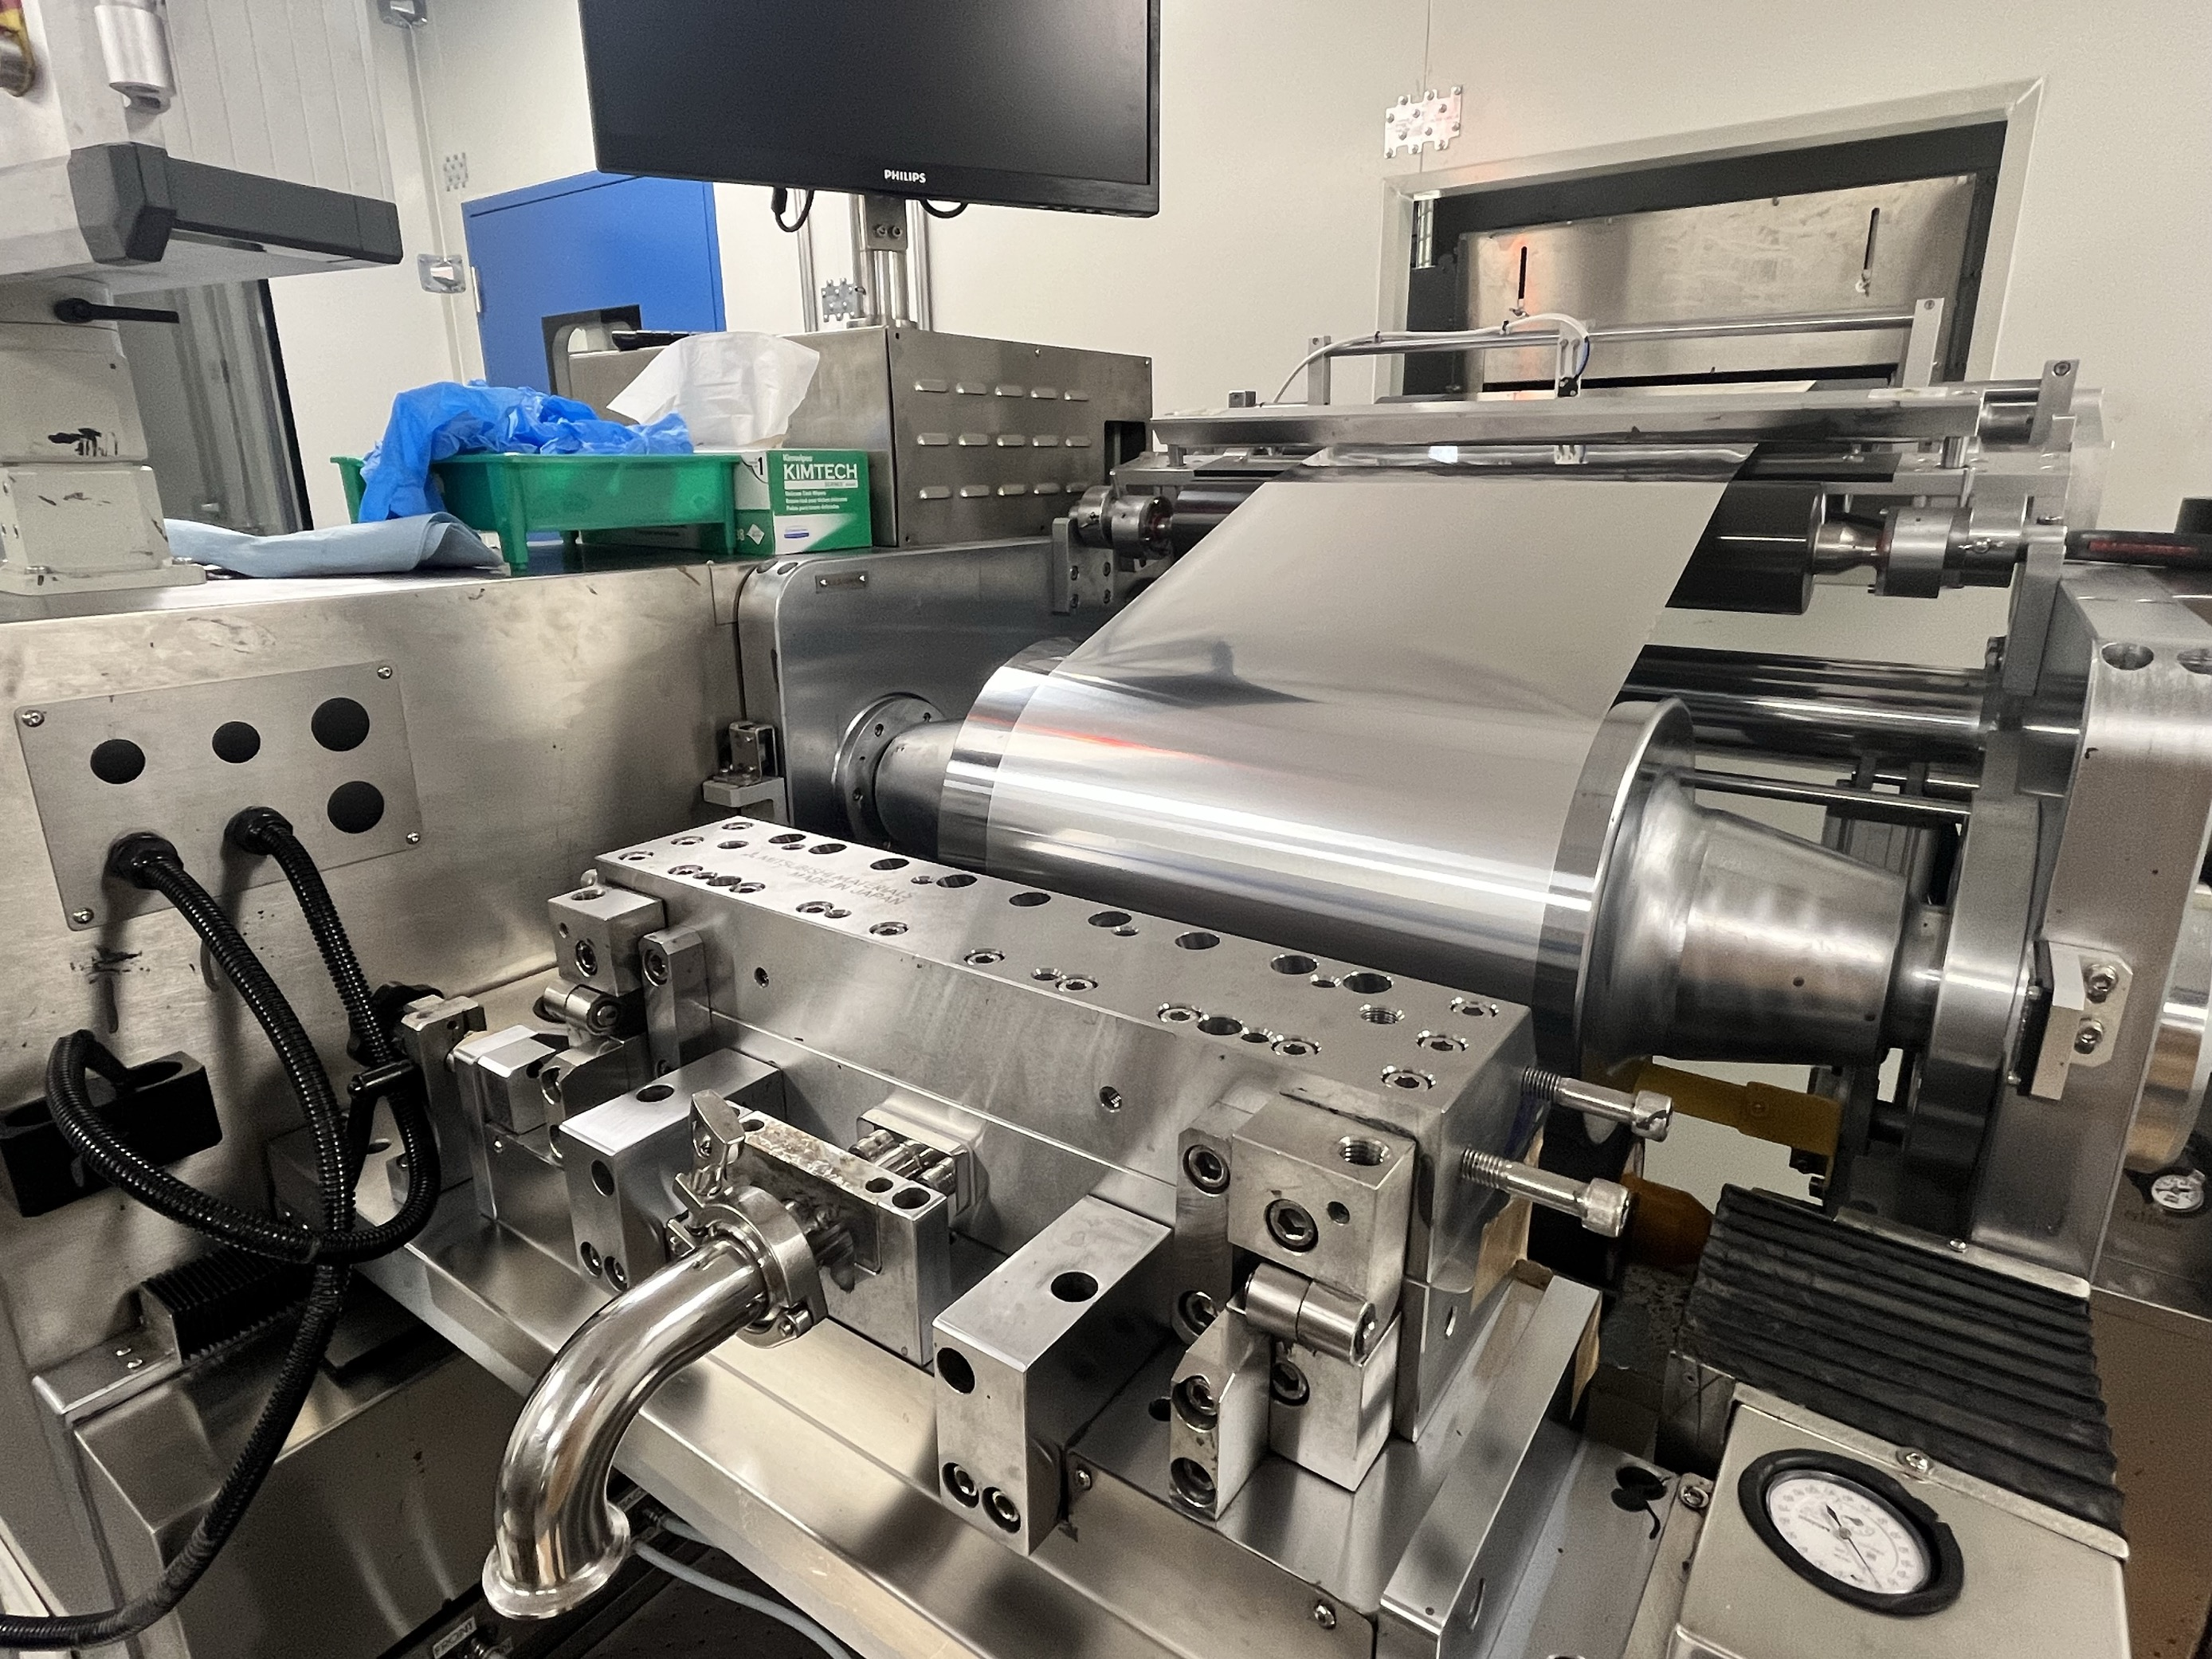
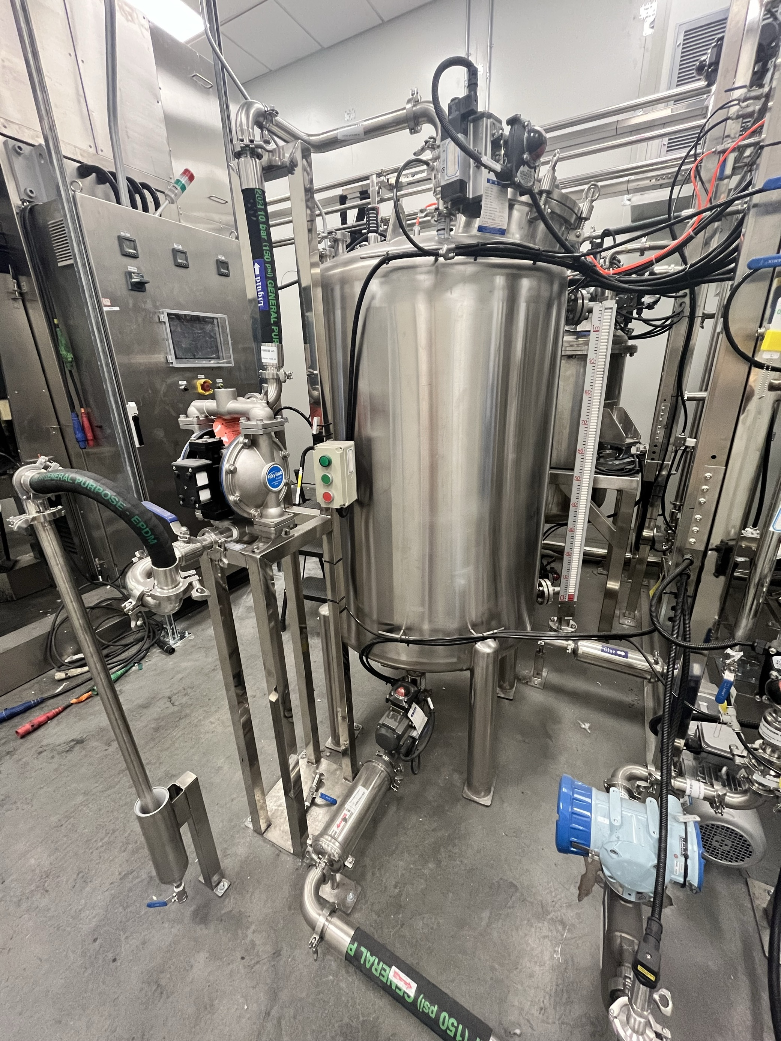
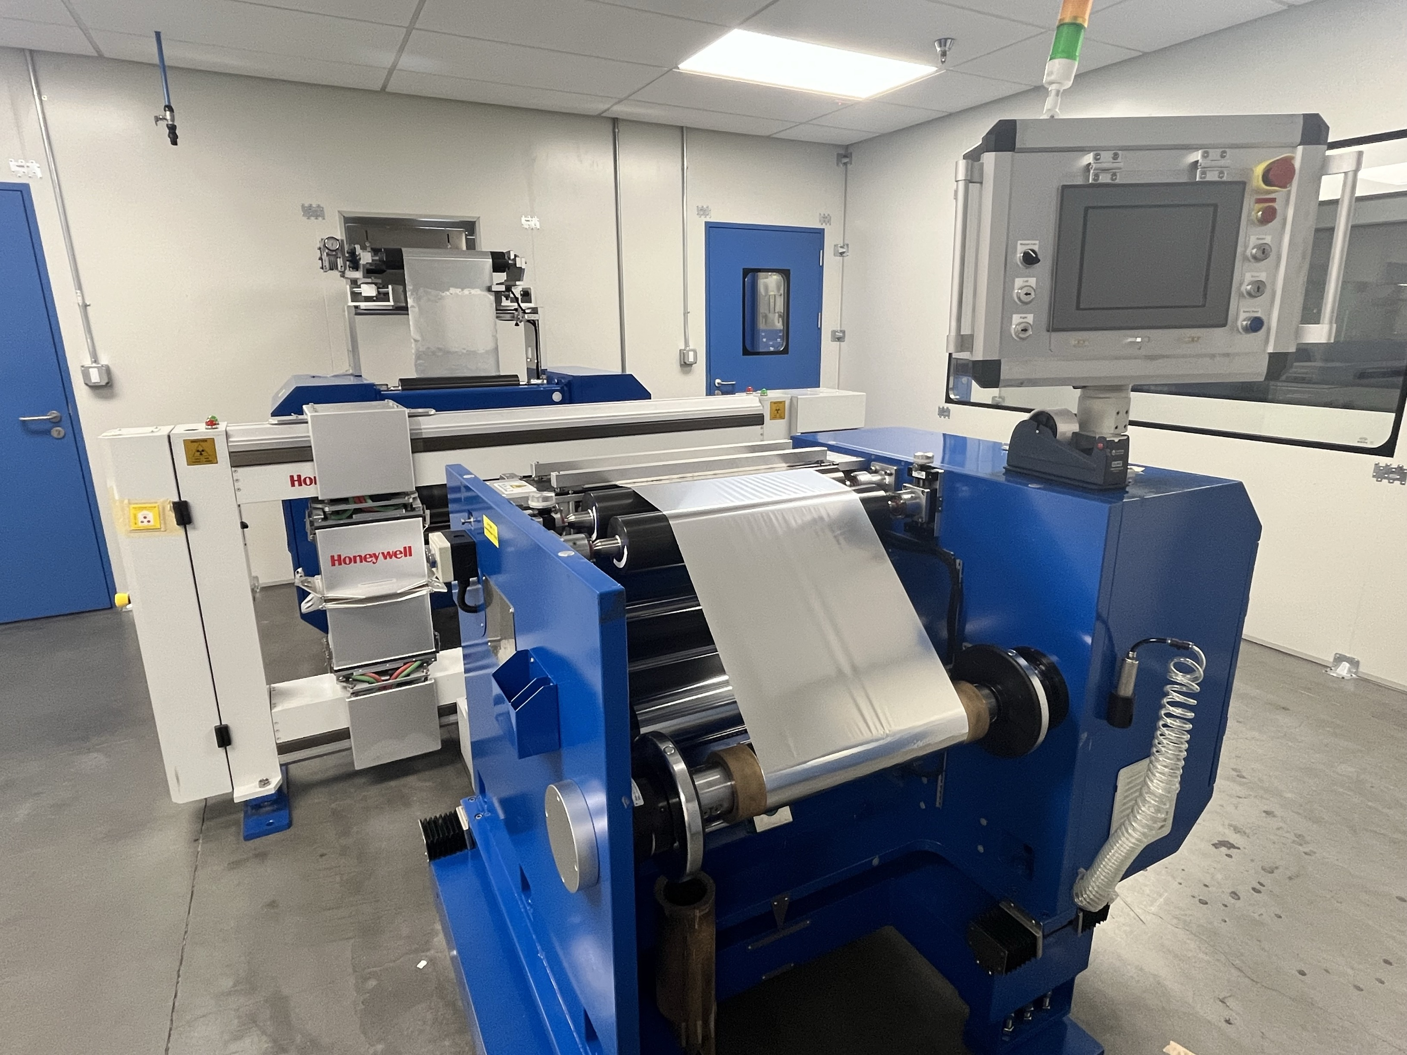
LFP Cell Manufacturing: Facility Overview

Slide 7
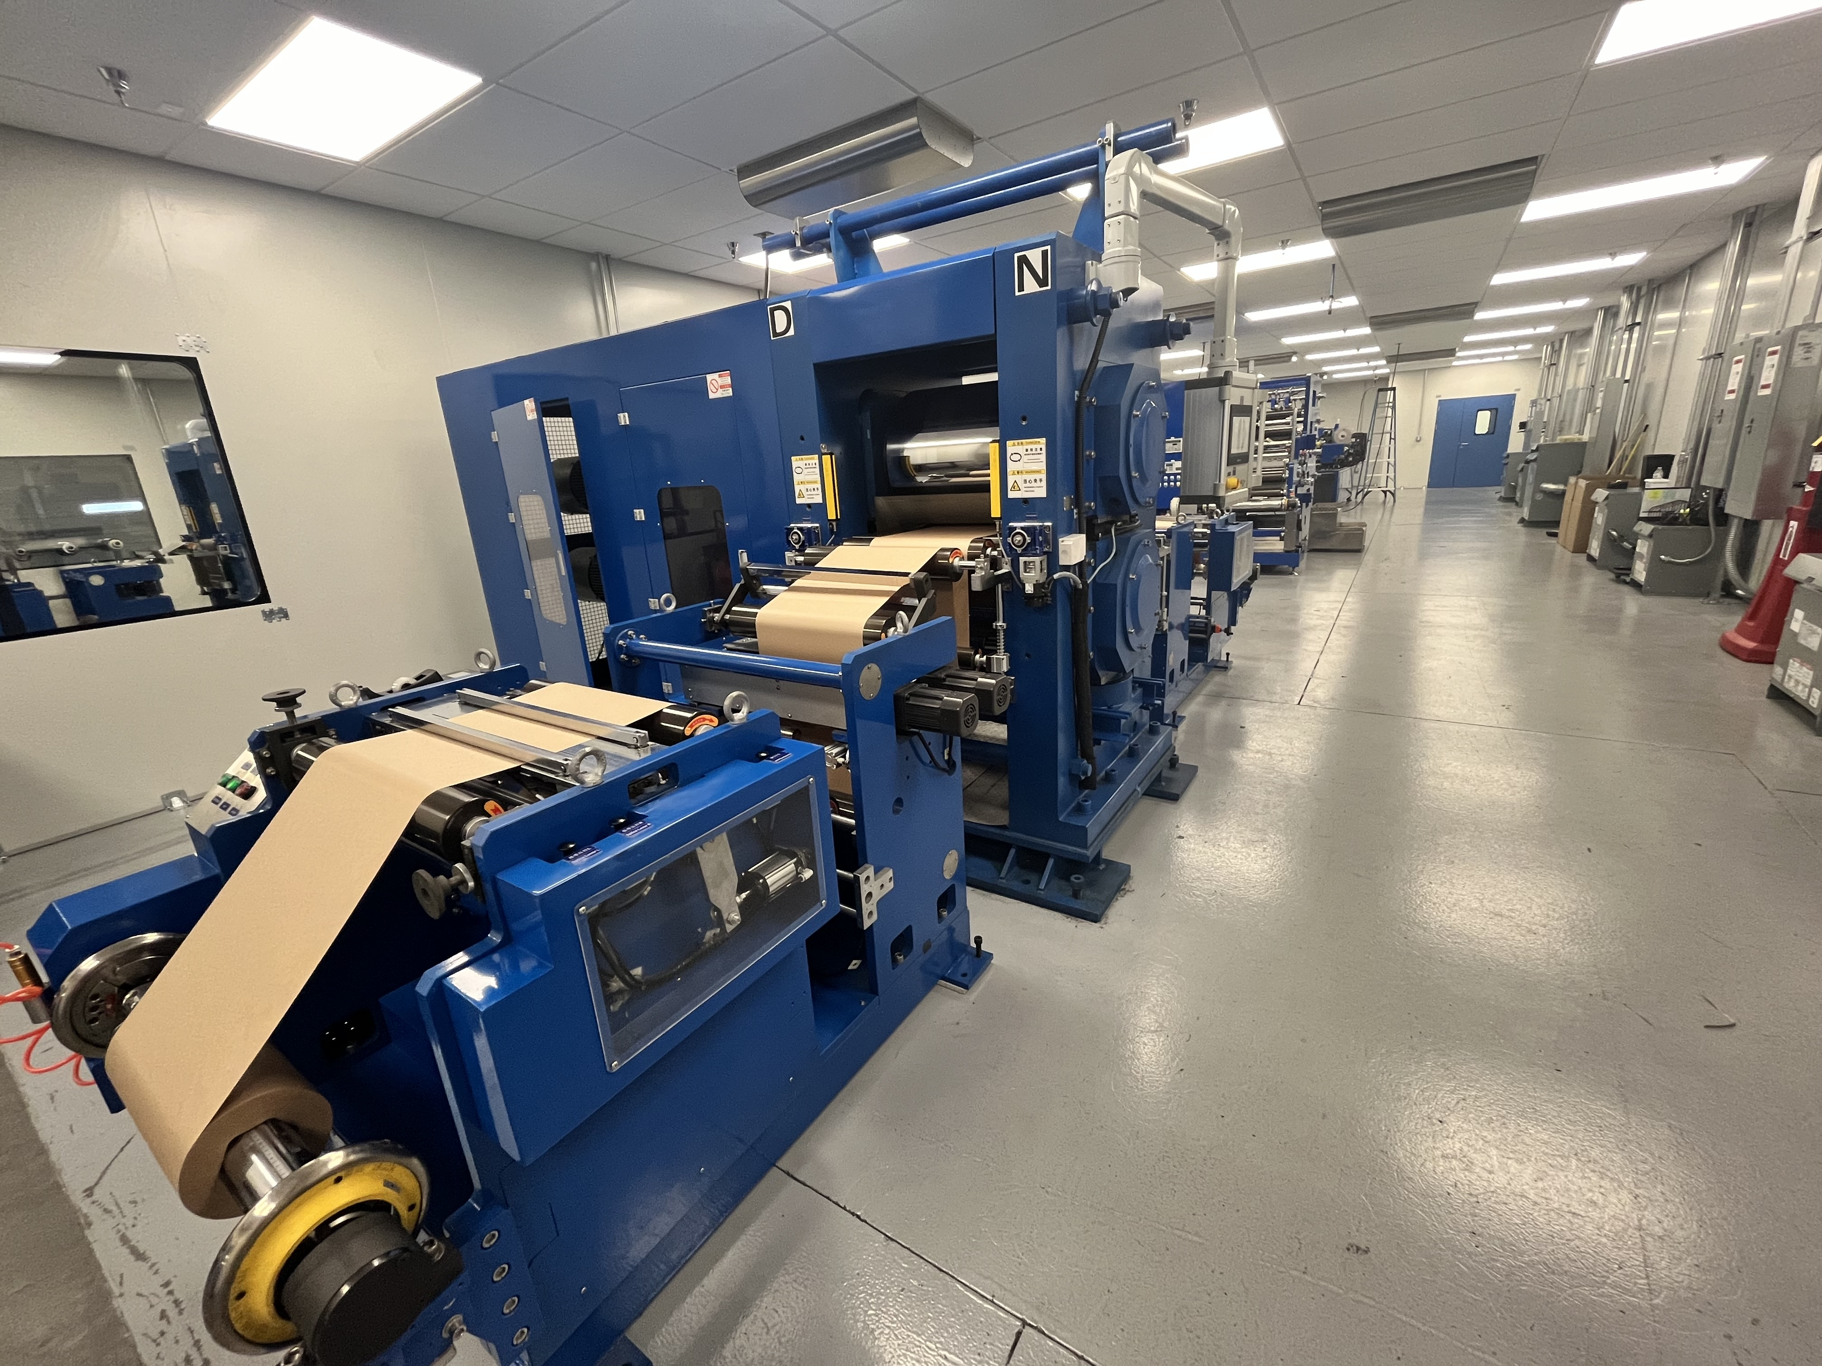
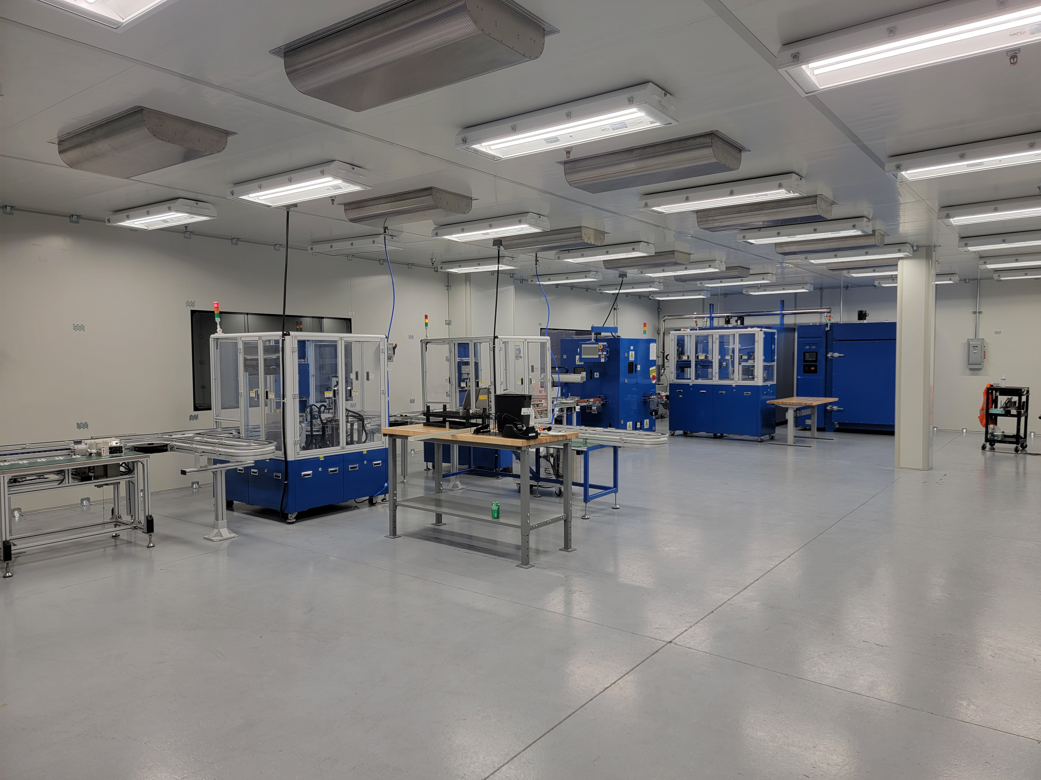
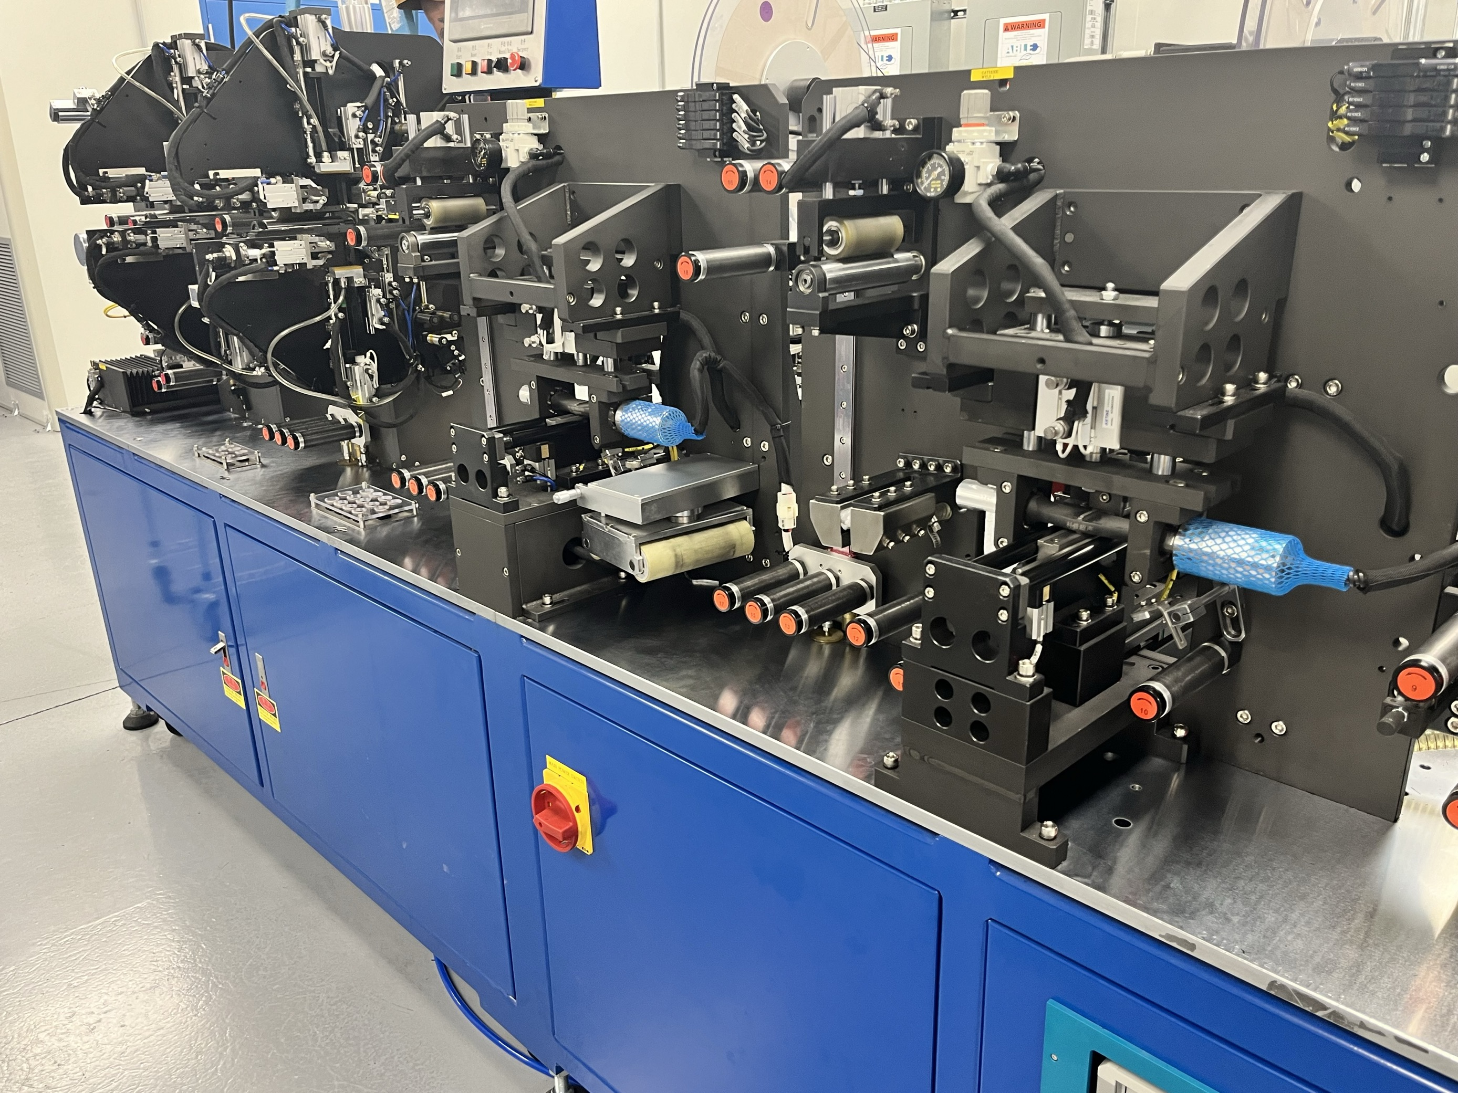
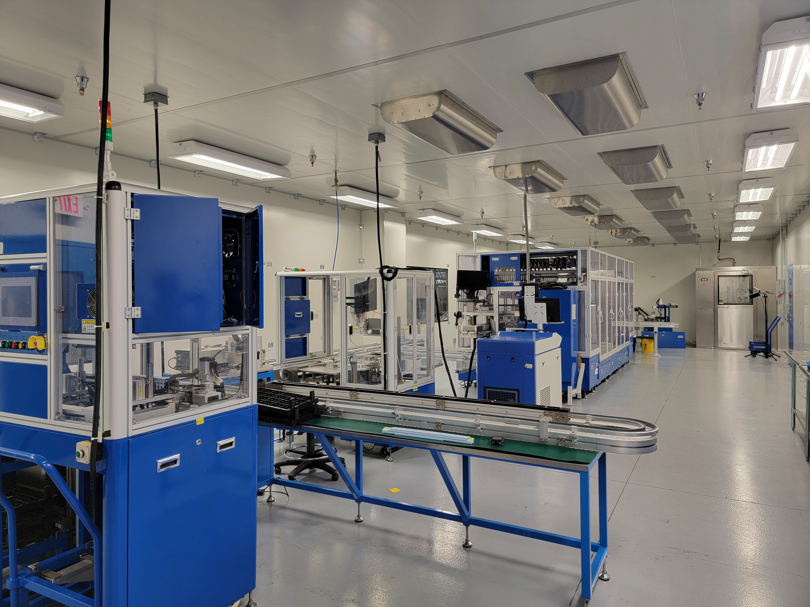
LFP Cell Manufacturing: Facility Overview

Slide 8
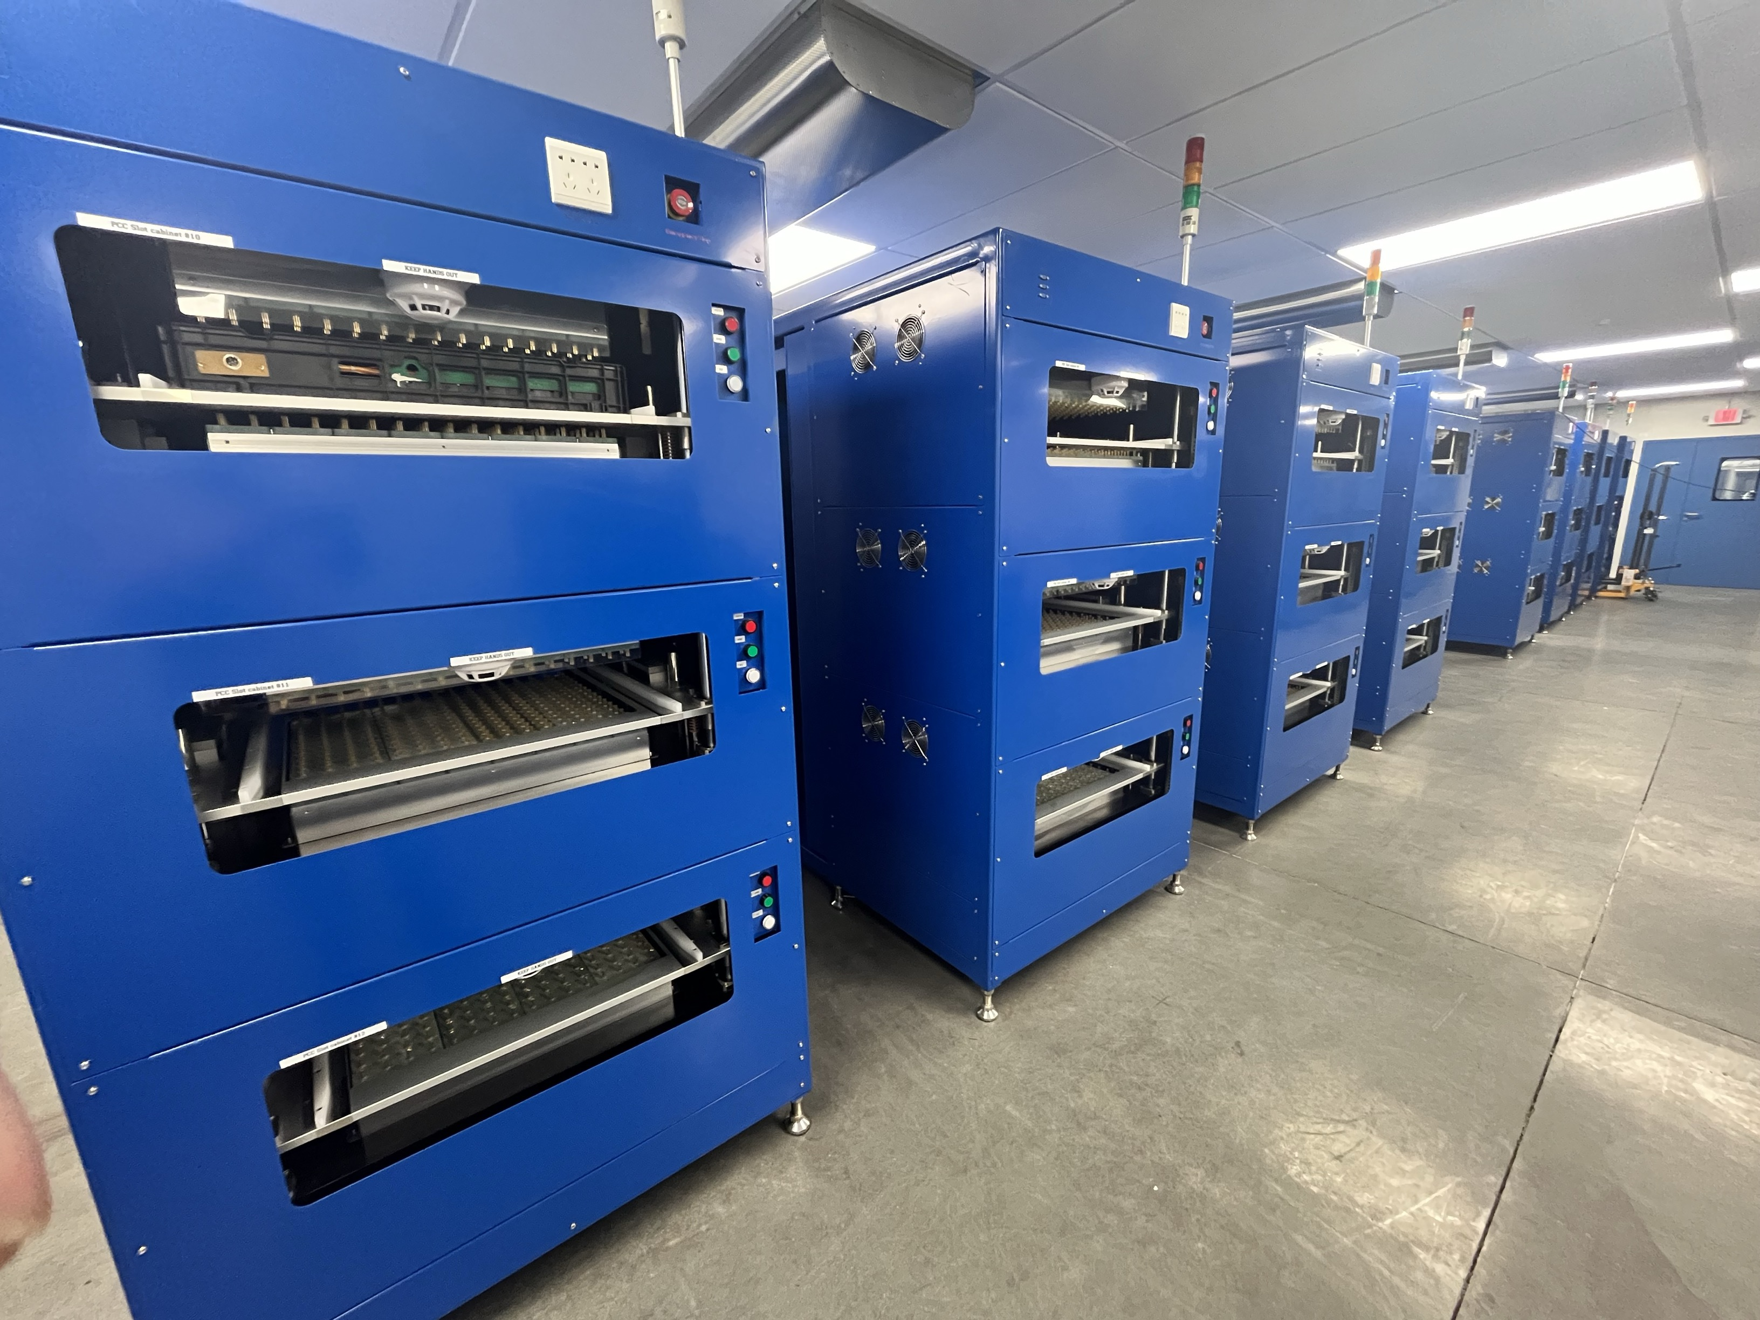
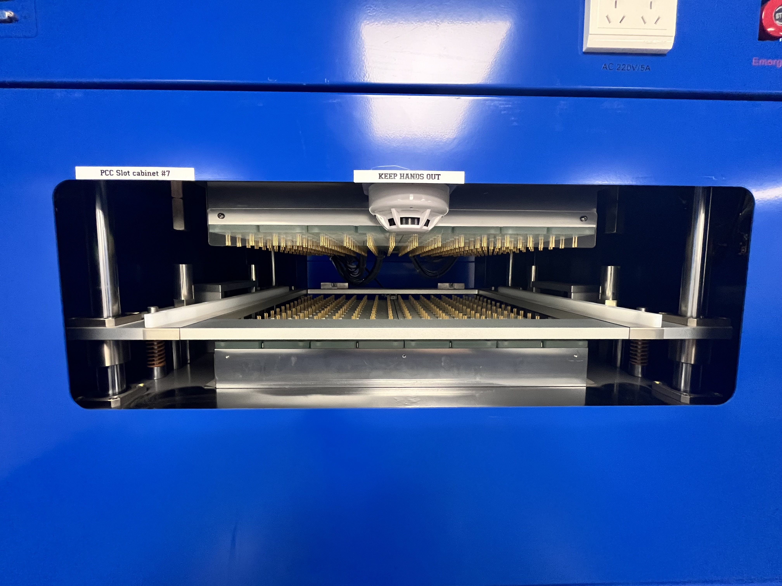
LFP Cell Manufacturing: Facility Overview

Slide 9
Challenges
Regulatory environment
Logistics, construction and operations
Workforce acquisition and development, professionals and hourly
Supply chain
Utility costs
Technical support

Slide 10
James Hodge, Ph.D.
jhodge@lithionbattery.com

