Slide 1
Operating Batteries at the Limit - Safely and Profitably
Advancing DoD
Battery Maintenance and Sustainment with Predictive Analytics
Robert Masse
Founder / CEO
MPSC DPEC
June 4, 2024
© 2023 Astrolabe Analytics, Inc. All Rights Reserved.

Slide 2
Outline
Astrolabe Overview
Problem Statement
Approach
Applications
Product Soft-Launch
MPSC Battery Maintenance Committee Plug
© 2023 Astrolabe Analytics, Inc. All Rights Reserved.

Slide 3
Core Team
Astrolabe combines battery and data science expertise
Robert Masse, PhD
Founder & CEO, Material Scientist
Shrilakshmi Bonageri, MS
Lead Data Scientist
Tahmida Shimu, MBA
Director of Strategy and Operations
Sebastian Kuhn, MS
Head of Product
© 2023 Astrolabe Analytics, Inc. All Rights Reserved.

Slide 4
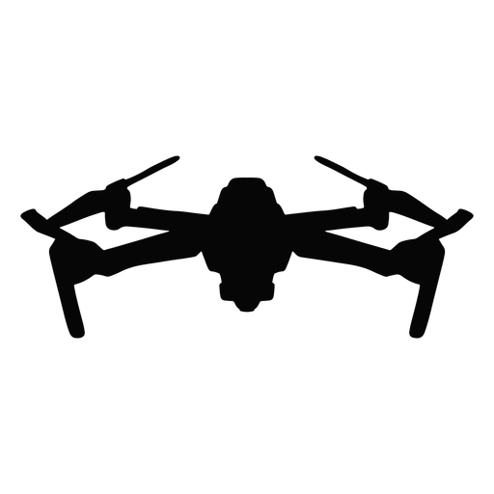
About Astrolabe
Established
Accelerating Electrification by enabling batteries to go beyond using Data Driven Battery Health and Performance Modeling.
$2.3M in non-dilutive funding
2018
Based in
Seattle, WA
Multiple commercial projects pertaining to eVTOL, drone, and commercial & industrial assets
Facts
Mission & Technology
Funding
Relevant Professional Memberships and Partners
Soteria Battery Innovation Group
Washington Cleantech Alliance
Vertical Flight Society
Military Power Sources Consortium
National Center for Manufacturing Sciences
© 2023 Astrolabe Analytics, Inc. All Rights Reserved.

Slide 5
Problem
Batteries impact the functional safety and economics
of electric hardware, vehicles, and devices.
But real-time battery maintenance is costly and impractical; we are unable to answer basic questions:
Battery Performance
Battery Health & End-of-life
Is my battery able to conduct its next mission?
Is my battery ready to power the next maneuver?
When is my battery
going to die?
Is my battery in danger of catching fire?
© 2023 Astrolabe Analytics, Inc. All Rights Reserved.

Slide 6
Consequences: High Cost and Danger
Maintenance
Field Operations
Premature Retirement
Vehicle loss
Batteries catch on fire or die unexpectedly.
Unsafe for users, operators
Overbuy inventory
Added maintenance hours
Jeopardize mission
© 2023 Astrolabe Analytics, Inc. All Rights Reserved.

Slide 7
To avoid this, the
battery developers, operators, and maintainers
need the means to
manage battery performance
and inform condition-based maintenance.
© 2023 Astrolabe Analytics, Inc. All Rights Reserved.

Slide 8
How can Astrolabe help?
Astrolabe provides software and services to forecast and monitor the health of battery systems:
- Drones/UAV
- Light electric vehicles
- Electric aircraft
Value proposition:
- Reduce battery maintenance and replacements costs
- Ensure high system safety and uptime
- Prevent mission failure

Slide 9
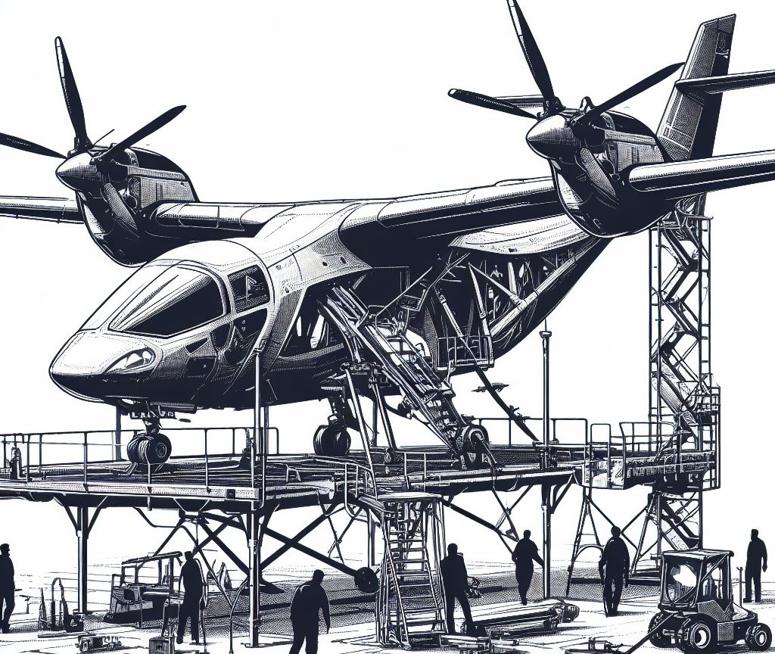
Value Proposition:
Reduced OpEx and increased mission readiness
Maintenance
Field Operations
Up to double the battery (calendar) life
50% reduced battery inventory
$400,000/yr estimated savings for DoD program
Real-time operator insights into the battery’s state allowing for timely incident management
100% readiness and uptime
Maritime
AUV/UUV
Dismounted Operations
Drone Logistics
Urban Air Mobility
© 2023 Astrolabe Analytics, Inc. All Rights Reserved.

Slide 10
How do we achieve that?
We forecast battery health, safety, performance using data-driven machine learning and electrochemically-inspired models
Is this battery safe for the next mission? Y/N
Do I have a warranty claim? Y/N
Is service required? Y/N
When?
Do I have to order to new batteries? Y/N
Your Data Here
(I, V, T)
Astrolabe Engine
Our algorithms can live on the cloud, as well as embedded on hardware
© 2023 Astrolabe Analytics, Inc. All Rights Reserved.

Slide 11
Astrolabe’s Solution
Algorithms
Lightweight software algorithms
Weak Cell Identification
To determine real-time battery health and remaining useful life
State of Health (SoH)
State of Power (SoP)
Embedded in battery hardware
Integrated in maintenance processes and software
Remaining Useful Life (RUL)
State of Charge (SoC)
© 2023 Astrolabe Analytics, Inc. All Rights Reserved.

Slide 12
Use case:
When does it make sense to use our tech?
01
02
There is a mission and/or business need into battery cycle life and performance due to safety, reliability, or efficiency concerns.
Historical data is available or there is cloud telemetry/ onboard sensing available as input data.
© 2023 Astrolabe Analytics, Inc. All Rights Reserved.

Slide 13
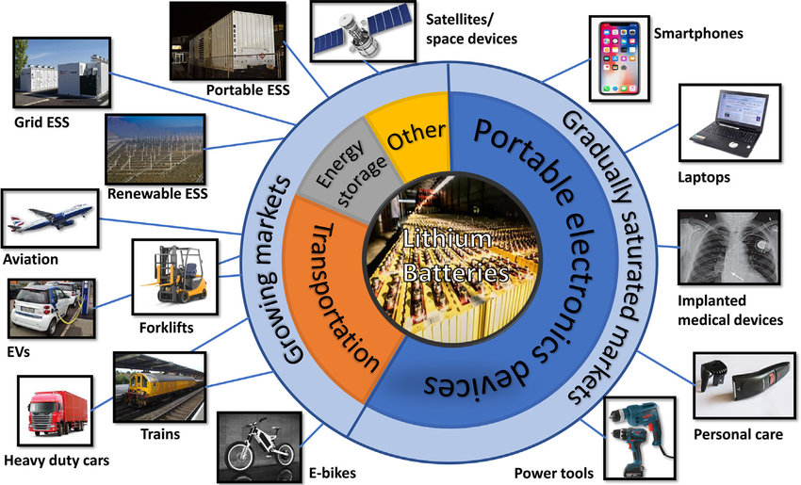
Q: Which Battery Vertical / Applications / Chemistries?
Ans: I don’t care, they’re all batteries to me
Key features:
Large (non-attritable) fleets
High value assets
Remote/autonomous devices
Failure unacceptable (or at least very expensive)
Chemistry Indifferent
Li-ion
Na-ion
Li-S
Silicon anode
Li-metal
Redox flow
Lead acid
Zinc, etc.

Slide 14
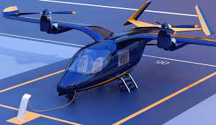
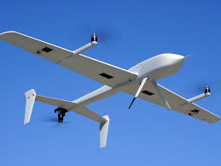
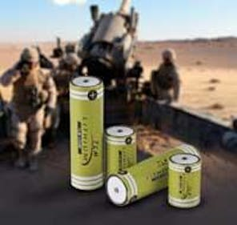
Applications
 | Embedded | Ground Control System | Cloud
EVTOL (USAF Phase 2) | ✔
UAV (under development) |  | ✔ | ✔
ESS (NSF Phase 2) |  |  | ✔
IoT / SWaP (under development) | ✔ |  | ✔
Notes:
The second case study id like to discuss involves pack level project with beta technologies where we have defeloped a preliminary algorithm for identify the weak links in a battery pack

Slide 15
Business Model
1. Contract R&D
(New product development)
Exploratory data analysis using:
- lab data
- historical field data
- live field data
Deliverable:
- data infrastructure
- recommendations
- POC algorithm for business problem
2. Licensing
(Managing assets in the field)
Integrate production-ready algorithms into:
- Fleet management software
- Embedded on BMS
- Ground control system
- Stationary storage EMS

Slide 16
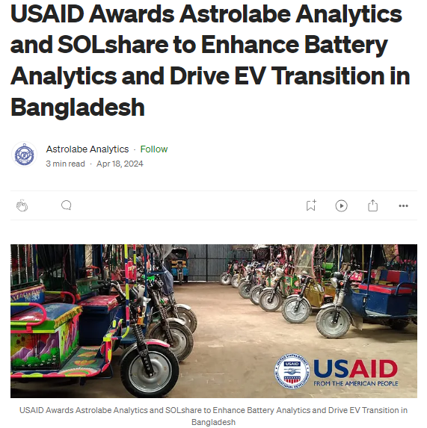
Traction
+$2.3M non-dilutive funding from US Air Force, NSF, USAID
Developing product integrations for:
Off-grid ESS (NSF)
Light EVs (USAID)
Drones/Robotics (USAF/NSF)
EVTOL (USAF)
Notes:
16077 delivers at 11M per (after 2028
TractionDirect applications in the Electric Aviation market
Methods to estimate performance from on-line data
Each flight helps to update the performance estimate of each battery pack.
Accurately determine performance
Annual inspection w/ off-line test of each battery pack to validate on-line estimates
Add’l detail

Slide 17
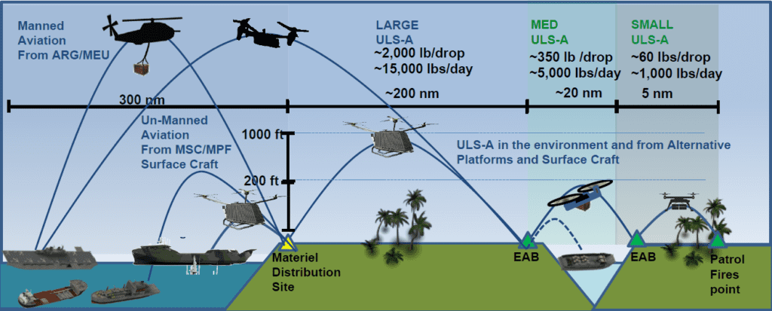
Defense Need
EVTOL aircraft deliver life cycle costs savings with increased operational mobility
(Carmine Borrelli, U.S. Marine Corps)
Notes:
The emerging electric aviation industry is producing game-changing products for both defense and private industry. The use of distributed electric propulsion technology will revolutionize the future of military operations, relief and humanitarian operations, and benefit the US economy as a whole. The benefits of electric aviation include lower operation and maintenance costs, environmental sustainability, and freedom to operate without runways when vertical take-off and landing capability is employed.
The development and assessment of energy storage systems is critical for this new environment. In contrast with automotive electrification, the aerospace and aviation markets demand higher performance and more stringent safety requirements. The standard operating procedures for electric aviation have not yet been defined, and there are gaps in understanding of battery safety and reliability as these systems age. This poses major challenges both for the certification agencies who must define these new safety standards or procedures, and the manufacturers who must implement these new processes.
In order to address this challenge, significant investments in telemetry and battery systems have been made, but the value of that data has not yet been realized. Astrolabe’s approach will develop the data infrastructure necessary to extract insights and value from raw data across the life cycle of the battery, from initial R&D and acceptance testing all the way through operations and eventual end-of-life (EOL) decommissioning. By combining cell-level understanding of battery health with state-of-the-art machine learning methods, Astrolabe will help inform the development of new SOPs for battery pack manufacturing, in-flight operations, routine maintenance, and EOL determination.

Slide 18
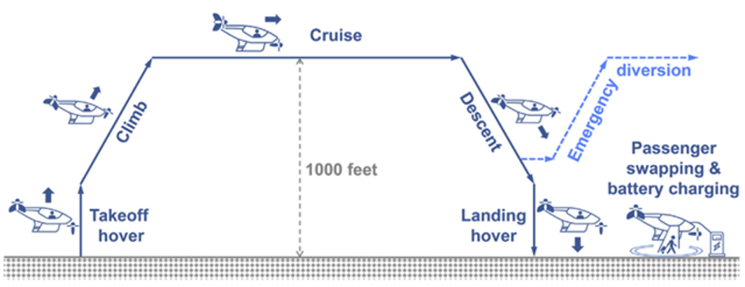
High Level Problem Motivation
Electric aviation represents a new arena for battery engineering and development
Less mature and requires higher safety and performance regulations than automotive
Batteries are a looming certification challenge for electric aviation hopefuls
Elan Head,
The Air Current (2022)
Certification Basis Under Development
eVTOL very demanding on batteries
+1MW of power for take off and landing
© 2023 Astrolabe Analytics, Inc. All Rights Reserved.

Slide 19
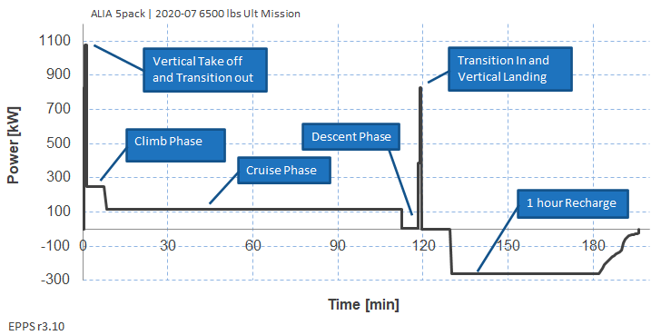
Power Requirements

Slide 20
Astrolabe eVTOL Analytics System
Legend
Condition-Based Maintenance (CBM) Dashboards
State of Health (SoH) Algorithm
Remaining Useful Life (RUL)
Inputs
Algorithms/Predictions
Output Media
Patent
Pending
State of Power (SoP) Algorithm
Remaining Hover Time
Flight Data (I, V, T)
System metadata
Weak Cell Identification
Operator Heads Up Displays (HUD)
State of Charge (SoC) Algorithm
Remaining Cruise Time
Characterization Test Data
Battery Model
Parameters
D2P2 AFWERX SBIR
© 2023 Astrolabe Analytics, Inc. All Rights Reserved.

Slide 21
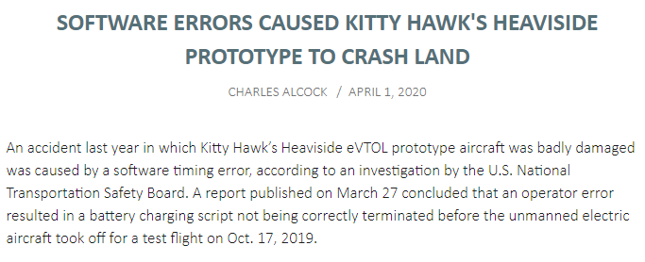
Casualty: Kitty Hawk
October 3, 2019 – Kitty Hawk reveals EVTOL called Heaviside
October 17, 2019 – Heaviside badly damaged in test flight crash
March 27, 2020 – NTSB determines battery charging algorithm error lead to crash
September 21, 2022 – Kitty Hawk winds down operations

Slide 22
Unofficial Product Soft Launch
Battery algorithms and analytics are
mission-critical,
but can’t exist in a vacuum,
which is why…
© 2023 Astrolabe Analytics, Inc. All Rights Reserved.

Slide 23
FLEET MANAGEMENT FOR SMART-BATTERY ENABLED DEVICES
Moontower provides product usage tracking, remote diagnostics, and performance insights for electronics hardware companies.

Slide 24
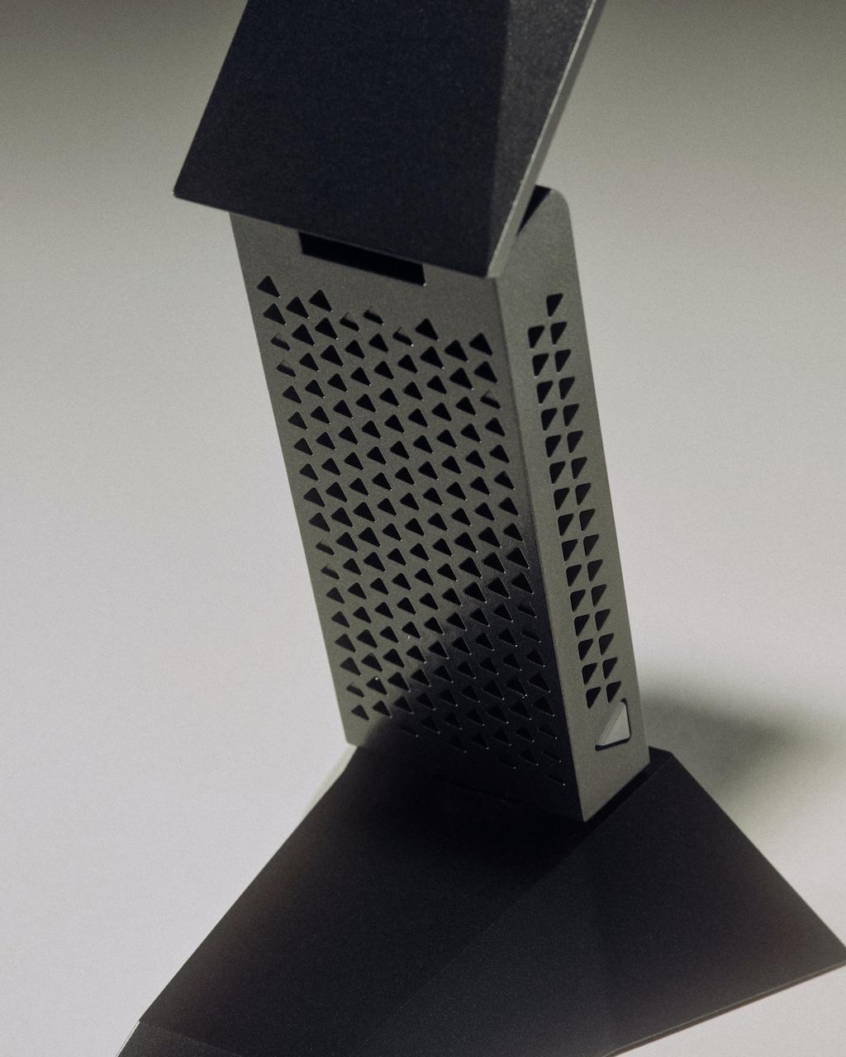
GUINN PARTNERS
Guinn Partners is a 40+ person contract engineering firm located in Austin, Texas.
Develop custom hardware and software solutions with more than 30 mobility companies over land, air and water.
Repeated found the need for battery-powered hardware devices to have sophisticated “fleet management”.
Motivation to build an affordable, customizable software platform to get important analytics rapidly onboarded.

Slide 25
THE PROBLEM
Companies with sophisticated, battery powered electronics products and a scaling user base need:
Performance reporting back to the home engineering team
An understanding of user’s usage patterns and product versions
The ability to test and rollout firmware upgrades through an intelligent system
But rarely is this built into starting product roadmaps, and it is complex and time-consuming to architect and execute while improving your core product engineering.

Slide 26
MOONTOWER IS:
A single software platform, with hardware integration to “smart batteries” (any battery with a BMS) that allows remote monitoring, field firmware upgrade, and extensive diagnostics
This gives you:
Granular, real-time, insight into how your product performs during development and deployment so you can:
Develop products efficiently
Get to market faster
Have a better understanding of how customers use the products
Provide an incredible user experience

Slide 27
MOONTOWER + ASTROLABE
"As strategic partners with Astrolabe Analytics, we recognize the critical need for advanced battery analytics in the burgeoning field of eVTOL aircraft”
“Our partnership aligns perfectly with our strategic goals, leveraging our deep experience in product development and Astrolabe's battery analytics to meet the growing demand for advanced data-driven solutions.”
Eric Davis, Guinn Partners

Slide 28
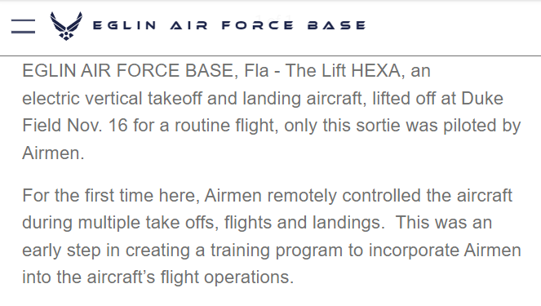
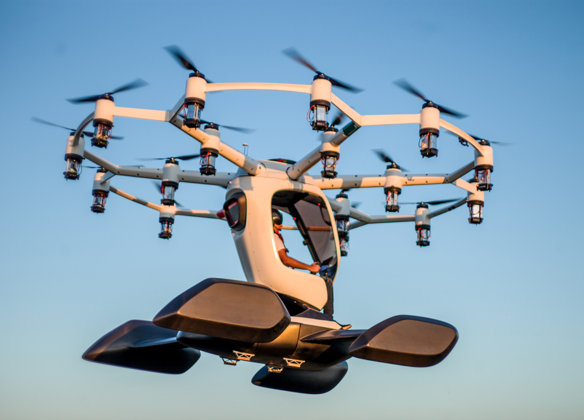
MOONTOWER + ASTROLABE
First demonstration:
Lift Aircraft’s HEXA
All-electric, single-seat, multirotor, amphibious ultralight vehicle under evaluation by the USAF

Slide 29
Astrolabe eVTOL Analytics System
Legend
Condition-Based Maintenance (CBM) Dashboards
State of Health (SoH) Algorithm
Remaining Useful Life (RUL)
Inputs
Algorithms/Predictions
Output Media
Patent
Pending
State of Power (SoP) Algorithm
Remaining Hover Time
Flight Data (I, V, T)
System metadata
Weak Cell Identification
Operator Heads Up Displays (HUD)
State of Charge (SoC) Algorithm
Remaining Cruise Time
Characterization Test Data
Battery Model
Parameters
D2P2 AFWERX SBIR
© 2023 Astrolabe Analytics, Inc. All Rights Reserved.

Slide 30
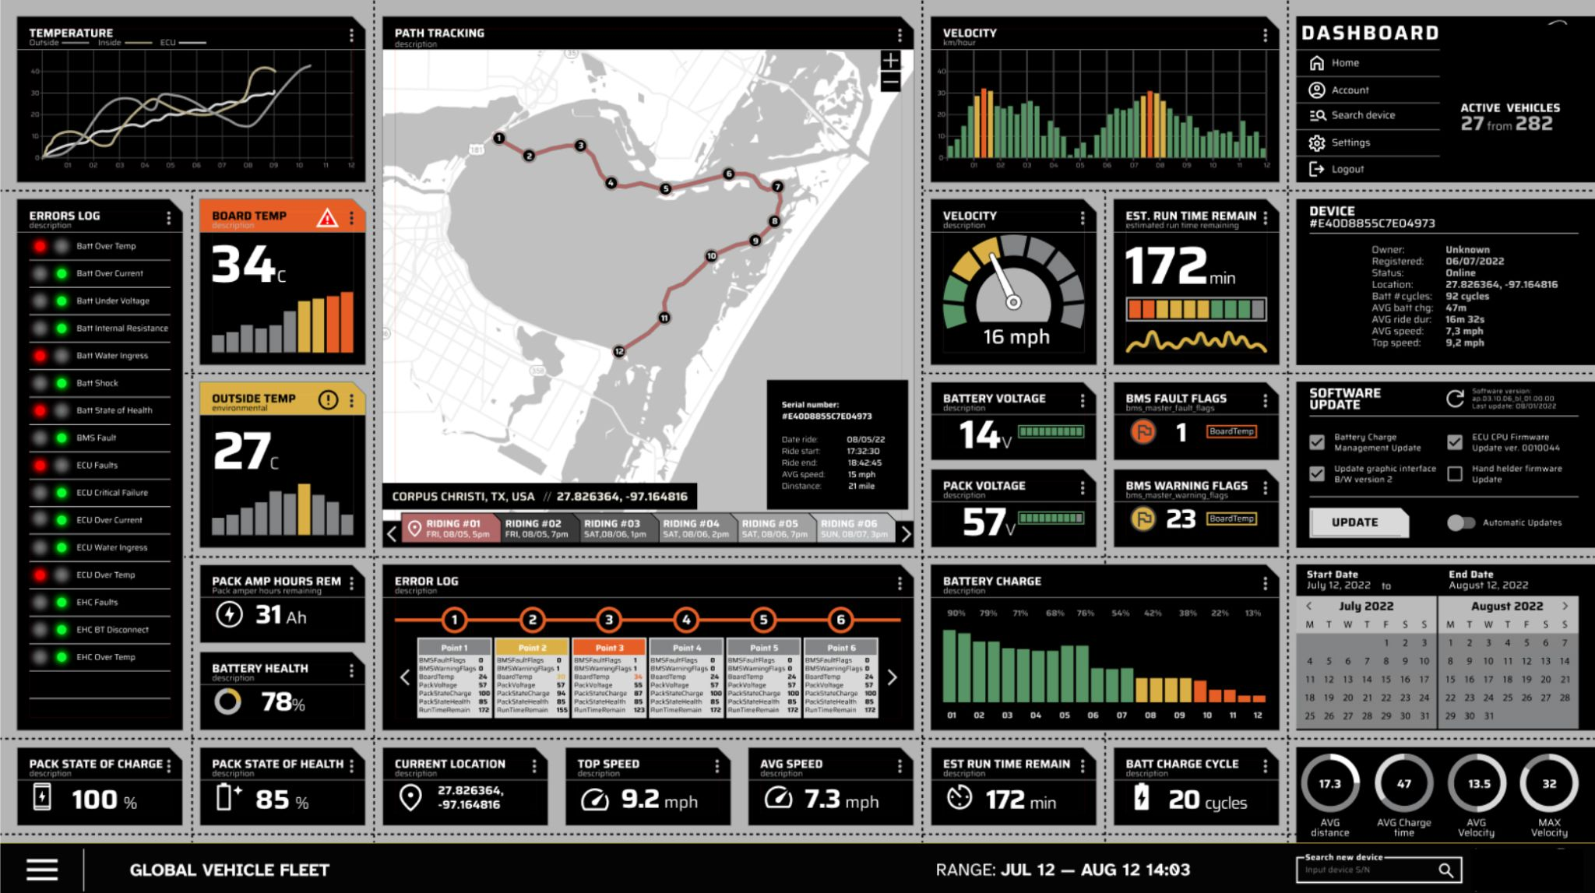
MOONTOWER IN ACTION: INTERNAL DASHBOARD

Slide 31
MOONTOWER IN ACTION: ERROR MONITORING & ESCALATION
This delivers not only battery analytics but deeper, holistic correlations between component/subsystem/vehicle operations and battery health and performance

Slide 32
CONTACT
CRAIG NEHRKORN craig@guinnpartners.com
ERIC DAVIS eric@guinnpartners.com
ROBERT MASSE robert@astrolabe-analytics.com

Slide 33
MPSC Battery Maintenance Committee
Goal: To share best practices for the maintenance and operations of the batteries in the DOD's inventory.
This would better allow operators and maintainers to quickly diagnose problems to avoid premature preventive maintenance and/or disposal of the battery, while ensuring high system safety and uptime.
Preliminary milestones and deliverables:
1) Identify common MTX issues and solutions in depots or fielded by the warfighter
2) Assess opportunities for battery end-of-life recycling or repurposing
3) Communicate results back to the consortium
Chairperson – Robert Masse (robert@astrolabe-analytics.com)
© 2023 Astrolabe Analytics, Inc. All Rights Reserved.

Slide 34
Appendix

Slide 35
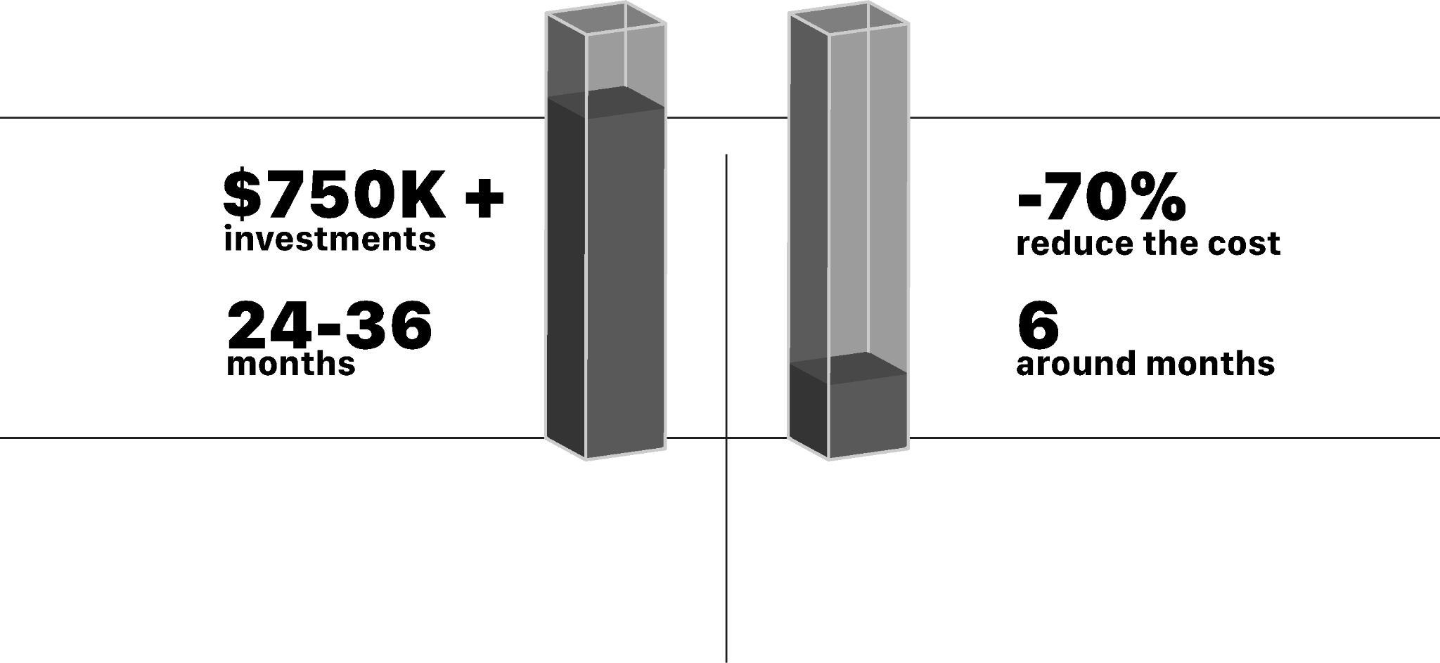
THE CHOICE: BUILD vs BUY
BUILD
vs
BUY
The true cost of internally building out customized systems of this nature - especially once thoroughly tested and matured - is typically 24-36 months and $750K+.
We’re able to reduce the cost of building out your fleet management system by 70+% and reduce time to market to around 6 months with our developed integration and enablement processes.

Slide 36
HOW IT WORKS
We have a three part integration for Moontower clients.
PHASE A: SCOPING
Over the course of 90 days our implementation team
Does a series of meetings with your team to get familiar with your tech stack
Works together to create a product requirements document for your Moontower implementation composed of phases related to technology you need that either is in the existing toolkit, or would take further development
Finalizes a timeline and implementation plan on how the product would be released in the field, and the how the team is supported in the backend

Slide 37
PHASE B: INTEGRATION
Over the course of 90 days our implementation team
Launches your products Moontower software instance to match the PRD from phase 1
Works with your team to finalize and release hardware and software updates for existing products are released into the field in phases pending the previously developed plan
Engage in a regular cadence of usage and training with your team to build a custom documentation package

Slide 38
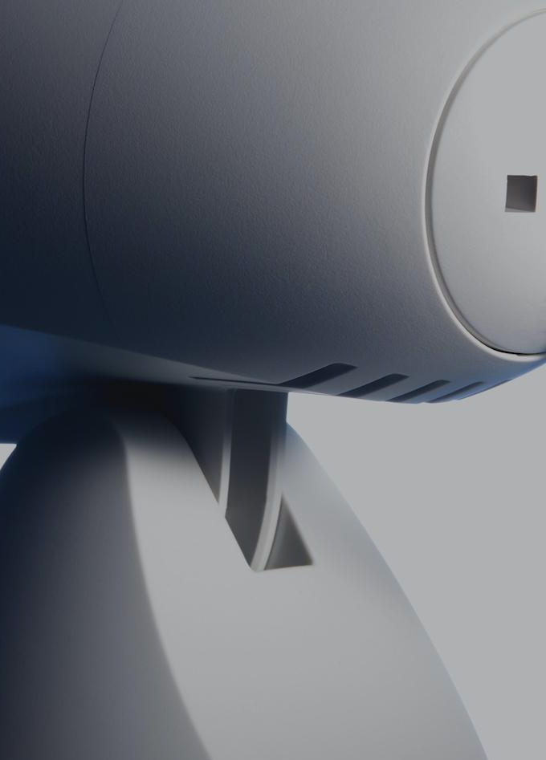
PHASE C: OPERATING
Our team takes a step back to let you use the software, and we maintain a monthly meeting cadence to discuss
Our upcoming roadmap and how we can tailor to your needs
Further integration development that might be needed
Training and operations issues resolutions

Slide 39
PRICING
The true cost of internally building out customized systems of this nature from scratch is easily 2-3 years and hundreds of thousands of dollars.
We’re able to reduce the cost by 70+% and reduce time to market to around 6 months.
Base Corporate License
Device access License
Developer
License
Viewer
License
One license per organization provides full access to MoonTower regardless of the number of connected devices
One license needed per connected robot, drone or aerospace vehicle tied to the serial number of the onboard ECU.
Use your in house IT or operations managers to build out different flavors
of custom dashboards, reports and workflows to
fit the needs of your different departments.
This license type provides read only access to select views, dashboards and reports.
$3k-8k / month
Annual commitment
$.10-$20/yr/device depending on scale
Free for the 1st developer
Free for the first three
C level executives

Slide 40
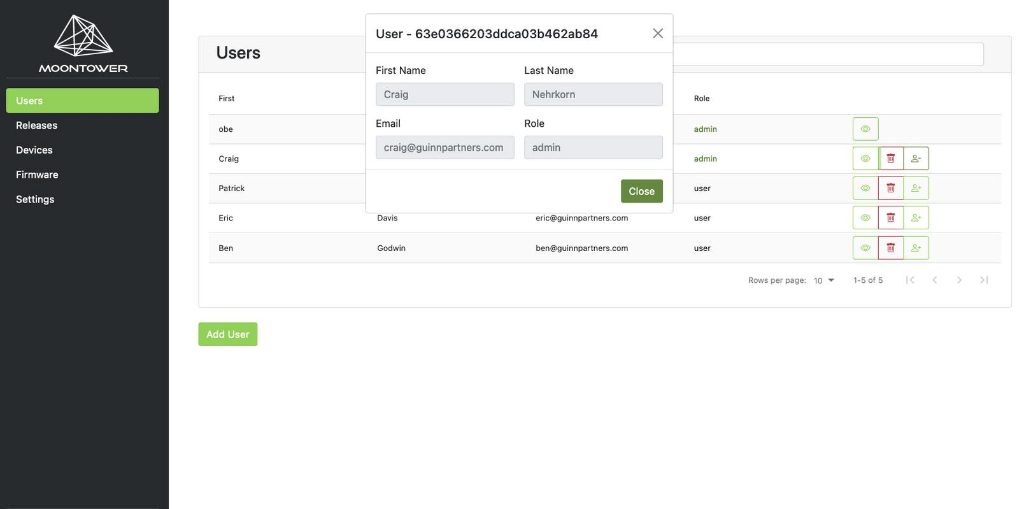
MOONTOWER IN ACTION: USERS
Manage your internal users, roles and permissions.

Slide 41
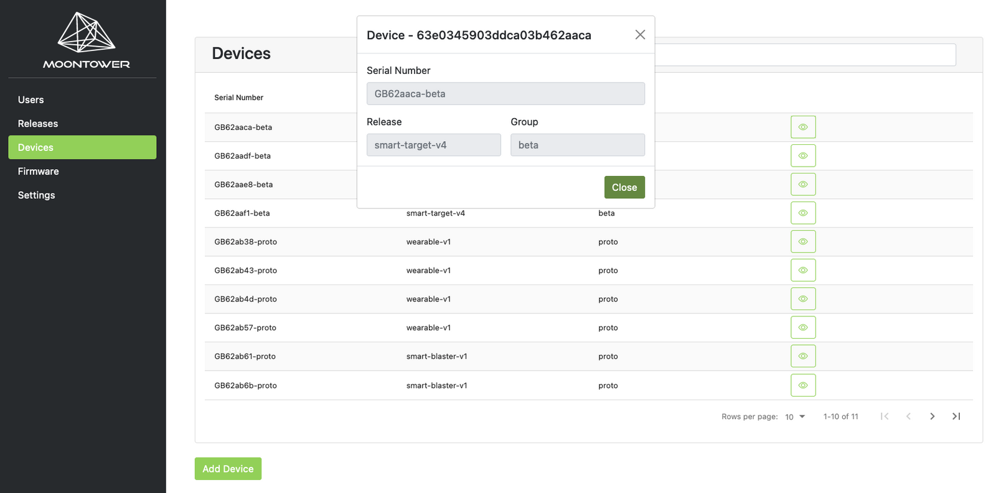
MOONTOWER IN ACTION: DEVICES
See all field devices, what release their on, and apply your own groups. Access control and geofence releases.

Slide 42
MOONTOWER ADDITIONAL FEATURES
DASHBOARD
See devices active in the world and their performance settings
Set specific parameters to monitor in your dashboard
Set parameters for problem identification
Push malfunctions to Zendesk
DATABASE
See release histories and what devices are on what release
Release updates by groups for testing
Release custom firmware versions to specific groups for clients or regional needs
Integrated with Google, AWS & Twilio for authentication

Slide 43
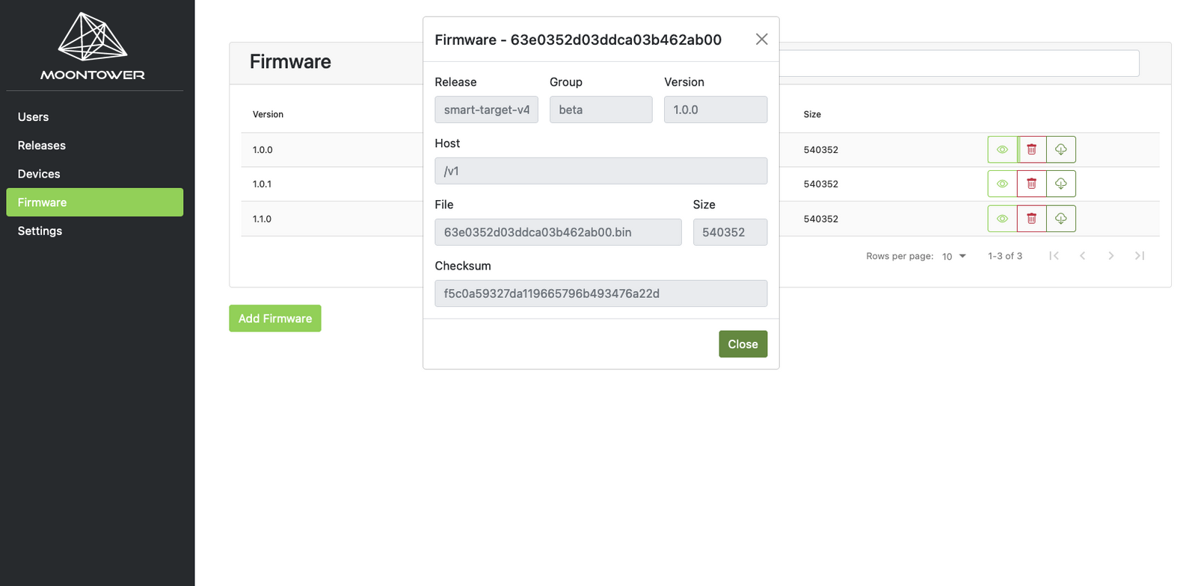
MOONTOWER IN ACTION: FIRMWARE
See all firmware versions, and add versions (with validation) right in the interface.

Slide 44
Battery Analytics Business Model:
Software and algorithms must tie back to
a line item on a financial statement
Design: Reduce R&D Expenses (OpEx)
Manufacture / Increase yield (Revenue),
Quality Control: Decrease scrap rate (COGS)
Operate / Manage: Reduce field failures (OpEx),
Increase efficiency (Revenue)
Insure / Maintain: Reduce insurance costs (OpEx)
Reuse / Recycle: Assess Depreciation (OpEx)

