Slide 1
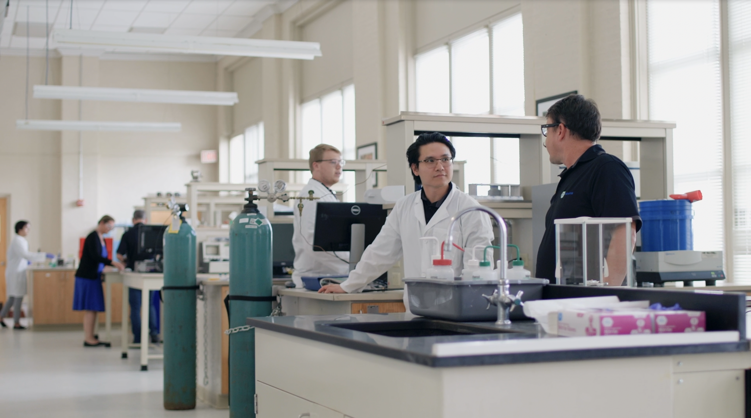
Delivering a Domestic Solution for Battery Anodes from Bio-Sourced Feedstocks
Redefining battery materials with homegrown innovation
Woman-Owned Small Business + Environmental, Social, and Corporate Governance
Notes:
Open with the hook – I am Dr. Carol Hirschmugl, PhD in Physics and Materials Science from Yale U, former prof at UWM , co-inventor, co-founder and CEO of COnovate. First I want to ask – Did you know that one of the critical materials for batteries – graphite – over 90% of battery grade graphite is delivered from China today, and they have reduced the supply chain and continue to threaten to put it at risk for the entire battery industry. Our materials will address this huge risk for the industry, at cost while delivering better performance.

Slide 2
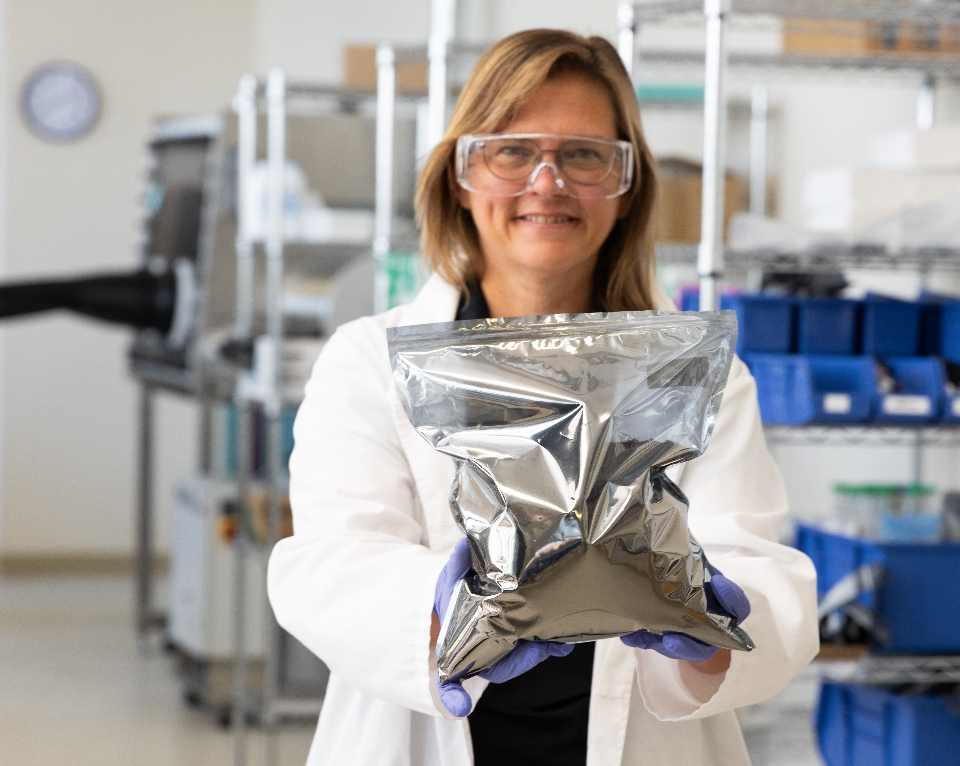
WHO WE ARE
COnovate is developing the sustainably sourced eCOphite™ domestic energy storage solution
Outperforms the incumbent: graphite
Lowers foreign dependence on battery materials
Seamlessly integrates with existing manufacturing processes and materials
Works with multiple battery chemistries (e.g. LIBs and NIBs Solid State)
Solves numerous industry challenges

Slide 3
The Problem
Lithium-ion battery anodes are stuck in the 1980s
Cathode innovations
LMO, LFP, LCO, NMC
ANODE MAKE-UP
Lithium-ion battery (LIB) anodes rely almost exclusively on graphite (90-100% of the active material).
FAILURE TO EVOLVE
Lithium-ion anode material is largely unchanged over the last 50 years.
Electrolyte innovations
Liquid organics, polymer gel, solid ceramic
Anode innovations
No major advancements

Slide 4
Graphite doesn’t cut it
Graphite can’t meet the demands of next generation lithium-ion batteries.
Unreliable Supply Chain
COST DEPENDENCE + UNPREDICTABILITY
Performance limitations
The battery market relies on high-risk geographies like China for graphite where mining creates significant environmental and health issues. A local, sustainable source is needed.
Battery production would come to a halt without graphite — and dependence on China produces anxiety about sourcing and reliable, predictable pricing.
Tesla, Mercedes are searching for better options.
CHARGE TIMES
Greater than 1 hour to achieve 80 % capacity.
SAFETY
Fire hazards under stress
NARROW OPERATING RANGE
Fails to perform in extreme heat and cold operating temperatures

Slide 5
Graphite environmental impacts
Graphite has inherent issues that prevent it from meeting the demands of next generation lithium-ion batteries and are driving high CO2 footprint impact.
Unreliable Supply Chain
MINIng and High Temperature Production
Performance limitations
The battery market relies on high-risk geographies like China for graphite where mined material creates significant environmental and health issues. A local, sustainable source is needed.
CHARGE TIMES
Especially problematic with electronics and EVs
SAFETY
Fire hazards under stress
NARROW OPERATING RANGE
Limited operating temperatures
Over 90% of battery grade graphite is mined and produced in China, requiring 3000 deg Celsius environment for 24 hours for graphitization.

Slide 6
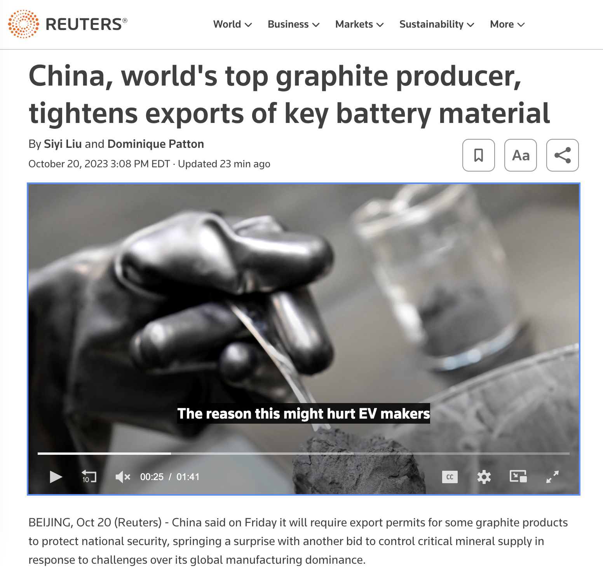
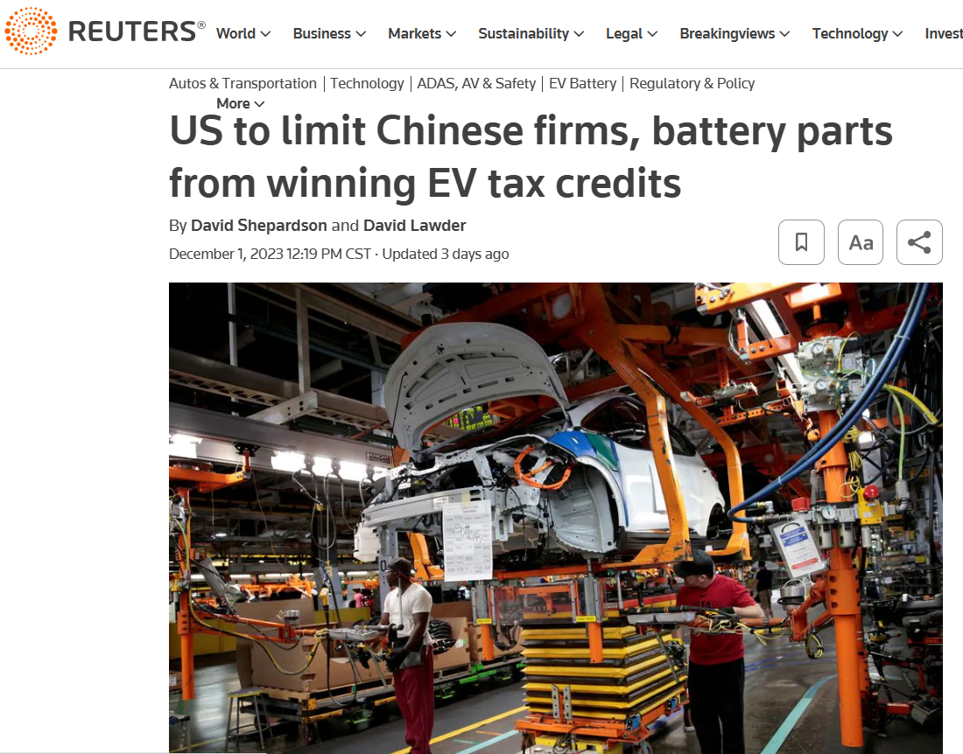
Current graphite supply chain at risk
“This bold and unexpected move by China in graphite has taken us by surprise, arriving far sooner than anyone could have predicted.”
Kien Huynh, chief commercial officer at Alkemy Capital Investments
“ Limits on Chinese content in batteries eligible for electric vehicle tax credits starting next year . …new rules, required under an August 2022 law, are designed to wean the U.S. electric vehicle battery chain away from China ”
REPORTING BY DAVID SHEPARDSON AND DAVID LAWDER

Slide 7
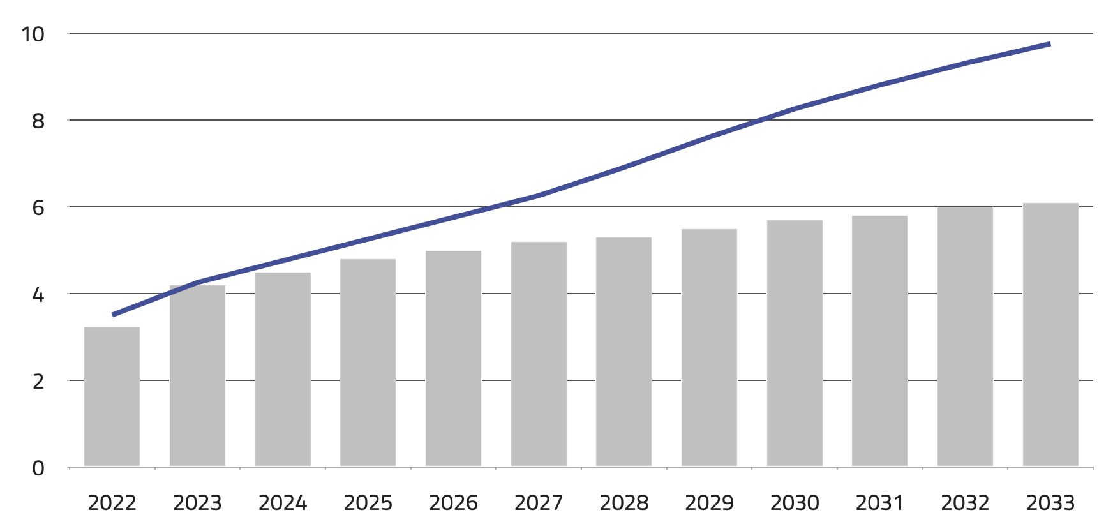
Demand for graphite exceeds supply
And is expected to for the next decade and beyond.
MASSIVE UPTICK IN DEMAND
Electric vehicle popularity drives a surge in demand from automobile manufacturers.
SIGNIFICANT LAG IN SUPPLY
Mined and synthetic graphite production resources can’t keep up with demand.
Source: Reuters
Demand (in mln tonnes)
Supply (of natural and synthetic graphite)

Slide 8
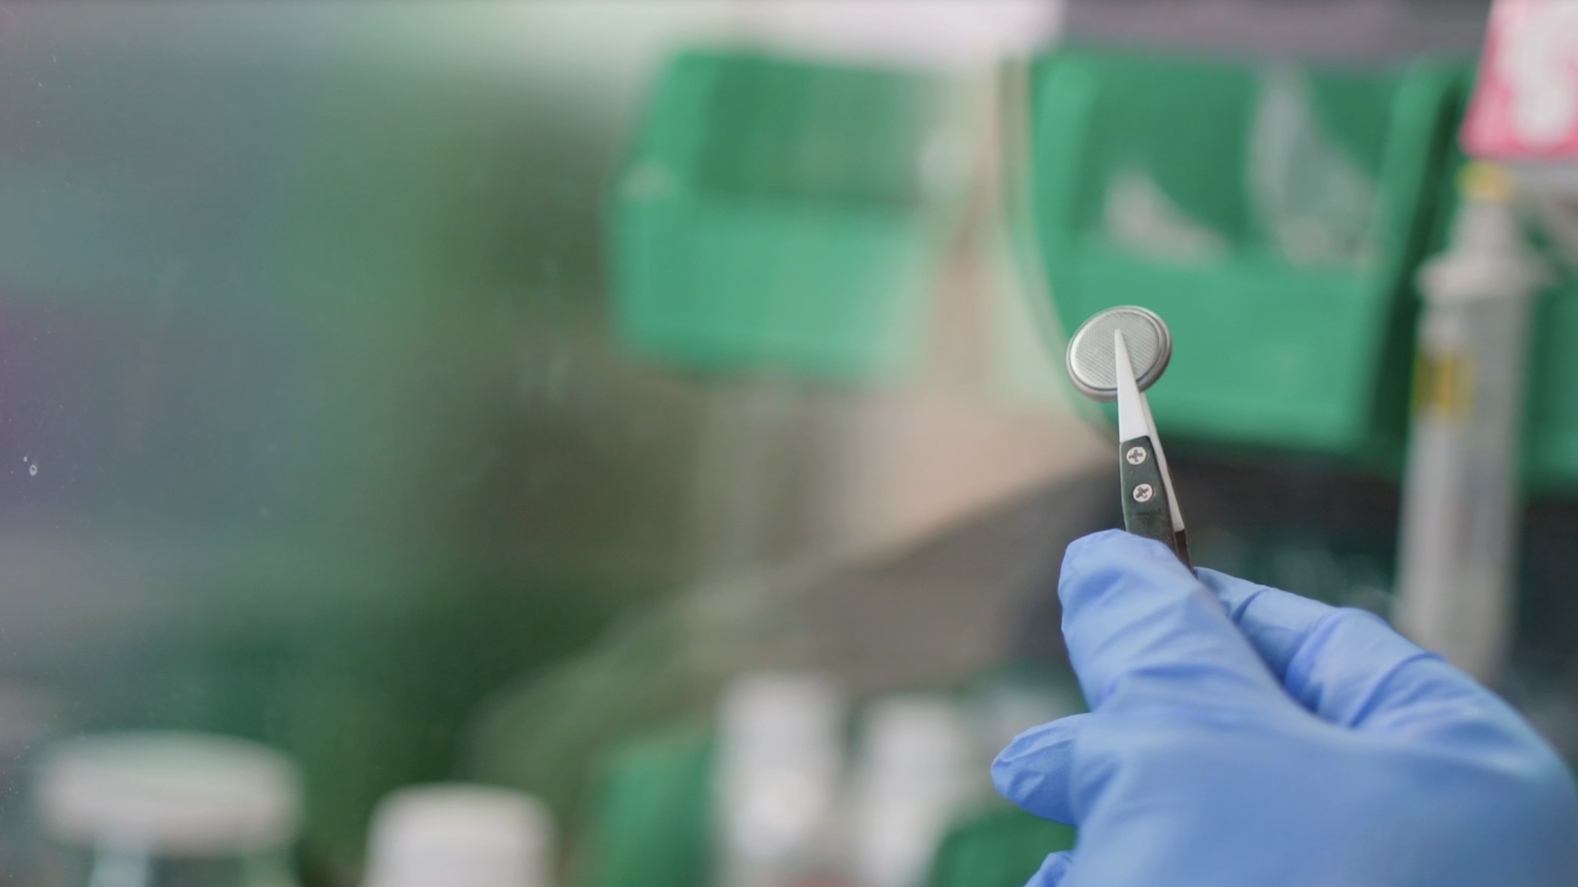
The solution
Our eCOphite material is different than graphite
CHEMICAL MAKEUP​ Bio-sourced composite with solid, stable form of carbon monoxide​
TARGETED APPLICATIONS ​ Battery anodes: Power tools, mobility, EV​
PRODUCTION ​ Demonstrated as a robust and reliable process operating at moderate temperatures and pressures
IP PROTECTION​ Two patents granted

Slide 9
Our eCOphite solution has significant advantages
eCOphite material will solve supply chain issues while improving price performance and the consumer experience.
RELIABLE, DOMESTIC Supply Chain
LESS MATERIAL USAGE LEADS TO COST SAVINGS
PERFORMANCE FOR MODERN LIFE
Our material is produced from bio-sourced feedstocks resulting in a localized, sustainable supply chain. It also has a lower carbon footprint and no toxic mining waste or health hazards.
eCOphite material delivers the same battery performance as graphite but with just 88% of the material — creating potential for significant cost benefits at scale.
Faster CHARGE TIMES
6x faster charging
improved safety
Reduced likelihood of shorts
Broader Operating Range
Performs in extreme temperatures

Slide 10
Pouch Cell Fast Charge Testing
Charge Rate testing: Graphite/COphite material blend electrodes vs NMC111 2C charge, C/2 Discharge
2.0V to 4.3V –COphite based cells, 3.0-4.3V Graphite Cells 21°C
Graphite vs NMC111 Cell 4
25% eCOphite-Graphite vs NMC111 Cell 3

Slide 11
Pouch Cell Low Temperature Testing -20°C
Low Temperature Cycling Results
eCOphite and COphite blend cells show >80% capacity retention after 20 cycles at -20°C
100% Graphite cells capacity drops to <15% of initial capacity during 20cycles at -20°C
Cells Cycling at -20°C

Slide 12
Pouch Cell Charge Rate testing
Charge Rate testing: Graphite/COphite material blend electrodes vs NMC111 1-5C charge, C/3 Discharge

Slide 13
eCOphite material emissions impact
eCOphite material is poised to solve supply chain issues and drastically reduce CO2 footprint while improving price performance and the consumer experience.
Lower Temperature Production and LESS MATERIAL USAGE LEADS TO CO2e Reduction
RELIABLE, DOMESTIC Supply Chain
PERFORMANCE FOR MODERN LIFE
eCOphite material offers a localized, sustainable supply chain from bio-sourced feedstocks. It also comes with a lower carbon footprint and no toxic mining waste or health hazards.
Faster CHARGE TIMES
6x faster charging
improved safety
Reduced likelihood of shorts
Broader Operating Range
Extreme temperature operation
eCOphite material requires only 700 deg C environment for 10 minutes and obtains the same battery performance as graphite with only 88% the amount of eCOPhite material — leading to significantly reduced CO2e.

Slide 14
Emissions Impact – Reduced by 85Mt CO2 emissions/year
Predicted CO2e for active anode material production for 6500 GWh LIBs/year by 2030
Active Anode Material | Quantity | Production Temp | Production [CO2e] | Shipping [CO2e] | Biofeedstock Carbon Capture * Yield [-CO2e] | Total [CO2e]
eCOphite Anode ** | 5 Mt/yr | 750 ºC | .035 Mt/yr | .02 Mt/yr | - (9 Mt/yr) (34%) = - 3.06 Mt/yr | 3 Mt/yr (Captured)
Natural + Synthetic Graphite * | 6 Mt/yr | 3000 ºC | 78 Mt/yr | 2 Mt/yr | 0 Mt/yr | 80 Mt/yr (Emitted)
* D. Surovtseva, E. Crossin, R. Pell, L. Stamford , J of Industrial Ecology, V26, p 964-979. http://doi.org/10.1111/jiec.13234
** 80% of eCOphite material delivers same energy density as 100% Of graphite material based on energy and specific capacity.
Notes:
Could be impactful for ESG purposes for companies – how to make that obvious for investors/strategic partners.
approx. 1 tCO2-e/70-75 kt-km shipping
How much CO2-e/degC-kt
How much CO2=e/ mining or harvesting?
t CO2 –e tonnes CO2 emissions -
Supply Chain – really hone into supply chain, . Thisis a national imperative to resolve
not less weight. Supply chain – two dynamics with lower footprint and high risk. Tie into domestic as a priority per lithium report from Craig. Get rid of the weight issue.

Slide 15
GO-TO-MARKET
COnovate has a rapid adoption path
MARKET ENTRY AS ADDITIVE SOLUTION
eCOphite material is similar in size, shape, surface area, density, and viscosity to graphite. We’ll sell it to battery or material manufacturers as an additive to be blended with graphite or graphite + silicon.
SEAMLESS DROP-IN ADOPTION Our solution is compatible with existing battery design and manufacturing infrastructure.
A RAPIDLY GROWING MARKET There are currently 250 lithium-ion gigafactories — each of which requires 1 kiloton of material per year. That number will grow to 500 in coming years.

Slide 16
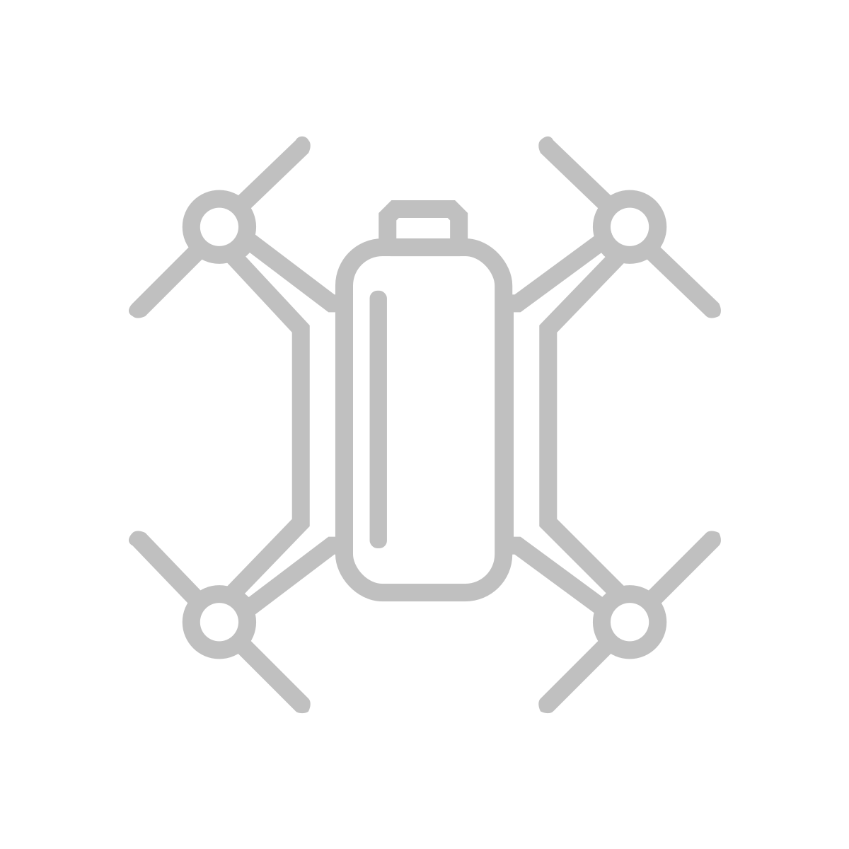
GO-TO-MARKET: short term
eCOphite commercialization timeline
Global MARKET
Active anode materials for entire lithium-ion industry $17B
COnovate is planning a 2025 market entry through power tools
Signed Letter of Intent with strategic partner to support key manufacturer introduction, testing, and material validation
eCOphite testing is underway with two battery companies
Total Available Market grows to $25B+ in 10 years
FUTURE Target MARKET
Electric vehicles $8B
FUTURE Target MARKET
Mobility
Sodium-ion batteries $800M
BEACHHEAD MARKET
Power tools
Lithium-ion batteries $150M

Slide 17
COnovate has a proven ability to rapidly scale
We’ve ramped bio-sourced material 7 orders of magnitude in 10 months.
MAY 2023
10+ kg/day with continuous process
Working with CMO’s to build pilot and full production capability
Daily production (in kilo grams)
APRIL 2022
Switch from lab to reactor production
AUG 2021
Scalable recipe
SEPT 2022
1 kg/day
2019
1-10 mg/day
APRIL 2021
100 mg/day
JULY 2021
1 g/day
FEB 2022
100 g/day
July 2022
300 g/day
JULY 2022
1-10 mg/day

Slide 18
COMpetition
eCOphite technology provides critical manufacturing and performance advantages over other solutions
Anode Technology | Domestically Sourced | High Temp Processing | Capital required to upgrade mfg facility | Adoption Timing | Battery Performance
eCOphite Anode | X (derived from sustainable biofeedstocks) | 700 deg C | Limited Investment | Rapid path to full adoption | + High capacity + Rapid charge + Seamless adoption + Excellent cold temperature performance
Natural Graphiite | >90% from China | 3000 deg C | Existing | Existing | - Reaching end of its roadmap - Environmentally challenging process
Synthetic Graphite | >90% from China | 3000 deg C | Existing | Existing | - Reaching end of its roadmap - derived from petroleum
Silicon | X | > 2300 deg C | Heavy Investment | Commercialized (low content) extended path for full adoption | +High capacity - Low calendar life - Massive swelling - Manufacturing challenges
Solid State |  | N/A | Heavy Investment | Extended path to adoption | + High energy density –complex manufacturing processes and battery designs

Slide 19
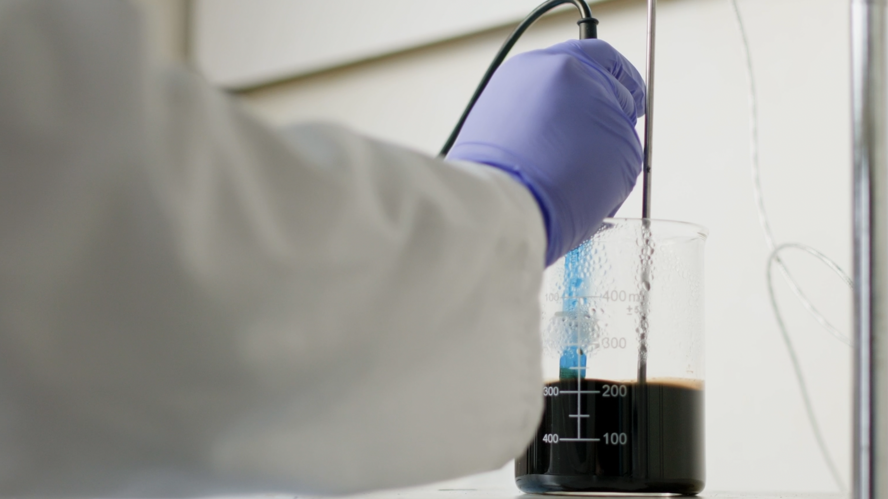
Intellectual Property
COnovate has a strong IP moat
Patent 1: 2016 for claims in composition of matter and application in batteries
Patent 2: 2023 for additional foundational claims in composition of matter, composition of matter by process, and application in batteries filed in all key geographies

Slide 20
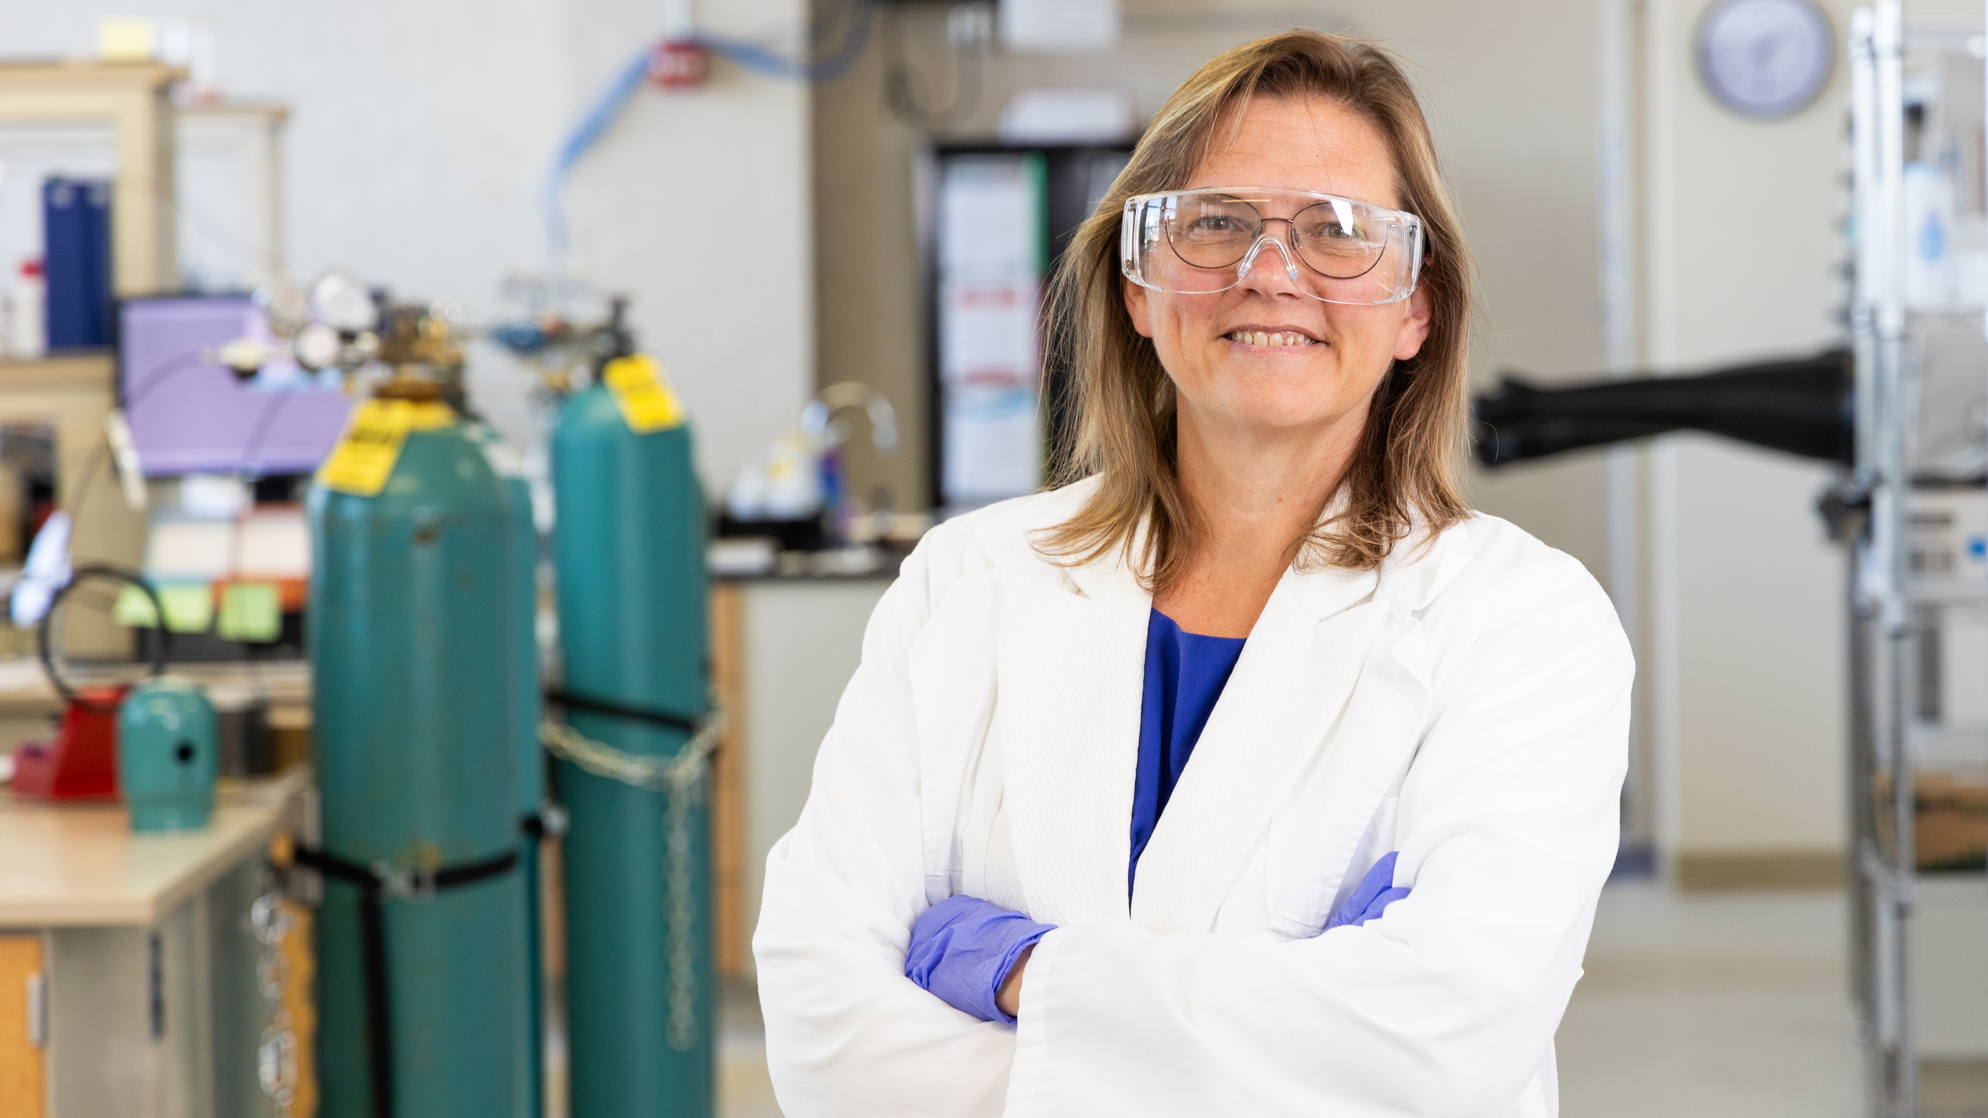
Thank you!
I’D LOVE TO TALK WITH YOU ABOUT CONOVATE’S FUTURE
Carol Hirschmugl, Ph.D.
CEO, Co-Inventor, and Founder
dr.carol.h@conovateinc.com
414-248-0846
Thank you + questions + contact info

Slide 21
Appendices

