Slide 1
U.S. ARMY COMBAT CAPABILITIES
DEVELOPMENT COMMAND
ARMAMENTS CENTER
Army In-House Munitions Power Source Prototyping and Testing Capabilities
05 June 2024
Daniel P. Schmidt
DISTRIBUTION STATEMENT A
Approved for public release: distribution unlimited.
Materials Engineer
U.S. Army DEVCOM Armaments Center
U.S. Army DEVCOM Armaments Center | DANIEL P. SCHMIDT | MATLS ENGR

Slide 2
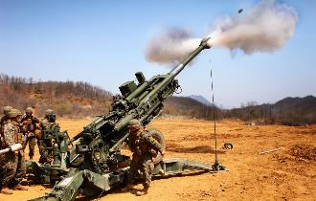
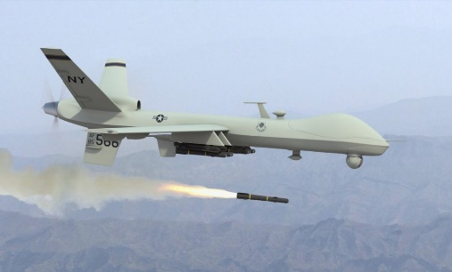
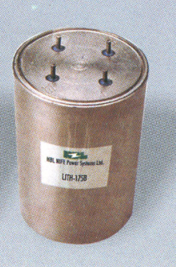
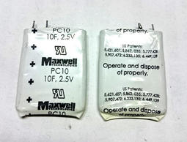
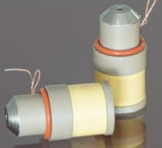
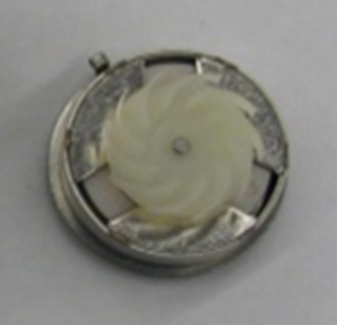
Introduction – The WHY
Power and energy continues to be a vital need for current and future missiles and munitions.
.
Due to minimal commercial usage of reserve batteries and munitions power sources, the Army / DoD have taken the initiative to invest in new designs, improved performance, and push for affordability.
Improving these power sources to do more is a key enabler for effectiveness, reach and agility.
Supercapacitors
Setback Generators
Liquid Reserve Batteries
Turbine Alternator
Thermal Reserve Batteries

Slide 3
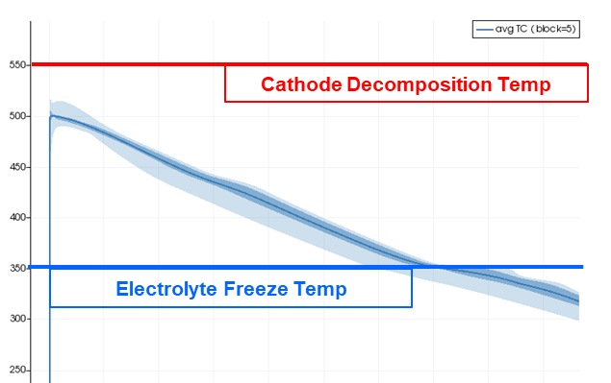
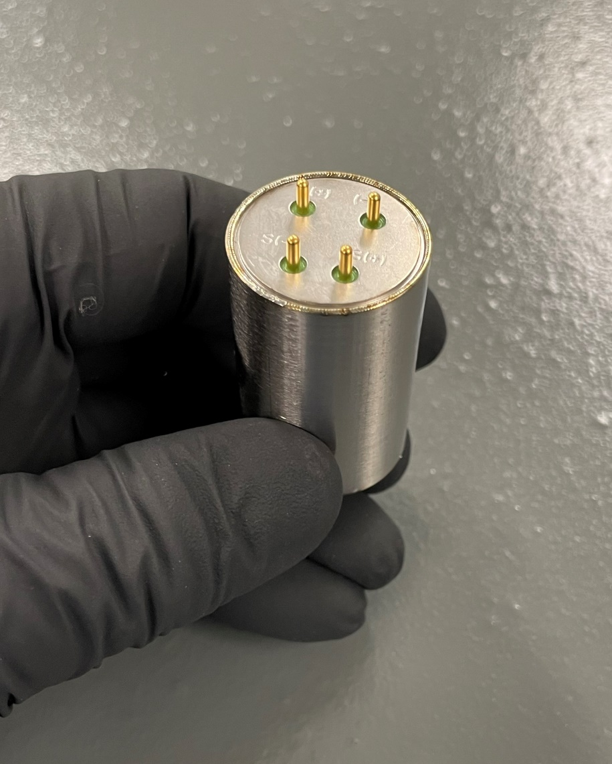
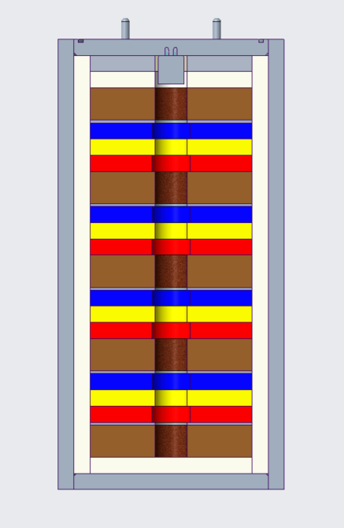
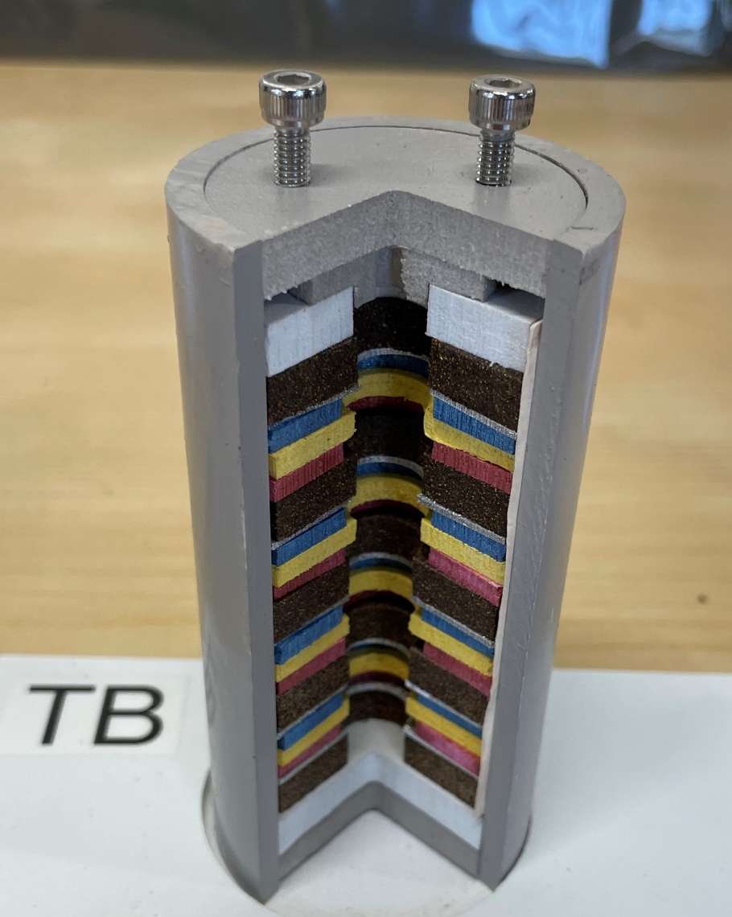
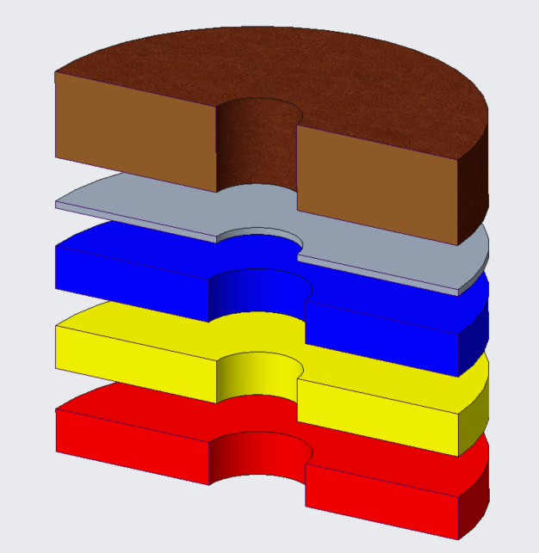
Thermal battery – WHAT IS IT?
  Thermal = heat activated
  When activated heat pellets raise core battery temp to 550°C or more
  Electrolyte/Separator temperature mostly determines runtime; Electrical conductivity is temperature dependent
Igniter provides spark for pyrotechnic reaction to heat battery up.
Single cell from battery
Heat Pellet
Current Collector
Anode
Separator
Cathode
Electrochemical cells consist of discs stacked like poker chips.

Slide 4

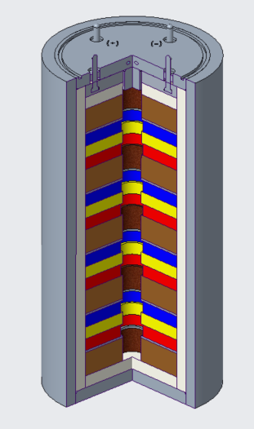
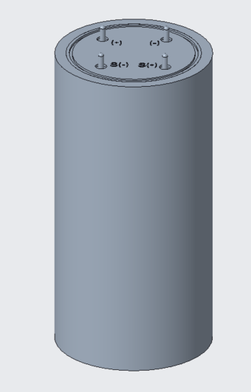
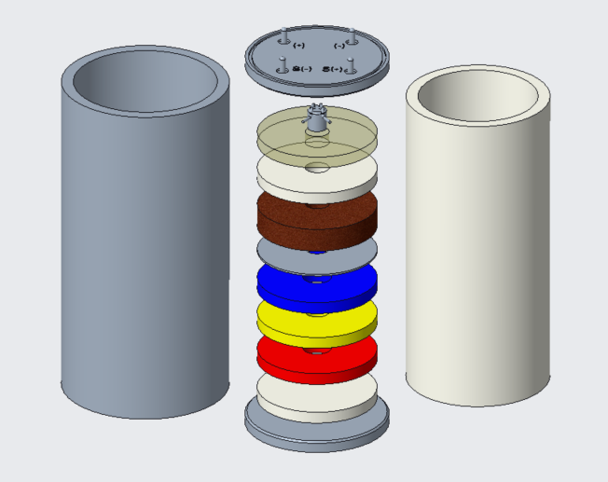

TB Prototyping
  Our team is focusing on establishing and strengthening our in-house capability to design, fabricate, and test full-up thermal batteries to advance the state-of-the-art.
  Going from powder to power and everything in between.
FACILITY
MATERIALS
COMPONENTS
ASSEMBLY
TESTING

Slide 5
TB Prototyping Process
FACILITY
MATERIALS
COMPONENTS
ASSEMBLY
TESTING

Slide 6
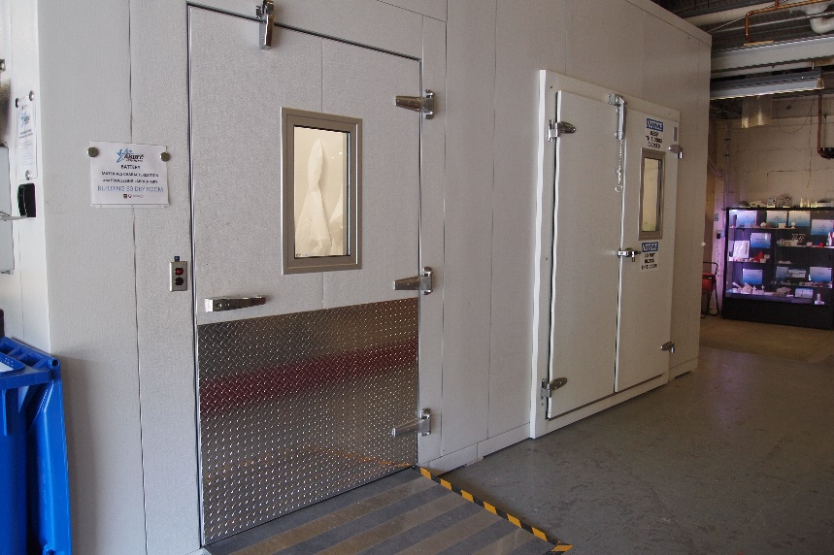
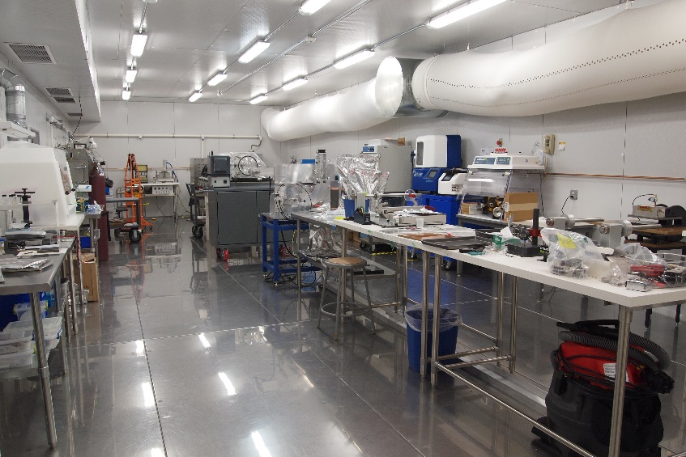
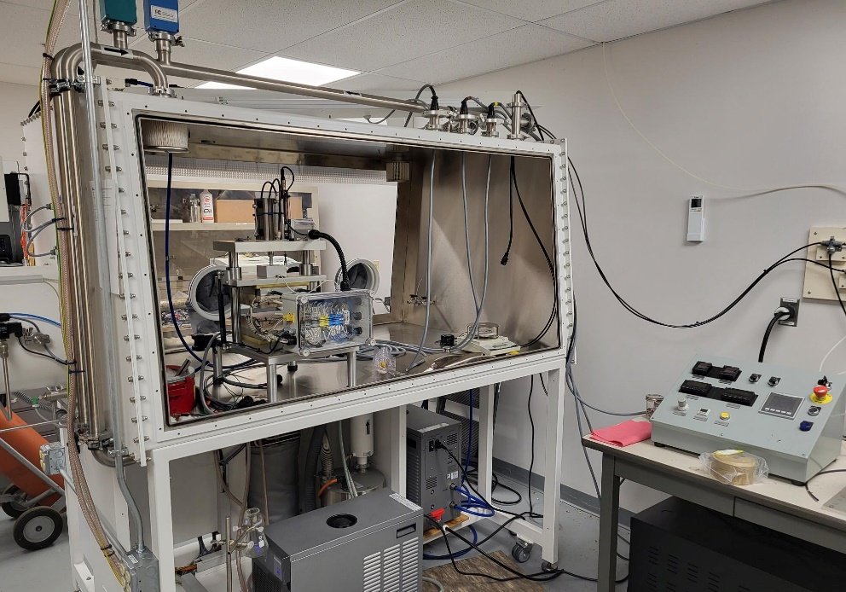
FACILITY - Dry Room / Glove Boxes
Dry Room Facility
  1200 square feet
  Relative Humidity as low as 0.03% (-90°F Dewpoint)
  Ability to handle moisture sensitive materials and conduct Destructive Physical Analysis (DPA) out in open environment.
Glove Boxes
  Argon environment, O₂ and H₂O < 1ppm
( U )

Slide 7
TB Prototyping Process
FACILITY
MATERIALS
COMPONENTS
ASSEMBLY
TESTING

Slide 8
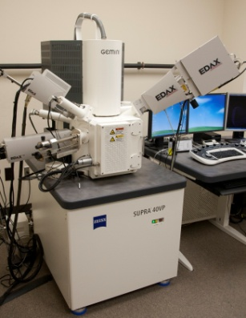
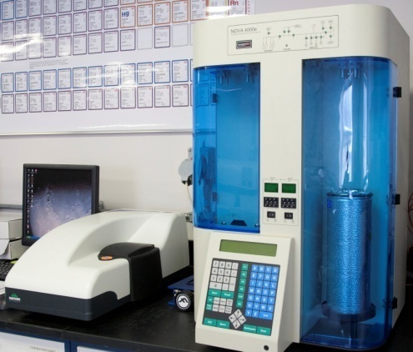
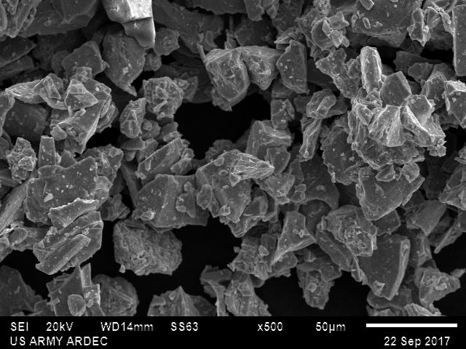
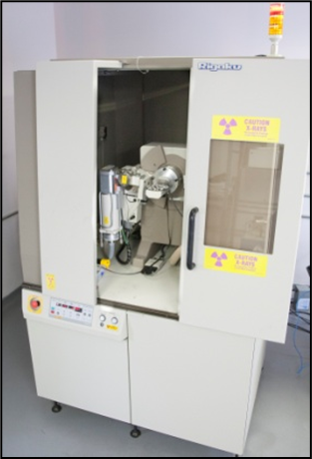
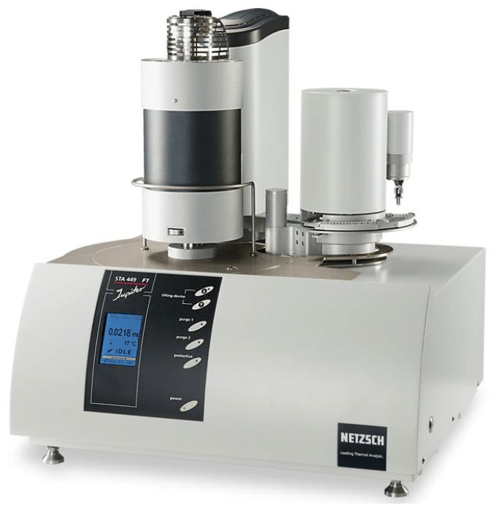
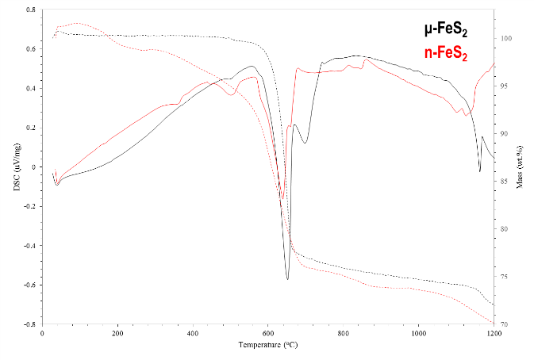
Materials - Characterization
In-House Capabilities:
  3D Laser Scanning Confocal Microscopy
  Field Emission Scanning Electron Microscopy (FE-SEM)
  Energy-Dispersive X-Ray Spectroscopy (EDS)
  X-Ray Diffraction (XRD)
  X-Ray Fluorescence (XRF)
  Gas Adsorption/Pore Size Analysis
  Simultaneous Thermal Analysis (STA)
  Karl Fischer titration
  Viscometers, Tensiometers, and Contact Angle Meters
( U )
( U )
( U )

Slide 9
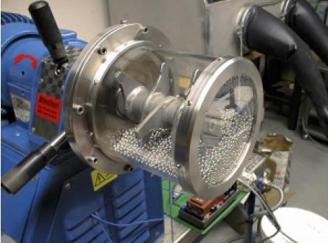
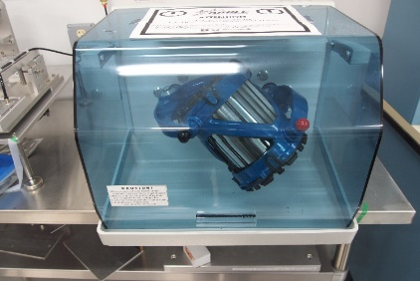
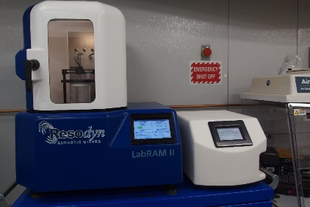
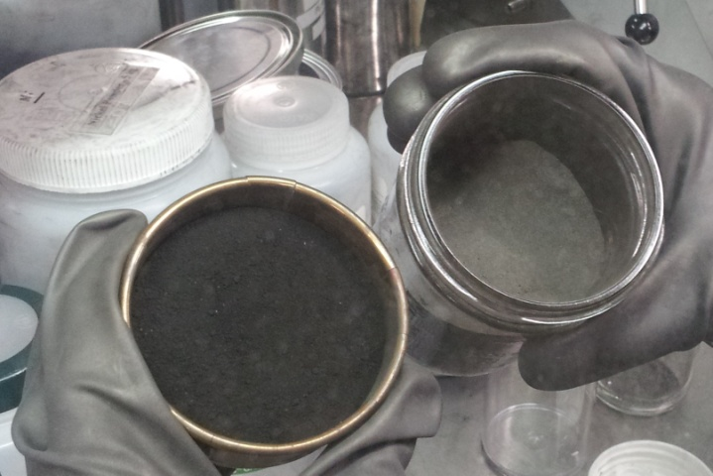
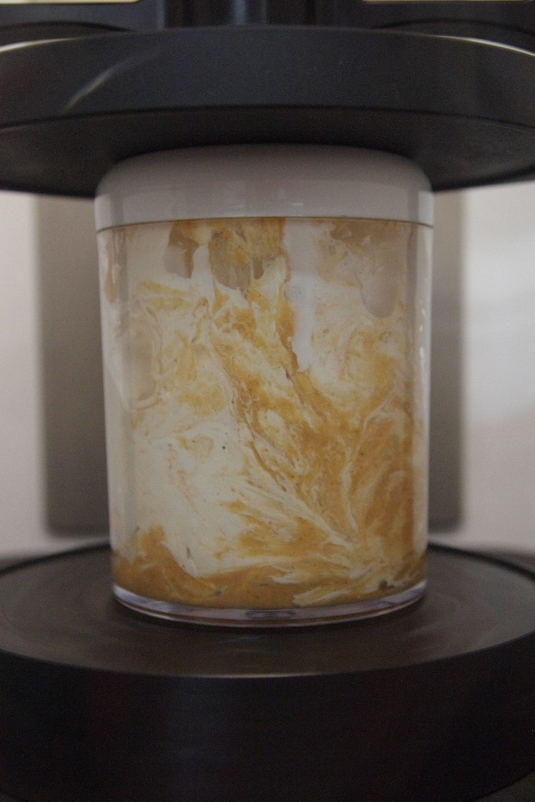
MATERIALS - processing and mixing
Advanced Powder Processing Facilities
  Plasma Reactor for bottom-up approach (nanoscale and spheroidized
  High Energy Mills for top-down approach (nanostructured powders and alloys)
Advanced Powder Mixing Facilities
  Standard Industry Mixers (V-Blender, Turbula, etc)
  Acoustic Mixers (Resodyn LabRAM)
  Solid, Liquid, and Slurry mixing capabilities (Planetary mixing, Microfluidizer)
( U )
( U )
( U )
( U )

Slide 10
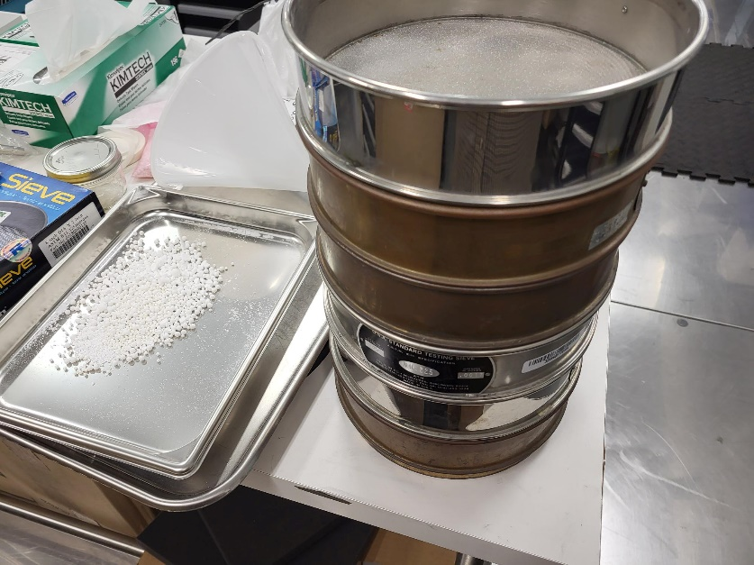
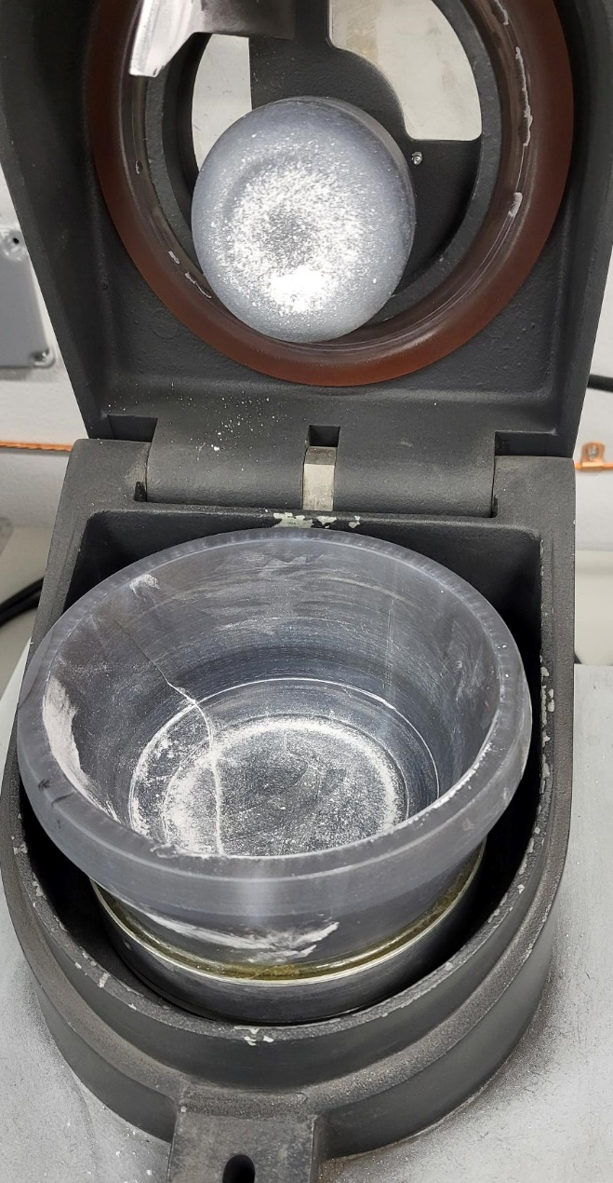
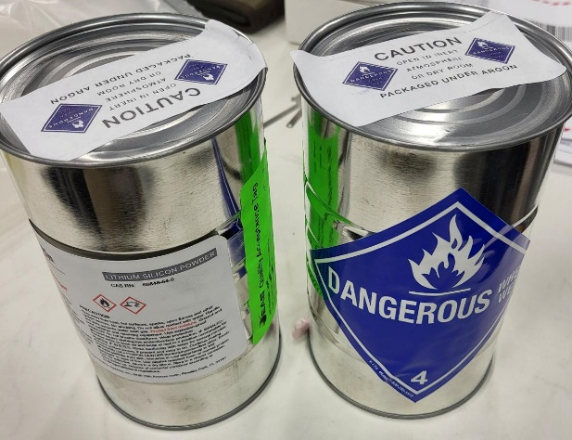
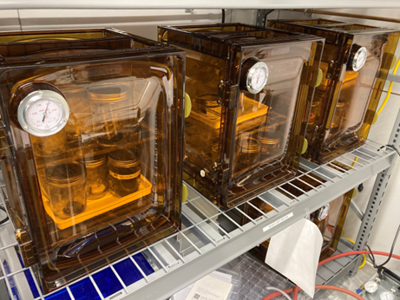
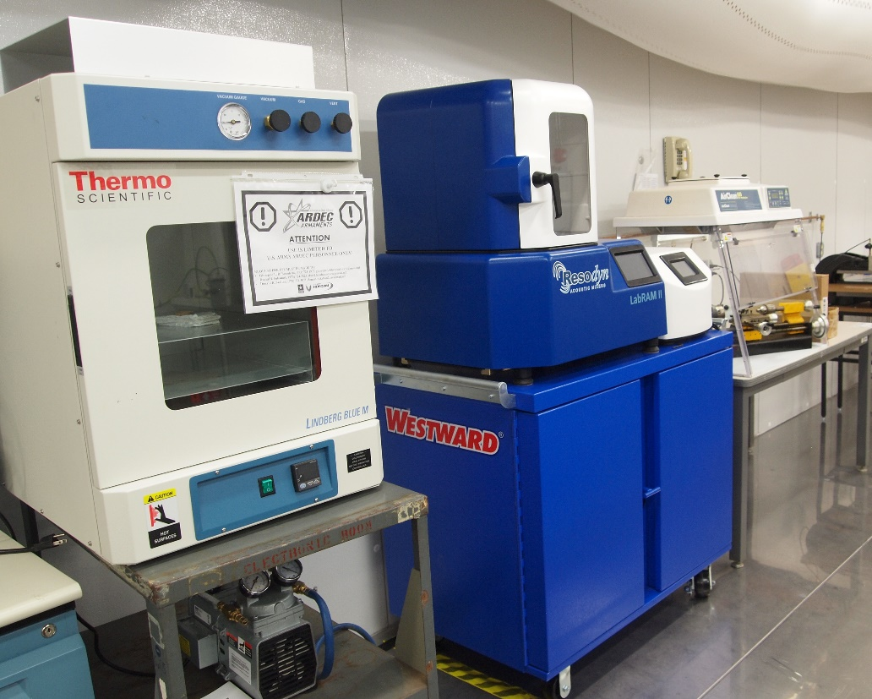
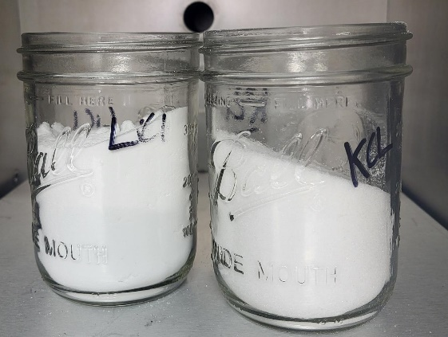
MATERIALS - Dry room processing
Accepting raw powders
Weighing and container sealing
Vacuum ovens and furnaces
  inert atmosphere
Blending / fusing / quenching
Sifting / milling
( U )

Slide 11
TB Prototyping Process
FACILITY
MATERIALS
COMPONENTS
ASSEMBLY
TESTING

Slide 12

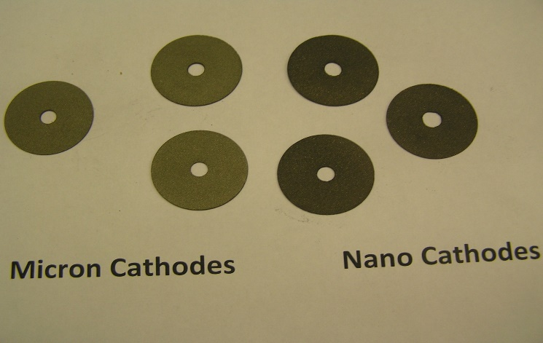
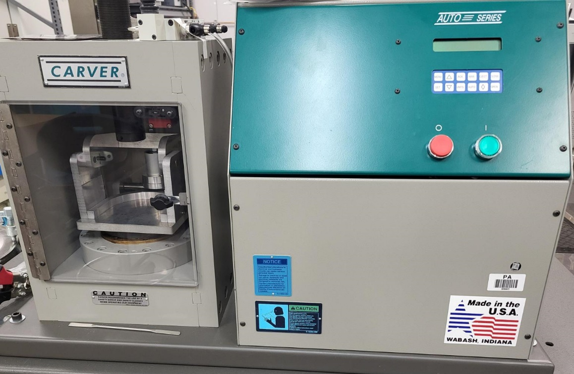
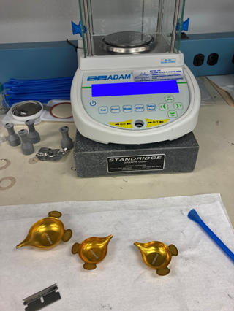
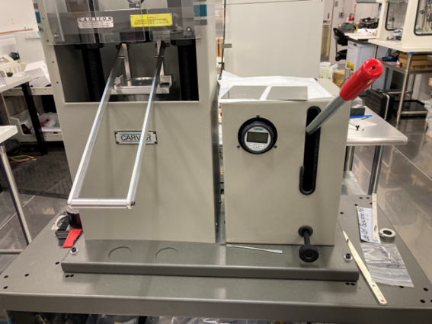
COMPONENTS – PELLET Consolidation
Pellet dies
Precision scales and loading fixtures
Manual and automatic presses
Thickness gauges and optical profilometer
Punches and arbor presses
12

Slide 13
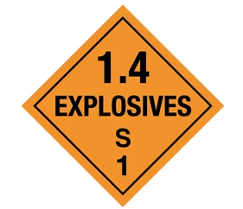
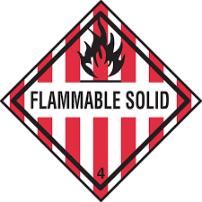
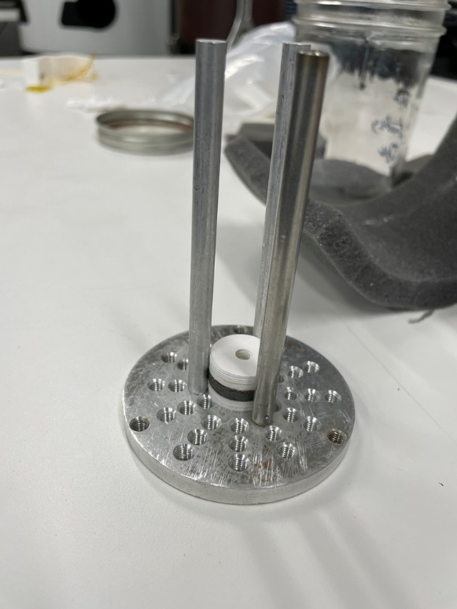
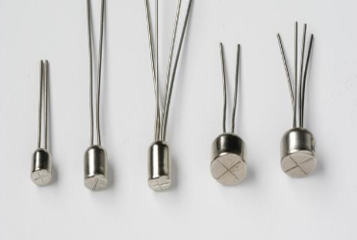
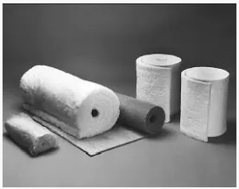
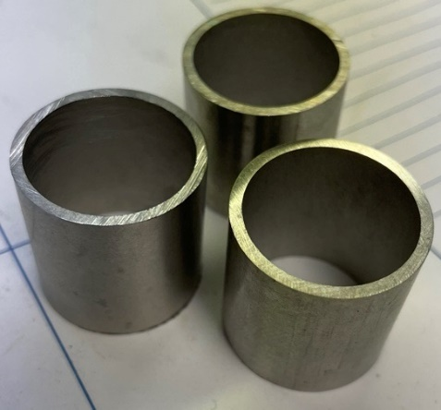
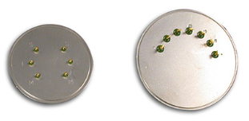
COMPONENTS – PREPARATION & STORAGE
Headers (Blanks and Pins)
Ignitors (explosive – 1.4S) and heat pellets (flammable solid – 4.1)
Current collectors
Insulation cutting, punching and storage
Cases
Endplates
Misc. supplies
13

Slide 14
TB Prototyping Process
FACILITY
MATERIALS
COMPONENTS
ASSEMBLY
TESTING

Slide 15
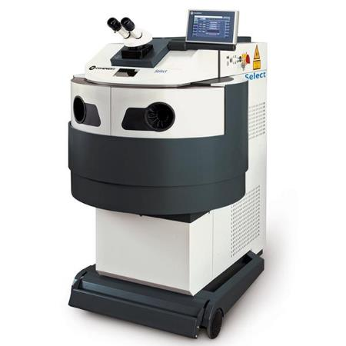
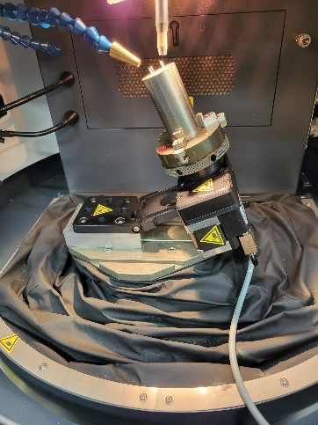
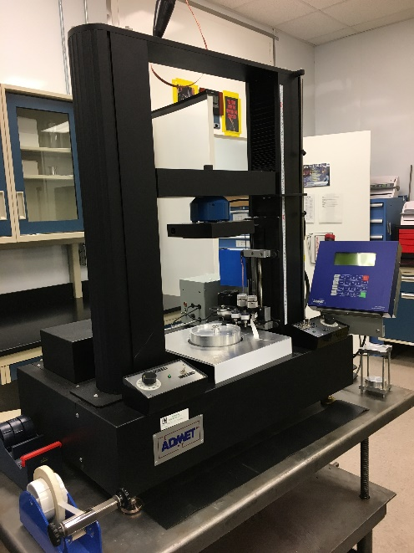
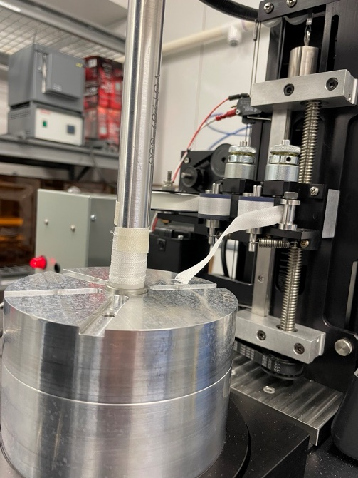
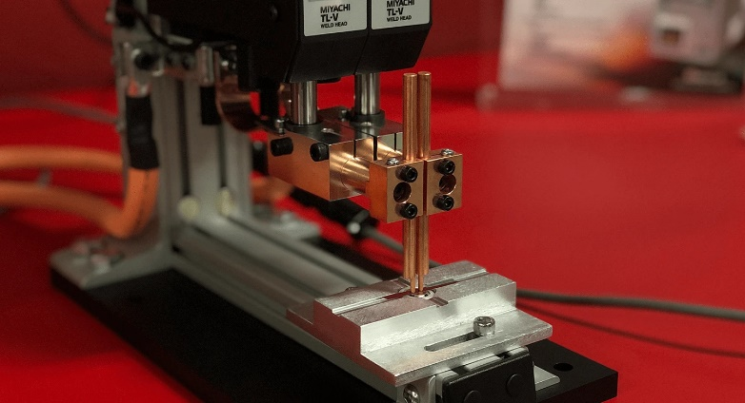
ASSEMBLY
Sub-assembly fabrication
  Laser welder and custom fixtures for headers, pins, igniter and current collectors
Stacking fixtures, tools and safety equipment for shorting leads and ESD protection
Stack Wrap Machine
  Precision tension and pressure control
  Automatic wrapping with height/speed controls
Resistance welder and laser welding for headers, case and endplates
(U)
(U)
(U)

Slide 16
TB Prototyping Process
FACILITY
MATERIALS
COMPONENTS
ASSEMBLY
TESTING

Slide 17




TESTING - Single cell & Other testing
Single Cell Tester
  Conduct electrochemical and mechanical characterization of materials in simulated internal Thermal Battery environment
  Deformation testing of Thermal Battery components
  Platen temperature and pressure control
Potentiostats & Boosters
  Programmable electrical load profiles
    Discharge testing
    Charge-Discharge Cycles
    Cyclic Voltammetry
    Pulse Voltammetry
  Electrochemical Impedance Spectroscopy (EIS)
  Electrochemical Cells (multiple volumes and sizes)
17

Slide 18


TESTING - Full battery testing
Description
Use programmable load to simulate the actual application power budget to evaluate battery performance.
Capabilities
  Programmable load to charge/discharge batteries
  Monitor/record external temperature of test item
  Temperature chamber to condition items prior to testing.
  High impedance electrometer
18

Slide 19



TESTING – INSPECTION
Radiography
2D X-Ray images
Full 3D CT scans
Pre-test and Post-test analysis
Helium Leak Detection
Helium bomb leak check equipment
Hermeticity check
Glass-to-metal seal integrity
Pre-test and Post-test analysis
Destructive Physical Analysis (DPA)
Precision tooling and equipment for precise disassembly
Use of characterization capabilities for analysis
(U)
(U)
(U)
(U)

Slide 20








TESTING - Modeling & simulation
Sandia Thermally Activated Battery Simulator (TABS)
  Developed through Joint DoD/DOE Munitions Program (JMP).
  Full battery thermal model for Thermal Batteries.
  Coupled thermal-electrochemical, thermal-electrochemical-mechanical models in development.
  Expanding Materials Database with DEVCOM-AC In-House Capabilities
Computational Based Engineering
  Perform engineering analyses on armaments in all stages of development and production.
  Develop methods and designs to integrate test data with structural models for use in model validation activities.
  Wide variety of codes utilized (ABAQUS, ANSYS, Matlab, etc)
20

Slide 21
TESTINg - AIR GUN AND INTERIOR BALLISTICS
SIMULATION TEST LABORATORY
Technology / Facility Description
  Air Gun Lab houses multiple test rooms for inert and explosively loaded hardware.
  Equipment to recreate environments experienced during gun launch.
  On-line data monitoring and acquisition.
Laboratory contains three (3) Air guns:
  155 mm rifled Howitzer
  5-inch smooth bore Naval Gun
  2-inch smooth bore
21

Slide 22


TESTING - 155mm Soft Catch (SCat) Gun
TEST FACILITY GOAL:
Achieve high-g gun launch in a tactical configuration, catch & recover the round with minimal imparted catch dynamics to conduct test & evaluation.
22

Slide 23





Key Engagements and Collaborations
Joint Enhanced Munitions Technology Program (JEMTP)
  Develop and demonstrate enabling and advanced munitions technologies.
National Armaments Consortium (NAC) – NACconsortium.org
  Teaming of industry, academia and our nation's laboratories to develop armaments in support of our Nation’s security.
  Other Transaction Authority (OTA)
    Aviation & Missile Technology Consortium (AMTC) – AMTCenterprise.org
    Department of Defense Ordnance Technology Consortium (DOTC) – NAC-DOTC.org
    Naval Energetic Systems and Technologies (NEST) Program – NSWCIHDNEST.org

Slide 24



Key Engagements and Collaborations
Broad Agency Announcement (BAA)
Small Business Innovation Research (SBIR) – https://www.armysbir.army.mil
Small Business Technology Transfer (STTR) – https://www.armysbir.army.mil
Army xTech Program – https://www.xtech.army.mil

Slide 25















Key Engagements and Collaborations
Cooperative Research And Development Agreement (CRADA)
Test Service Agreement (TSA)
Engineering Service Agreement (ESA)
All of these agreements leverage laboratory and testing facilities.
Davidson Warhead Facility
Drop Tower Facility
High Performance
Propellants Complex
Remote Armaments Facility
Wind Tunnel Facility
Fuze Development Center
Ballistic Evaluation Center
Directed Energy Facility
Demilitarization Facility
Precision Armaments Complex
Electromagnetic Effects Complex
Energetics Synthesis, Formulation and Scale-up Complex
Non-Destructive Evaluation Facility

Slide 26
Daniel P. Schmidt
U.S. Army DEVCOM Armaments Center
daniel.p.schmidt.civ@army.mil
(973) 270-8429
26

Slide 27
27

