Slide 1
Department of Defense Battery Demand and Efforts to Secure the Industrial Base
June 5, 2024
Mr. Eric Shields, Senior Battery Advisor OASD, Industrial Base Policy
eric.b.shields.civ@mail.mil
DISTRIBUTION STATEMENT A. Approved for Public Release
POC: Eric Shields 571 309 7593

Slide 2
Topics Today
Part I: Introduction to DOD’s Industrial Base Policy Office
Part II: Review of Prior DOD Demand Briefing Findings & Implications
Part III: Updates to FY23 Findings
Part IV: Ongoing Policy Actions & Activities

Slide 3
Part I: Introduction to Industrial Base Policy

Slide 4
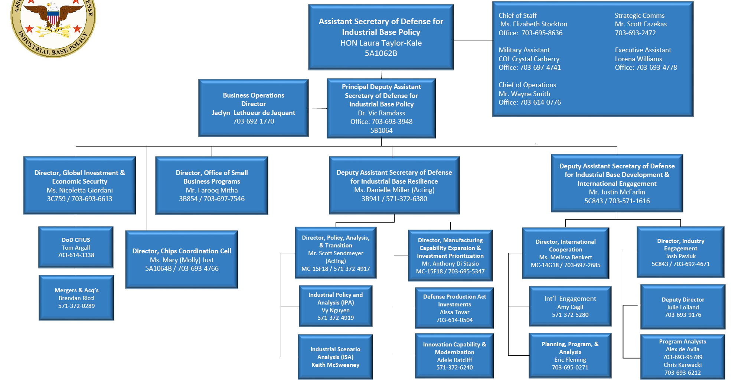
OASD(Industrial Base Policy)
Ms. Carla Zeppieri

Slide 5




Battery Sector Team
Mr. Eric Shields
  Mechanical Engineer
  Battery Sector Lead
  Battery Safety & Operational Energy Expert
  Chair, Defense Advanced Battery Working Group
  DOD Lead - FCAB Leadership Team
Mr. David James (ctr.)
  COL U.S. Army (ret.)
  Senior Industrial Base Analyst
  Senior Industry Engagements Lead
  Battery Strategy Lead
  Battery Tooling Study Lead
Mr. Eric South
  Electrical Engineer
  Former Marine
  Operational Energy Power & Data Specialist
  Program Manager, Battery Analytics
  Standard Battery Transition Lead
Mr. Dylan Fleming (ctr.)
  Battery Industrial Analyst
  Industry Engagements Support
  Battery Policy Lead
  Stockpiling and Production Ramp Assessments

Slide 6

The Role of the Battery Sector
Critical areas we are directly responsible for:
Industry Engagements
Supply Chain Analytics & Assessments
Congressional Requests
DOD Investment Advocacy to Reduce Risks
Coordinating w/ Allies & partners
Coordinating w/Interagency (FCAB)
Defense Advanced Battery Working Group (DABWG)
Policy and Strategy
Annual DOD Battery Summit
Important areas we are also responsible for:
Briefing DOD Leadership on Battery Risk
Informing Defense Production Act investments
Enabling transition of DOD batteries to secure sources
Maintaining awareness of the Industry Needs/ Tech Trends
Informing Mobilization
Informing Requirements
Priority areas we do our best to advocate for:
Service Process Improvements
Battery Workforce
Battery Tooling Investment
Domestic Battery Pilot Lines
DOD Battery Recycling Initiatives
Commercial Cell Production
Safety Technology Advancements

Slide 7
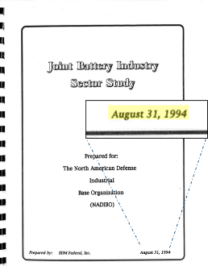

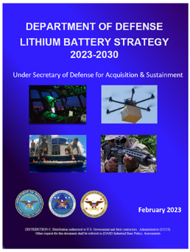

Standardization & DOD Demand
1994 - Joint Battery Industry Sector Study
“The lack of communication between military organizations and battery suppliers concerning battery procurement plans and requirements is a problem. The U.S. and Canadian governments should improve these communication efforts to allow suppliers to plan more effectively and maintain production stability.”
2022 - Securing Defense-Critical Supply Chains
“Aggregate demand: Since each program consumes a small portion of total demand, it is difficult for industry to anticipate the number of orders from year to year. DoD can better signal to industry what the likely total demand is across multiple programs in the near term.”
2023- DoD Lithium Battery Strategy 2023-2030
“The DoD must make significant investments in standardization of military batteries and cells over the next five to ten years to avoid substantial cost and availability risks for future high-volume battery needs. Standardization is the near-term opportunity for the DoD to reduce the types of batteries and aggregate battery demand”
2024 – National Defense Industrial Strategy
“To mitigate the risks of unnecessary customization, the DoD seeks an intelligent balance between customization and standardization…Increasing standardization allows for economies of scale, streamlined production processes, and greater interoperability.”

Slide 8

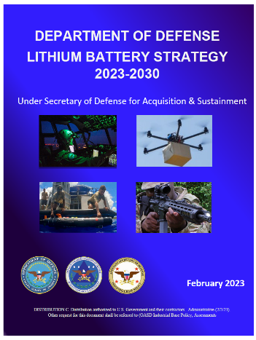

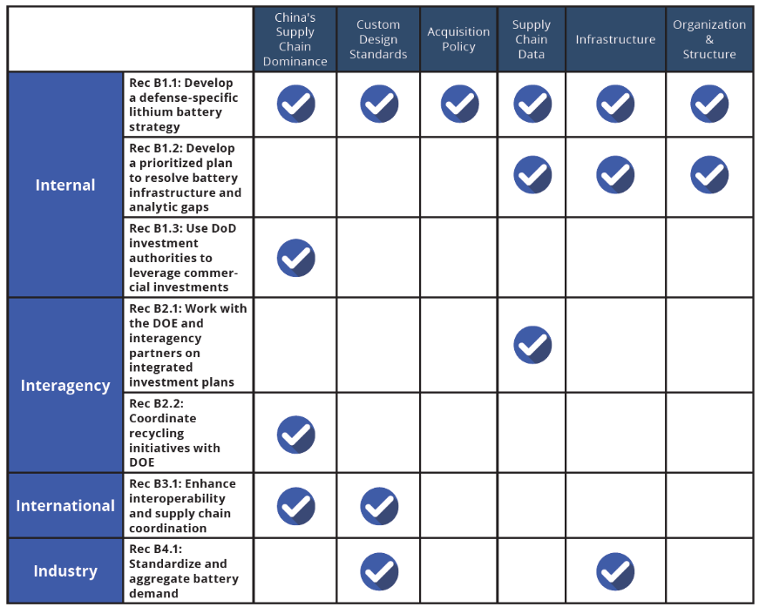
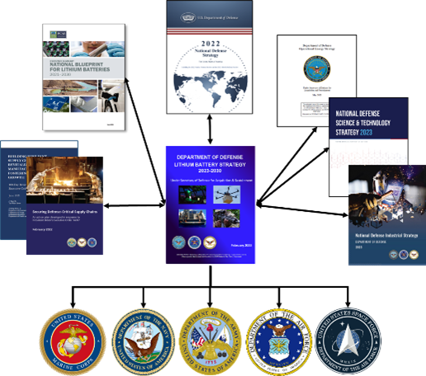
Battery Strategy in the NDIS Implementation Plan
Signed by USD(A&S) February, 2022
Signed by USD(A&S) February, 2023
Signed by DSD January, 2024
NDIS Implementation Plan
In Process
NDIS Priorities
Resilient Supply Chains
Workforce Readiness
Flexible Acquisition
Economic Deterrence
NDIS Battery Initiatives
Under Development

Slide 9
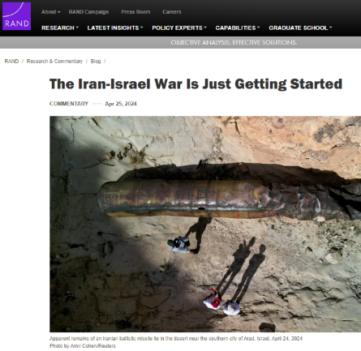
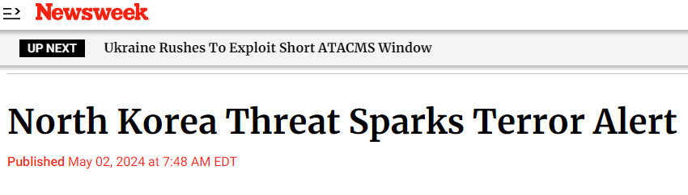
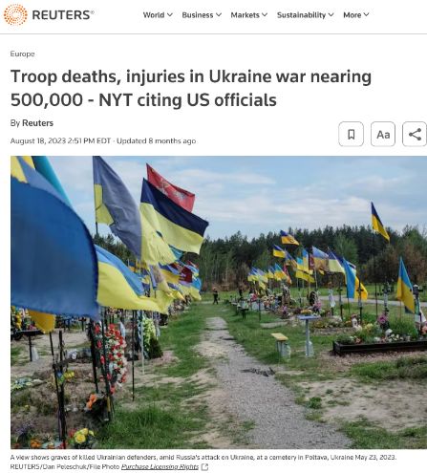




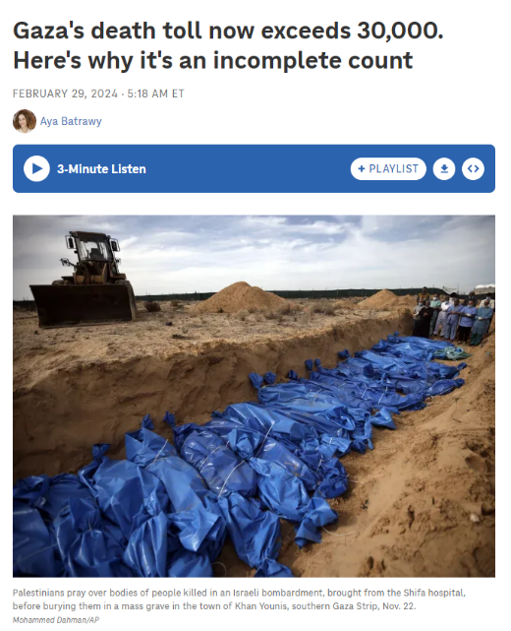
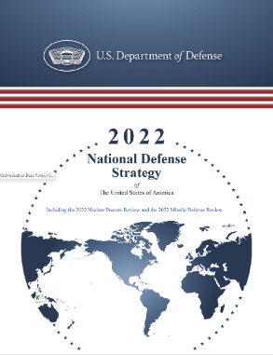
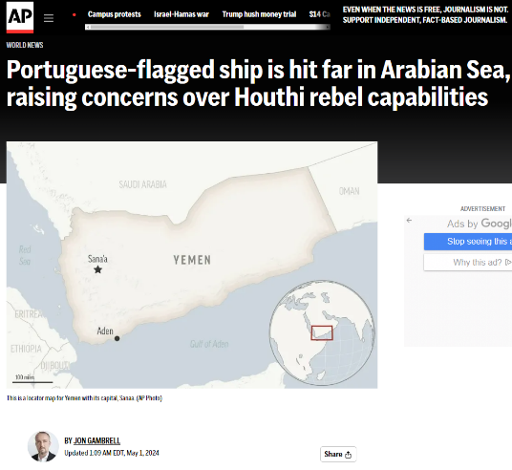
Complex Geopolitical Environment
The National Defense Strategy directs the Department to act urgently to sustain and strengthen U.S. deterrence, with the People’s Republic of China (PRC) as the pacing challenge for the Department. The NDS further explains how we will collaborate with out NATO Allies and partners to reinforce robust deterrence in the face of Russian aggression while mitigating and protecting against threats from North Korea, Iran, violent extremist organizations, and transboundary challenges such as climate change. 2022 National Defense Strategy of The United States of America
Secretary of Defense, Lloyd Austin

Slide 10
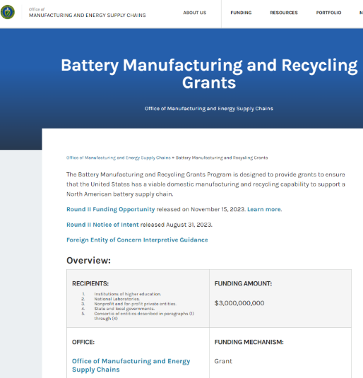
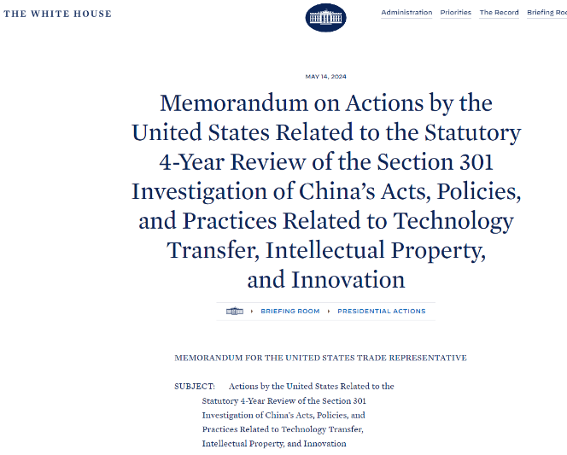
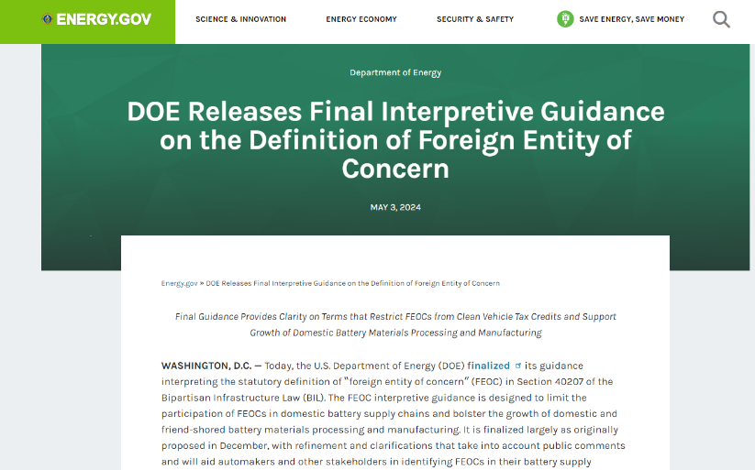
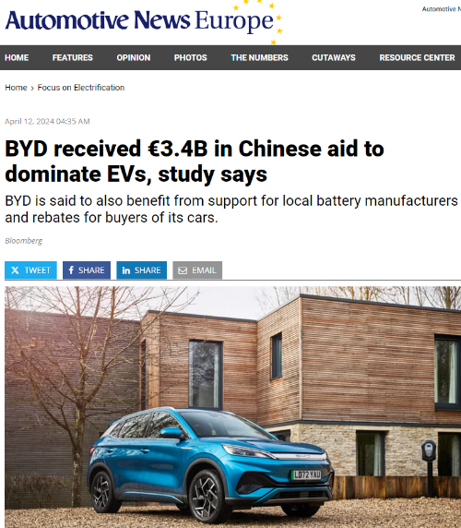
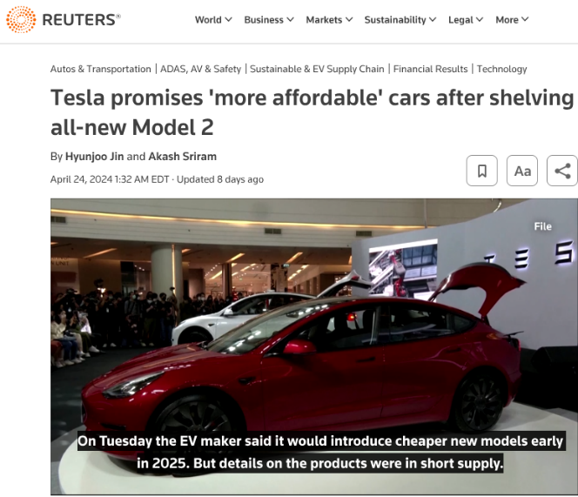

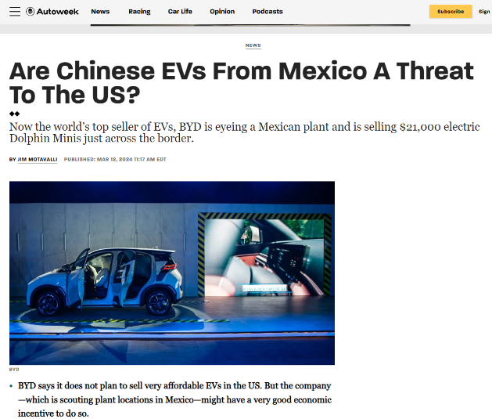

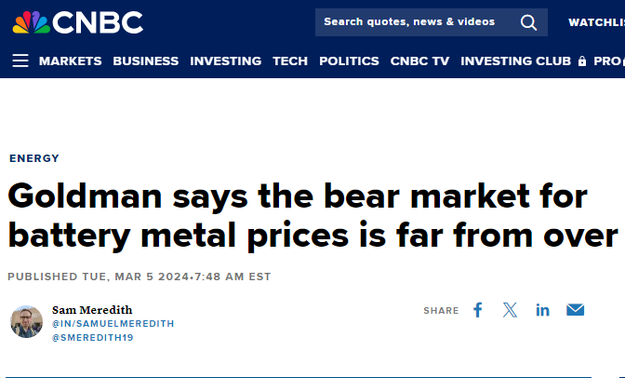
Dynamic and Competitive Global Battery Market

Slide 11

Remarks by Secretary of the Treasury Janet L. Yellen at a Press Conference in Beijing, the People’s Republic of China April 8, 2024
“…I expressed concern to senior Chinese officials that there are features of the Chinese economy that have growing negative spillovers on the U.S. and the globe. …Now, we are seeing an increase in business investment in a number of “new” industries targeted by the PRC’s industrial policy. That includes electric vehicles, lithium-ion batteries, and solar.
China is now simply too large for the rest of the world to absorb this enormous capacity. Actions taken by the PRC today can shift world prices. And when the global market is flooded by artificially cheap Chinese products, the viability of American and other foreign firms is put into question.
We’ve seen this story before. Over a decade ago, massive PRC government support led to below-cost Chinese steel that flooded the global market and decimated industries across the world and in the United States. I’ve made clear that President Biden and I will not accept that reality again. I know that these serious concerns are shared by our allies and partners, from advanced economies to emerging markets.” [1]
[1]. https://home.treasury.gov/news/press-releases/jy2241

Slide 12

Press statement by President von der Leyen following the trilateral meeting with French President Macron and President of the People's Republic of China Xi Jinping May 6, 2024
"The first topic: Chinese subsidized products. These subsidized products – such as the electric vehicles or, for example, steel – are flooding the European market. At the same time, China continues to massively support its manufacturing sector. Combined with a domestic demand that is not increasing, the world cannot absorb China's surplus production. Therefore, I have encouraged the Chinese government to address these structural overcapacities.
..We need to improve the resilience of our supply chains. For example, we tackle excessive dependencies by diversifying sources of critical raw materials. This is why we have negotiated several agreements to widen the number of countries from which we obtain critical raw materials.... "

Slide 13
Draft Section 301 Tariff Revisions
Product Category | Rate Change (effective date)
Electric vehicles | Increase from 25% to 100% (2024)
Batteries, Battery Components and Parts, and Critical Minerals
Battery parts (non-lithium-ion batteries) | Increase from 7.5% to 25% (2024)
Lithium-ion electrical vehicle batteries | Increase from 7.5% to 25% (2024)
Natural graphite | Increase from 0% to 25% (2026)
Permanent magnets | Increase from 0% to 25% (2026)
Semiconductors | Increase from 25% to 50% (2025)
Other critical minerals | Increase from 0% to 25% (2024)
Medical Products
Facemasks | Increase from 0-7.5% to 25% (2024)
Syringes and needles | Increase from 0% to 50% (2024)
Medical gloves | Increase from 7.5% to 25% (2026)
Ship to shore cranes | Increase from 0% to 25% (2024)
Solar cells (whether or not assembled into modules) | Increase from 25% to 50% (2024)
Steel and aluminum products (including steel- and aluminum-intensive products) | Increase from 0-7.5% to 25% (2024)

Slide 14
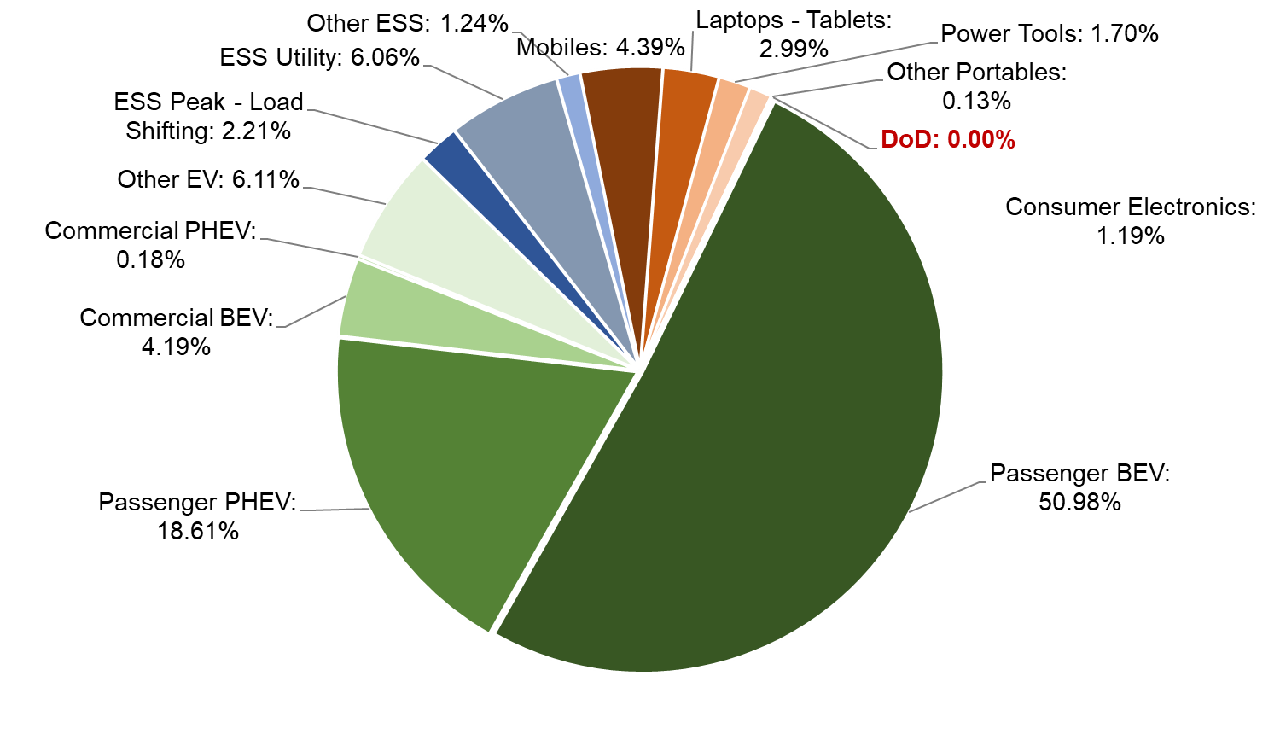
DOD in the Global Li-ion Market
Global lithium-ion battery market breakdown. Category labels are followed by percentage of the total lithium-ion market. In 2022, total global lithium-ion battery demand was 642 GWh. Source: Benchmark Minerals Intelligence

Slide 15
Part II: Review of Prior DOD Demand Briefing Findings

Slide 16
Summary of FY23 DOD Demand Signal Findings (Presented June 2023)
DoD buys ~500-700MWh of rechargeable batteries per year dominated by non-lithium chemistries
DoD has completed a partial analysis of current and future rechargeable demand although additional effort is needed to close data gaps
Growth of li-ion demand is expected to be driven by tactical vehicle and ground support equipment domains, though dismounted warfighter and unmanned systems applications are expected to contribute to growth
Specialty markets and specialty battery designs will continue to be needed to meet many DoD missions
Aggregation of demand can lower costs and flatten the DoD purchase behavior making DoD a more predictable customer
DoD standardization investments are structured to target the largest known opportunities, although future standard formats may be needed in the DoD portfolio

Slide 17
Part II: Updates to FY23 Findings on DOD Battery Acquisition

Slide 18
By Application: Advanced Rechargeable Battery Requirements Hierarchy
UxS
Advanced & Developing
Range & Capability
Advanced
Space Systems
Weight, Lifetime, & Reliability
Advanced
Dismounted Operations
Endurance, Weight, & Reliability
Silent Watch, Silent Mobility Fuel Economy
Advanced Battery Requirements Maturity
Criticality
Recently Completed & Developing
Tactical, Combat, and Logistics Vehicles
Uninterrupted Power Supplies Aviation
Emergency Runtime, Safety, & Weight
Under Development
Under Discussion
Ground Support Equipment
Life Cycle Cost, Fuel Economy
Under Discussion
Main Storage Battery
Volume, Safety, Lifetime, Reliability
Being Studied
Uninterrupted Power Supplies
Life Cycle Cost and Maintenance

Slide 19
DOD Battery Industry Tensions
Urgency to move to secure supply chains
Schedule
Lack of presently available secure supply chains
Urgency to reduce cost and speed deployment
Cost
Need to protect domestic and allied economies from market manipulation
Need to maximize Service / Joint Force performance
Performance
Need to maximize individual system performance
Urgency to electrify and field improved capability
Environmental & Social Governance
Need to protect the environment, eliminate coercive labor, and buy consistent with our values
Urgency to reduce proliferation and systemic cost
Standardization
Need to protect some Program Office flexibility
Pursuit of/Belief in free market principles
Market Behavior
Economic and National Security (Autarky)

Slide 20


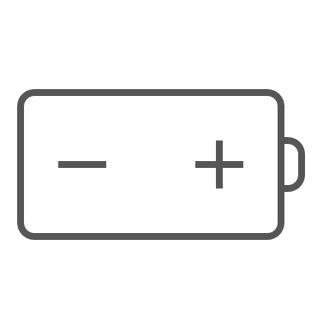



DOD Battery Facts and Figures
=
=
Unique Rechargeable Batteries Purchased Each Year
>1,300
>$155M
>581 MWh
>360
=
=
Manufacturers & Suppliers
Primary, Thermal, Reserve, and Specialty Batteries
>3,800
>$300M
>104 MWh
=
=
~150
All Known Unique Battery Designs in Service
Program Office Customers
>5,100
>$455M
>685 MWh

Slide 21
Commercial, standard Li-ion batteries achieve higher performance and lower cost
Ni–Cd
Li-ion
Ni–MH
Commercial EV batteries
PbA
Li-ion
EV Pack
Li-ion EV Cell
CATL 2024 LFP Cell Goal
DoD purchased batteries
PbA – Lead Acid
Ni–Cd – Nickel Cadmium
Ni–MH – Nickel Metal Hydride
Li-ion – Lithium ion
EV – Electric Vehicle
Cost and performance of current fielded DOD Batteries have lower performance and higher costs than those in the EV sector
Notes:
Purpose of this slide is to set the stage and introduce the graphic

Slide 22
DOD Annual Demand vs. Procurement Price
Each represents a unique battery purchased by a DoD per vendor
PbA – Lead Acid
NiCd – Nickel Cadmium
Li-ion – Lithium ion
PbA Aircraft
Li-ion Dismounted
Ni–Cd Aircraft
PbA Ground
Current EV Pack Cost
Aggregating purchases and buying larger volumes drives costs down for all chemistries* and the majority of DOD applications require less than 1 MWh annually
Notes:
560 MWh per year versus 560 GWh

Slide 23
Base Case DOD Electrification Scenario
Other domains 49 MWh
Ground domain EV lithium-ion 102 MWh
Ground domain 6T lithium-ion 45 MWh
Ground domain lead acid 311 MWh
Air domain lithium-ion 4.5 MWh
Dismounted domain lithium-ion 20 MWh
Lithium-ion battery demand is projected to increase from 14 MWh to 172 MWh by 2050 under conservative electrification assumptions. Modest growth rate in demand relates to longer lifetimes for li-ion vs. legacy chemistries.
Lead Acid
Nickel Cadmium
Lithium-ion

Slide 24
Alternate DOD Electrification Scenario
Lead Acid
Nickel Cadmium
Lithium-ion
Other domains 49 MWh
Ground domain EV lithium-ion 825 MWh
Ground domain 6T lithium-ion 185 MWh
Ground domain lead acid 69 MWh
Air domain lithium-ion 4.5 MWh
Dismounted domain lithium-ion 20 MWh
Under more aggressive electrification scenarios, li-ion demand could rise to greater than 1GWh /year

Slide 25
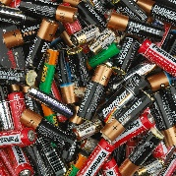

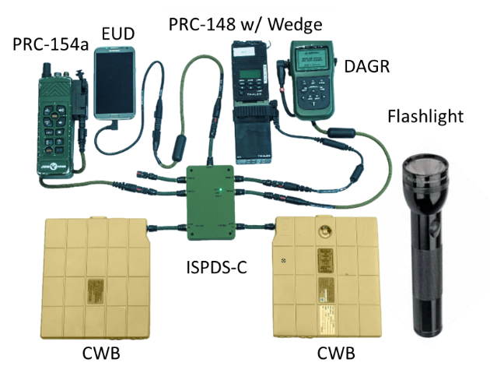

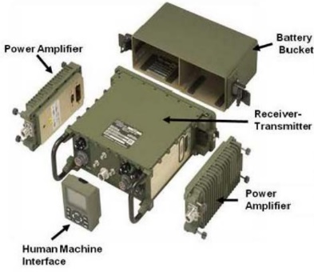

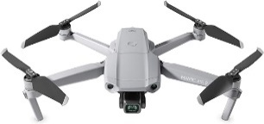

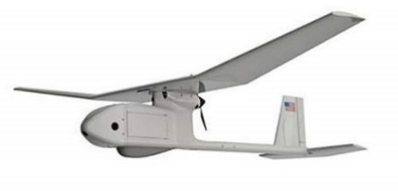
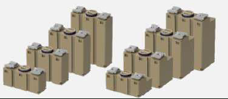
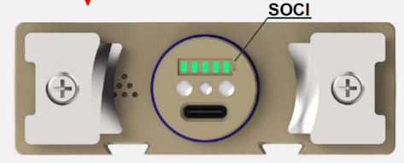
Dismounted Domain: Current Largest DoD Consumer of Li-ion Batteries, Largely Standardized, Heavily Reliant on 18650s
Approx. 90k packs, > 1M 18650 cells, 15 MWh, $28M annually
  Mostly standardized batteries except for handheld tactical radio batteries
Opportunity to reduce costs, improve safety & interoperability by:
  Standardizing tactical radio batteries
  Closing non-certified battery loopholes (e.g., “designed to standard” BB2590s)
Full benefits in the dismounted domain hinge on interoperability across systems
  Ex., STUB interoperability reduces soldier cognitive burden & enables opportunity to optimize soldier/squad energy management via increased energy awareness
  Further assessments required to fully quantify the benefits of greater interoperability and potential intersection of dismounted and unmanned systems batteries
loose cells
BB2590
COTS
BB2557
?
STUB

Slide 26
Battery Data by Domain per Year
Rechargeable batteries purchased by DOD make up 75% by cost, 24% by quantity, and 85% by energy
Average rechargeable battery: $230 per battery | 914 Wh | $252 per kWh
Average primary battery: $25 per battery | 55 Wh | $455 per kWh

Slide 27
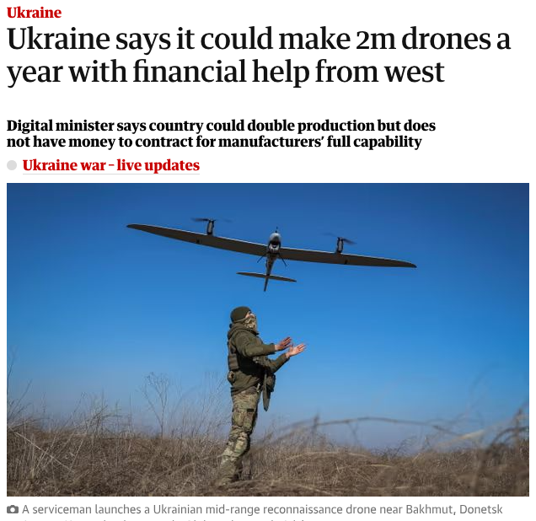
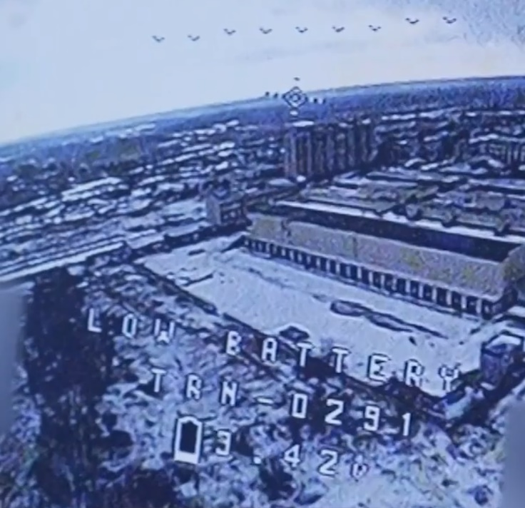
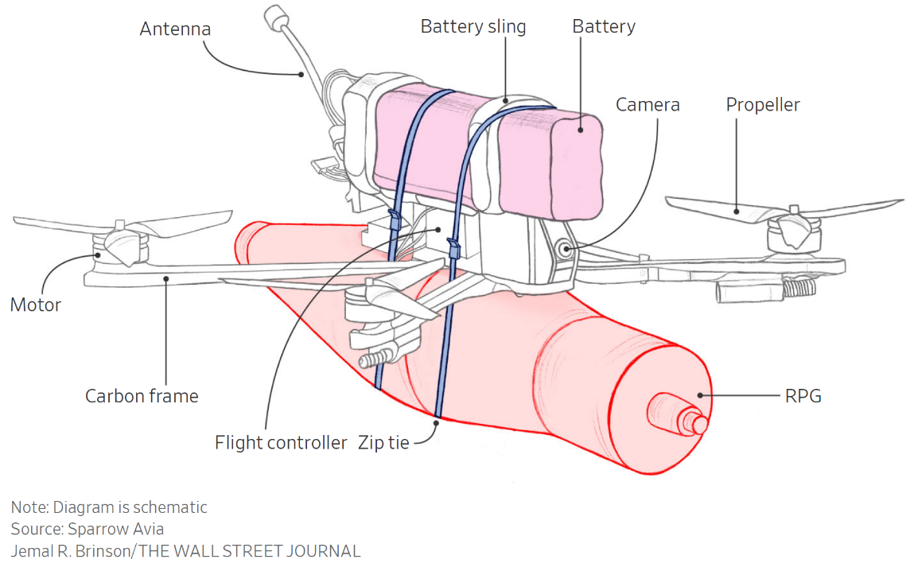
Wartime Implications For UxS Production
[1]
https://news.panasonic.com/global/stories/1011
A commercial drone with a ~4lb payload can fly ~2 miles on a 300Wh battery capable of ~C/2 rate^{[2]}
A demand of 2 million drones each requiring a 300Wh li-ion battery would represent ~ 100% of DOD’s total annual battery demand and >1,000% of DOD annual li-ion needs
[1] https://www.wsj.com/world/low-on-ammo-ukraine-tries-to-build-a-million-explosive-drones-57f8fb52
[2]. https://uavsystemsinternational.com/pages/heavy-lift-payload-drones

Slide 28
Wartime Demand Comparison
Each represents a unique battery purchased by a DoD per vendor
Conceivable demand, just for Ukrainian UAVs?
PbA Aircraft
Li-ion Dismounted
Ni–Cd Aircraft
PbA Ground
Current EV Pack Cost
While peacetime demand figures are comparatively easy to project, wartime demands for batteries, particularly in attritable systems, may place massive demands on production capacity
Notes:
560 MWh per year versus 560 GWh

Slide 29
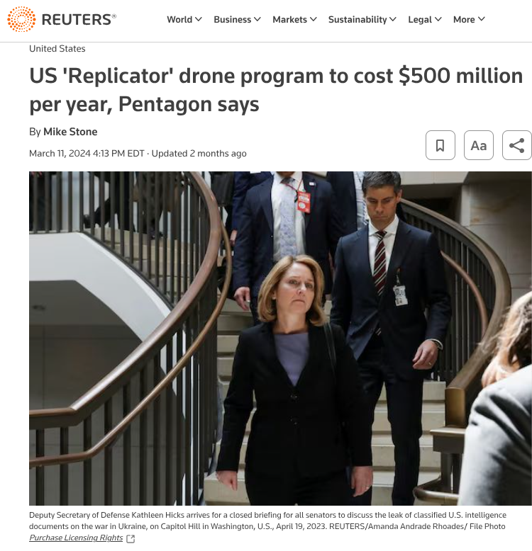
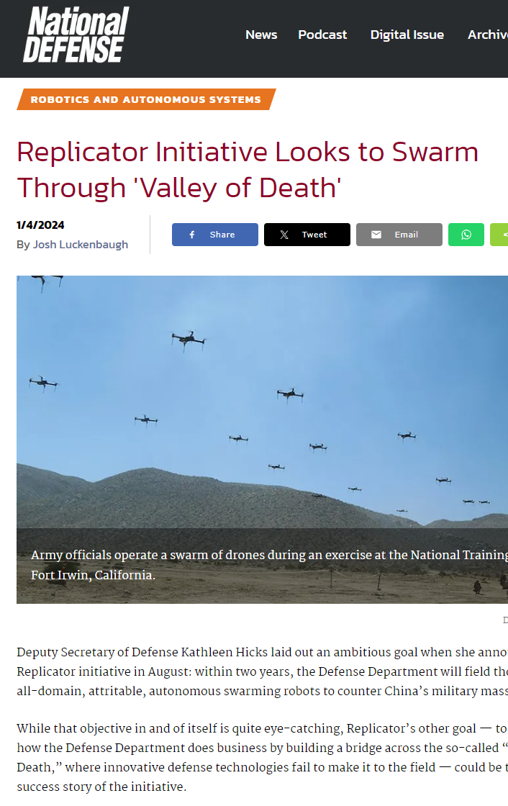
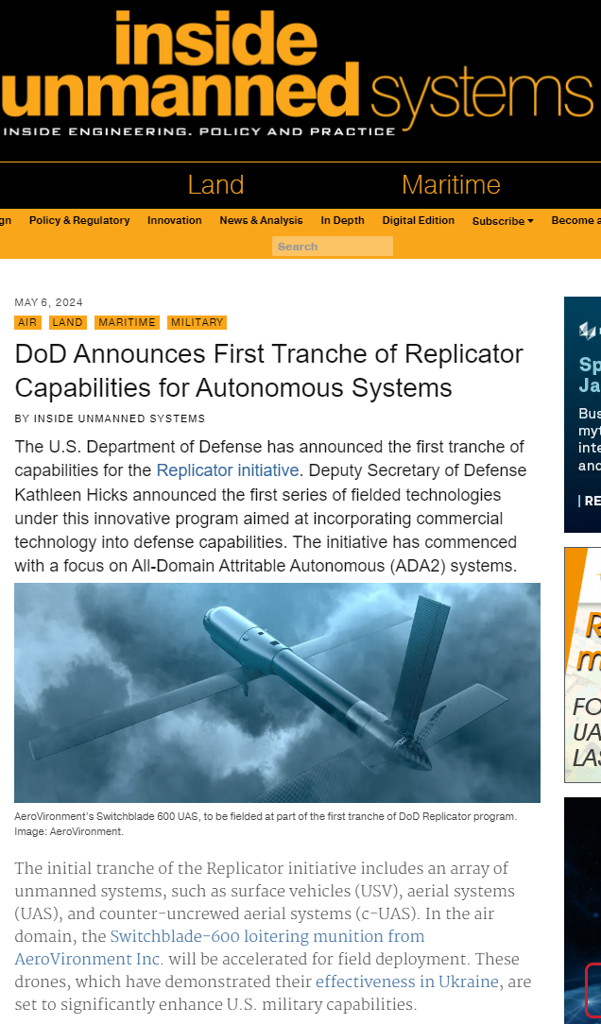

DIU Replicator Program
Goal: “To field thousands of all-domain, attritable, autonomous, swarming robots.”
"In the air domain, the Switchblade-600 loitering munition from AeroVironment Inc. will be accelerated for field deployment. These drones, which have demonstrated their effectiveness in Ukraine, are set to significantly enhance U.S. military capabilities." ~May 6, 2024

Slide 30
Part III: Ongoing Policy Actions & Activities

Slide 31

18650 Investment Notice
Notice: Due to a substantial cut in FY24 appropriations to the Defense Production Act Title III program, the $120M planned for investment in domestic 18650 cell production, which was included in Presidential Budget Request 24 and the FY24 NDAA, was eliminated
All current high-volume 18650 production is in China, South Korea, Japan, Malaysia, and Taiwan (increasingly China)
A number of companies are looking to establish 18650 production in North America, however the 2170 market is larger, making support of the smaller cylindrical format more difficult for producers from a business case perspective

Slide 32
NDAA Battery Provisions & Congressional Intent
FY23 NDAA – Sec 225 – Warfighter Battery Electric Transition Pilot Program
Congress provided DOD (USD(R&E)) the authority to establish a program to research and rapidly transition and field domestic batteries.
FY23 NDAA - Sec 325. Policy to Increase Disposition of Spent Advanced Batteries Through Recycling
Congress has directed DOD to develop policy to push recycled battery materials from DOD systems back into the domestic supply chain
FY24 NDAA – Sec. 154 Prohibition on Availability of Funds for Procurement of Certain Batteries
Congress specifically restricted procurement of batteries from six large Chinese battery producers
HASC Hearing April 17, 2024 exchange between Chairman Mike Walz and Assistant Secretary of Defense EI&E
Walz: "I can't believe that Congress needs to push this. Weaning our clean energy programs off of Chinese Communist Party production. So, can you speak to what the Department's proactively doing to encourage investment in domestic - or allied for that matter - energy capabilities and production sources..."

Slide 33
Conclusions
Continued trends in China to dominate the global lithium-ion market will continue to challenge the establishment of a secure and affordable battery industrial base
The U.S. Government must continue to work hand in hand with industry to develop and execute industrial policies which encourage competition and innovation while protecting American and allied businesses from market manipulation
The DOD demand for li-ion batteries is projected to continue to grow, though significant uncertainty remains in the scale of production required under a wide range of future scenarios
Congress is continuing to direct the DOD to take action to secure supply chains for batteries, both for installations and for operational capabilities and OSD is working with DOD Services to achieve those objectives

Slide 34
How Industry Can Help
When supply chain security issues, dependencies, and tradeoffs are identified please communicate them 'up' both through Primes and Sponsors to improve risk visibility.
Please continue to communicate your recommendations on how DOD can be a better customer (even if you've told us before!)
Please continue to assess your own supply chain dependencies, risks, options, and choices given the rapidly changing security, policy, and economic landscape.
Please continue to keep the warfighter front in center in your mind. Profit and sustainability in business is a fundamental requirement. Outside of that, we are all here to get the warfighter overmatch capability and effective coordination between industry and government is how we achieve that.

Slide 35
Briefing Contributors
MITRE
Dr. Fernando Tavares
Dr. Alex Cocco
Dr. Brandon Hopkins
This work was sponsored and supported by:
Ms. Ruthanne Darling, Director for the Operational Energy Capability Improvement Fund (OECIF), OUSD(A&S)
Ms. Bethany Harrington, Director, Technology & Industrial Base Assessments, OUSD(R&E)
Mr. Eric Shields, Senior Battery Advisor Policy Analysis & Transition OUSD(A&S)

Slide 36
Questions
Yes, slides are available.
Email: david.r.james6.ctr@mail.mil

