Slide 1



HYBRID INTELLIGENT
DIAGNOSTIC SCREEN

Slide 2


OUR CORE BUSINESS
Mobile Energy, Delivered Locally
Hybrid Systems (Battery Systems + Generator)
Natural Gas/Propane Powered Generators
Mobile EV Charging Solutions
Industrial Engine Repair & Remanufacturing
Rapid Prototyping & Manufacturing
Founded in 1973 and headquartered in Casper, WY, Moser Energy Systems is the leader in engineering, manufacturing, and servicing industrial prime power and standby, distributed power generation systems
POWER WHEN YOU NEED IT. WHERE YOU NEED IT.

Slide 3
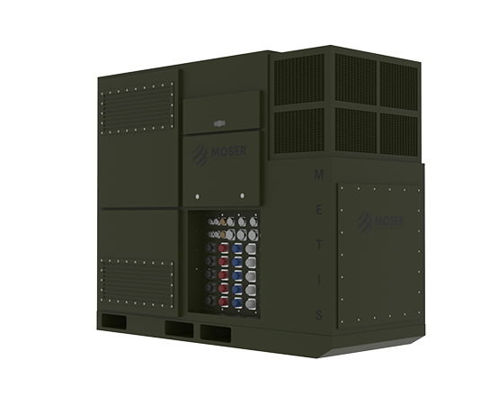
METIS
200kW Tactical Inverter
Integrates with three AMMPS generators
68kW (3C) BES
30kW PV input
Silent watch, silent run generator, peak modes of operation
POWER WHEN YOU NEED IT. WHERE YOU NEED IT.

Slide 4
MTG 250HR
250kW Tactical Generator
JP8 powered with 208V/415V output
Integrates with METIS for a 500kW pulse peak output
POWER WHEN YOU NEED IT. WHERE YOU NEED IT.

Slide 5
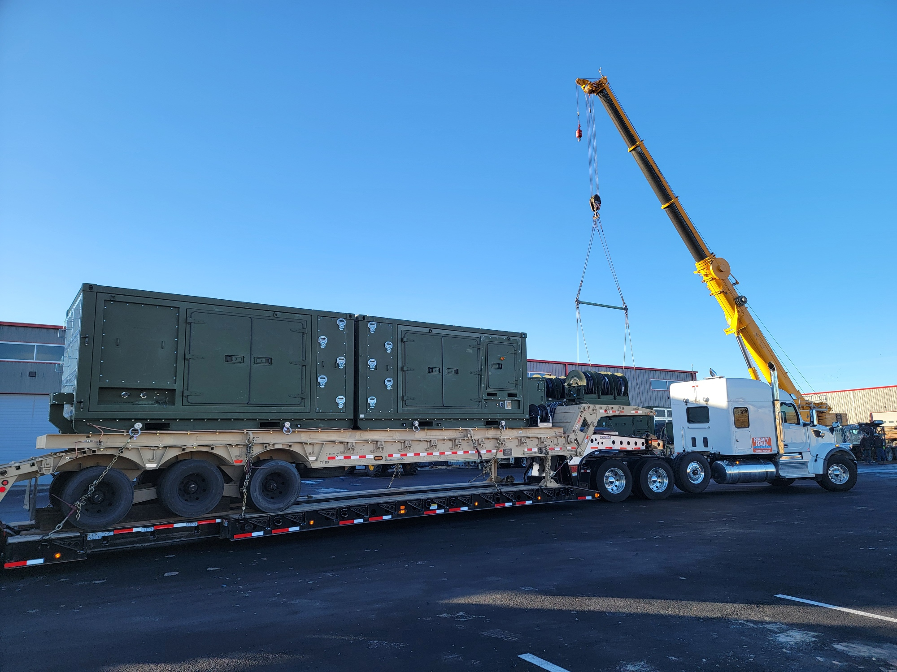
LTPS PROTOTYPE
Large Tactical Power System
Two 500kW 480V generators
Undergoing testing at APG
POWER WHEN YOU NEED IT. WHERE YOU NEED IT.

Slide 6





RAPID PROTOTYPING
Moser’s design and engineering teams develop unique controls that allow for the ready integration of engine driven generators and battery energy storage and incorporate it as a standard option in the product line.
Engineering and design team integrates suggested refinements and enhancements from the performance and design review.
March 1st
2021
March-May
2021
March 25th
2021
June-July
2021
August 23rd
2021
Moser recognizes a need in the existing tactical generator inventory.
The MTG250HR operates semi-publicly for the first time for a performance and design review with U.S. Army CERL.
Moser first publicly demonstrates the MTG250HR operating at G2 according to ISO8528 in conventional configuration at CBITEC in Fort Leonard Wood, Missouri.
POWER WHEN YOU NEED IT. WHERE YOU NEED IT.

Slide 7
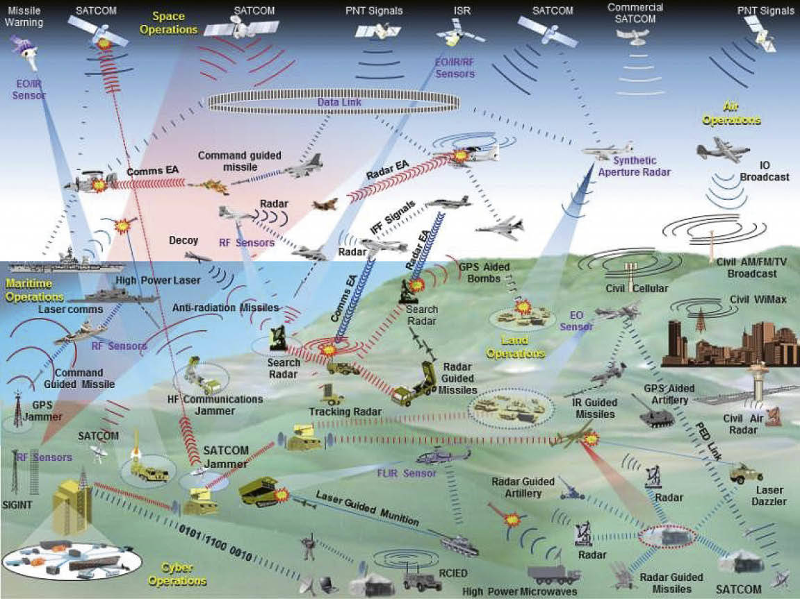
STATING THE CHALLENGE:
CONTESTED LOGISTICS IN AN INTENSELY ELECTRIFIED BATTLEFIELD
Weapons
Radar/missile defense
Field hospitals
Mobility
POWER WHEN YOU NEED IT. WHERE YOU NEED IT.

Slide 8
HYBRID SYSTEMS: With Intelligent Controls
ANSWERING THE “WHY?”
Since 1970, the Army’s fuel demands have increased 374%, Maj. Gen. Michelle Donahue, commanding general of Army Combined Arms Support Command, said during a recent AUSA Hot Top forum. Demand for maintenance has grown 37%, she said.
What to Watch: The service must work to reduce those demands, particularly as it prepares for a contested battlefield where adversaries can more easily disrupt supply lines and resupply operations, she said.
“If we want to ensure sustainment isn’t a crippling piece, from a warfighter’s perspective, we’ve got to reduce demand. The sustainment community cannot continue to be the growth industry for the United States Army.”
POWER WHEN YOU NEED IT. WHERE YOU NEED IT.

Slide 9
HYBRID POWER SYSTEMS
Hybrid power systems combine engine-driven generators with battery energy storage.
Much like a hybrid car, this enables more efficient and effective power using a smaller prime mover.
The battery is used at the extreme edges, both low and high, enabling the engine to operate at peak efficiency to manage the average loads.
Hybrid power systems require sophisticated sensors, precise power measurements, and a controlled load in the form of a battery.
HIDS re-purposes these components to create an instrumented dynamometer that can be used to predict relative system life.
POWER WHEN YOU NEED IT. WHERE YOU NEED IT.

Slide 10
HYBRID POWER SYSTEMS: Power Electronics
Modern power electronics and controls provide precision integration of stored energy to support connected loads.
Seamless load sharing between the engine-driven prime mover and the stored energy of the battery is managed by the devices and software collectively referred to as the “hybrid controller.”
The controller collects high-resolution data from various sensing devices that enable the ideal merging of two sources of power.
These same devices and controls can serve a secondary diagnostic role to a sophisticated hybrid power system.
POWER WHEN YOU NEED IT. WHERE YOU NEED IT.

Slide 11
HYBRID INTELLIGENT DIAGNOSTICS SYSTEM (HIDS)
HIDS technology provides a comprehensive analysis of the power system.
The power system performance and relative advancement in the life cycle are analyzed by the HIDS* technology.
HIDS utilizes the hybrid controller to process data from the sensing devices on the engine, inverter, and battery to calculate the Engine Life Cycle score (ELC).
ELC scores are compared to a digital twin of the power system’s baseline performance data, established at the power system’s “zero hour.”
Zero-hour baseline data is calculated by HIDS providing ELC score of “1.”
Subsequent HIDS scores will progress up to “10” indicating performance that is at the end of the power system’s service life.
POWER WHEN YOU NEED IT. WHERE YOU NEED IT.

Slide 12
HOW HIDS WORKS
HIDS (integrated with the Moser Hybrid Controller) manages the BES to ensure that adequate storage capacity is available to accept a full rated-power load step from the engine-driven generator.
The connected generator is commanded a load step equal to the rated power of the generator system.
Data from the engine sensors is delivered to HIDS at the same time as data from the power sensing devices on the inverter and battery is processed by HIDS.
The resulting response to the load step is processed by HIDS and compared to a known expected response that is established as the specific generator’s baseline performance.
POWER WHEN YOU NEED IT. WHERE YOU NEED IT.

Slide 13
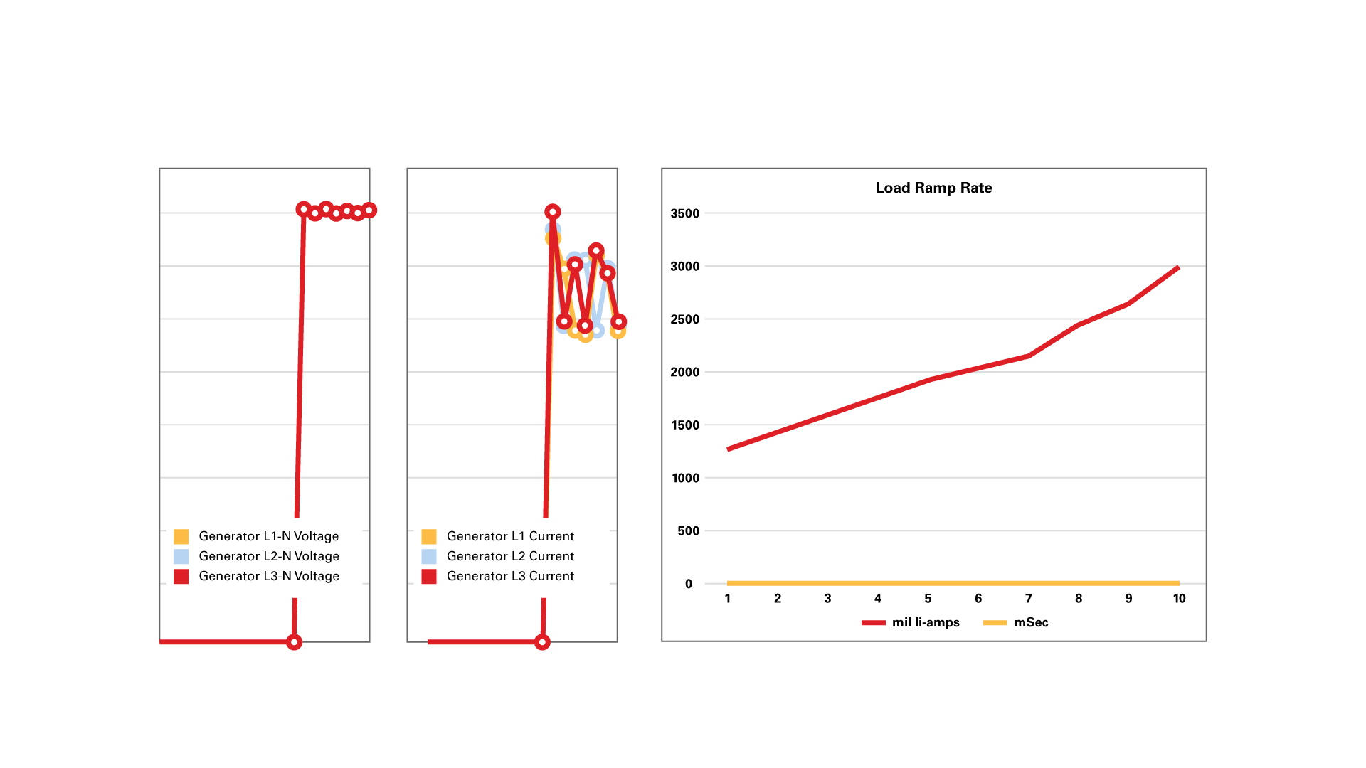
HIDS POWER ANALYTICS
POWER WHEN YOU NEED IT. WHERE YOU NEED IT.

Slide 14
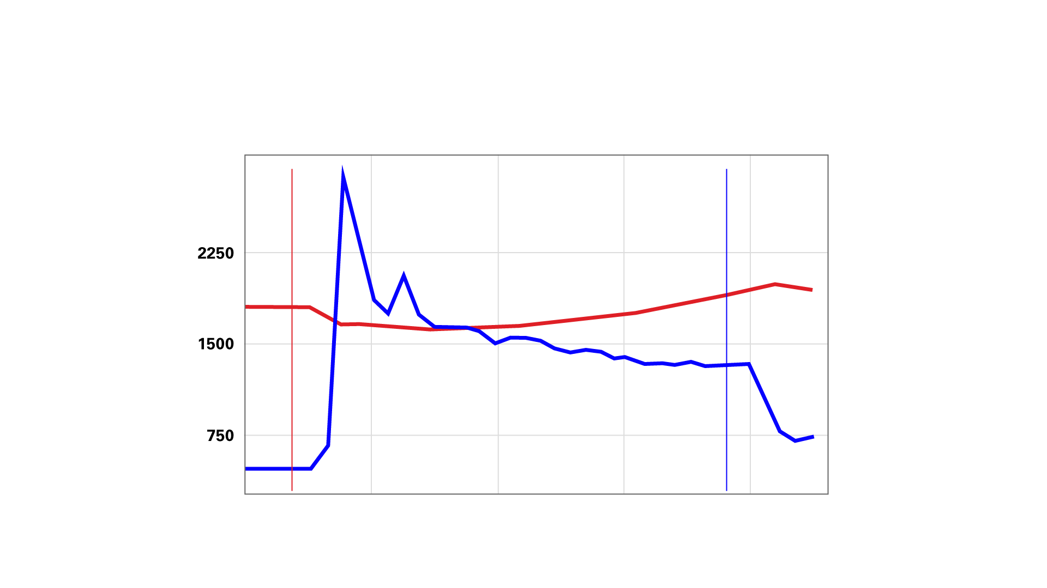
HIDS ENGINE RESPONSE ANALYTICS
The power system’s response to a load command is first analyzed by closely monitoring the throttle response (blue line) and the deflection in RPM (red line), or droop in RPM, and the time required to fully recover to the commanded RPM (in this case 1800 RPM).
POWER WHEN YOU NEED IT. WHERE YOU NEED IT.

Slide 15
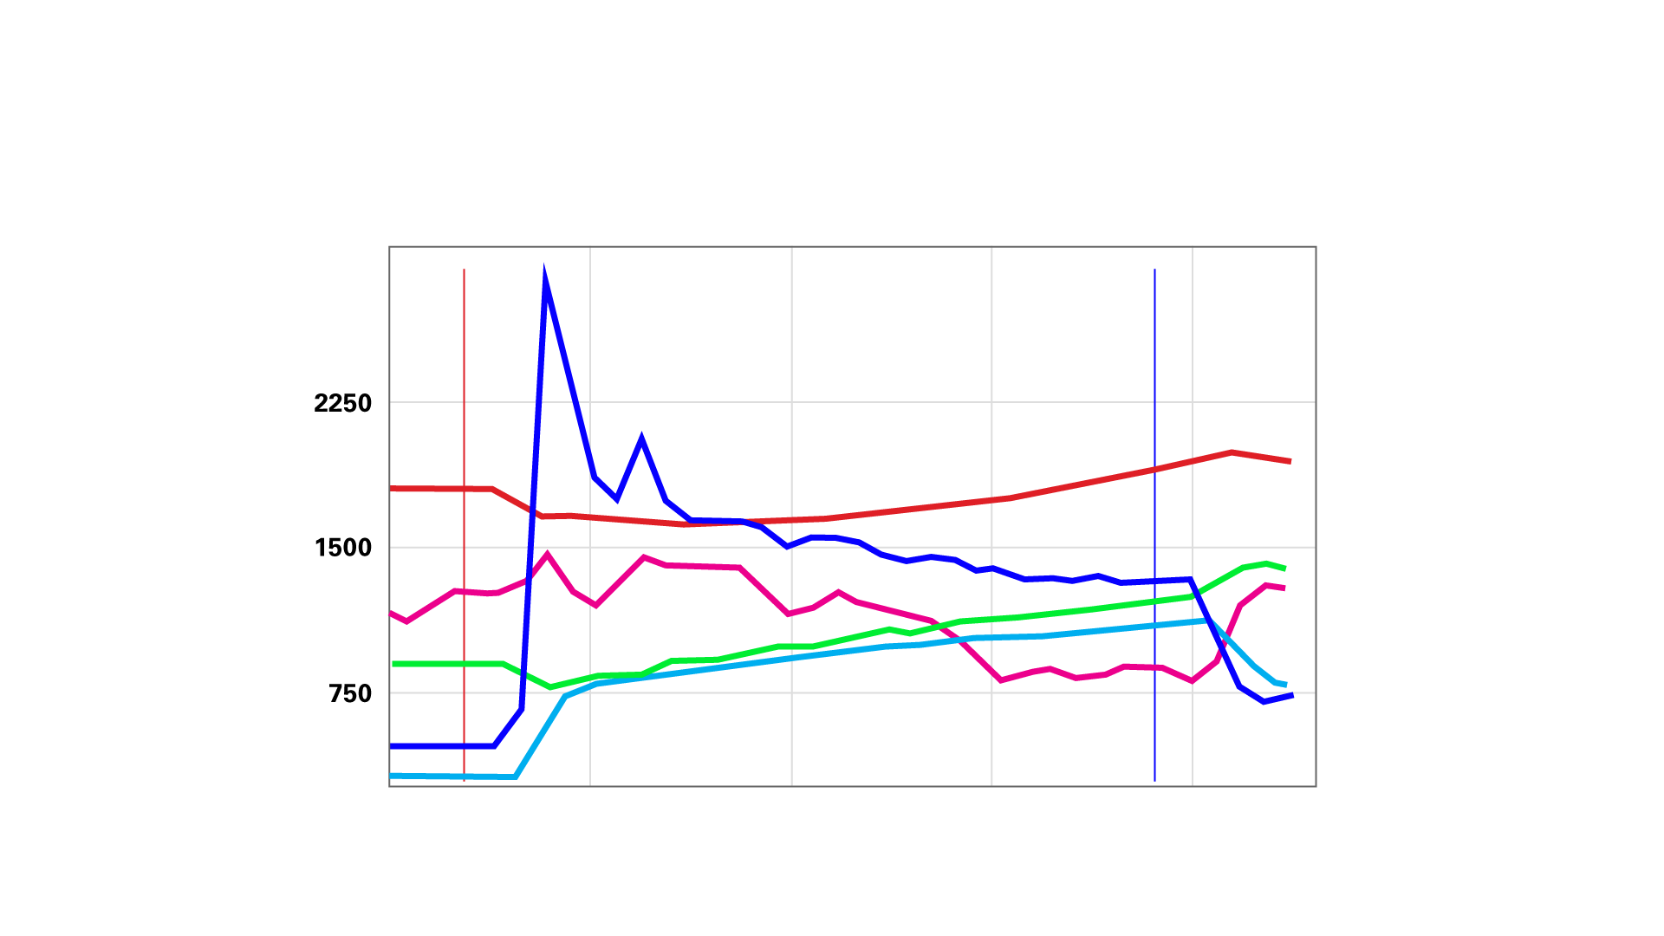
HIDS ENGINE RESPONSE ANALYTICS
The engine sensors provide governor response and fuel consumption data to calculate the HIDS ELC score.
POWER WHEN YOU NEED IT. WHERE YOU NEED IT.

Slide 16
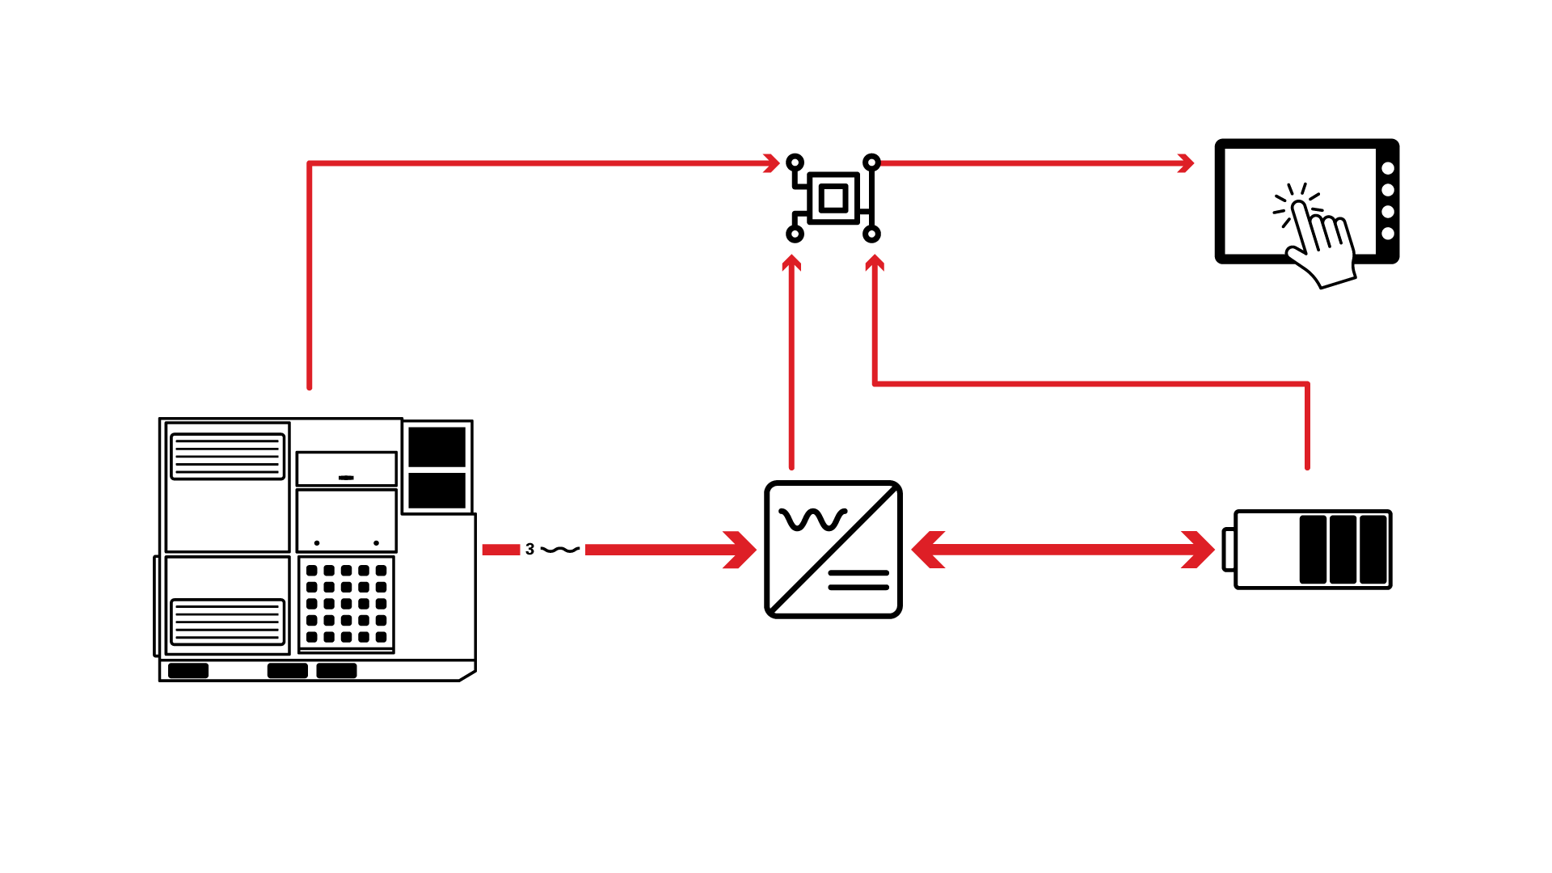
HYBRID INTELLIGENT DIAGNOSTICS SYSTEM
ELC Score
Displayed
ELC Calculation
Energy Data
Power Data
Engine Data
POWER WHEN YOU NEED IT. WHERE YOU NEED IT.

Slide 17
HYBRID INTELLIGENT DIAGNOSTICS SYSTEM
ELC Score
Displayed
The Hybrid Controller with HIDS uses the data inputs to calculate the power system’s ELC score
ELC Calculation
Generator controller communicates data to the Hybrid Controller.
The ELC score is displayed on the HMI
The BMS transfers energy data to the Hybrid Controller
The inverter transfers power data to the Hybrid Controller
Energy Data
Power Data
Engine Data
POWER WHEN YOU NEED IT. WHERE YOU NEED IT.

Slide 18


HIDS POWER SYSTEM MODEL BASELINE
Model HIDS score establishes the baseline ELC for all production units and the ELC scores for each HIDS test over the life of the power system.
HIDS uses the baseline data to create the power system model digital twin establishing the model baseline.
Model baseline HIDS data is established using a significant sample size of identical power systems tested at ISO conditions at the OEM level.
POWER WHEN YOU NEED IT. WHERE YOU NEED IT.

Slide 19
PRODUCTION HIDS POWER SYSTEM BASELINE
Each power system establishes that specific unit’s baseline digital twin and ELC “1” score used as the baseline for comparison with all subsequent ELC scores.
The HIDS score is used to establish consistent unit-to-unit performance and provide consistent acceptance testing standards.
Each Production power system provides an initial “zero-hours” HIDS score to establish the specific power system’s digital twin.
POWER WHEN YOU NEED IT. WHERE YOU NEED IT.

Slide 20
HIDS POWER SYSTEM MODEL BASELINE
The ELC score goes higher as the power system’s life advances through the life cycle.
The power system’s digital twin is saved to the hybrid controller and uses the data to establish ELC scoring relative to the specific digital twin.
Each production power system establishes its digital twin and specific zero-hour HIDS baseline ELC “1” score.
POWER WHEN YOU NEED IT. WHERE YOU NEED IT.

Slide 21

HIDS ELC SCORE
PARAMETER
SCALE
READING
COMPOSITE SCORE
TPS
IAT
MAP
TIP
CCP
ECT
VIB
FF
EGT
RR
1 to 10
1 to 10
1 to 10
1 to 10
1 to 10
1 to 10
1 to 10
1 to 10
1 to 10
1 to 10
7
6
6
6
5
5
6
5
6
7
Parameter: Key parameters are accessed through engine controller on the generator during a commanded and controlled load cycle.
Scale: Parameters are evaluated on a graded scale.
Reading: Resulting values for each parameter are displayed on HMI.
Composite Score: The average of the values are registered and recorded to inform the O&M schedule and determine the expected life cycle.
5.9
Average Score
5.6
Hours to EOL
28,000
The average of the last ten scores are displayed.
The expected remaining hours on the engine at the current rate of degradation are displayed.
POWER WHEN YOU NEED IT. WHERE YOU NEED IT.

Slide 22
HIDS ELC SCORE OVER ENGINE LIFE SPAN
PARAMETER
SCALE
READING
COMPOSITE
SCORE
PARAMETER
SCALE
READING
COMPOSITE
SCORE
PARAMETER
SCALE
READING
COMPOSITE
SCORE
TPS
IAT
MAP
TIP
CCP
ECT
VIB
FF
EGT
RR
1 to 10
1 to 10
1 to 10
1 to 10
1 to 10
1 to 10
1 to 10
1 to 10
1 to 10
1 to 10
7
6
6
6
5
5
6
5
6
7
TPS
IAT
MAP
TIP
CCP
ECT
VIB
FF
EGT
RR
1 to 10
1 to 10
1 to 10
1 to 10
1 to 10
1 to 10
1 to 10
1 to 10
1 to 10
1 to 10
8
7
7
8
7
7
7
6
6
7
TPS
IAT
MAP
TIP
CCP
ECT
VIB
FF
EGT
RR
1 to 10
1 to 10
1 to 10
1 to 10
1 to 10
1 to 10
1 to 10
1 to 10
1 to 10
1 to 10
9
8
8
8
8
7
8
8
7
9
5.9
Average Score
5.6
Hours to EOL
28,000
7.0
Average Score
6.8
Hours to EOL
23,000
8.0
Average Score
7.6
Hours to EOL
<10,000
POWER WHEN YOU NEED IT. WHERE YOU NEED IT.

Slide 23
HIDS USE CASES
Accurate assessment of system life cycle eliminating deployment of compromised or end-of-life assets
Reliable indication of a compromised power system with a performance evaluation score relative to digital twin data
Intelligent auto-sequencing of multiple generator applications for precise equalizing of operating hours and power system end-of-life
Predictive logistics and intelligent inventory control assigning the best power systems to the most critical missions
POWER WHEN YOU NEED IT. WHERE YOU NEED IT.

Slide 24
HIDS SUMMARY
Hybrid power systems reduce fuel consumption, lower emissions, and provide robust power response from smaller engines.
Sophisticated hybrid controls can significantly enhance reliability, improve predictive maintenance, and better manage the life cycle of critical power systems through machine learning and digital twin technology.
The Moser Hybrid Control System with Hybrid Intelligent Diagnostic Screening helps provide a more resilient, and efficient, power system for the warfighter.
POWER WHEN YOU NEED IT. WHERE YOU NEED IT.

Slide 25
DARRIN MOORMAN
Senior Vice President, Business Development
765.265.2365
darrin.moorman@moserenergy.com
260 Craig Thomas Blvd, Evansville, WY 82636 | 800.584.9833 | moserenergy.com

