Slide 1
REV STATION

Slide 2
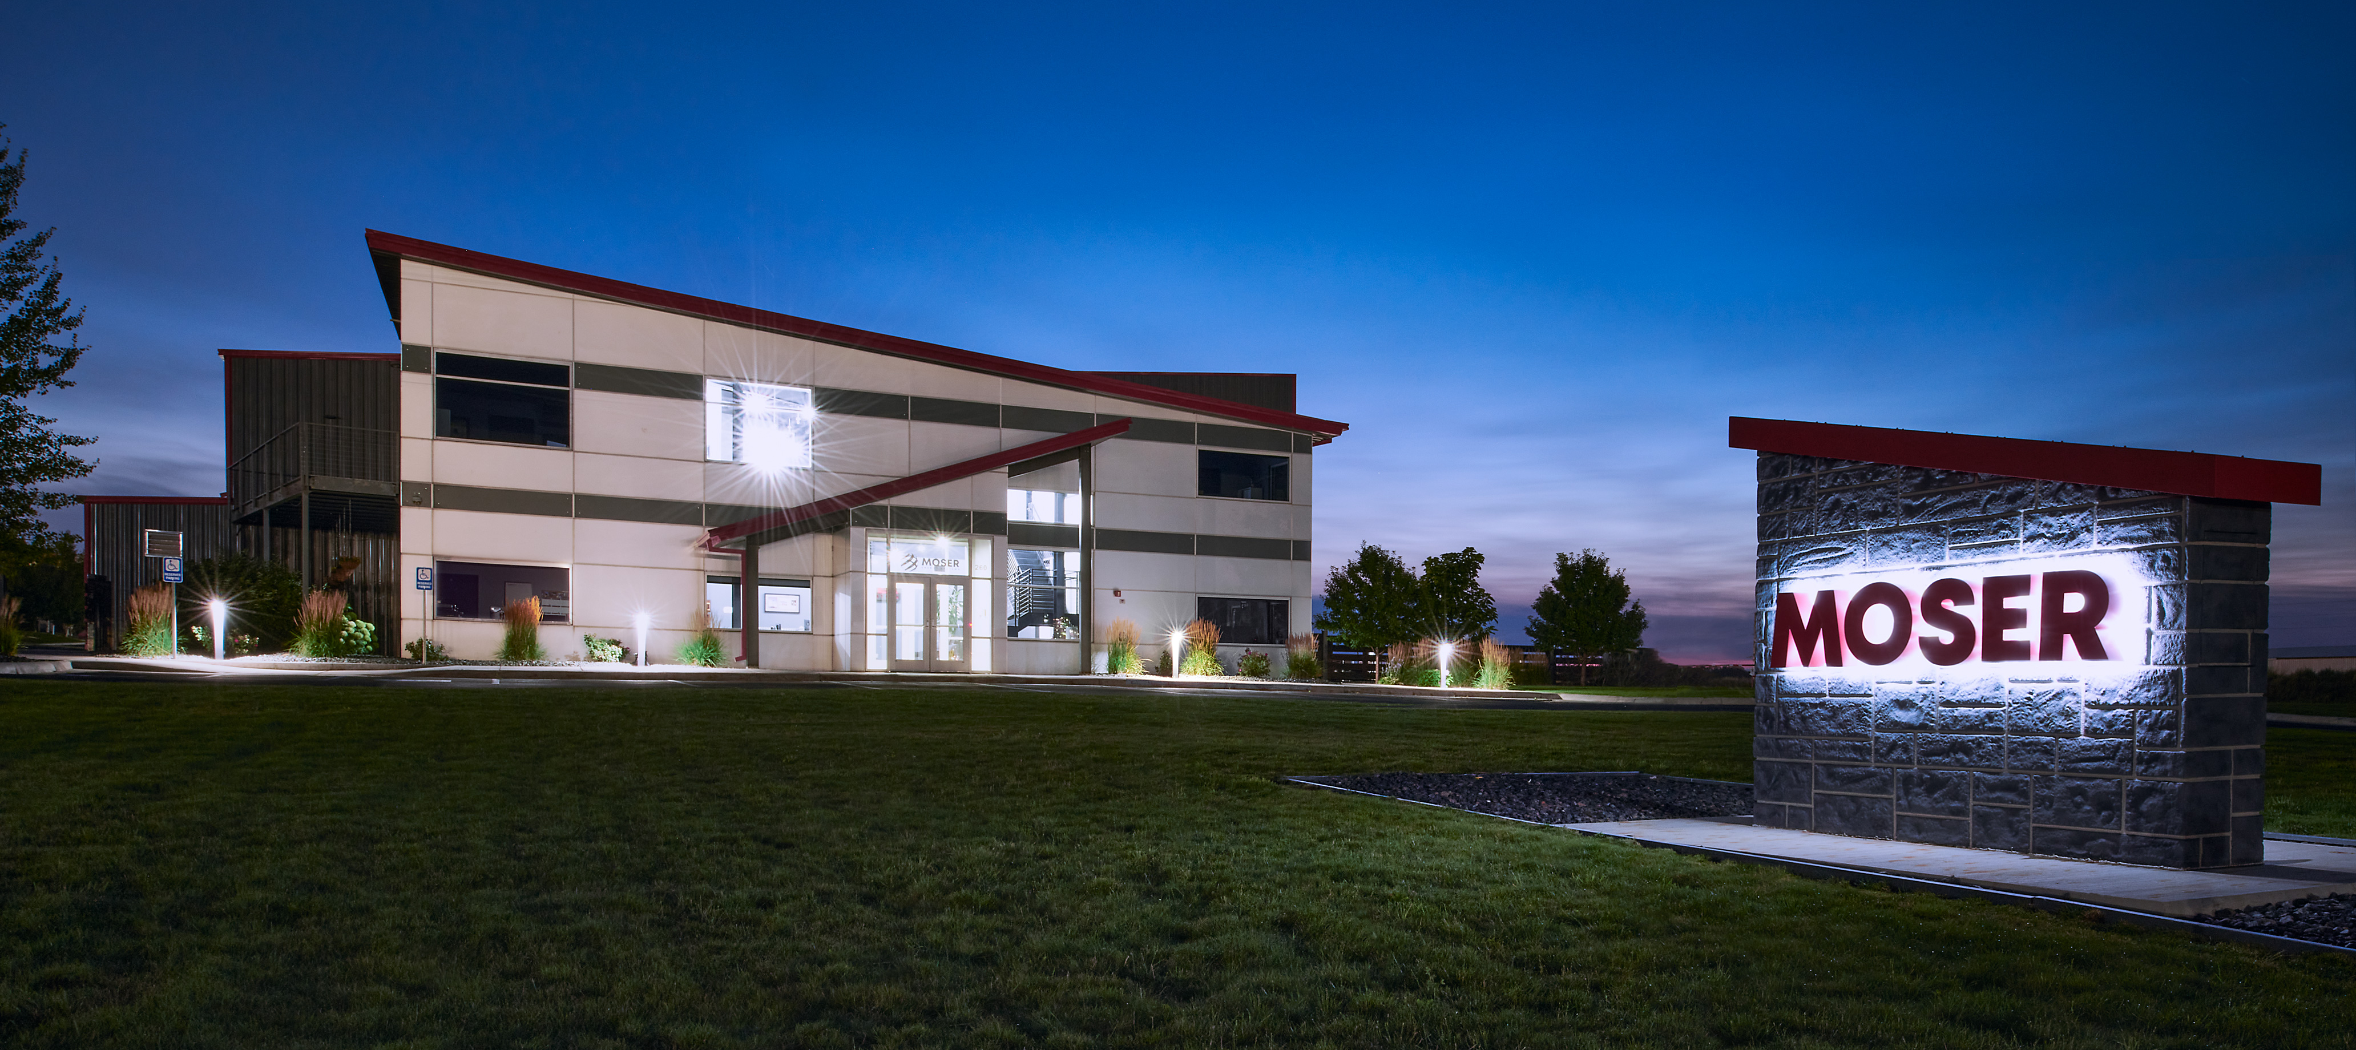
OUR CORE BUSINESS
Mobile Energy, Delivered Locally
Hybrid Systems (Battery Systems + Generator)
Natural Gas/Propane Powered Generators
Mobile EV Charging Solutions
Industrial Engine Repair & Remanufacturing
Rapid Prototyping & Manufacturing
Founded in 1973 and headquartered in Casper, WY, Moser Energy Systems is the leader in engineering, manufacturing, and servicing industrial prime power and standby, distributed power generation systems
POWER WHEN YOU NEED IT. WHERE YOU NEED IT.

Slide 3
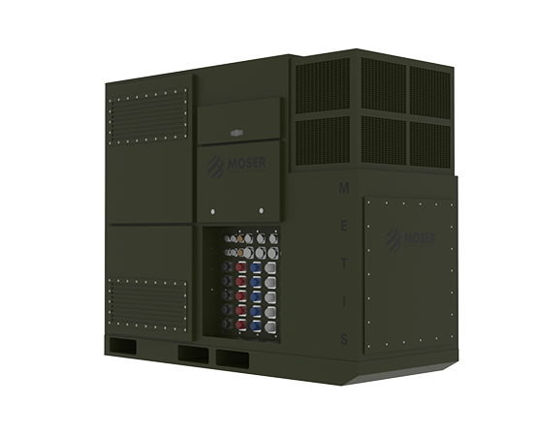
METIS
200kW Tactical Inverter
Integrates with three AMMPS generators
68kW (3C) BES
30kW PV input
Silent watch, silent run generator, peak modes of operation
POWER WHEN YOU NEED IT. WHERE YOU NEED IT.

Slide 4
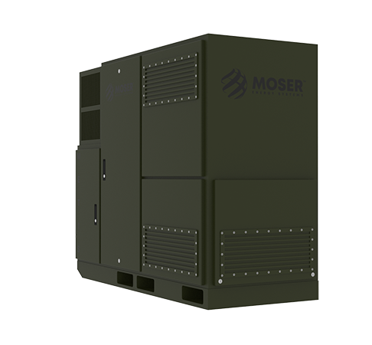
MTG 250HR
250kW Tactical Generator
JP8 powered with 208V/415V output
Integrates with METIS for a 500kW pulse peak output
POWER WHEN YOU NEED IT. WHERE YOU NEED IT.

Slide 5
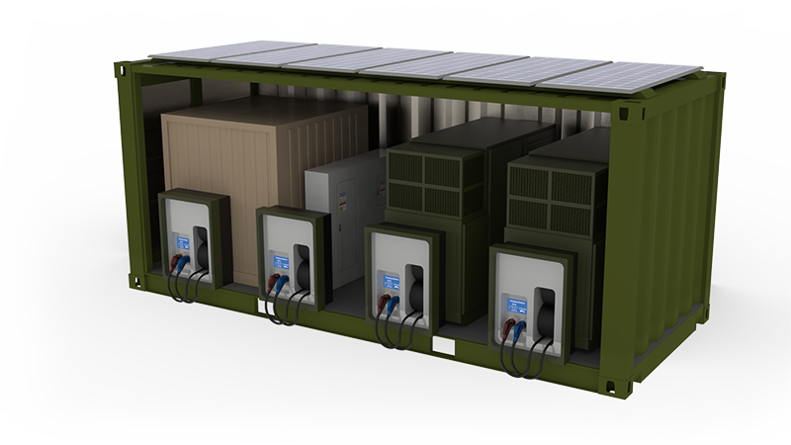
LTPS PROTOTYPE
Large Tactical Power System
Two 500kW 480V generators
Undergoing testing at APG
POWER WHEN YOU NEED IT. WHERE YOU NEED IT.

Slide 6
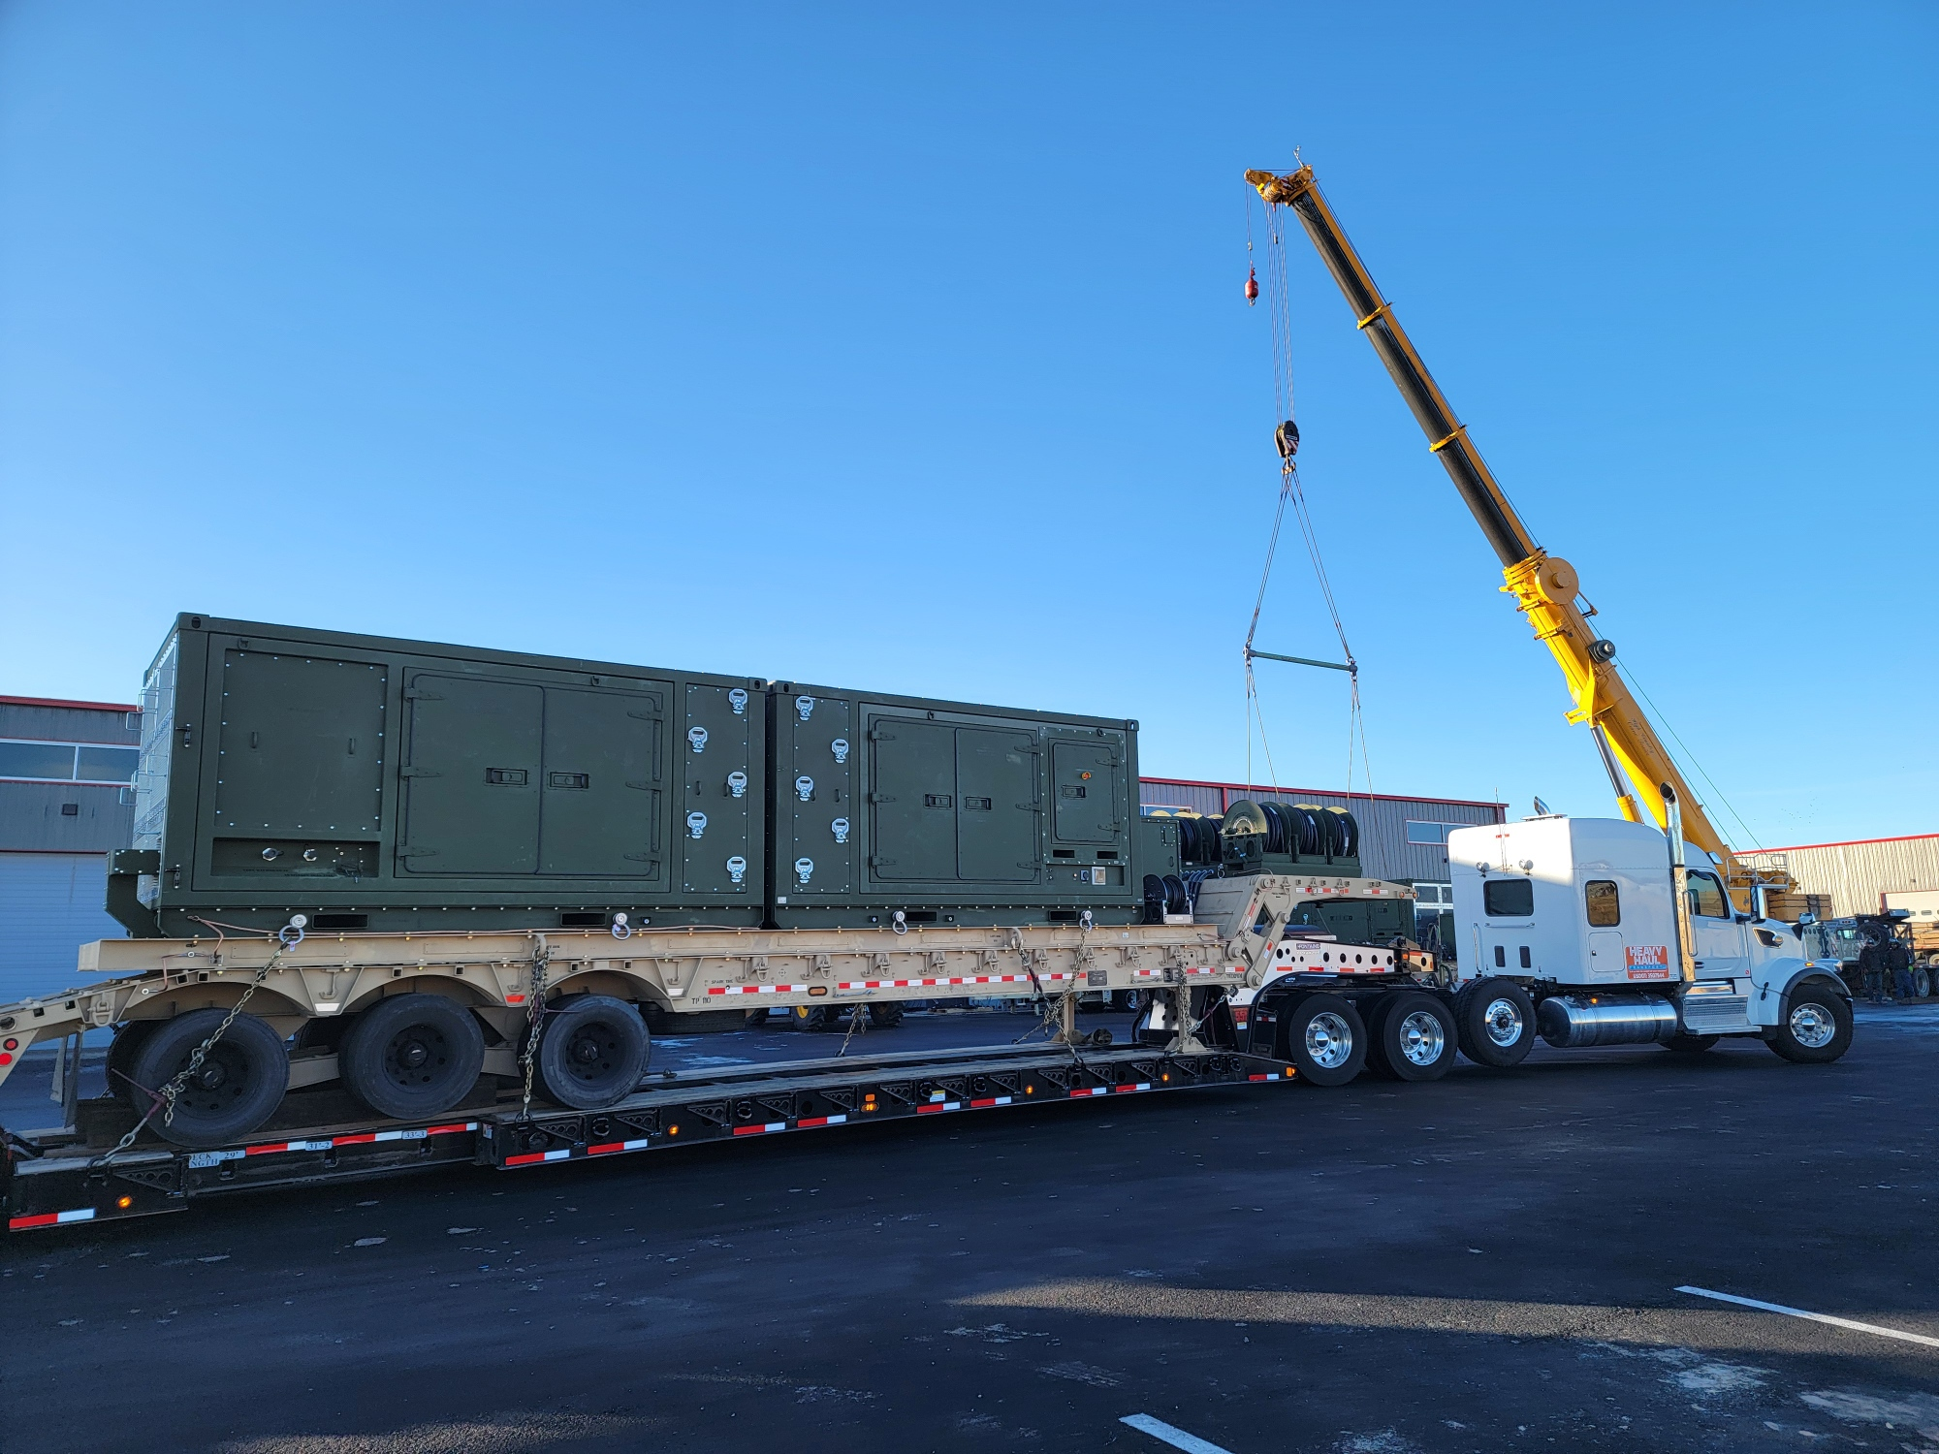
LTPS PROTOTYPE
Large Tactical Power System
Two 500kW 480V generators
Undergoing testing at APG
POWER WHEN YOU NEED IT. WHERE YOU NEED IT.

Slide 7
RAPID PROTOTYPING
Moser’s design and engineering teams develop unique controls that allow for the ready integration of engine driven generators and battery energy storage and incorporate it as a standard option in the product line.
Engineering and design team integrates suggested refinements and enhancements from the performance and design review.
March 1st
2021
March-May
2021
March 25th
2021
June-July
2021
August 23rd
2021
Moser recognizes a need in the existing tactical generator inventory.
The MTG250HR operates semi-publicly for the first time for a performance and design review with U.S. Army CERL.
Moser first publicly demonstrates the MTG250HR operating at G2 according to ISO8528 in conventional configuration at CBITEC in Fort Leonard Wood, Missouri.
POWER WHEN YOU NEED IT. WHERE YOU NEED IT.

Slide 8
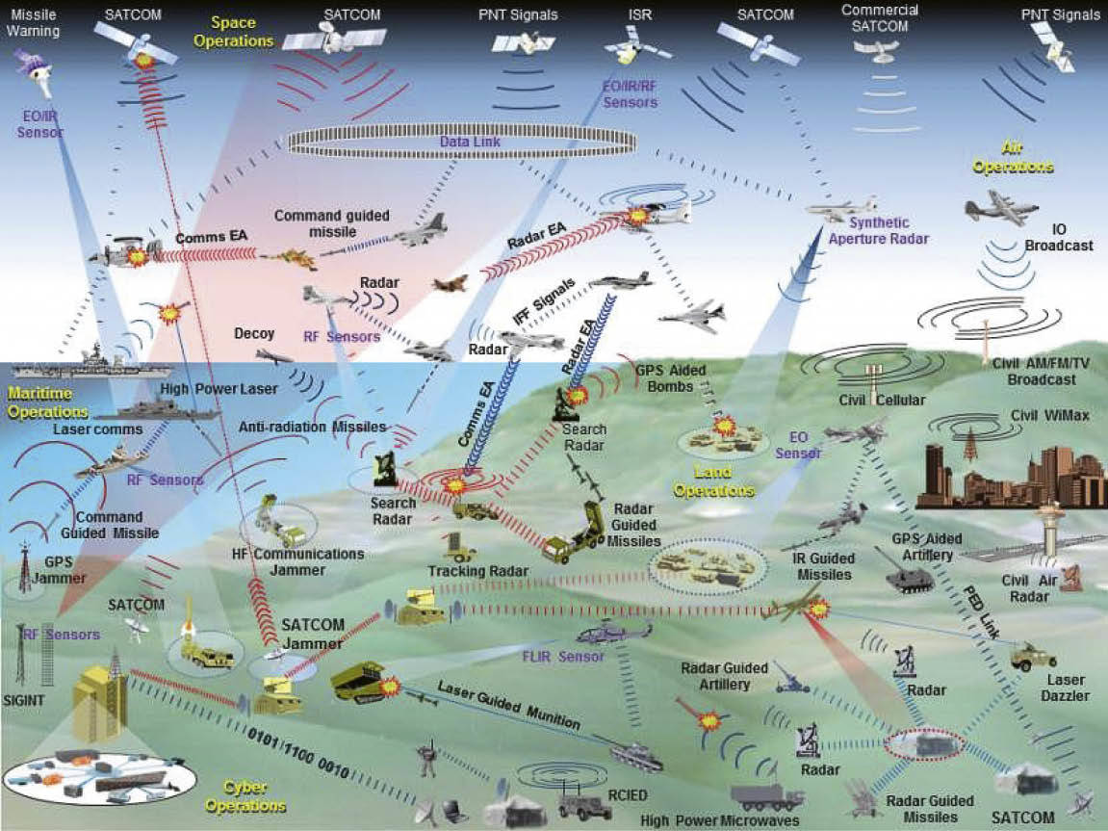
STATING THE CHALLENGE:
CONTESTED LOGISTICS IN AN INTENSELY ELECTRIFIED BATTLEFIELD
Weapons
Radar/missile defense
Field hospitals
Mobility
POWER WHEN YOU NEED IT. WHERE YOU NEED IT.

Slide 9
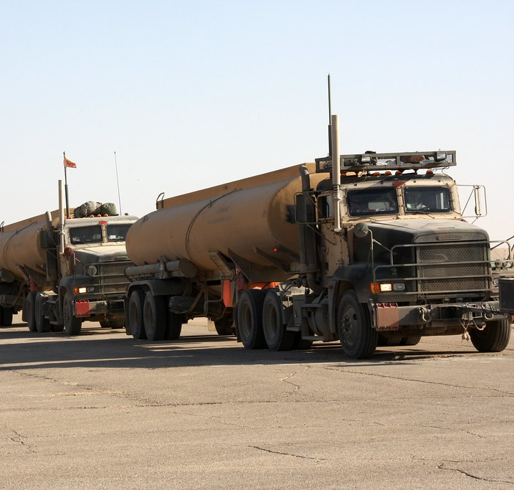
LOGISTICAL CHALLENGES
Fuel demands account for more than 50% of the resupply efforts.
Approximately 1 in 24 convoys suffer a casualty.
Saving Fuel = Saving Lives
POWER WHEN YOU NEED IT. WHERE YOU NEED IT.

Slide 10
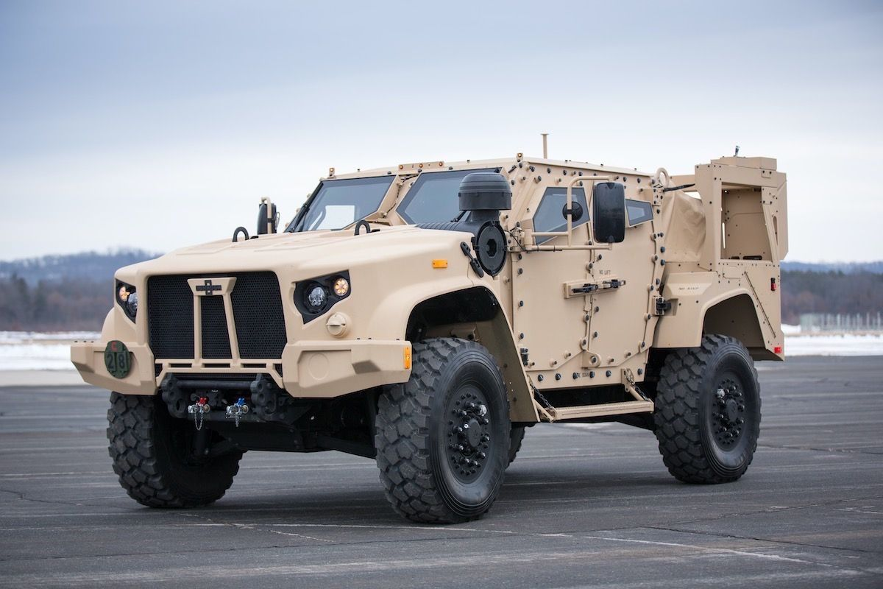
RAPID BATTERY CHARGING
High power demands
Intermittent loads
AC to DC conversion
Difficult to manage load demands
POWER WHEN YOU NEED IT. WHERE YOU NEED IT.

Slide 11
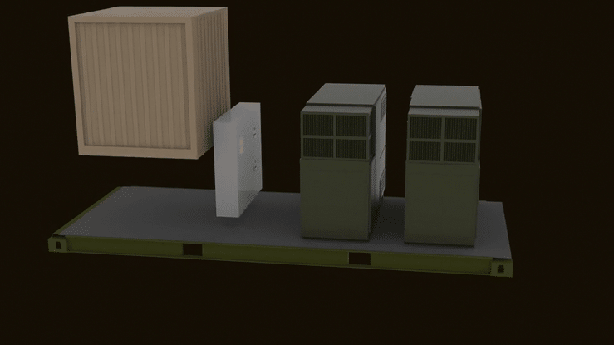
POWER WHEN YOU NEED IT. WHERE YOU NEED IT.

Slide 12
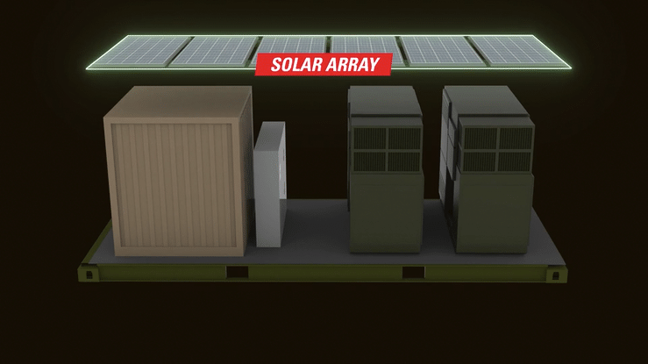
POWER WHEN YOU NEED IT. WHERE YOU NEED IT.

Slide 13
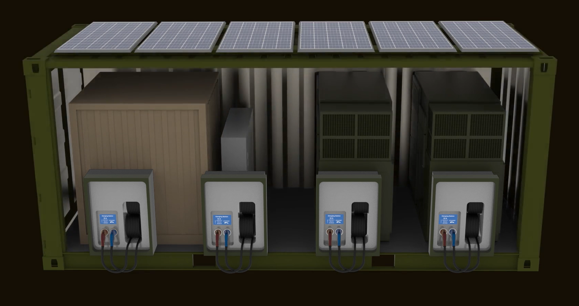
POWER WHEN YOU NEED IT. WHERE YOU NEED IT.

Slide 14
POWER WHEN YOU NEED IT. WHERE YOU NEED IT.

Slide 15
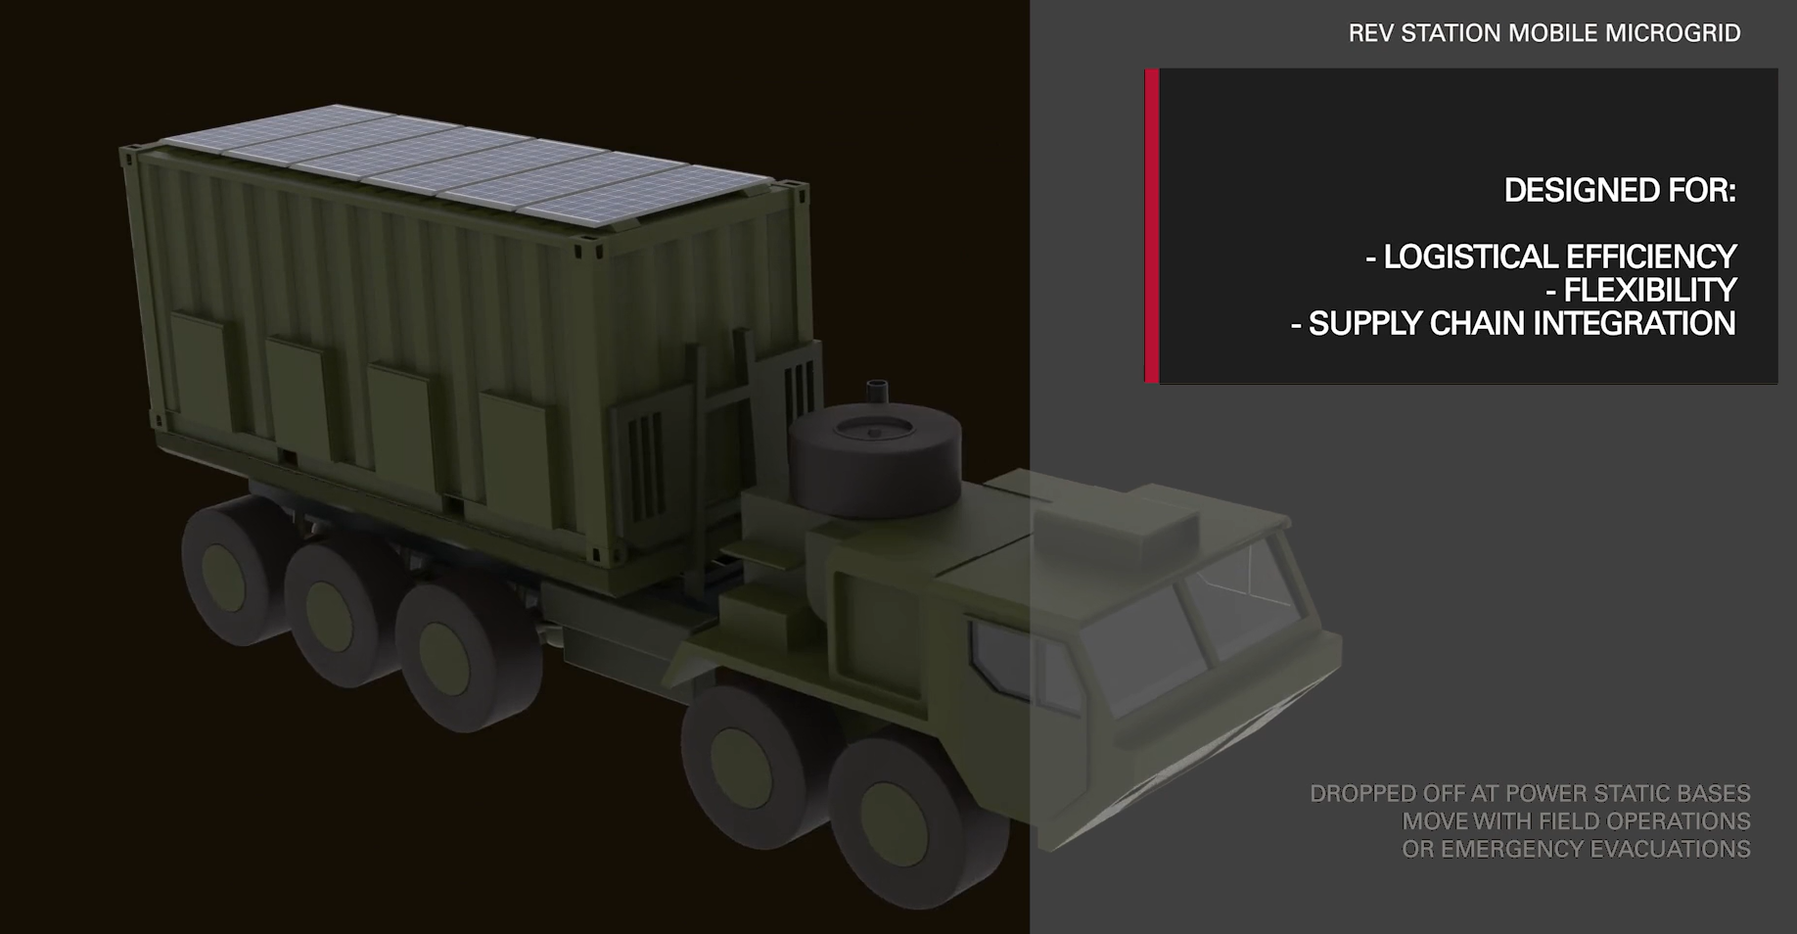
POWER WHEN YOU NEED IT. WHERE YOU NEED IT.

Slide 16
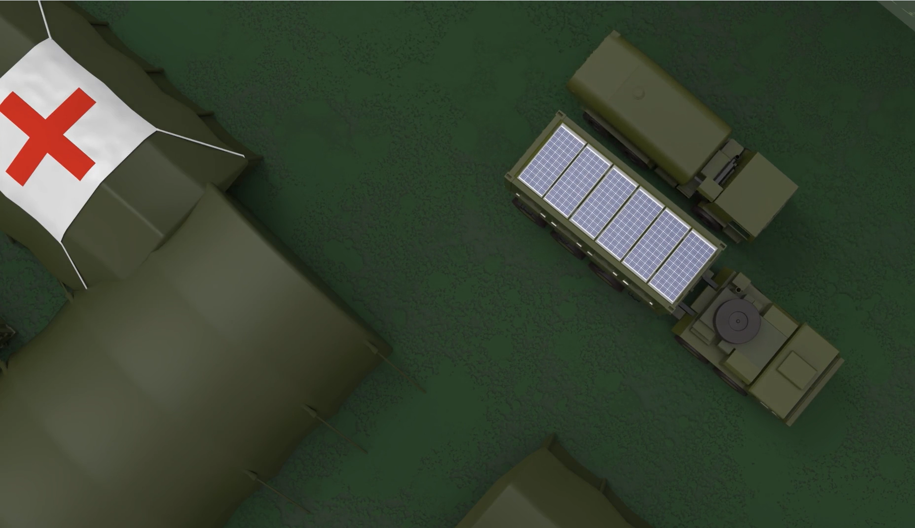
POWER WHEN YOU NEED IT. WHERE YOU NEED IT.

Slide 17
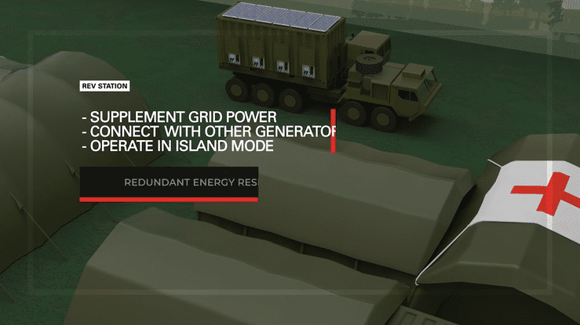
POWER WHEN YOU NEED IT. WHERE YOU NEED IT.

Slide 18
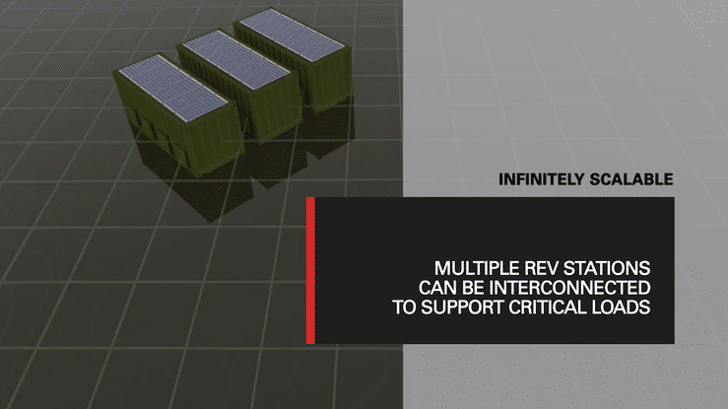
POWER WHEN YOU NEED IT. WHERE YOU NEED IT.

Slide 19
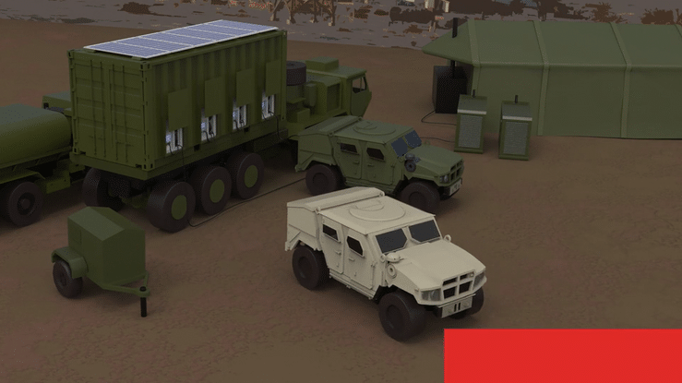
POWER WHEN YOU NEED IT. WHERE YOU NEED IT.

Slide 20
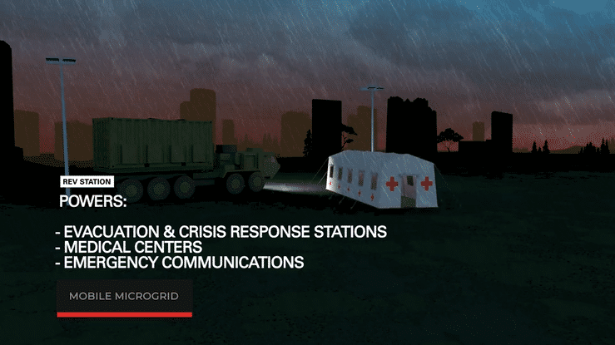
POWER WHEN YOU NEED IT. WHERE YOU NEED IT.

Slide 21
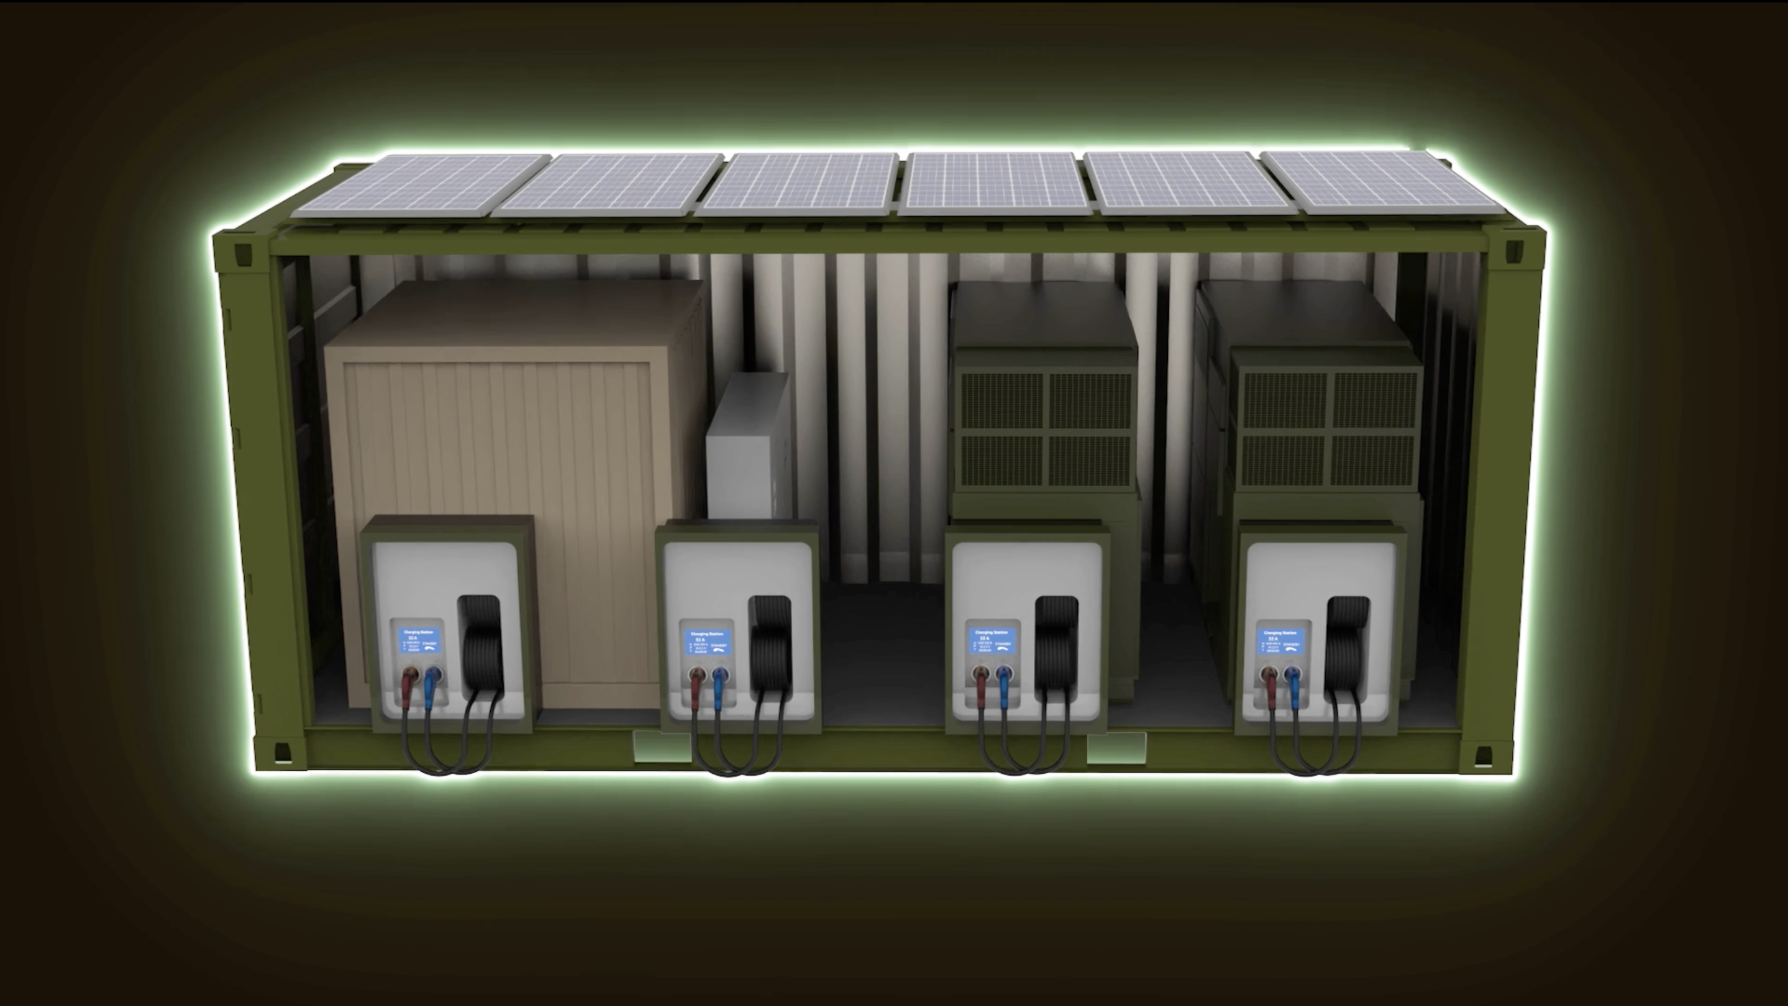
POWER WHEN YOU NEED IT. WHERE YOU NEED IT.

Slide 22
DARRIN MOORMAN
Senior Vice President, Business Development
765.265.2365
darrin.moorman@moserenergy.com
260 Craig Thomas Blvd, Evansville, WY 82636 | 800.584.9833 | moserenergy.com

