Slide 1
ODYSSEY Connect
Battery Monitoring: A Strategic Technology
North America EnerSys Transportation Specialty Team
June 4, 2024

Slide 2
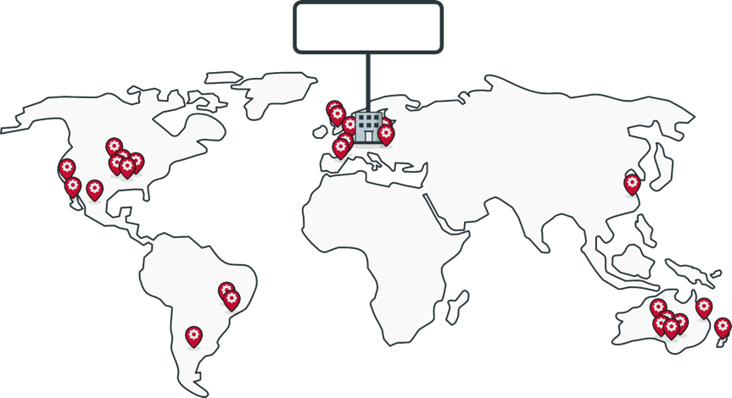
Our Global TPPL Footprint
EnerSys HQ
Reading, PA, USA
Global manufacturing facilities
EnerSys EMEA
Switzerland
EnerSys APAC
Singapore
Warrensburg, MO, USA
TPPL
Newport, Wales, UK
11,000+
employees
worldwide
Headquartered in Reading, PA United States
TPPL
TPPL
TPPL
Arras, France
TPPL
Springfield, MO, USA
TPPL
Indicates a Thin Plate Pure Lead (TPPL) Manufacturing site
© 2022 EnerSys. All Rights Reserved.

Slide 3
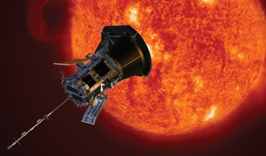
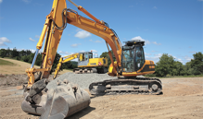
EnerSys Specialty
TRANSPORTATION
DEFENSE
SPACE
© 2021 EnerSys. All Rights Reserved.

Slide 4
ODYSSEY Connect
Large National Fleet Case Study
“Enersys GRP31 ACE batteries have been paramount in our 12v electrical system evaluations. We have used them in tractors, APUs, liftgate trailers, and even battery charger evaluations. Insight into how a battery is surviving is the value ACE has brought us.
While analyzing battery temp in an under-cab battery box application, we can see the internal battery temp rather than the surface temp, allowing us to focus on how to isolate/direct heat for maximum temp reduction.”

Slide 5
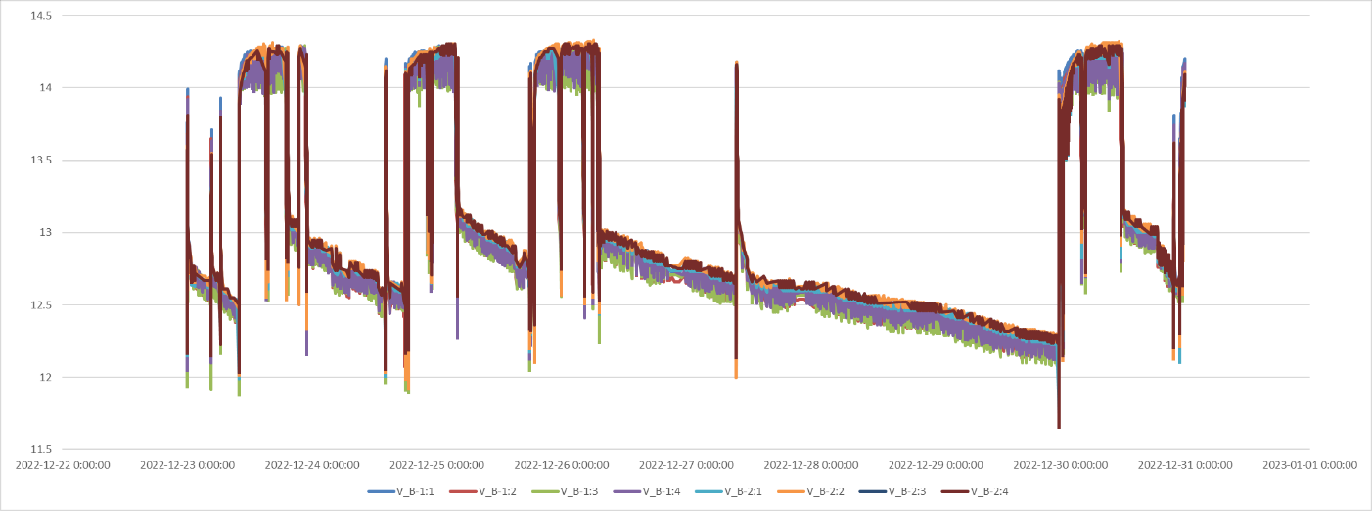
ODYSSEY Connect
Large National Fleet Case Study
“ACE has also been used for voltage drop and battery pack balance investigations. Reviewing historical raw ACE data allows us to see system inefficiencies from certain batteries in a pack carrying most of the starting load to batteries that are not receiving full charge.
Increasing battery life is very important to us in providing customers increased uptime as well as aiding our sustainability efforts. ACE gives us the data to do so.”

Slide 6
ODYSSEY Connect
In Transportation applications engine cranks are captured in the engine crank matrix

Slide 7
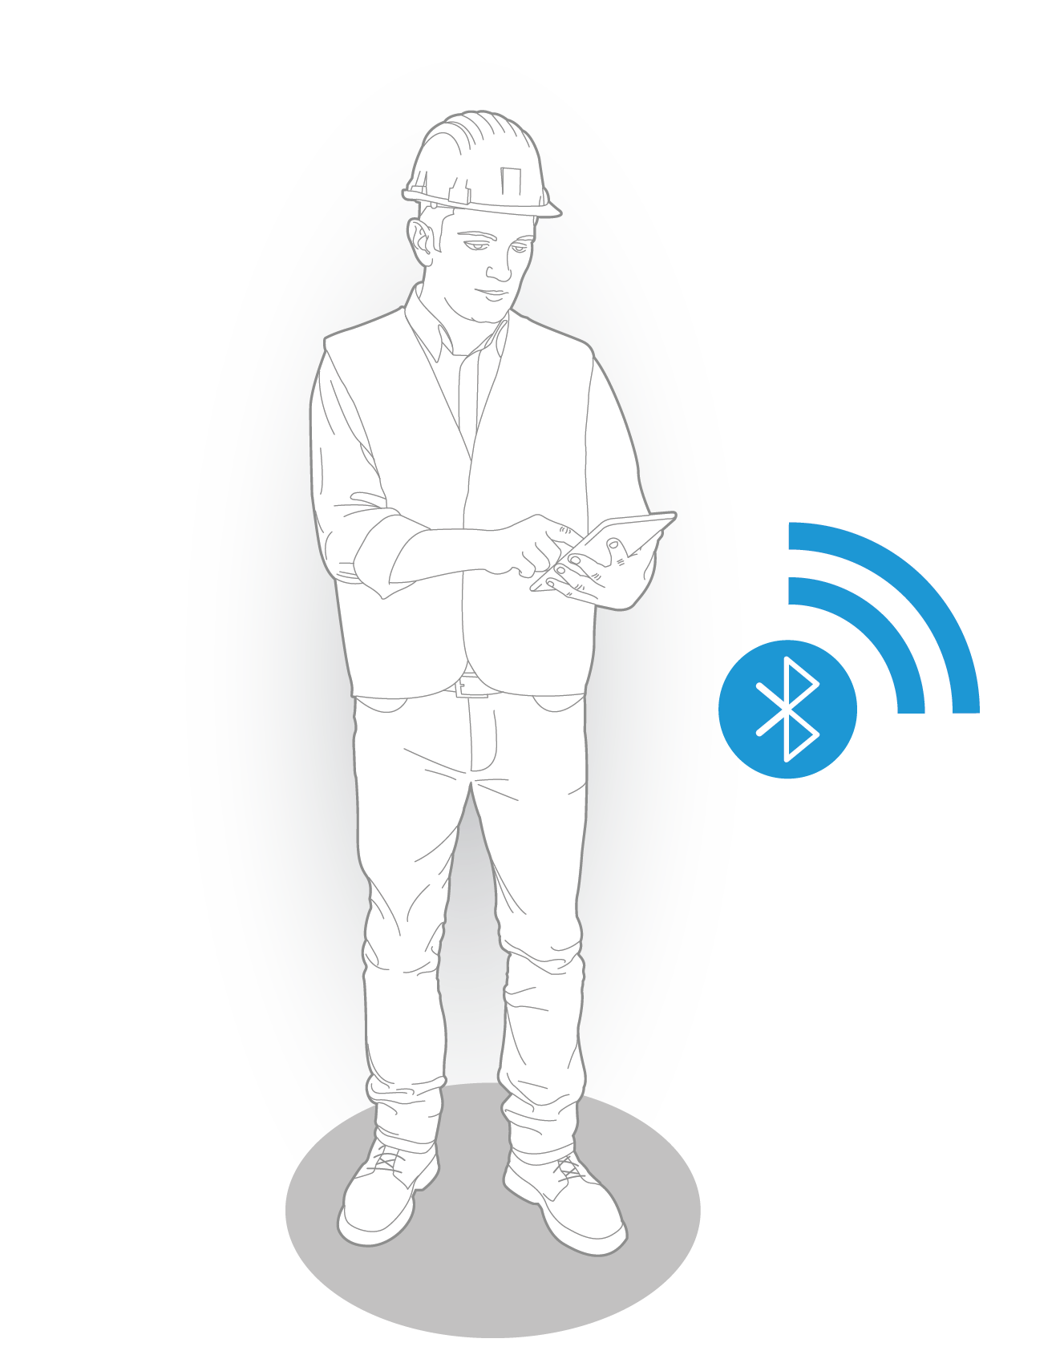
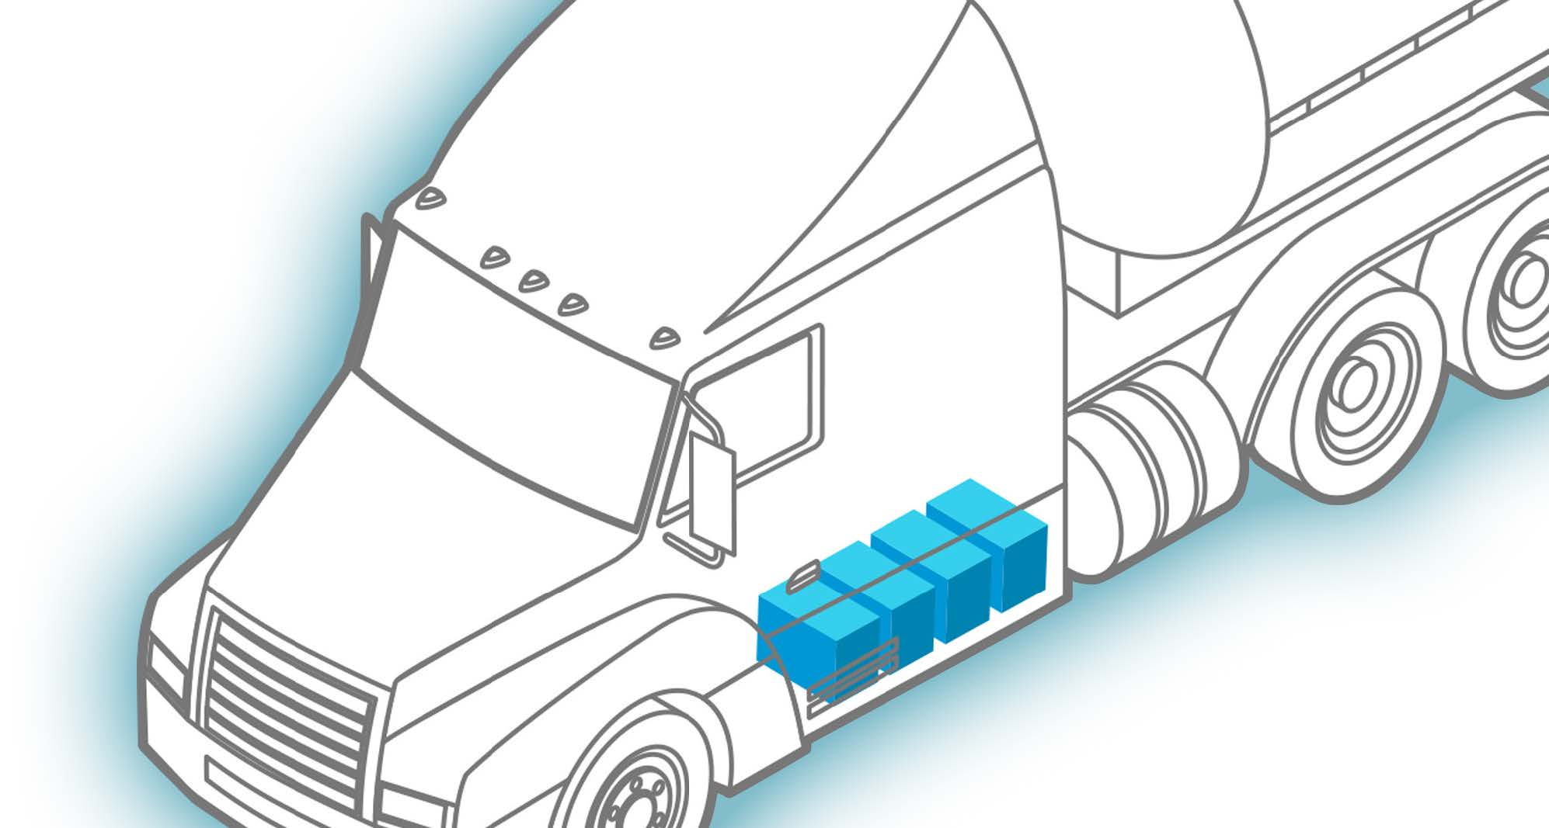
Battery + Sensor + App
© 2022 EnerSys. All Rights Reserved.
© 2023 EnerSys. All Rights Reserved.
7

Slide 8
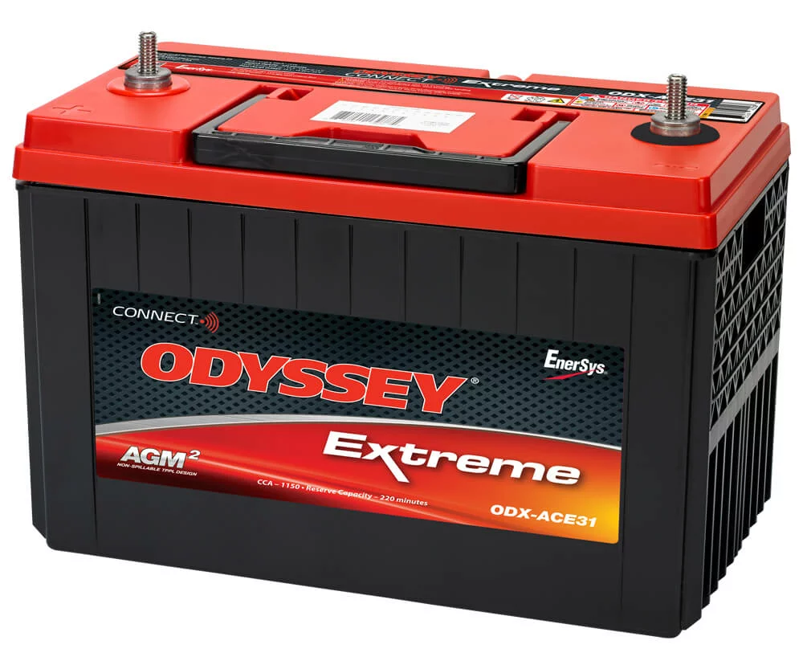
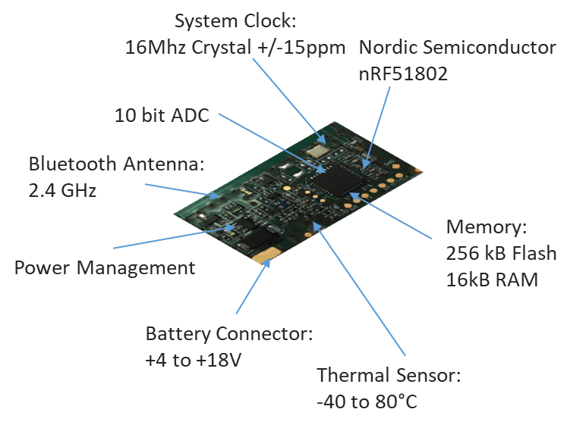
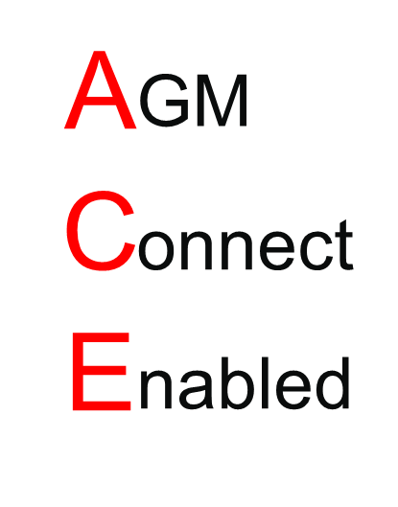
ODYSSEY Connect
Embedded Sensor in Battery

Slide 9
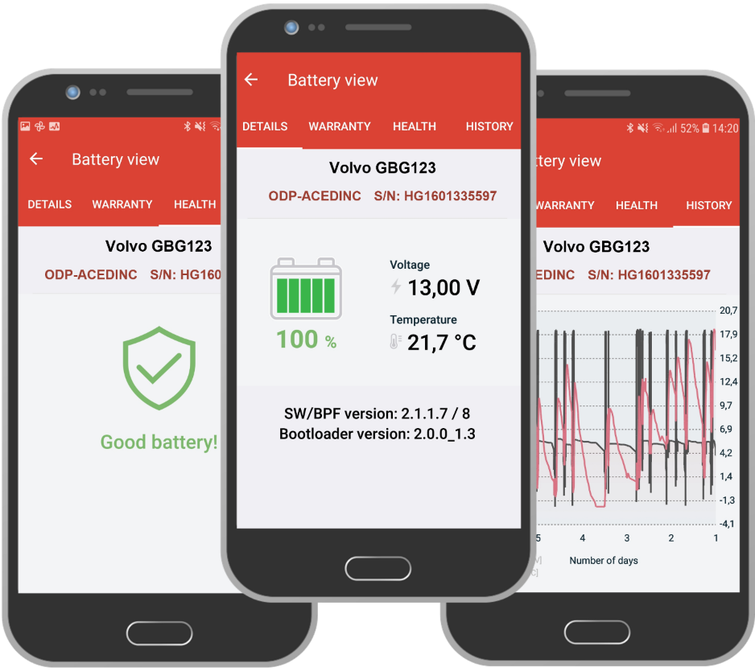
ODYSSEY Connect
Android and ios App
Communicates with the battery using Bluetooth®
Available for Apple and Android smart devices
ODYSSEY CONNECT information includes:
State-of-Health (SoH)
State-of-Charge (SoC)
Voltage & Temperature
Warranty guidance
Battery Highs & Lows
SoC graph (6-days)
V & T graph (6-days)
Purchase date (user input)

Slide 10
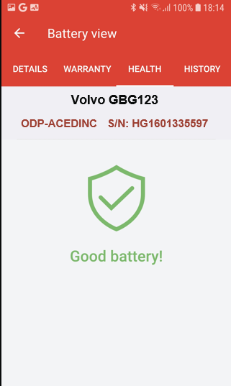
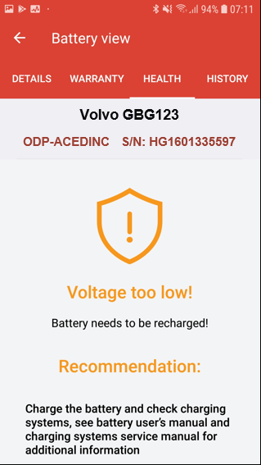
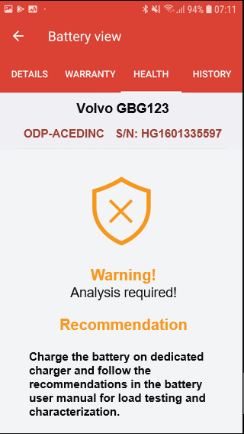
ODYSSEY Connect
Android and ios App

Slide 11
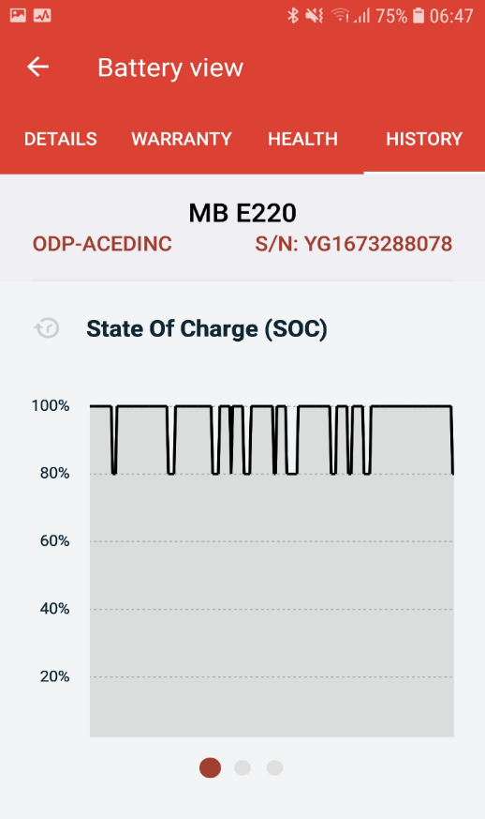
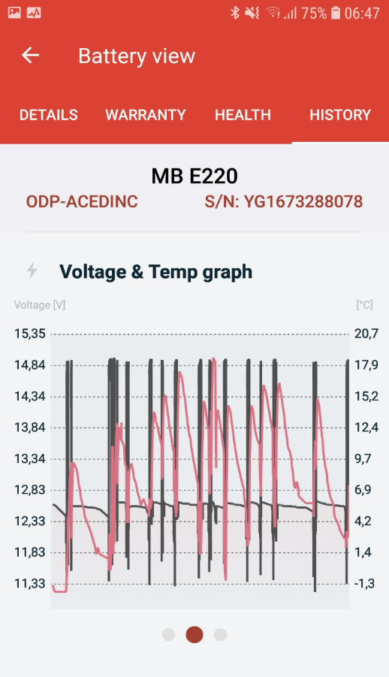
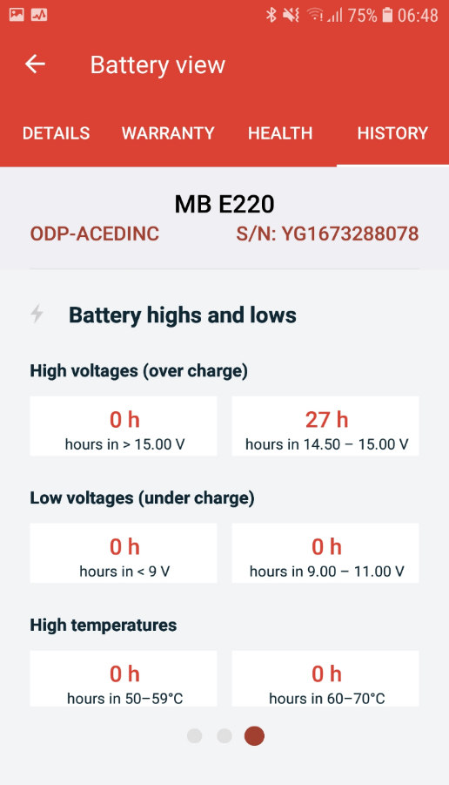
ODYSSEY Connect
Android and ios App

Slide 12
ODYSSEY CONNECT Installation

