Slide 1
DPEC EnerSys Overview
Mark Matthews
President, Specialty—GLOBAL
Notes:
Group Dry Run Notes 5’30’23:
16 minutes
Great energy
Mentioned Daimler a lot – can we mention any other customers? Make sure any public company names we use are doing “well”
Mark – can add Penske from fleet side. Look into NavisStar
Dave – can we introduce new names? Be specific when going through service. Not orders of magnitude / 5x – where you can introduce another line (freightliners service oppty is 5x
High-level introduction:
Joined Enersys in 2016
Started career as lithium battery engineer
25+ years of experience in energy storage and battery technology
Driving comprehensive energy solutions transformation with a talented team of 1k+ engineers
Innovating energy systems solutions in critical applications
Leveraging expertise in batteries and energy conversion
Enabling the system through our proprietary technology and software

Slide 2
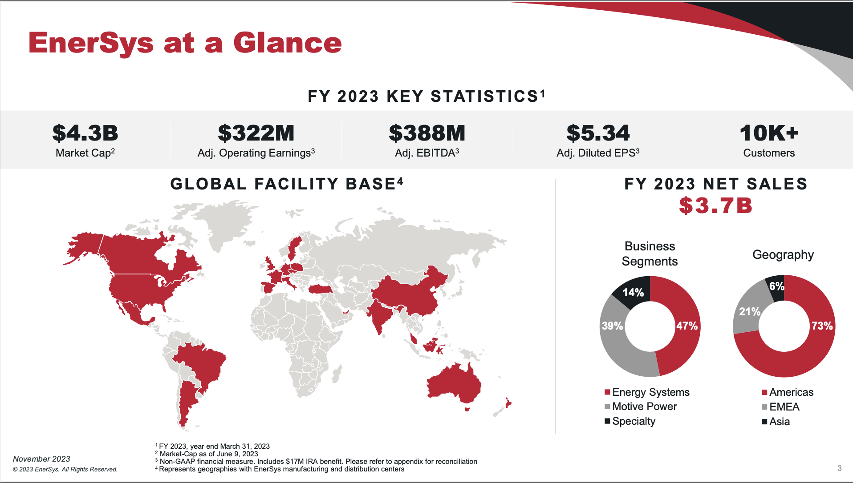

Slide 3
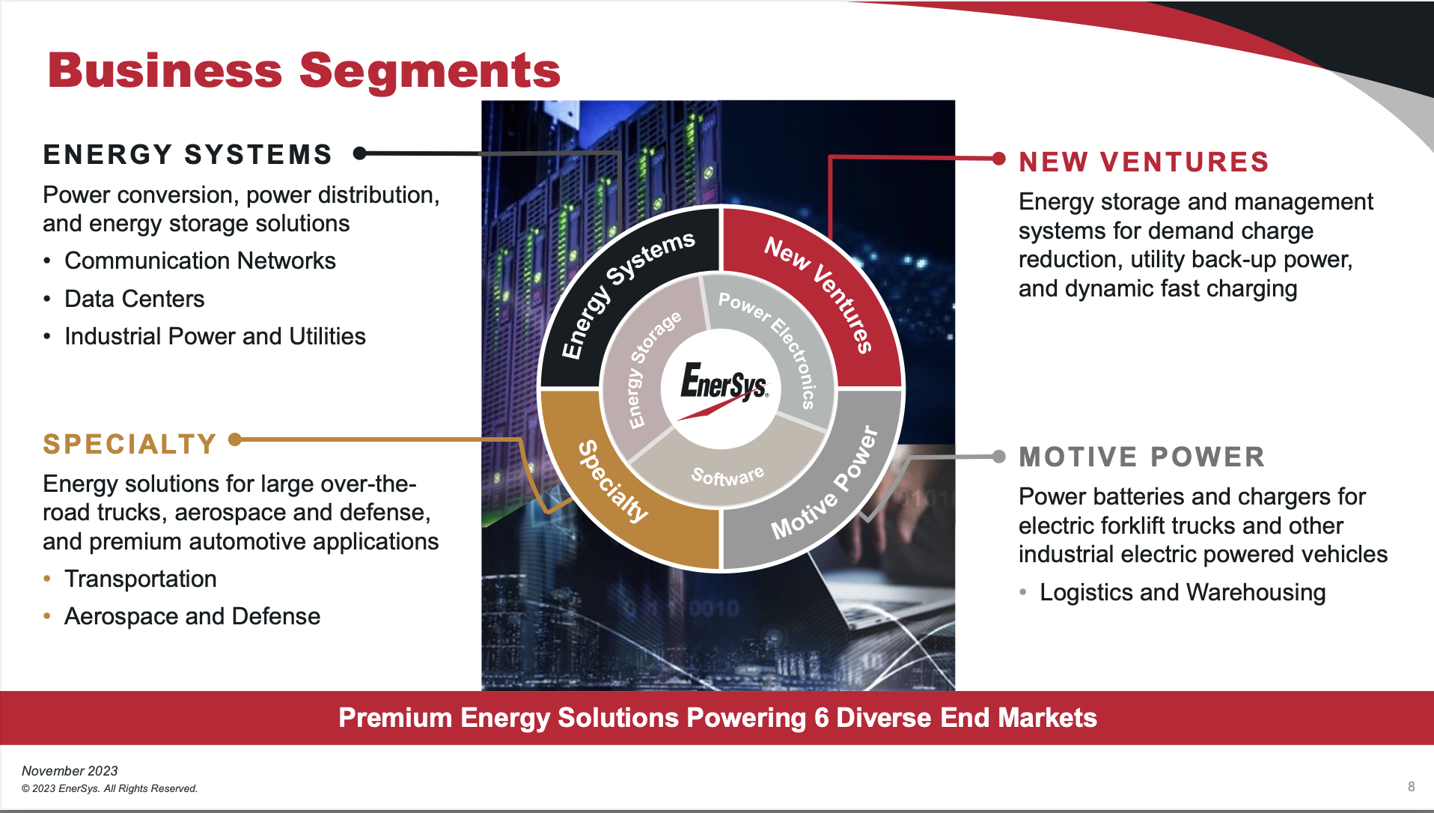

Slide 4
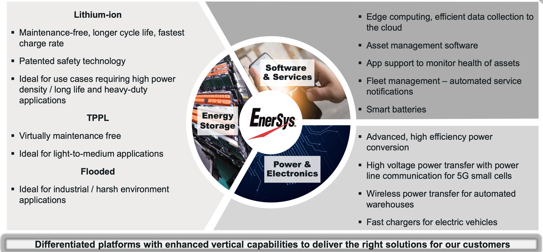
Technology to Meet Customer Needs
Notes:
EnerSys is the global leader in stored energy for industrial applications – motive power, reserve power, aerospace & defence

Slide 5
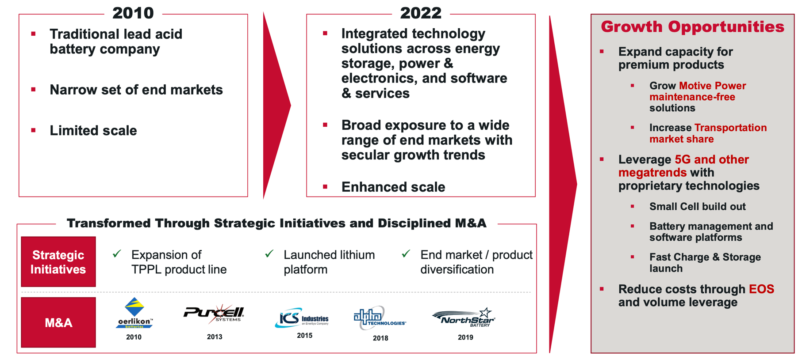
Technology Driven Portfolio Transformation
Notes:
EnerSys is the global leader in stored energy for industrial applications – motive power, reserve power, aerospace & defence

Slide 6
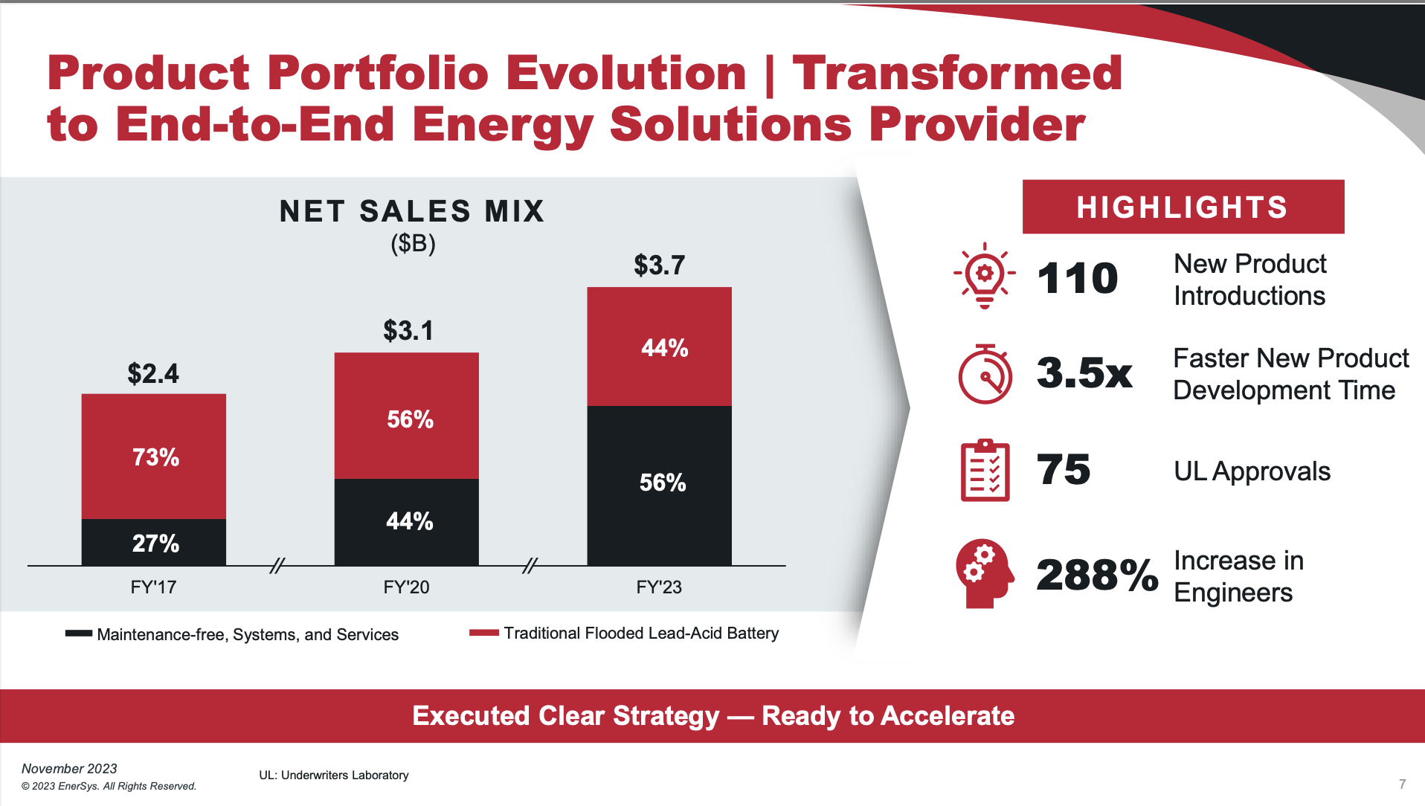
Notes:
EnerSys is the global leader in stored energy for industrial applications – motive power, reserve power, aerospace & defence

Slide 7

Key STG / EnerSys Initiatives
© 2022 EnerSys. All Rights Reserved.

Slide 8
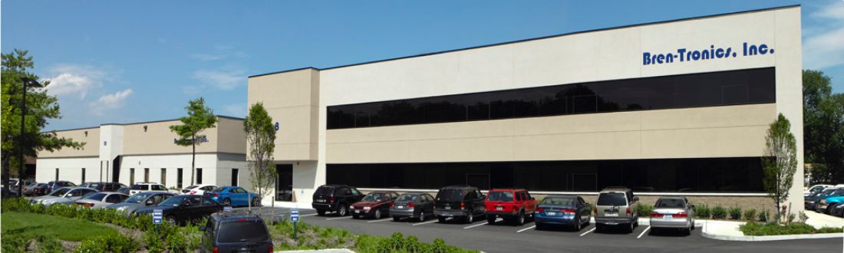
Bren-Tronics Acquisition
expecting to Close by end of CYQ2
Strengthen our position as a critical enabler of the energy transition and supports our growth in the attractive and growing military and defense end markets
Accelerate EnerSys’ progress in expanding our lithium product offerings
Leverage our respective strengths to solve critical DOD energy storage challenges
Additional product volume will be well supported by our planned Greenville Gigafactory

Slide 9
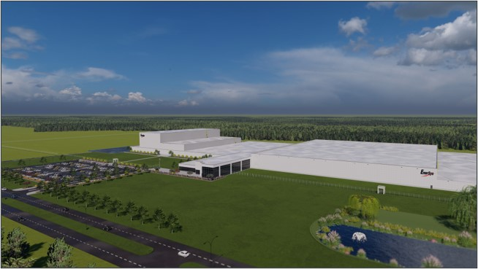
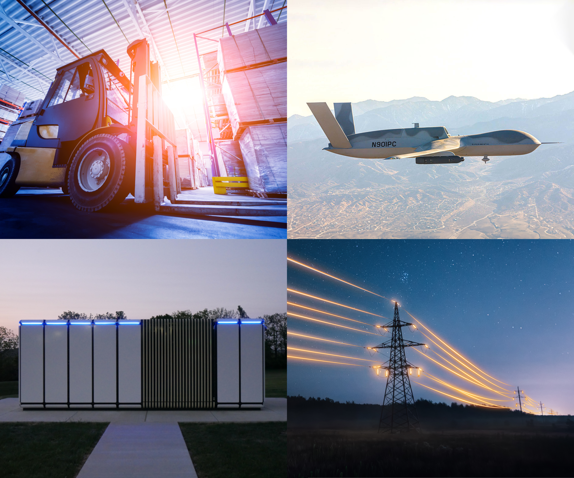
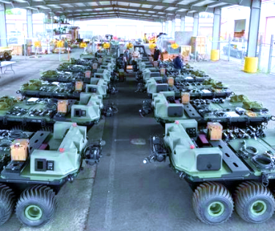
Lithium Gigafactory to Support All LOBs
Artist rendition of EnerSys 4GWH lithium gigafactory, Greenville, SC
Factory supports multiple end-markets
Notes:
Product for all LOBs are planned and included in our strat plan and return on investment analysis
Greenville, SC
4 GWh per year
500,000 sqft; 140 acres
$500M investment
IRA tax credits
$200 million state and local funding
DOE funding
2025 – construction beginning of year
2027 – production by end of year

Slide 10
EnerSys Gigafactory – Basis for Plant
Vertical Integration and Supply Chain Assurance
EnerSys has initiated development of the ENS1 lithium-ion prismatic cell for use in industrial products and systems such as DC Fast Charge & Storage, motive power battery systems, IT network UPS, and telecommunications reserve power systems. This cell design is intended to provide the highest volumetric energy density for these target markets.
This U.S. based manufacturing facility will support an annual production capacity of at least 4GWh. Combined with a planned domestic supply chain for raw materials and components, this approach provides security of supply for commercial markets at a competitive market price.
The planned timing for the gigafactory includes breaking ground in early 2025, construction complete late 2026, and start of ramp production (SORP) late 2027.
The gigafactory is also intended to include a cylindrical cell line with flexibility to produce both 18650 and 21700 form factors. EAS is currently under contract from the Defense Innovation Unit (DIU) to develop a US made 18650 cell for use in the LI6T battery pack.

Slide 11

EnerSys Gigafactory – Technology Partner
Opportunities
Enables long-term growth for both companies
Optimizes cell sizing in battery solutions to meet customer needs
Provides a reliable domestic supply of lithium-ion cell
    Essential to supply chain strategy
Scale and flexibility with large production capacity and ability to create custom cells
Accelerates facility ramp speed with Verkor experience in high-speed electrode production
Entered non-binding MOU with Verkor SAS, to explore development of lithium-ion battery gigafactory in U.S.
Verkor is a proven European technology leader focused on large-scale industrialization of lithium-ion batteries
Evaluating various funding and operating
structures for factory
US Government continues to reinforce critical nature of EnerSys's high-energy density batteries and services for domestic production

Slide 12
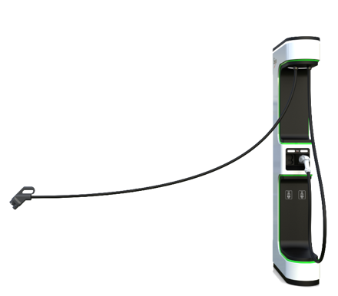

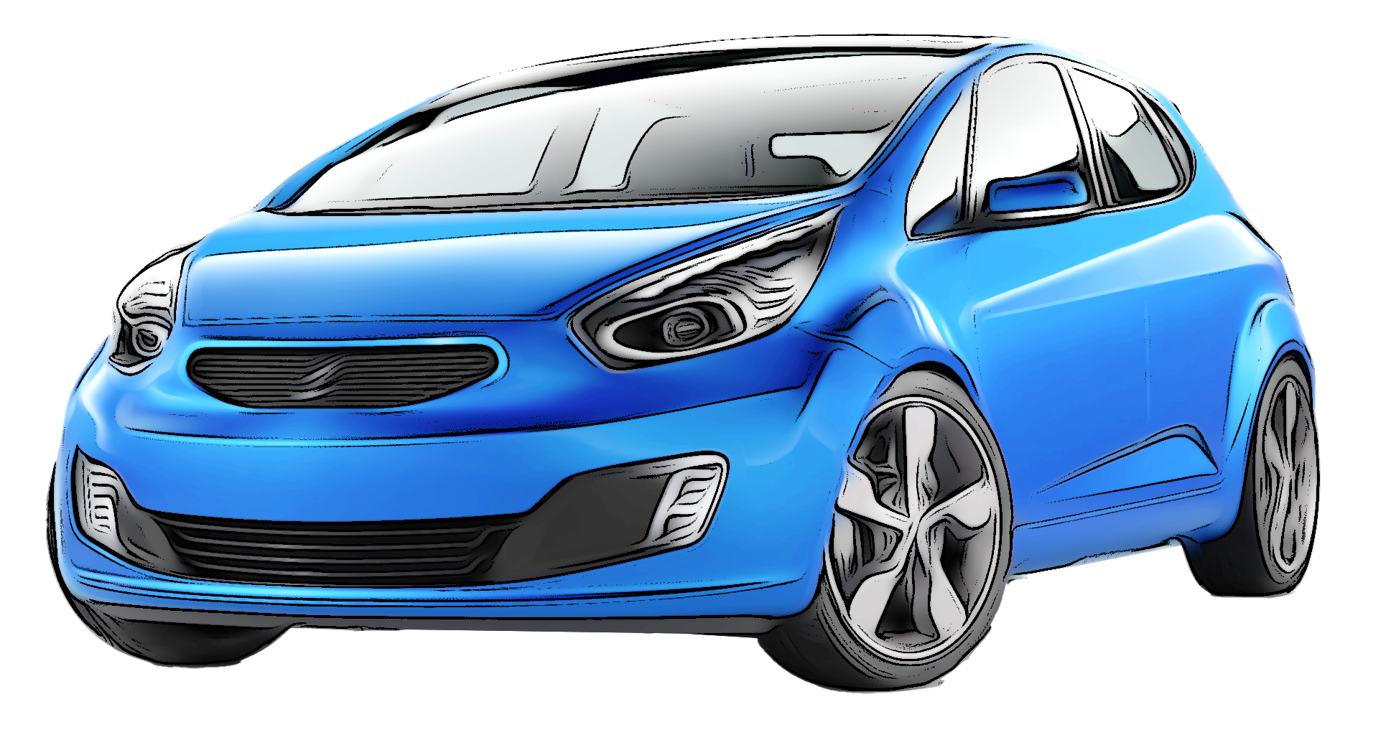

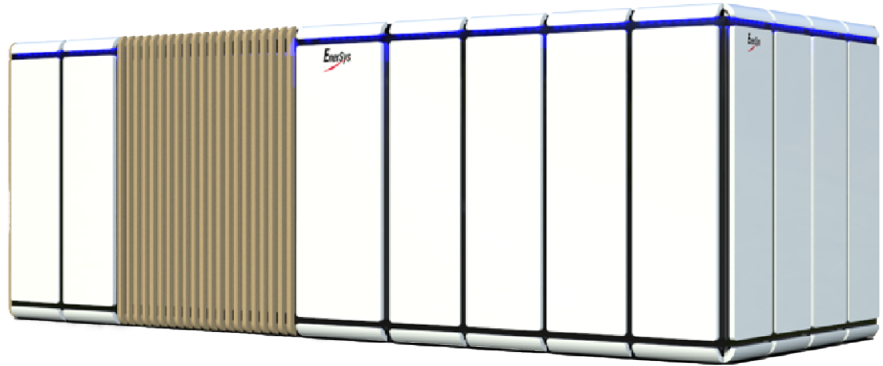


Powering the Future through
Energy Management Capabilities
SMART ENERGY LOAD & ENERGY ECOSYSTEM
System Input
System Output
EV-Pedestal
150kW
Commercial
Solar
Fast Charge & Storage
600kW Lithium-Ion Batteries
Commercial Buildings and Multi-Family Units
Grid
Infrastructure
Grocery Stores
Peak Shaving
Demand Charge
Virtual Power Plants
80 - 90 Average American Homes
Current Capabilities
Opportunities
Clean
Decentralized
Resilient
Optimized
kW: Kilowatt

Slide 13
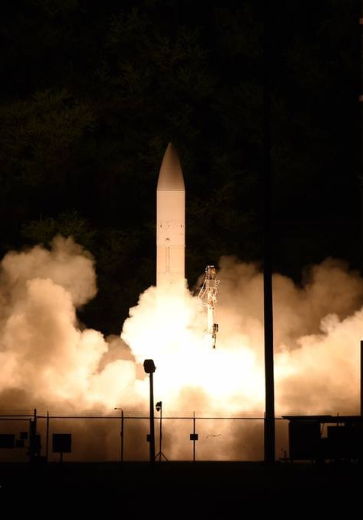
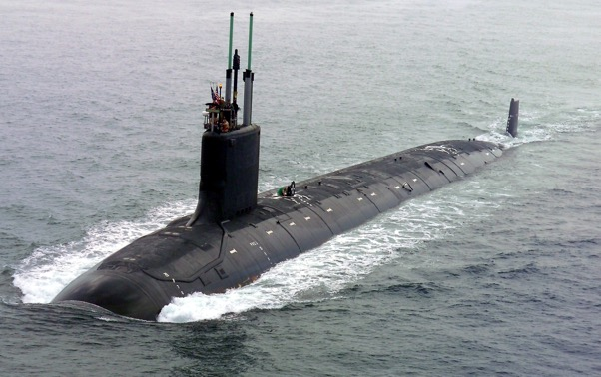

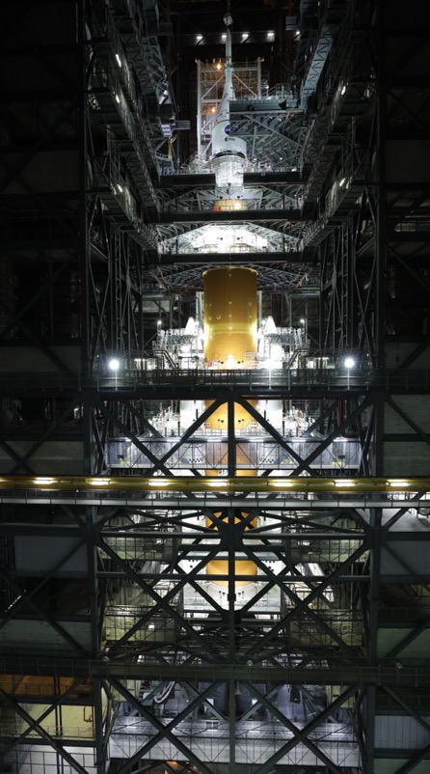
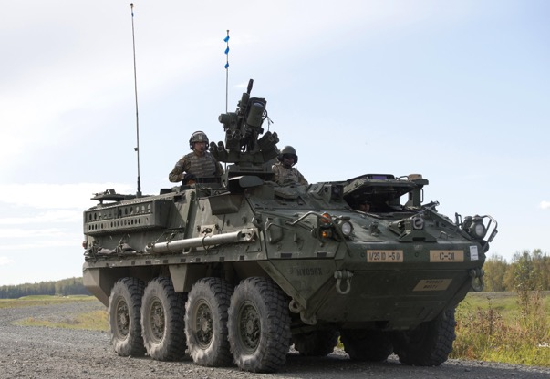
Speciality
© 2021 EnerSys. All Rights Reserved.
Notes:
Option 2

Slide 14



Specialty at a Glance
FY 2024 KEY STATISTICS¹
Net Sales | Transportation Installed Base³ | Customers Served | Market Share³
$600M+ | 1.8M Trucks | 700+ | 30% U.S. OEM Truck Market
Transportation
Aerospace and defense
Key Innovations
Best-in-class power and energy for heavy-duty trucks
Odyssey® ACE Connect services support battery health and life
Superior performance for less down time
Revenue by
End Market
Key Innovations
Aerospace
6B+ cell hours without failure
Defense
70%+ of DoD spend on 6T TPPL batteries for U.S. Army ground vehicles
Lithium IP for next gen U.S. Space and Missile Defense applications
OEM: Original Equipment Manufacturer; ACE: Advanced Connected Energy; DoD: Department of Defense; TPPL: Thin Plate Pure Lead
¹ FY 2023, year end March 31, 2023
² Non-GAAP measure. Please refer to appendix for reconciliation
³ U.S. Transportation Truck Market Class 4 - 8
Notes:
Dry Run Feedback 5’30’23
Confirm revenue mix 60/40
Confirm images are correct ones to show
Corbin Notes 5’11’23
Mention net sales 2-3 years ago and discuss expectations by 2027 (or $1B by 2030)
Our investments over the past few years, particularly the acquisition of NorthStar, position us to yield strong earnings growth as we expand our capabilities in defense and trucking
We are proud to offer best-in-class power and energy for heavy duty batteries
ACE technology has built trust with end-users as it proves that our batteries can last twice as long as the competition
Technology has been proven in space with +5B cell hours without failure
Products offer innovative solutions that prevent failure, providing value for defense and commercial industries
Lithium IP will continue to drive innovation in aerospace and other sectors
Partnerships with companies like Penske show the real value of our TPPL product in reducing downtime and improving efficiency
Proud to manufacture products in the U.S. and support for the largest fleet of vehicles in the world, the US military
Focus on innovation and building trust allows us to expand our capabilities and provide value to a range of industries

Slide 15


Driving Innovative Solutions
Transportation
Aerospace and defense
Evolving Needs
Maximizing fleet up-time
Increasing anti-idle laws and decarbonization efforts
Growing electronic demands
Actions Taken
2019: expanded TPPL capacity with NorthStar acquisition
2022: enabled faster fulfillment through new U.S. distribution center
Evolving Needs
High cycle life and reliability
Transition to TPPL from Flooded batteries
Actions Taken
Integrated products for critical applications
Focused on Lithium-ion technology
Best-in-class cycle life (>50k cycles) for zero-volt lithium-ion chemistry
Meeting High Performance and Reliability Needs Across Industries
DoD: Department of Defense; TPPL: Thin Plate Pure Lead; AGM: Absorbent Glass Mat
Notes:
Dry Run Feedback 5’30’23
Point on helping fleets ‘have a voice’ is a great point
Corbin Notes 5’11’23
Recognize the evolving needs of our customers and continue to evolve our strategy to meet those needs
Technology roadmap alignment choices have been the cornerstone of our growth in aerospace and defense
Space and defense industries require maximum reliability and least amount of maintenance
DoD moved from flooded to TPPL
Batteries provide high cycling reliability
Patented 0-volt technology ensures full recovery after years of not being charged
Success in the commercial market has translated to dominating the transition from flooded to TPPL
Trucking industry demand starting power for 100% uptime and reserve power for long-lasting operation of all necessary loads
Batteries provide best of both worlds, and we need to increase our capacity to meet this incredible demand
Batteries improve quality of life for the workers and reduce idle engines, reducing both carbon emissions and noise pollution
Customers already demanding fast replacement capabilities for batteries needed 4-5 years in the future.
US distribution center is key to unlocking the massive aftermarket opportunity
We are excited about the future of our businesses and the impact we can make in the markets we serve while also driving sustainability
Opportunity to do a ‘call back’ to align with messaging from Joern’s section on technology platforms / tech roadmap and a ‘call forward’ on Patrice discussing new MO state of the art facility that invests in automation and will handle TPPL capacity

Slide 16




Specialty Manufacturing Footprint
Technology | Location | Markets Served
Lithium-Ion Batteries | Longmont, Colorado, USA | Space
Lithium-Ion Batteries | Culham, United Kingdom | Space
Lithium-Ion Batteries, Chargers* | Commack, New York, USA | Soldier Power, Directed Energy, Large Format DOD
Lithium-Ion Materials Plant | Santa Clarita, California, USA | US Space
Lithium-Ion Batteries, Chargers* | Paris, France | Soldier Power, Directed Energy, Large Format DOD
Thermal Batteries | Pinellas Park, Florida, USA | Munitions and Missile Defense
Thermal, Liquid Reserve and Lithium-Ion Batteries | Horsham, Pennsylvania, USA | Munitions, Medical and Space
TPPL Batteries | Warrensburg, Missouri, USA | Transportation, Submarine, Aviation, Military Vehicles
TPPL Batteries | Springfield, Missouri, USA | Transportation
TPPL Batteries | Newport, United Kingdom | Transportation, Aviation, Military Vehicles
TPPL Batteries | Arras, France | Transportation, Military Vehicles
Transportation Distribution | Springfield, MO | Transportation
Lithium-Ion** | Greenville, South Carolina, USA (operational 2028) | All STG Markets
* Acquisition signed / not closed. **Awaiting formal BOD approval

Slide 17
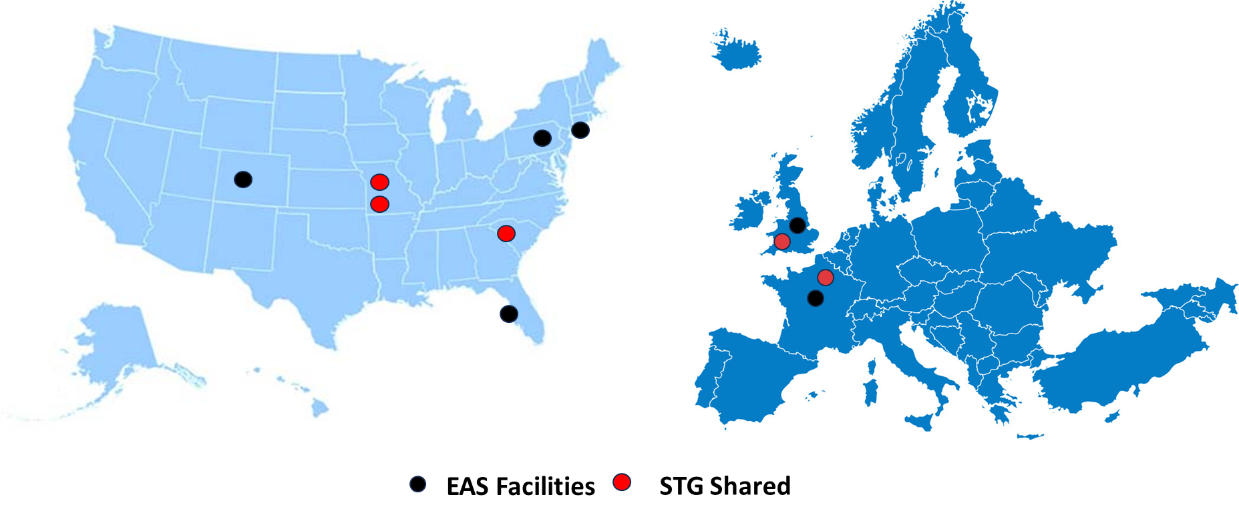
Specialty Global Footprint

Slide 18



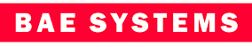




STG Growth Strategy
Integrating as Battery experts to our customer base
Enabling Technology / Chemistry specifically designed for application
Applications / programs funded through US DOD and Prime Contractors Programs
Customer Support Alignment with Project Management Team Structure
Technology Roadmap Integration to drive capabilities

Slide 19
Thank You
© 2022 EnerSys. All Rights Reserved.

