Slide 1


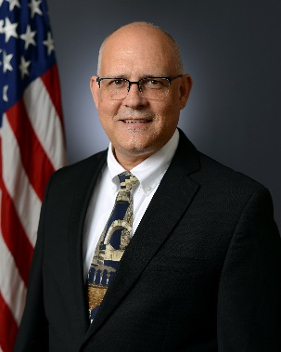
DoD Renewable Energy Generation and Storage (REG&S)
Dr. Robert A. Mantz
Principal Director for REG&S
Office of the Under Secretary of Defense Research and Engineering/Critical Technologies
Controlled by: OUSD(R&E)
Controlled by: DCTO(CT)/PD, REG&S Category: CTI
Distribution Statement A
POC: robert.a.mantz.civ@mail.mil
June 2024
Distribution Statement A. Approved for Public Release: Distribution Unlimited

Slide 2





CRITICAL TECHNOLOGIES
HTTPS://WWW.CTO.MIL
@OUSDRE
DISTRIBUTION A.
APPROVED FOR PUBLIC RELEASE: DISTRIBUTION UNLIMITED

Slide 3
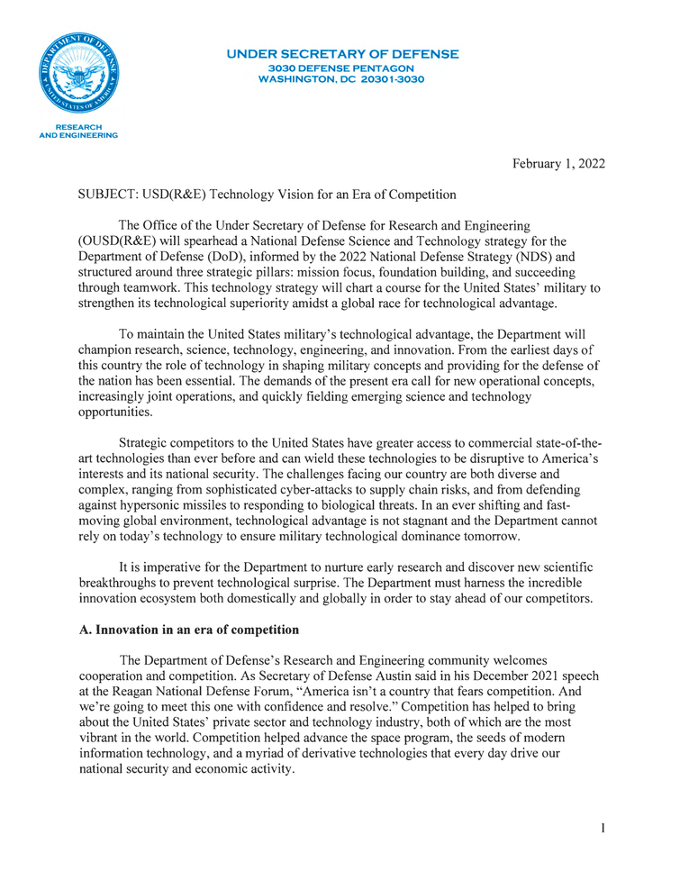
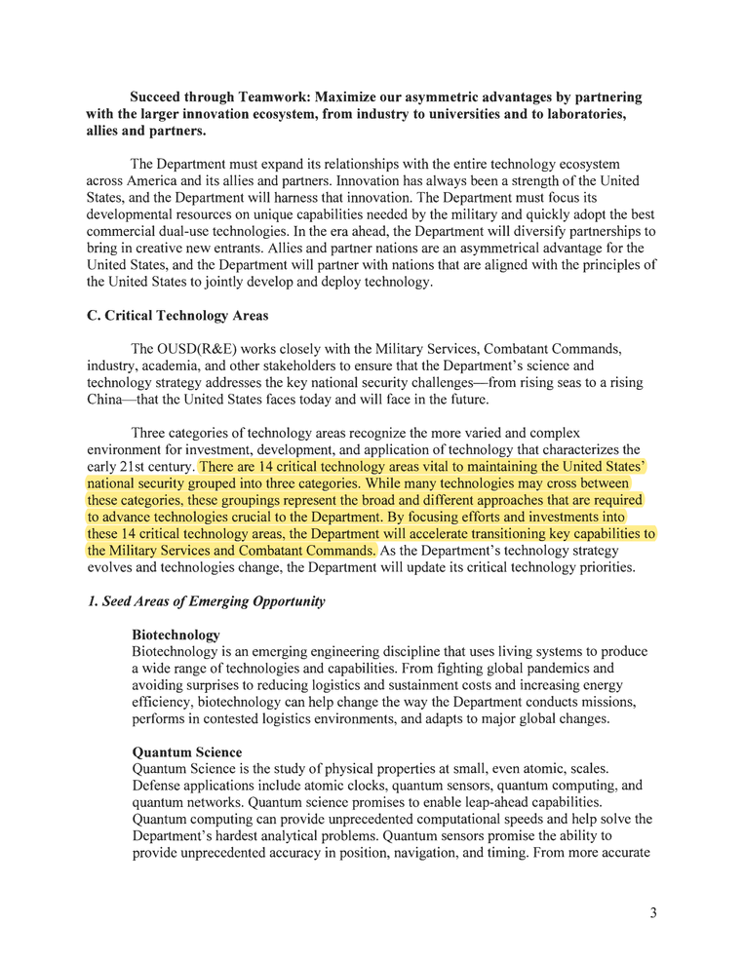

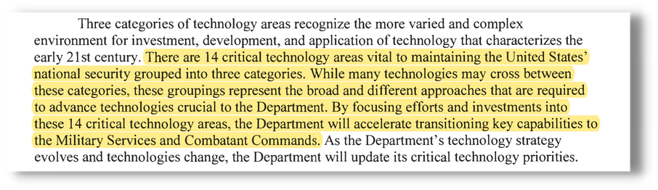
OUSD (R&E) STRATEGIC VISION
TECHNOLOGY VISION FOR AN ERA OF COMPETITION

Slide 4

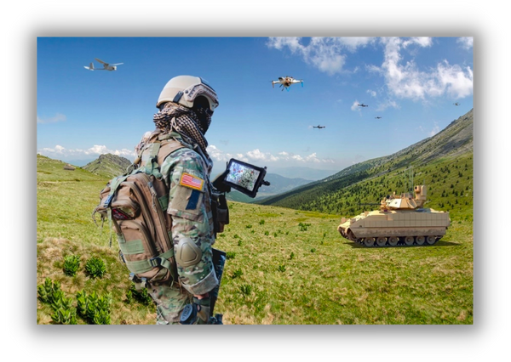
OUR WHY
We exist to maximize the technological advantage of our service men & women to ensure they are never in a fair fight, today and in the future.

Slide 5
OUR MISSION
To drive the critical technological vision for the DoD, to accelerate the transition of key capabilities, and to maximize our technological advantage for the future fight.
"We cannot expect success fighting tomorrow's conflicts with yesterday's weapons or equipment."
- 2018 National Defense Strategy

Slide 6








OUR STRATEGY
01.
02.
Establish Critical Technology Roadmaps
Identify and Leverage Synergies
Set the technical direction for the DoD and align industry, academia, and international partners towards a common vision.
Between the critical technology areas to amplify impact for the warfighter.
Keep Constant Pulse of the State-of-the-Art
Raise the Technical Literacy
Recognize the quickest route to critical technology, fast follow the commercial sector where appropriate, take the lead when not.
Of the force in all critical technology areas.
03.
04.

Slide 7
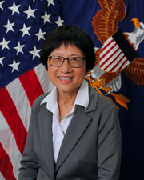

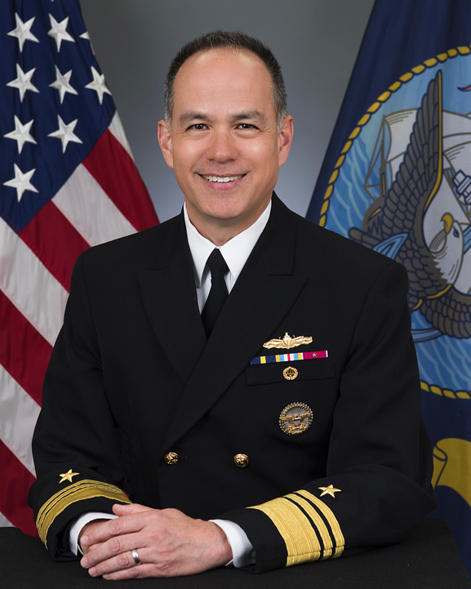

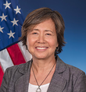



















OUSD(R&E) ORGANIZATIONAL STRUCTURE
UNDER SECRETARY
OF DEFENSE RESEARCH & ENGINEERING/CTO
MISSILE DEFENSE AGENCY
DEFENSE INNOVATION UNIT
DEFENSE ADVANCED RESEARCH PROJECTS AGENCY
ASSISTANT SECRETARY OF DEFENSE FOR SCIENCE & TECHNOLOGY
ASSISTANT SECRETARY OF DEFENSE FOR CRITICAL TECHNOLOGIES
ASSISTANT SECRETARY OF DEFENSE FOR MISSION CAPABILITIES
DASD, S&T FOUNDATIONS
DASD, S&T FUTURES
DASD, S&T PROGRAM PROTECTION
DASD, MULTI-DOMAIN JOINT OPERATIONS
DASD, PROTOTYPING & EXPERIMENTATION
DASD, MISSION INTEGRATION
DASD, APPLIED TECHNOLOGY
DASD, ENABLING TECHNOLOGY

Slide 8
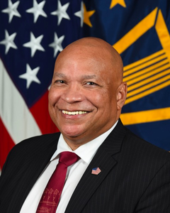

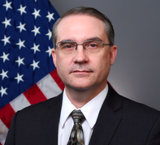
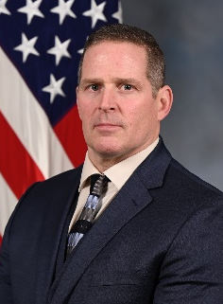
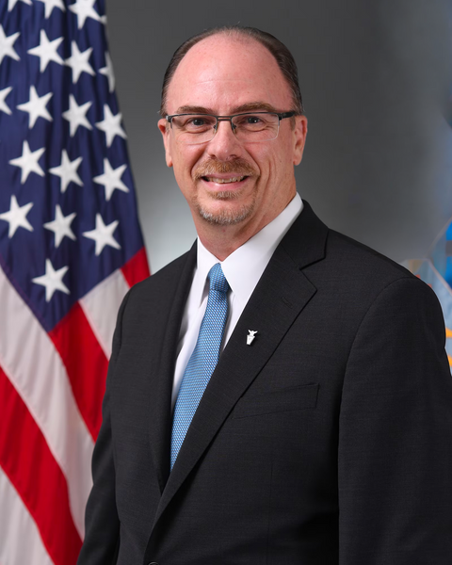
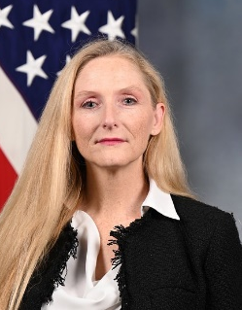
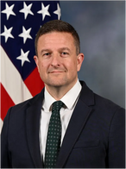
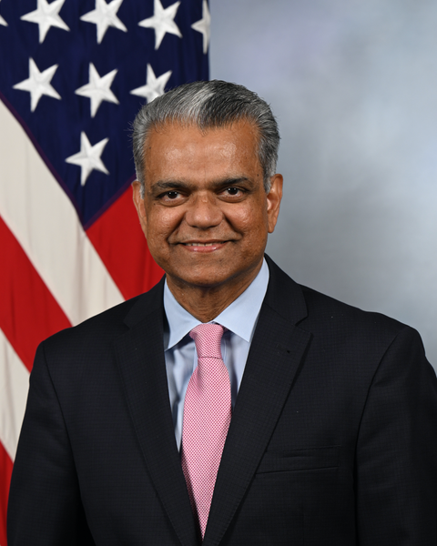
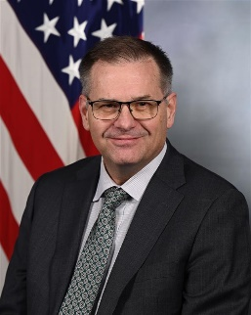
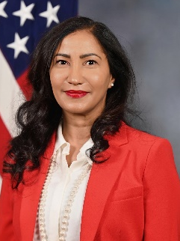
ASD(CT) LEADERSHIP
PTDO ASD(CT)
MR. HOLLIDAY
PD ASD
DR. HIGHNAM
DSD, APPLIED TECH.
VACANT
DSD, ENABLING TECH.
VACANT
PD AD. COMPUTING
DR. SHULL
PD DE
DR. PETERKIN
PD HUM-MACH INT
DR. PALMER
PD HYPERSONICS
DR. WEBER
PD INSS
MS. SCHOENBERG
PD IS & CYBER
MR. HARR
PD ME
DR. SHENOY
PD REN. ENERGY
DR. MANTZ
PD SPACE TECH
MR. ECCLES
PD TRUSTED AI & AUTONOMY
DR. SABLON

Slide 9










SUMMARY OF CTAs
Advanced Computing & Software
Includes supercomputing, cloud computing, data storage, computing architectures, and data processing. The speed at which software develops outpaces DoD’s ability to stay up to date. We must rapidly modernize legacy software systems with resilient, affordable, and assured new software that has been designed, developed, and tested using processes that establish confidence in its performance.
Directed Energy
Directed energy systems will allow us to counter a wide variety of current and emerging threats with rapid responses & engagement at the speed of light. High-power lasers and high-power microwave technologies both offer new ways to counter diverse sets of threats.
Human-Machine Interfaces
Rapid advancements in this technology will have a multitude of benefits for our service members. Highly immersive realistic training environments provide real-time feedback to enhance warfighter performance. Intuitive interactive human-machine interfaces enable rapid mission planning and mission command by providing a common operational picture to geographically distributed operations.
Hypersonics
While strategic competitors are pursuing and rapidly fielding advanced hypersonic missiles, the DoD will develop leap-ahead and cost-effective technologies for our air, land, and sea operational forces.
Integrated Network Systems-of-Systems
An interoperable network that leverages emerging capabilities across the electromagnetic spectrum such as 5G, software defined networking and radios, and modern information exchange techniques will allow us to better integrate many diverse mission systems and provide fully networked command, control, and communication that is capable, resilient, and secure.
Integrated Sensing
& Cyber
To provide advantage for the joint force in highly contested environments, we must develop wideband sensors to operate at the intersection of cyberspace, electronic warfare, radar, and communications. Sensors must be able to counter advanced threats and can no longer be stove-piped and single function.
Microelectronics
Diminishing microelectronics manufacturing in the U.S. and supply chain concerns have highlighted national economic and security risks. Working closely with industry, academia, and across the Government, we are addressing the need for secure microelectronics sources and will leverage state-of-the-art commercial development and production for defense microelectronic solutions.
Renewable Energy Generation & Storage
Renewable energy generation and storage promises to decrease warfighter vulnerability and deliver new operational capabilities for the Department. From more efficient batteries to diversifying energy sources and reduced fuel transportation risks, renewable energy generation and storage will add resilience and flexibility in a contested logistics environment.
Space Technology
Our space strategy must shift away from exquisite satellites to a more robust and proliferated architecture. Novel space technologies are necessary to enable resilient cross-domain operations. The space strategy must incorporate technologies that enhance our adaptive and reconfigurable capabilities in space situational awareness, space control, comms path diversity, on-orbit processing, and autonomy.
Trusted AI &
Autonomy
Machine learning is an engineering subfield of AI that trains software models using example data, simulations, or real-world experiences rather than by direct programming or coding. Autonomy is the engineering discipline that expands robots' abilities to perform tasks while limiting the need for human interaction. Trusted AI with trusted autonomous systems are imperative to dominate future conflicts.

Slide 10

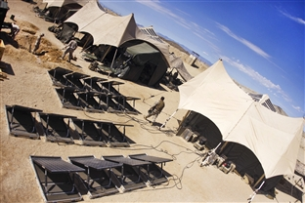
RENEWABLE ENERGY
GENERATION AND STORAGE
OFFICE OF THE ASSISTANT SECRETARY OF DEFENSE FOR CRITICAL TECHNOLOGIES
Renewable energy generation and storage (REG&S) promises to decrease warfighter vulnerability and deliver new operational capabilities for the Department of Defense (DoD).
REG&S includes solar wind, bio-based and geothermal technologies, advanced energy storage, electronic engines, and power grid integration.
From more efficient batteries to diversifying energy sources and reduced fuel transportation risks, renewable energy generation and storage will add resilience and flexibility in a contested logistics environment.
10

Slide 11
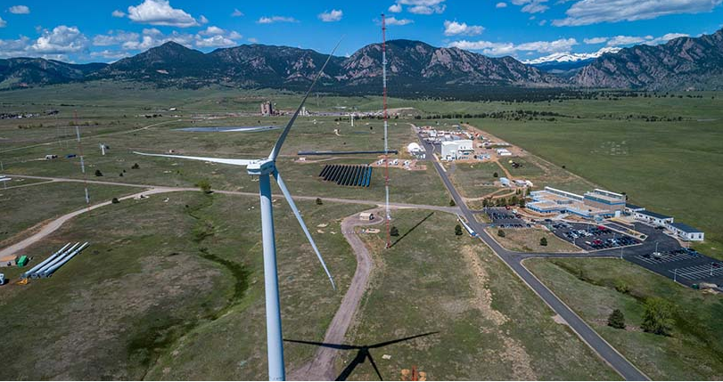
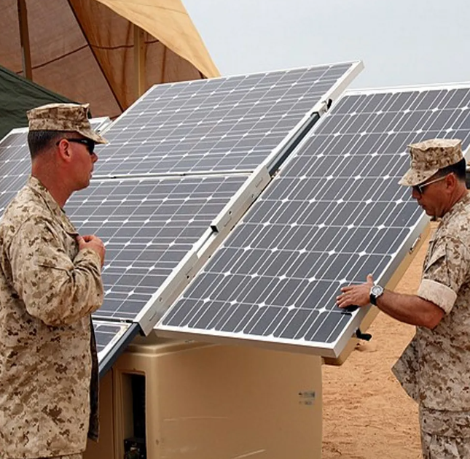
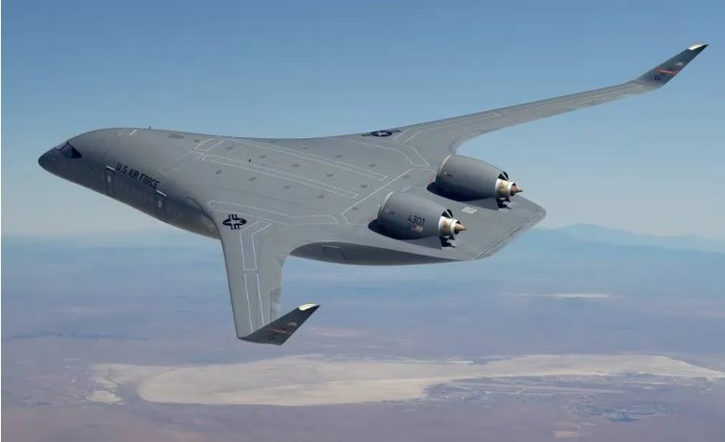
REG&S STRATEGIC VISION
OFFICE OF THE ASSISTANT SECRETARY OF DEFENSE FOR CRITICAL TECHNOLOGIES
Develop capabilities that reduce fuel / energy required to accomplish the mission; and provide commanders more resilient energy supplies to enable mission flexibility considering challenges associated with contested logistics and new capabilities that can shift the energy paradigm.
11

Slide 12
CHALLENGES
OFFICE OF THE ASSISTANT SECRETARY OF DEFENSE FOR CRITICAL TECHNOLOGIES
Modern military capabilities are predicated on assured access to sufficient and secure supplies of energy. Our homeland is no longer a sanctuary in this regard, and logistics will be contested both within the United States and abroad.
To increase our resilience and adaptability vis-à-vis any adversary, the DoD needs to develop and field renewable / clean energy capabilities that will provide robust energy to the Joint warfighter – in support of the National Defense Strategy.
12

Slide 13
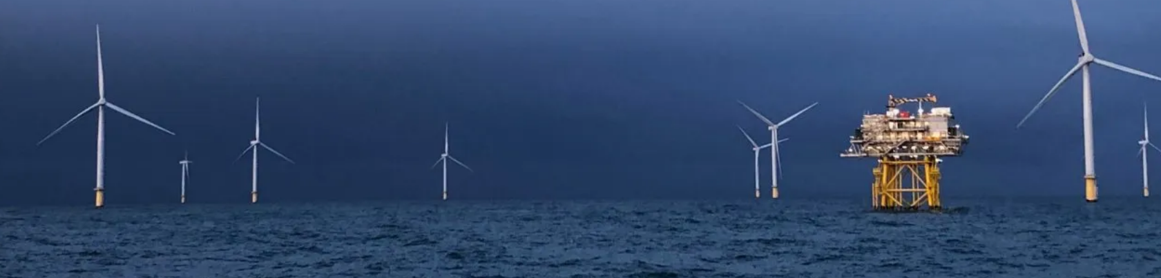
THREE MAIN FOCUS AREAS
OFFICE OF THE ASSISTANT SECRETARY OF DEFENSE FOR CRITICAL TECHNOLOGIES
REG&S for Deployed / Mobile Operations
REG&S for Fixed Bases
Reduce fuel / energy required to accomplish the mission
13

Slide 14
PREMISES
OFFICE OF THE ASSISTANT SECRETARY OF DEFENSE FOR CRITICAL TECHNOLOGIES
Renewable Energy Generation and Storage includes:
Enabling technologies – such as microgrid and power beaming, which must be developed to take full advantage of renewable energy sources
Nuclear energy technologies – which have game-changing potential; like traditional renewable energy sources, they enable onsite energy production and reduce logistical burdens
The DoD often isn't at the forefront of renewable energy technology research and development.
The Principal Director for REG&S utilizes the combined research investments in commercial and academic sectors, as well as other federal government agencies. This is especially relevant for the Department of Energy (DoE), which frequently invests significantly in renewable energy technology that aligns with DoD needs.
14

Slide 15
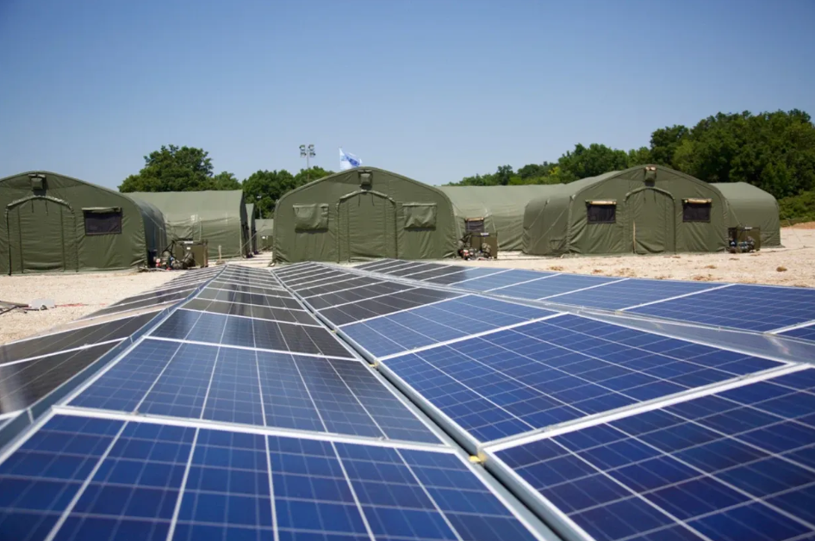
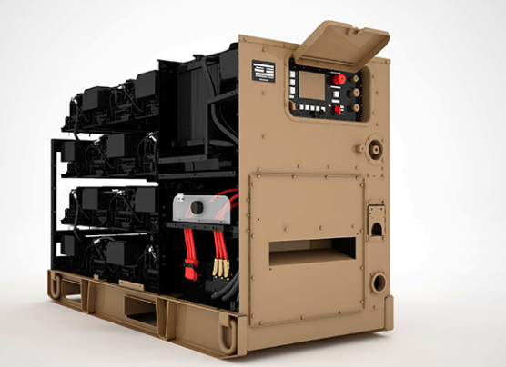
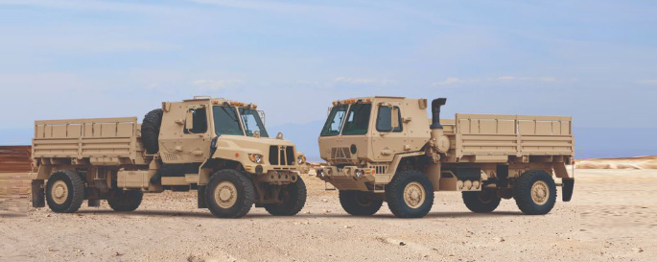
THRUSTS
OFFICE OF THE ASSISTANT SECRETARY OF DEFENSE FOR CRITICAL TECHNOLOGIES
REGS for Deployed/Mobile Operations
  Lithium and New Advanced Batteries
  Long Duration Energy Storage
  Power Beaming
  Tactical Fuel Production and Consumption
  Small Modular Reactors at Deployed Locations
REGS for Fixed Bases
  Microgrids
  Long Duration Energy Storage
  Next Gen Photovoltaics
  Renewable Aviation Fuel
  Small Modular Reactors
  Geothermal
  Ocean Thermal Energy Conversion (OTEC)
Reduce operational fuel/energy requirements
  Aerodynamic Improvements to Reduce Drag
  Vehicle Hybridization/Electrification/Hydrogen
  Blended Wing Body / Oblique Flying Wing
  Advanced Air Breathing Engines
15

Slide 16



TRANSITION ENABLERS
OFFICE OF THE ASSISTANT SECRETARY OF DEFENSE FOR CRITICAL TECHNOLOGIES
Department of Energy
Allied Partnering
Industrial Base
    Industry Visits
Professional Conference Attendance
Invited Speaker National Meetings
Industrial base investments to ensure capability and capacity that enable affordable production at scale and pace
National Labs
ARPA-E
Office of Electricity
Office of Energy Efficiency and Renewable Energy
- Geothermal Technologies Office
- Advanced Materials & Manufacturing
Technologies Office
  Office of Science
  Vehicle Technologies Office
NATO S&T Organization Panel Activities
  Bilateral Agreements
        Information Exchange & Project Arrangements
Defence Innovation Accelerator for he North Atlantic (DIANA)
Defense Science and Technology Executive Working Group (DSTX)
Workforce and Infrastructure
Leverage current and future DoE investments
Coordination with Electrochemical Society
Li-Bridge
  Energy and Power COI
Engaging in Allied partnerships to leverage synergies in S&T
Ensure technically competent workforce through targeted research investments and collaborative partnering between academia, professional societies, labs, and industry
16

Slide 17
SUMMARY
OFFICE OF THE ASSISTANT SECRETARY OF DEFENSE FOR CRITICAL TECHNOLOGIES
DOE, SCO, OECIF, SERDP/ESTCP, DIU, and the services are making significant DoD investments in renewable energy technologies.
Significant DoD specific challenges remain especially for deployed/mobile operations.
The DoE is making investments that can contribute to DoD readiness/capabilities; however, these are largely applicable to the REGS for Fixed Bases Focus Area.
OUSD(R&E) is helping leverage and align REGS investments across the Federal Government and is actively engaged with industrial and non-traditional suppliers.
17

