Slide 1
June 2, 2024

Slide 2
Who We Are

Slide 3
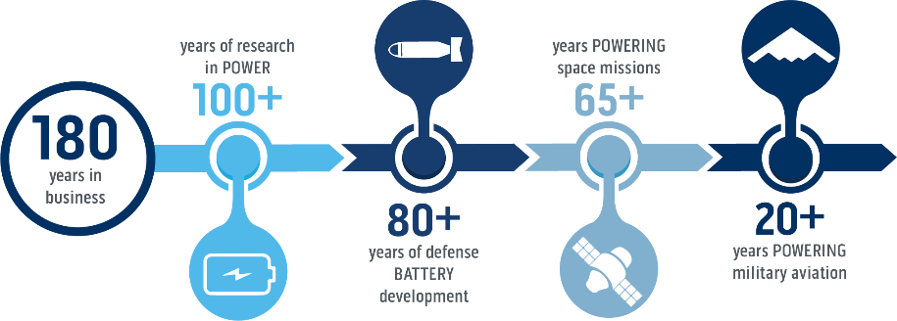
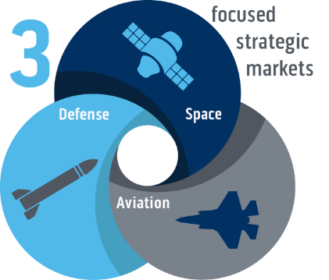
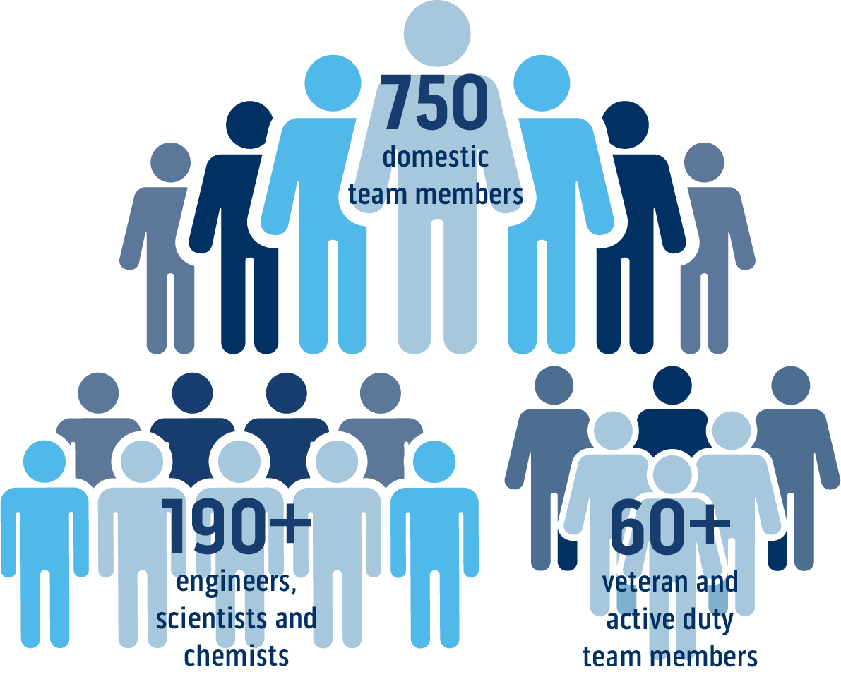
EaglePicher at a Glance
Small Business Certification

Slide 4
1843 – Founded as a mining company, mining lead

Slide 5
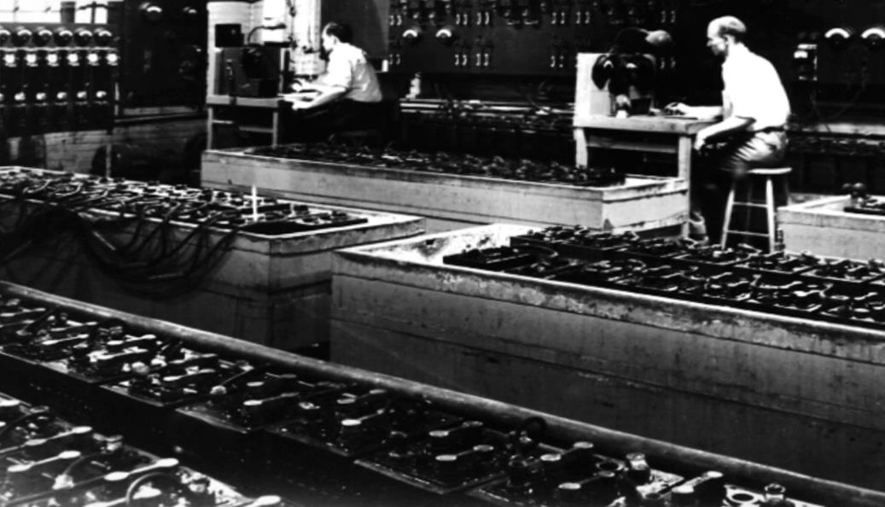
1922 – Researches battery storage technology and begins developing highly efficient lead batteries

Slide 6
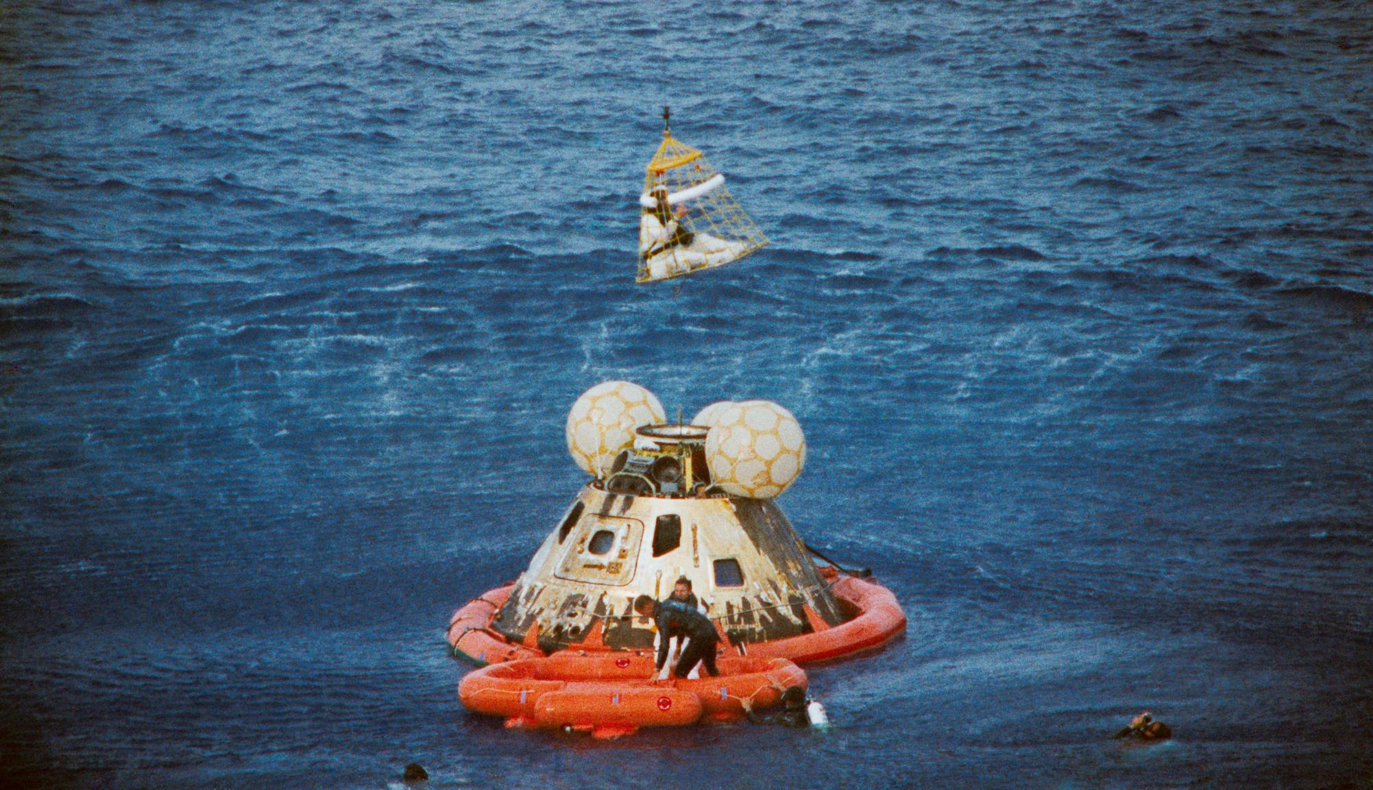
1970 – Provides power solutions for safe return of Apollo 13 astronauts
Image courtesy of NASA

Slide 7
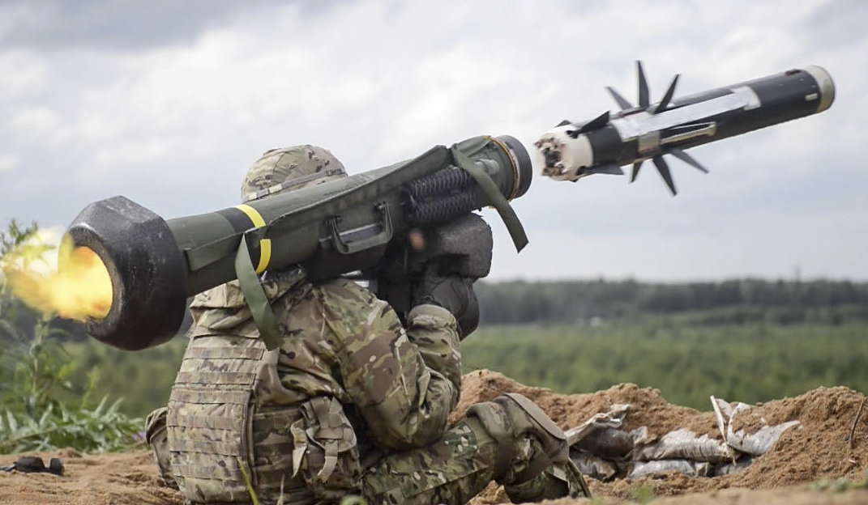
1990 – Powers Javelin missile program
Image courtesy of U.S. Department of Defense

Slide 8
2002 – Delivers first military aircraft lithium-ion battery used in the B-2 stealth bomber

Slide 9
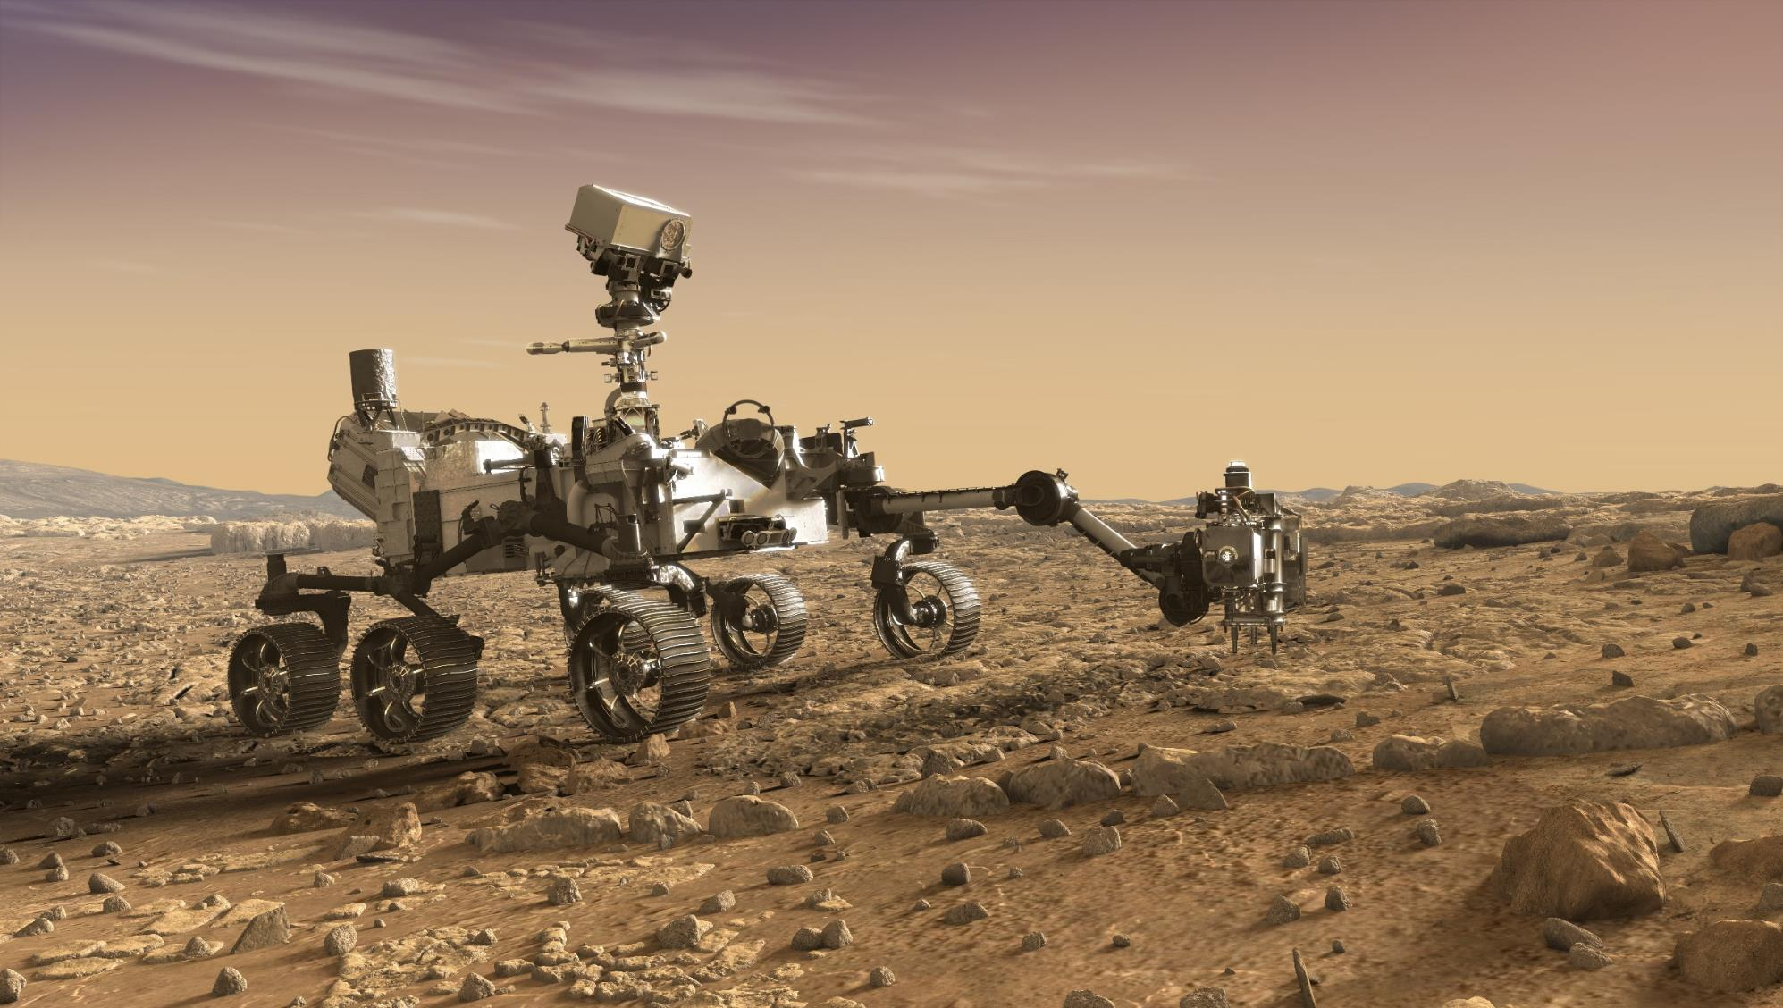
2020 – Powers Mars rover Perseverance

Slide 10
What We Do

Slide 11
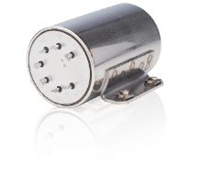
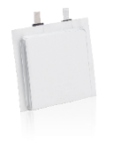
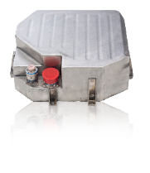
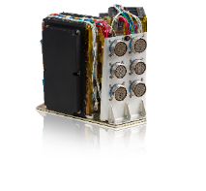
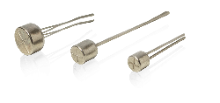
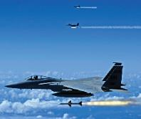
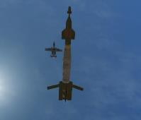
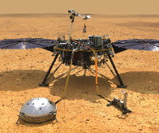
Products and Applications
Thermal
Lithium Ion
LiCFx
Silver Zinc
Systems
Energetics
Military aviation
Military aviation
UAV
Military aviation
UAV
Military aviation
Military aviation
UAV
Ejection seats
Aviation
Missiles
Munitions
Torpedoes
Directed energy
Missiles
Portable power
UUV
Portable power
Missiles
Missiles
Underwater vehicles
Topedoes
Directed energy
Missiles
Torpedoes
UUV
Missiles
Fuze arming
Guidance systems
Defense
Exploration
Launch vehicles
Exploration
Launch
Satellites
Human-rated
Deep space probes
Exploration
Launch vehicles
Exploration
Launch vehicles
Satellites
Sequencing
Space

Slide 12
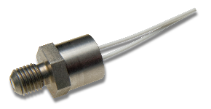
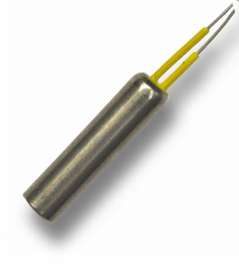
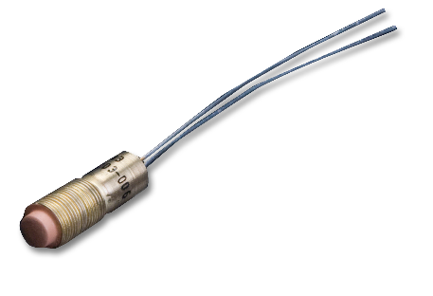
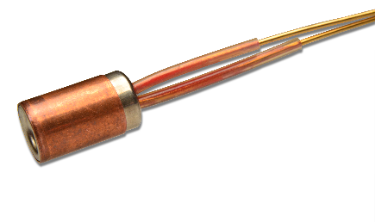
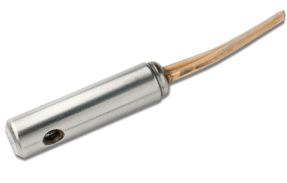
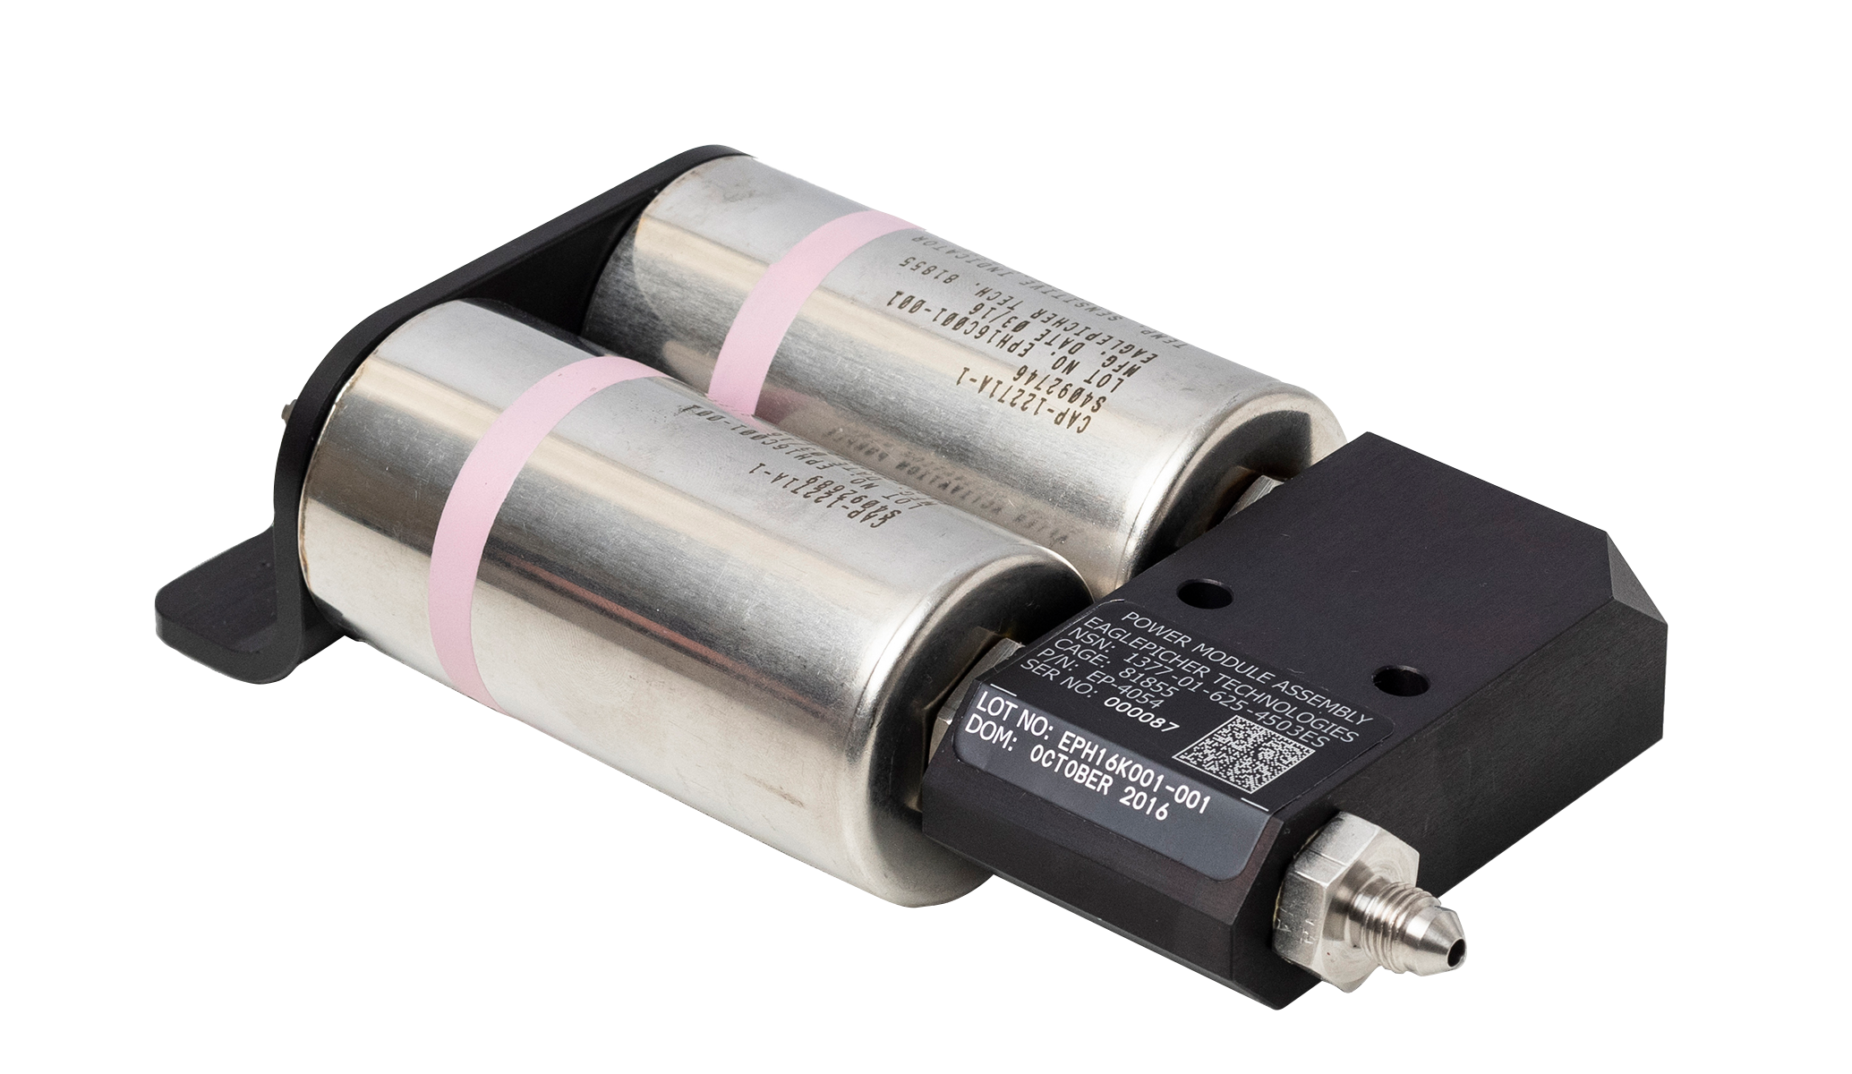
Energetics Portfolio
 | Actuators | Cutters | Gas Generators | Igniters | Switches | Pyrotechnic Valves
Function | Forward push Linear retraction Curvilinear motion | Server lines/rods Puncture burst discs | Fluid displacement Gyro spin up Pyrotechnic initiation Applied pressure | Impart hot gas/particles Impulse | Open/close electrical circuits Instantaneous or delayed | Quick acting valves Start or stop liquid flow
Applications | Fuze arming & alignment Push/pull mechanical loads Prime/stab detonation Switch/relay operations | Life support Seeker cooling Inflators | Batteries Guidance systems Void expansion Energetic trains | Thermal batteries Pyrotechnic valve initiation Rocket motors Guidance systems Energetic trains | Sequencing multiple events from a single initiation | Fire extinguishing systems Emergency activation fluid systems
Output | > 100k annually | > 36k annually | > 1.5k annually | > 100k annually | > 36k annually

Slide 13
Customers and Partners
Defense
Aerospace
DoD

Slide 14
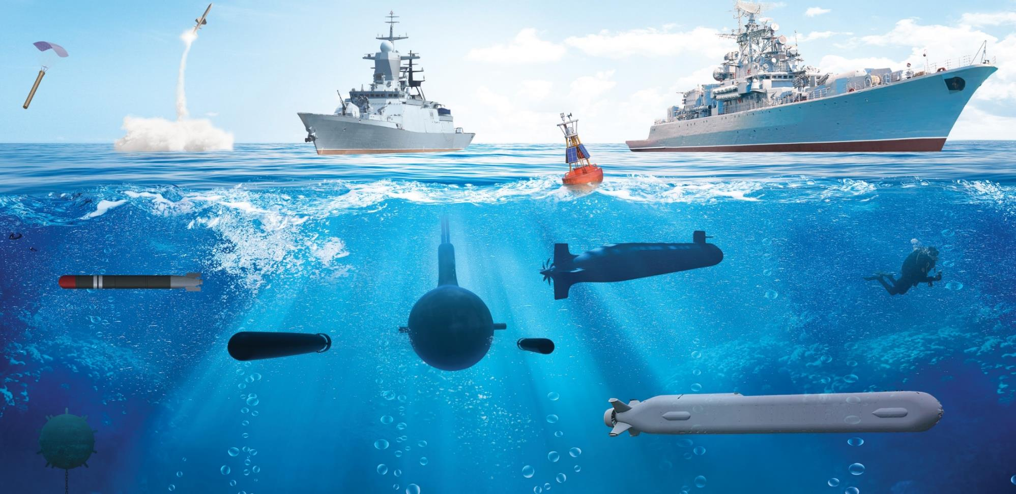
Sea Applications
Navel Weapons Systems
Harpoon Missile
Energy Storage Ship Power
Trident Missile
SM-6 Missile
Weather
Buoy
Sonobuoy
Jet Boots Diver Propulsion
System
Electric Motor Power
Heavyweight Torpedo
Cruise Missile
Propulsion for
Large Underwater Vehicles
Captor Mine
Large Unmanned Underwater Vehicles

Slide 15
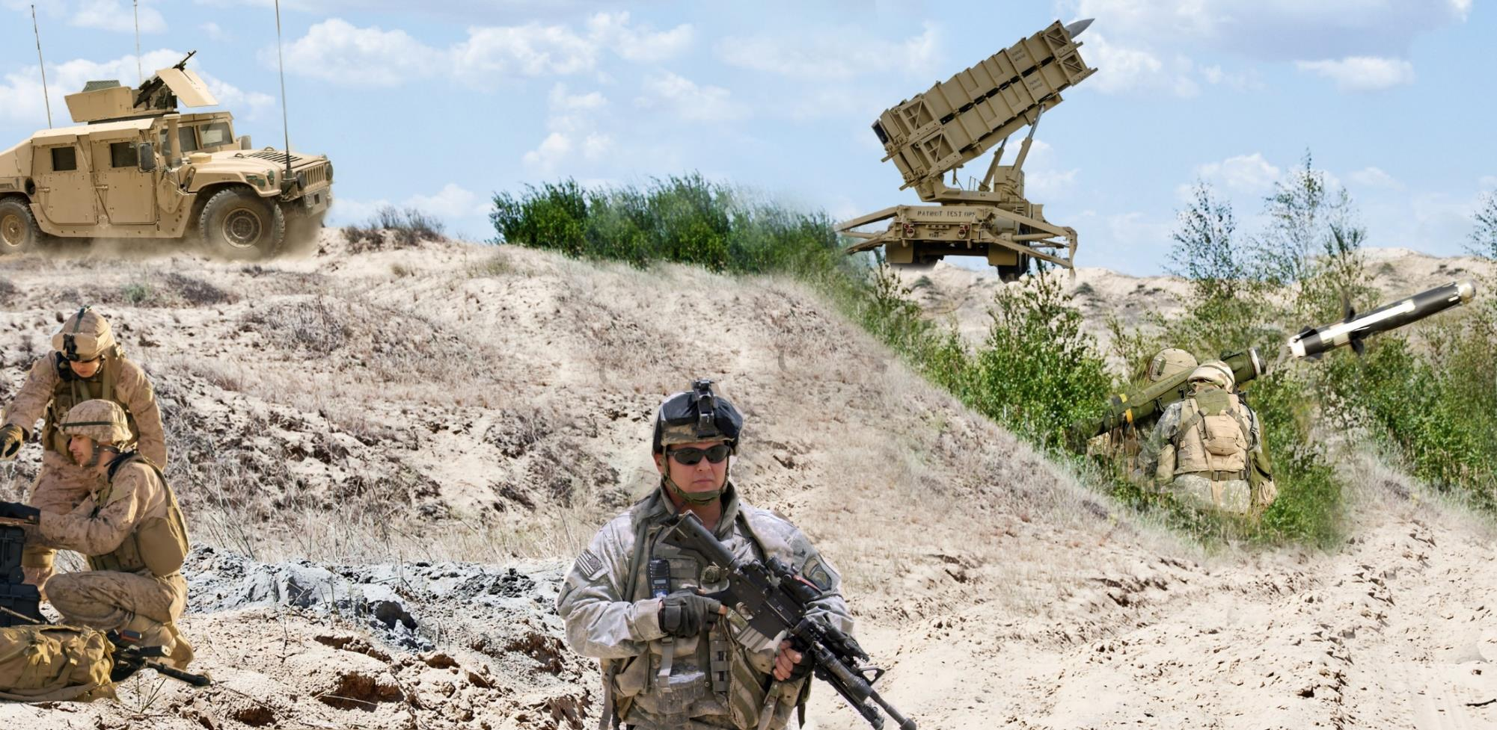
Land Applications
HEL TVD
Patriot
Missile
Javelin Missile
Soldier
Portable Power
Conformal Battery

Slide 16
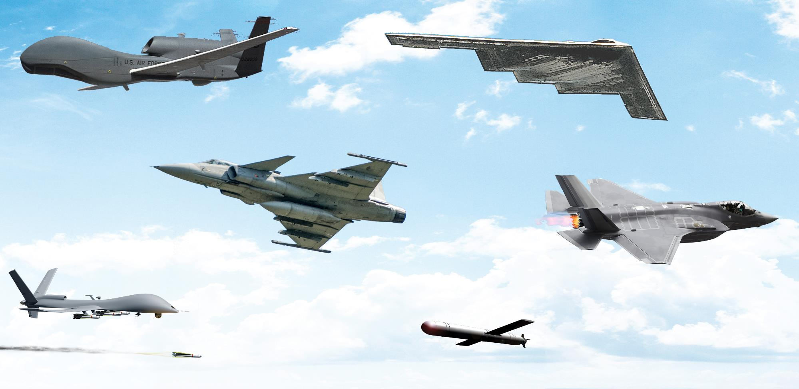
Air Applications
B2 Stealth Bomber
Global Hawk
Gripen Series
Unmanned Aerial Vehicles
Joint Strike Fighter
Loitering Munitions

Slide 17
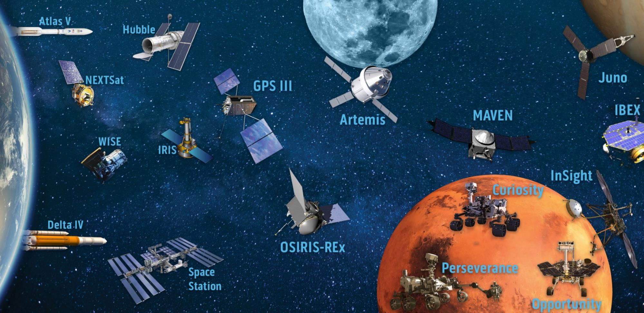
Space Applications

Slide 18
How We Do It

Slide 19
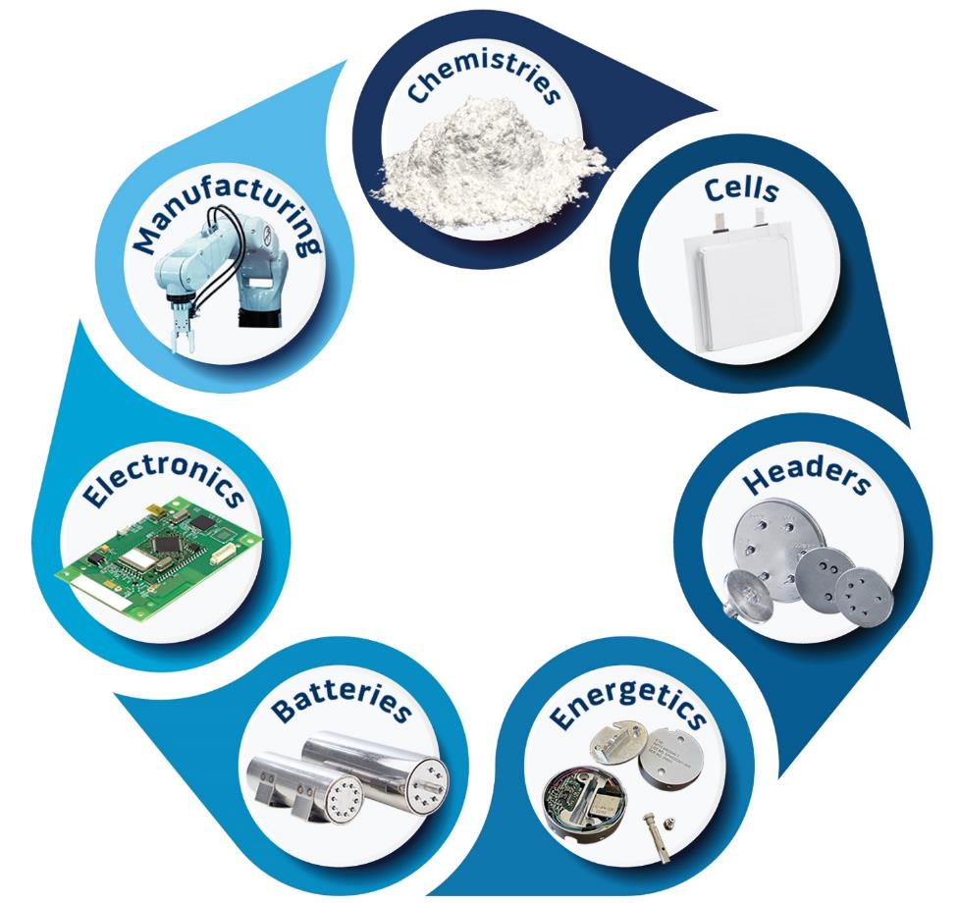
Integrated Power
Expertise in 30
electrochemistries
Scalable, automated
production
Cylindrical, pouch
and prismatic
Battery management system
Glass to metal seals,
connectors and
feedthroughs
High energy and high
power with safety
architecture
Initiation, control, sequencing
and sensing

Slide 20
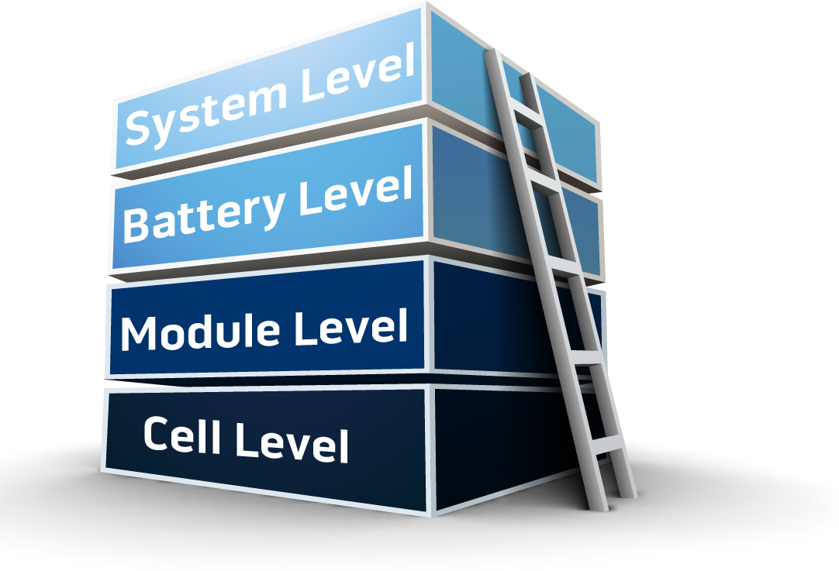
Holistic Approach to Safety
Battery management system interface
Protection, optimization, communication
Propagation prevention
Containment, direction, dissipation
Thermal management
Remove heat, manage heat dissipation
Performance, abuse tolerance, response control
Chemistry and form factor

Slide 21
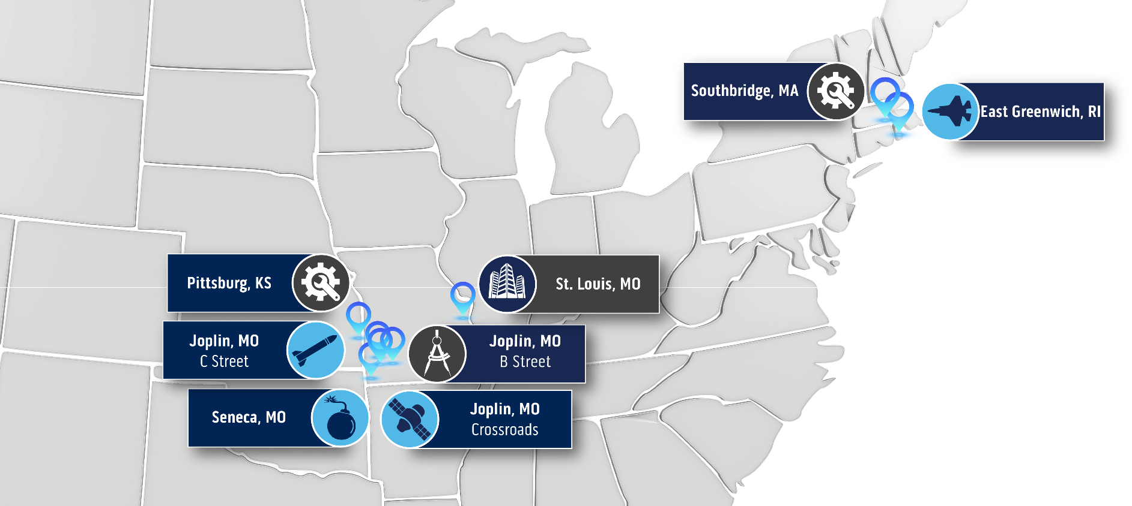
Modular, Scalable Manufacturing Footprint
Full Domestic Production

Slide 22
Automated, High-Volume Thermal Battery Production

Slide 23
Domestic Cell Production
Remove this one and replace with coating video here
Domestic manufacturing of our own cells
Coating shows coating our own cells
101-104 or 6

Slide 24
State-of-the-Art Electronics Lab

Slide 25
Multi-Point Quality Check Points

Slide 26
In-House Testing Capabilities

Slide 27
Where We Are Going

Slide 28
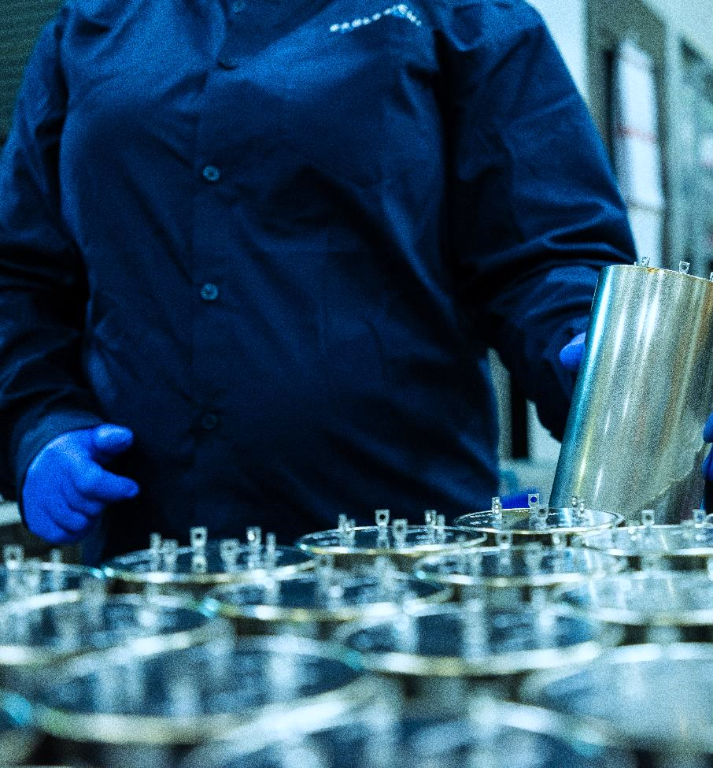
New Ownership
Ownership structure is now sole-proprietorship, Oct. 2023
Steve Westfall, President
Obtained Small Business Certification
All primary NAICS codes including energetics by month end
Fulfills small business set asides
Committed to small business collaborations
Commitment to our national security
Investment in heritage chemistries
Advancement in “new technologies”

Slide 29
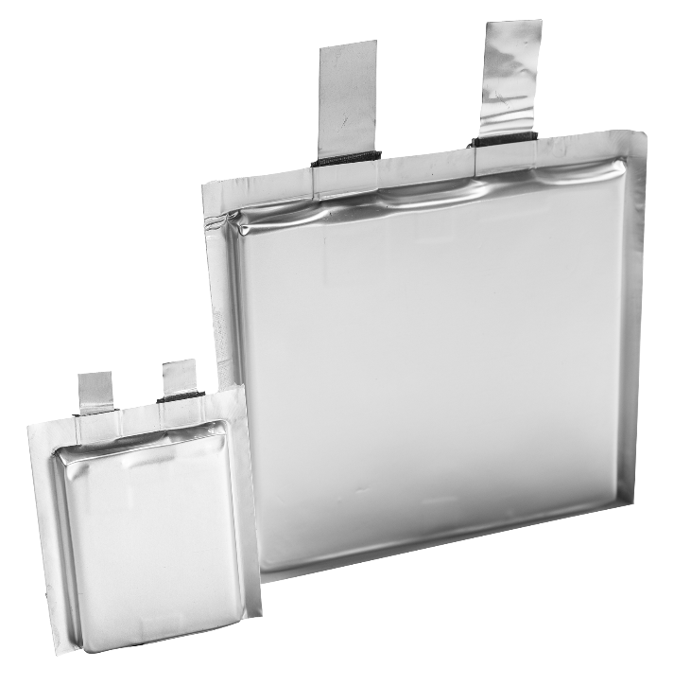
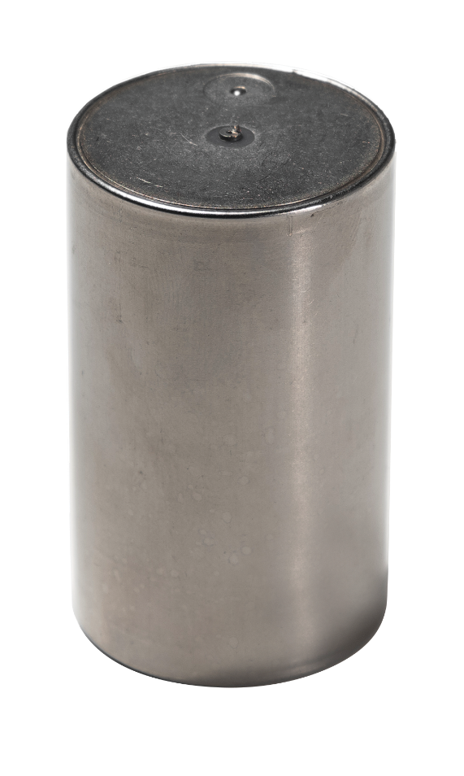
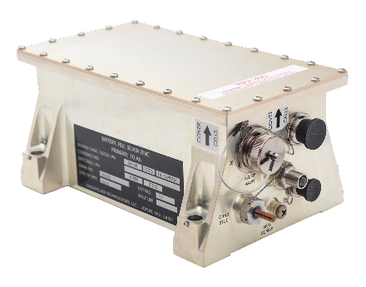
On The Horizon
Increased spending in R&D
High-power and high-energy lithium-ion
Supporting directed energy, space, underwater, military aviation
Thermal battery advancements
CFx cylindrical and prismatic pouch cells
Facility investments
Domestic lithium-ion & CFx production expansion
Lithium-ion cylindrical cell production for military applications
CFx D cell, 18650 and pouch cells for military application
Modernization of silver zinc production
Acquisitions to expand current portfolio

Slide 30
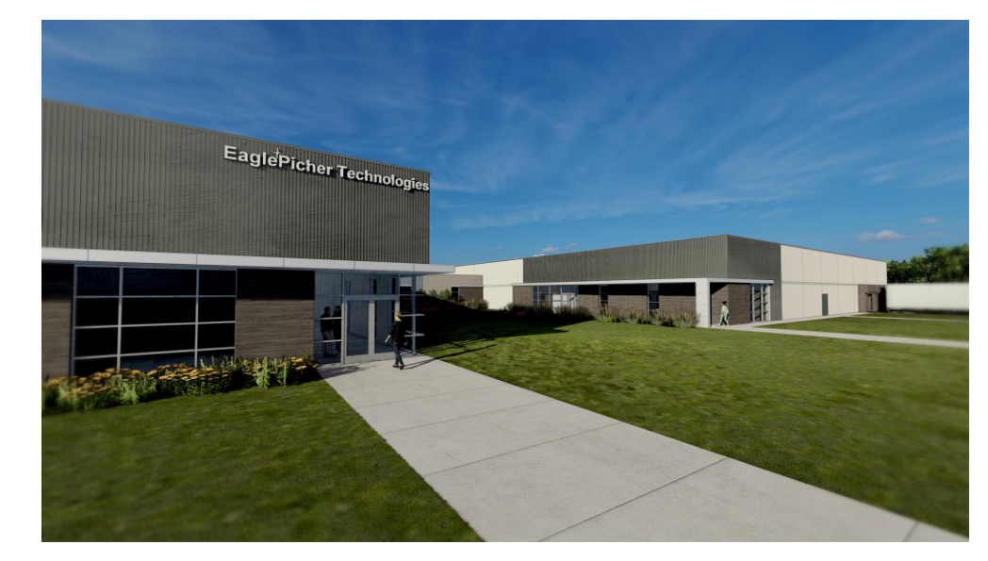
Energetics Expansion
Energetics growth and investment
New modernized facility located in Joplin (near Crossroads facility)
75k sq ft campus, 3 times current production capacity
Automation and standardization of processes
Completion end of 2025

Slide 31
Experience the Power
Keynote Speaker
John Kelly
September 30-October 3, 2024
Glendalough Conference Center DoubleTree
Springfield, MO
www.eaglepicher.com/powerup

Slide 32
Visit Us Booth #210

