Slide 1
Elimination of Premature Combat Vehicle Battery Failure using Solar Charging
DPEC 2024 – June 6
By: Dan Stieler
dstieler@powerfilmsolar.com

Slide 2
Who is PowerFilm
A company offering custom design, engineering and manufacturing of remote, portable solar solutions to meet client needs. We make our home in Ames, Iowa, and our solutions are manufactured in the United States.
We pride ourselves in building complete solutions tailored to your specific needs. This includes a rapid prototyping process and volume production to fit your needs.
Founded in 1988, we bring deep expertise to both government and commercial customers across a wide range of solar technologies, encapsulants, substrates and electronics.

Slide 3
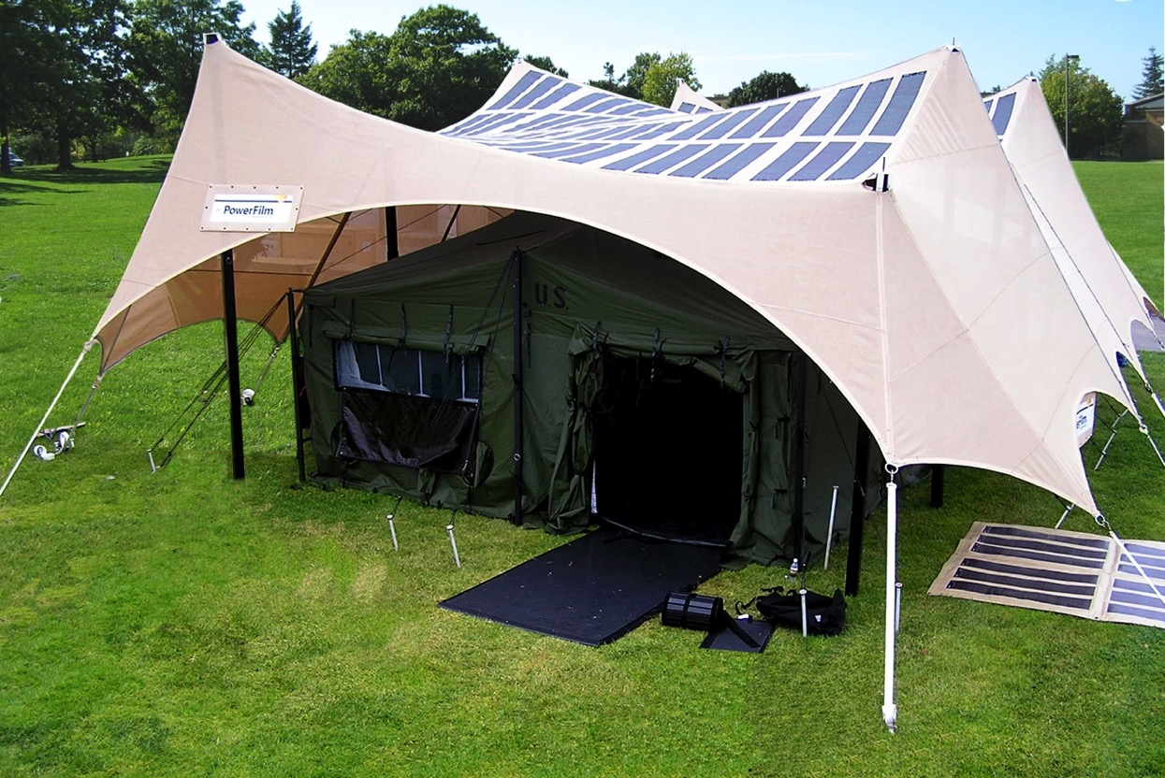
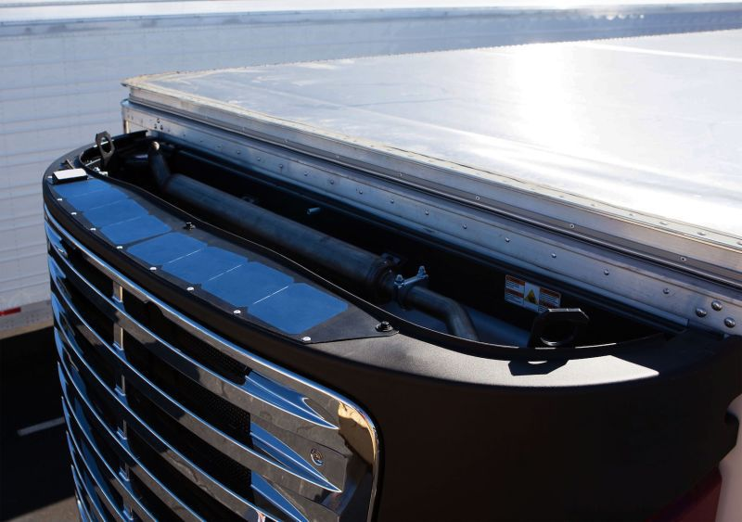
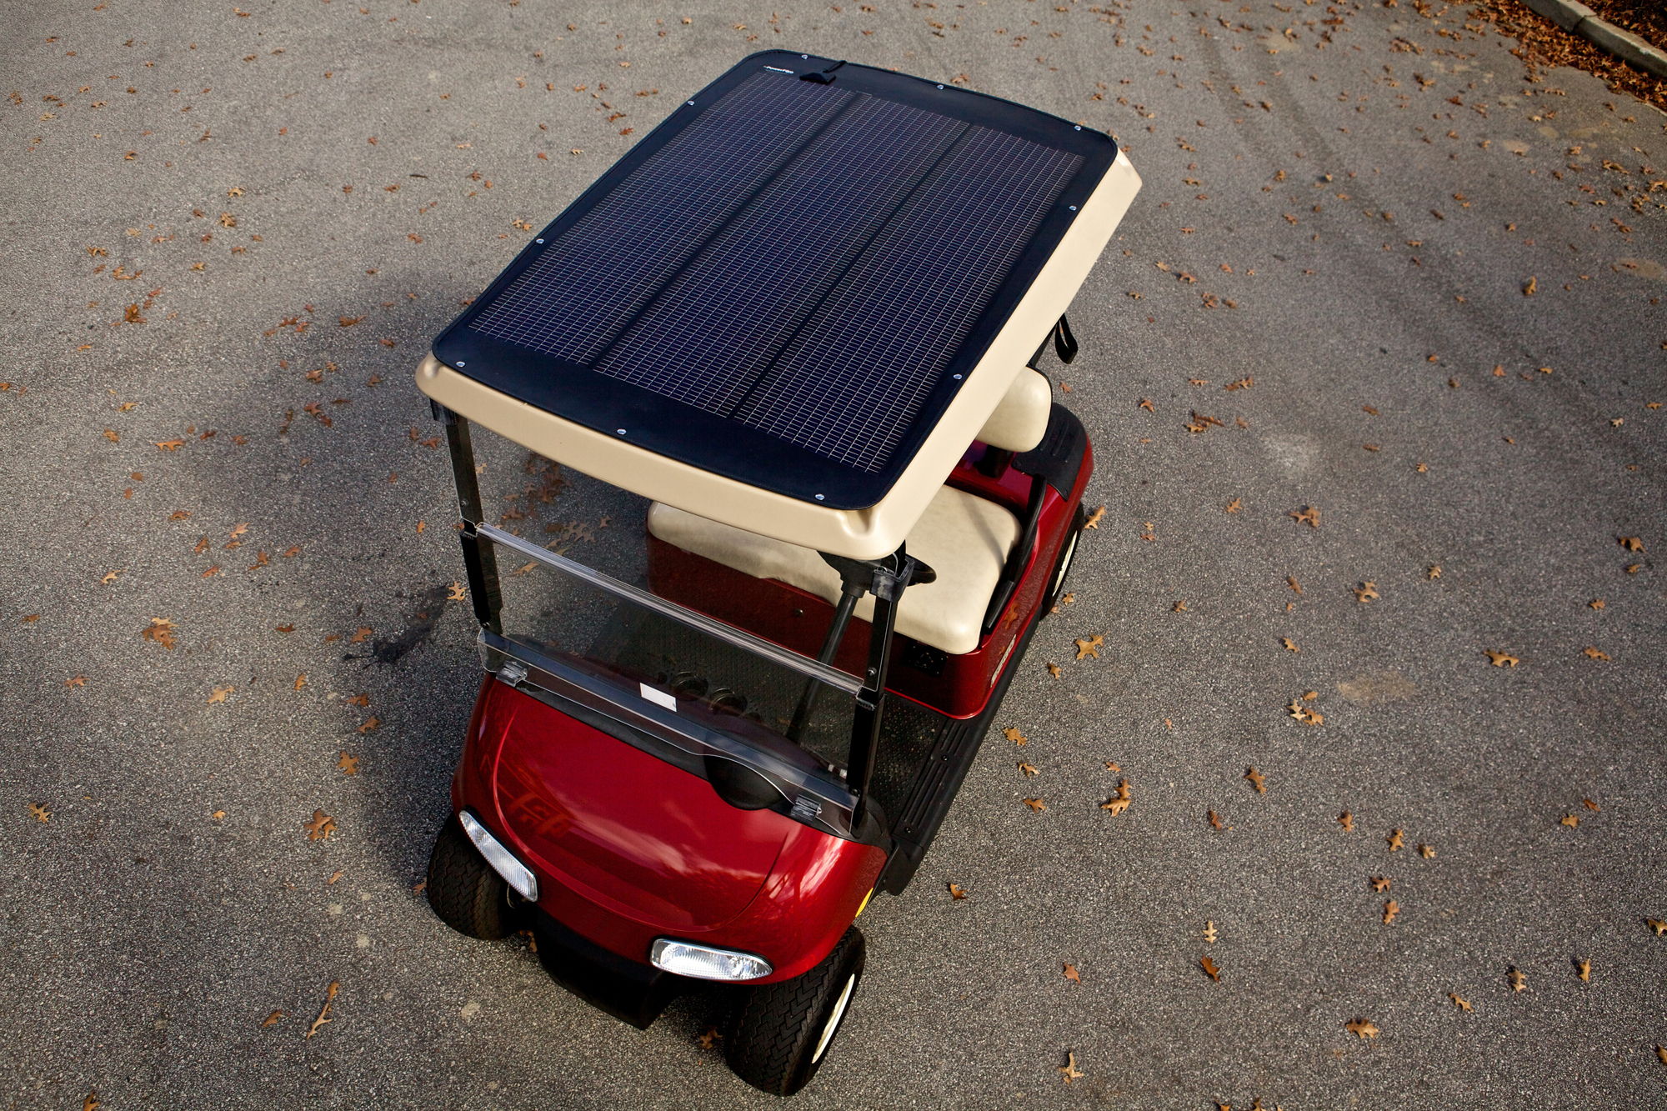
Markets Served
Government Solutions: MIL-STD-810G certified products to both US and Allied militaries. Combat-proven solutions have been deployed globally in man portable, vehicle and basing configurations.
Commercial Designs: Our custom technology and engineering expertise provide quick understanding and response to your application needs in power, supporting electronics and performance under varying environmental conditions.
Consumers Directly: Through an international network of distributors, our customers receive cutting edge products designed and engineered to withstand the toughest tests under the most challenging conditions.

Slide 4
Battery Issues in Low-Usage Vehicles
Battery failure is #1 part driver in frequency and #13 in cost for all Non-Misson Capable (NMC) orders*
During FY 2016 DOD spent over $80M replacing 373,000 6T batteries*
Average battery replacement interval is 13 months, but should be 6 to 8 years*
Discharged and unbalanced vehicle batteries negatively affect a unit’s readiness, maintenance costs, logistics, disposal, and environmental impact*
https://oshkoshdefense.com/vehicles/medium-tactical-vehicles/fmtv/fmtv-a2/
*Luoto, E.A., “Tactical Vehicle Solar Recharging”. DAC-FA-22-0032-AORS 2020, CCDC DAC. September 2020

Slide 5
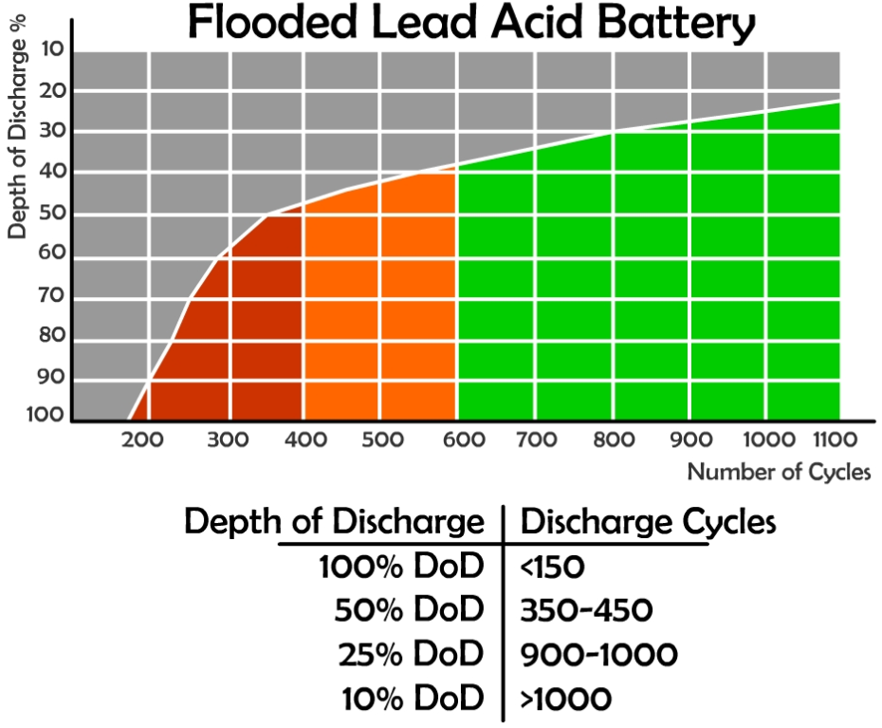
Why do Low-Usage Vehicles Suffer from Battery Failure?
Parasitic draws on vehicles deplete and unbalance sets of batteries
Lifetime dependent on Depth of Discharge (DOD) of batteries
Hawker 6T Datasheet*
40% DOD => 900+ cycles
100% DOD => 180+ cycles
*https://hawkerbattery.com/wp-content/uploads/2020/06/Hawker-Armasafe-Plus-6TAGM-battery-Data-Sheet-Low-Res.pdf – Hawker 6T datasheet
https://greensarawak.com/wp-content/uploads/2017/12/deapthofdischargeandcyclelife.jpg
Notes:
https://hawkerbattery.com/wp-content/uploads/2020/06/Hawker-Armasafe-Plus-6TAGM-battery-Data-Sheet-Low-Res.pdf – Hawker 6T datasheet
deapthofdischargeandcyclelife.jpg (1920×942) (greensarawak.com) – figure

Slide 6
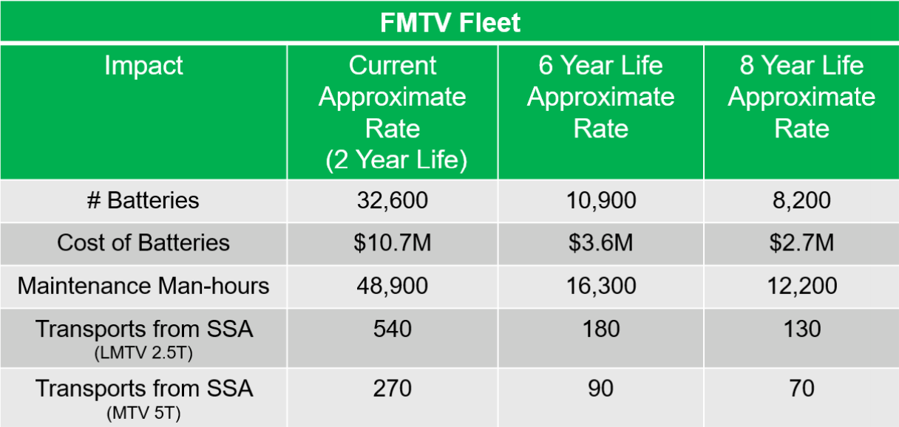
Impact of Extending Battery Life
*Luoto, E.A., “Tactical Vehicle Solar Recharging”. DAC-FA-22-0032-AORS 2020, CCDC DAC. September 2020

Slide 7
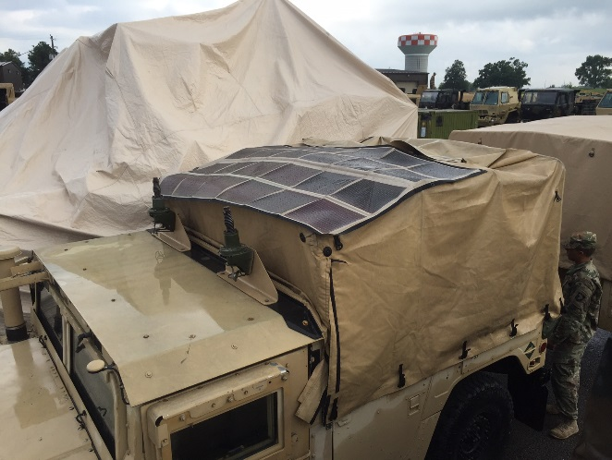
Solar System Requirements
Maximum desired time to recharge a vehicle battery system from 0% SOC to 100% SOC is 60 days
Requires 5-25W of solar per 120AH Hawker Battery
20W system in southern US
50W system anywhere in CONUS
100W system farther north like Alaska
Charge controller
Maximum Power Point Tracking (MPPT) preferred
Available with built in battery balancing
Waterproofing required

Slide 8
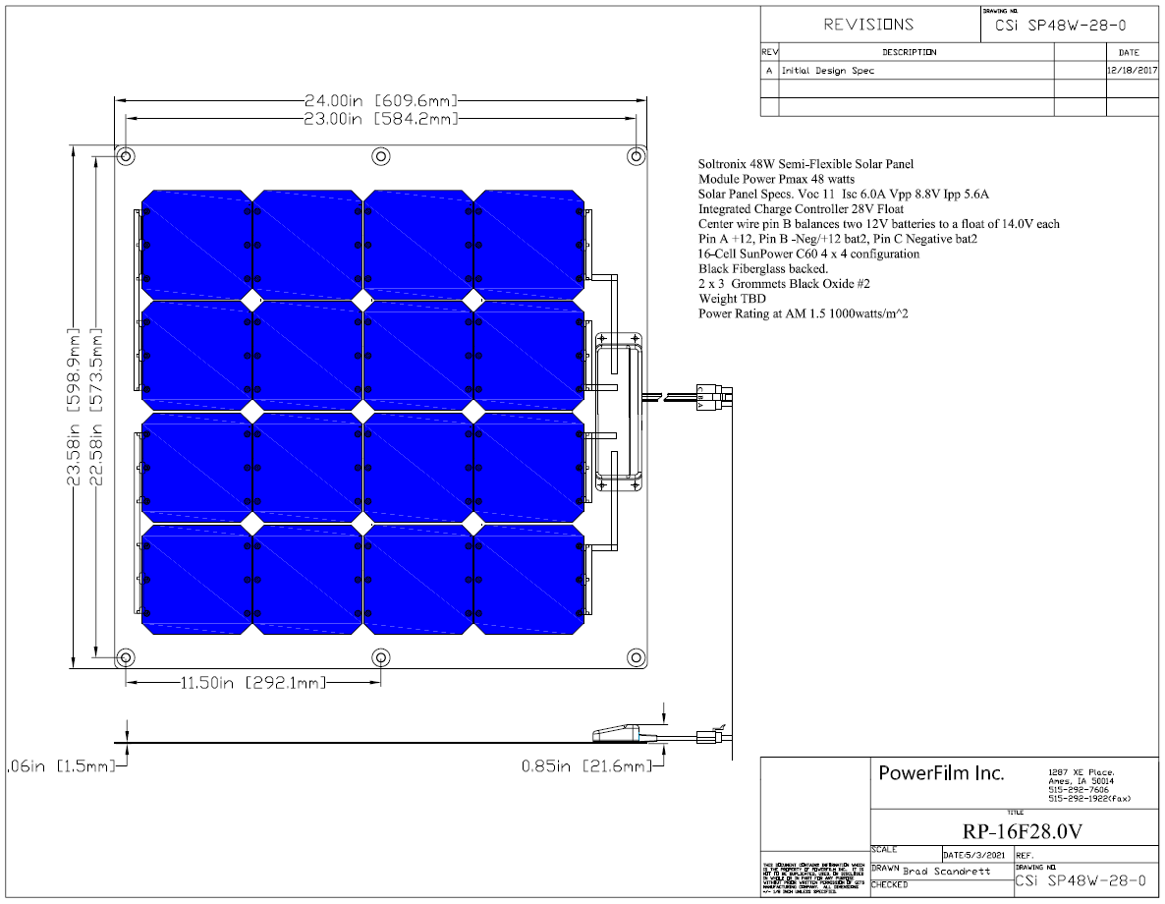
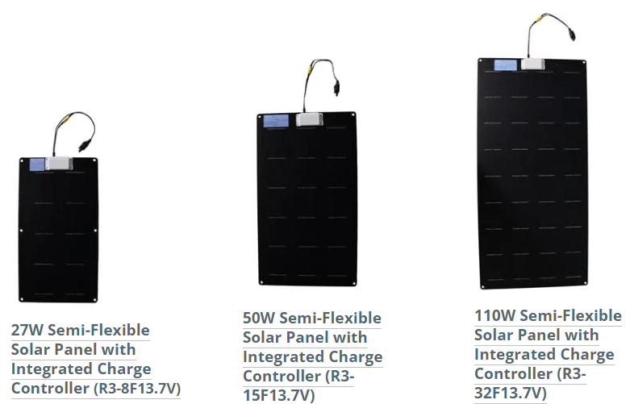
Solutions Available from PowerFilm

Slide 9
Charge Controller
Integrated into junction box on panel for easy installation and lower cost vs additional component to mount
Mechanically connected to panel vs glued
Customer specified connectors
Short circuit protected
Maximum Power Point Tracking (MPPT) yields 30% more power over entire battery voltage range vs Pulse Wave Modulation (PWM)
Coroplast abrasion tape or double jacketed wires
Charge controller can include balancing of multiple batteries

Slide 10
Durability/Performance Advantages
Accelerated lifetime tested to 25 year standard PV standard or Mil 810G
Thermal Shock - 185F to -40F cycling for 1 week (IEC61646)
Damp Heat – 185F/85% RH for 1000 hours (IEC61646)
Humidity Freeze – 185F/85RH to -40F for 10 cycles(IEC61646)
IP67
Shock - 50g, 6.3mS (Trucking Specified)
Vibration – 15.3grms (EN60068-2 64:1993)
Salt Fog – 5% salt solution spray for 500 hours (ASTM-B-117-73)
UV Exposure – QUV accelerated aging for 1000 hours

Slide 11
Durability/Performance Advantages
Hail Impact - <3% reduction in power after 5 hits with ¾” steel ball
Laminate – ETFE
95% clarity vs 85% for PET
Self Cleaning and Decontaminatable
EMI emissions complaint
Superior low intensity light collection
Flexibility – To 17” radius
Temperature -60F to 185F
Humidity 0 to 100%
Altitude 0 to 40,000+MSL
Fungus – No growth
Icing – No damage
Low temperature coefficient-0.29%/C vs 0.42%/C

Slide 12
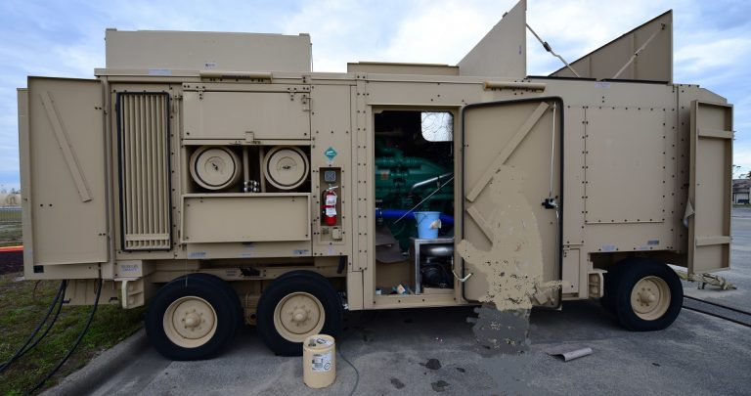
Current Application
BEAR Power Unit – 800kW
12kW starter battery
240-2400WHr monthly parasitic loss
Two 110W panels produce up to 1100WHr per day or 33kWhr per month

Slide 13
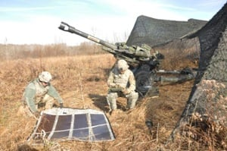
Questions
For more details contact
Kip Johnson, VP Marketing & Sales 515-292-7606 Ext 140 kjohnson@powerfilmsolar.com
Dan Stieler, President 515-292-7606 Ext 177 dstieler@powerfilmsolar.com

