Slide 1

High Energy Lithium Carbon Monofluoride Batteries Qualified for Portable Power
Rob Gitzendanner, Greg Miller, Mario Destephen, Mark Robertson
This document does not contain technology or technical data controlled under either ITAR or EAR.

Slide 2

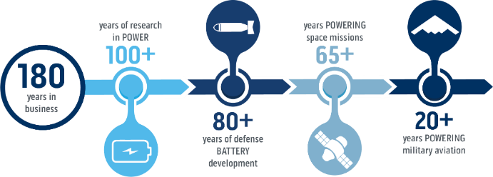

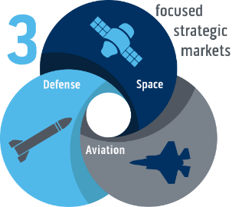


EaglePicher at a Glance
Expertise in More than
30
Battery Chemistries
Small Business
Battery Manufacturing (335910)

Slide 3

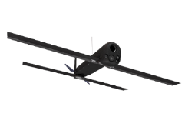



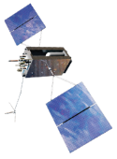



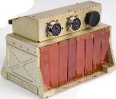
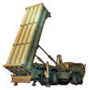


Battery Chemistries and Applications
BA5790
Space Exploration
Lithium-
Manganese
Dioxide
(MnO₂)
UUVs
Conventional Lithium-Ion
Lithium-CF_{x}
Loitering Munitions
Lithium- Thionyl Chloride
Advanced
Lithium-Ion
(Silicon,
High Energy)
Aqueous
(Ag-Zn)
Satellites
Lithium-Oxyhalide
Primary
(one-time use)
Aqueous
(Ag-Zn,
Alkaline)
UAS
Secondary
(rechargeable)
Lithium Metal
High Power Lithium-Ion
Lithium- Thermal
THAAD
Torpedoes
Directed Energy
Thermal batteries
Military Aircraft

Slide 4
Hybrid CF_{x} for
Portable Soldier Power

Slide 5
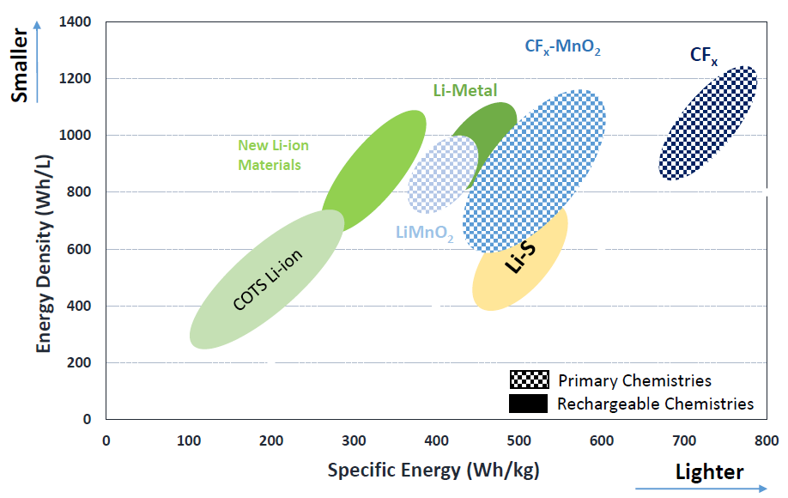
What is Hybrid/CF_{x}
Hybrid of CF_{x} and MnO₂ chemistry to take advantage of both materials
High specific energy (>500Wh/kg) and energy density (>800 Wh/l)
Long shelf-life (>10 years), capacity loss <1%/year
Wide operating temperatures (-40°C to +85°C)

Slide 6
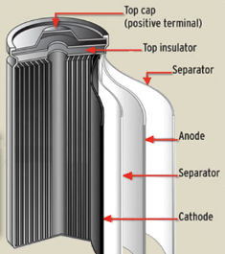
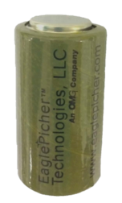
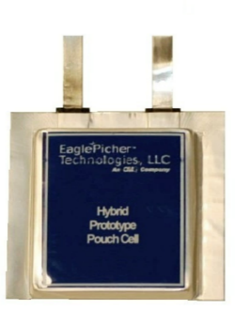
Lithium Hybrid CF_{x} Cells (Non-Rechargeable)
Enabling Characteristics
  Reduced heat generation vs. pure CF_{x}
  Increased rate capability (up to 4C)
  Voltage drop is significantly reduced (vs CF_{x})
  Web coating process enables cylindrical and pouch cell formats
Applications
Monitoring
Soldier power
Space power
Strategic missiles
Unmanned aerial vehicles
Comparable D-Size Cell | Li-SO₂ | Li-MnO₂ | Li-CF_{x} (LCF-514) | Li-CF_{x}/MnO₂ (LCF-15004)
Operating Voltage (V) | 2.8 | 2.8 | 2.6 | 2.7
Capacity (Ah) | 7.5 | 13 | 20 | 16
Weight (g) | 85 | 122 | 72 | 96.5
Specific Energy (Wh/kg) | 247 | 298 | 710 | 448
Energy Density (Wh/L) | 382 | 662 | 1000 | 786
Hybrid CF_{x} D Cell
Hybrid CF_{x} Pouch Cell

Slide 7
Battery Specification
Battery produced is compliant with MIL-PRF-32271A, Performance Specification Batteries, Non-Rechargeable, Lithium General
  Type IV – Hybrid/CFx Battery
  Class 2 – Require complete discharge in order to be considered non-reactive for disposal, includes Complete Discharge Device (CDD)
  Features E – Battery contains: Short Circuit, Over Current, Over Temperature and Charge Protection, as well as State of Charge Indicator (SOCI) and State of Charge data output terminals
Recently completed all First Article Testing with approval from Government sponsor

Slide 8
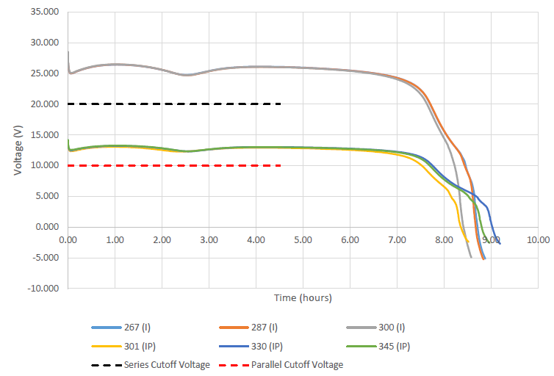
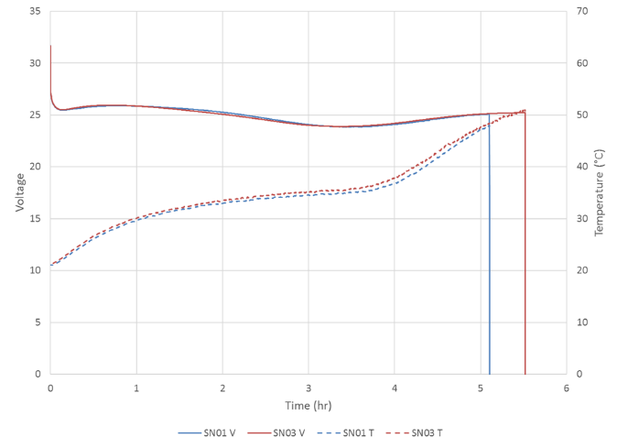
Battery Performance Testing – Capacity
~50% Greater run time with Hybrid/CFx battery
EaglePicher
Competitors Design

Slide 9
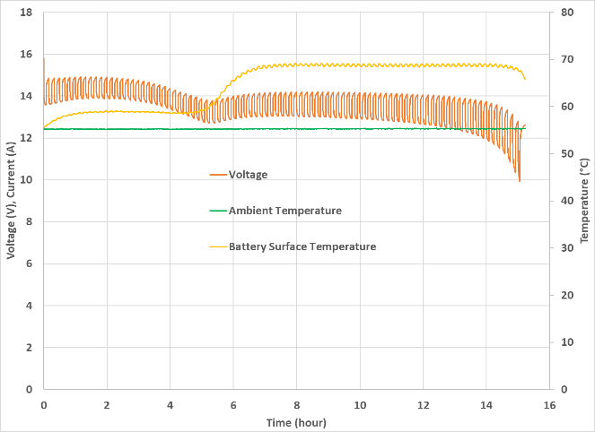
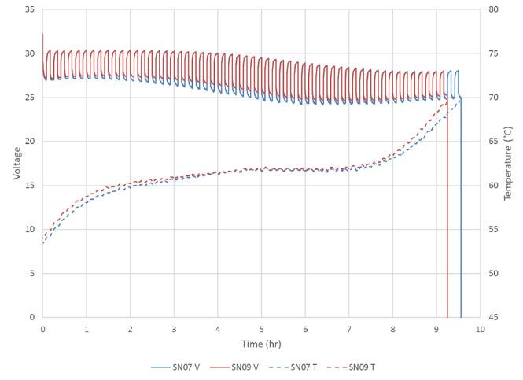
Battery Performance Testing – Pulsed Power Test
Hybrid CF_{x} battery provides ~50% greater run time.
EaglePicher
Competitors Design

Slide 10
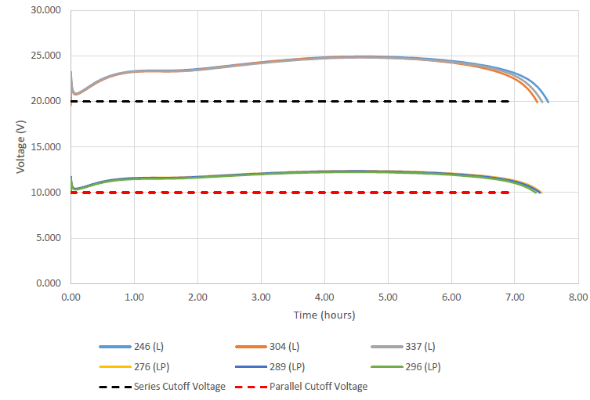
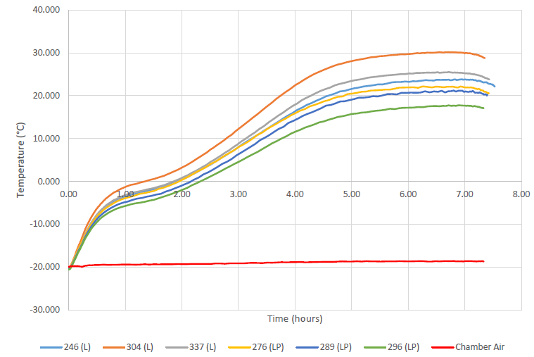
Low Temperature Performance
After exposure to high temp (55°C) and physical drop test, batteries soaked at -20°C and discharged.
Batteries exceed discharge requirement (7hrs) without significant temp rise on case.

Slide 11
Batteries Transportation Testing
40 Cells and 8 Batteries have completed UN38.3 Testing
All tests Pass
Battery is UN3090 Class 9 Lithium Metal Battery, but otherwise unregulated for standard modes of transportation.

Slide 12
Cell Impact Testing

Slide 13
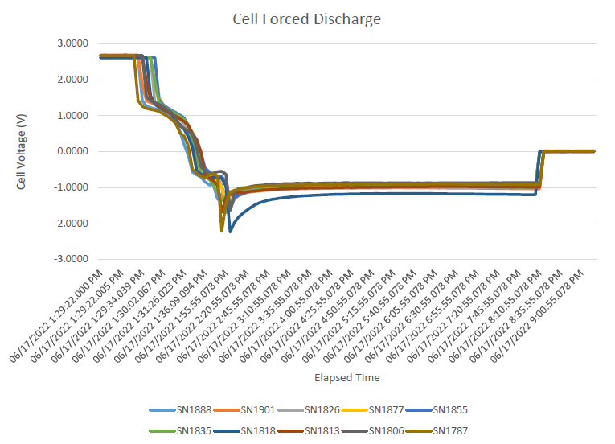
Forced Discharge

Slide 14
Nail Penetration Testing

Slide 15
Outside Testing - Complete
NSWC Crane – Safety
  Battery Voltage
  Constant Current Discharge & Reversal
  Short Circuit
  Charging
  Electrical Safety Device
DEVCOM C5ISR – Performance
  Visual/Mechanical
  Battery Voltage
  Desert Cycle Storage
  IT/ITP Capacity
  LT/LTP Capacity
  HT/HTP Capacity

Slide 16
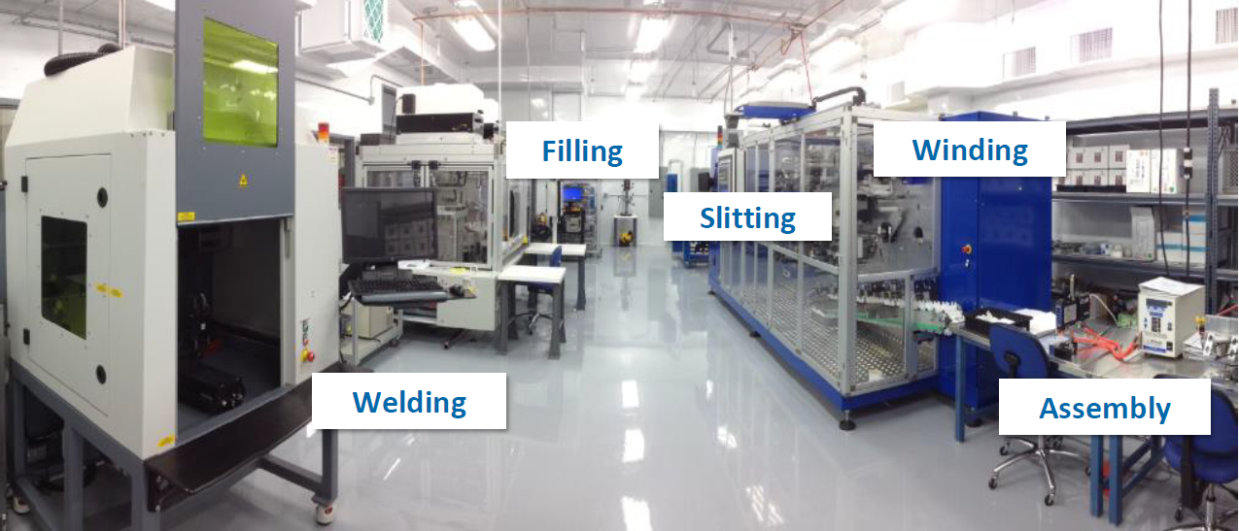
Production Ready
Semi-automated cell and battery production capability established and validated (MRL 10)
100% Domestic Cell and Battery Manufacturing

Slide 17
Summary
Battery has completed all requirements for First Article testing IAW MIL-PRF-32271A
Transportation testing per UN38.3 complete
Safety assessment by NSWC Crane and Performance assessment by US Army C5ISR complete
Production line is established and proven capable
  All product and component drawings, materials specifications and documentation are released
  All manufacturing, inspection and test procedures released
  Material sources of supply have been identified and verified
High Energy, High Reliability, US Domestically Manufactured Energy Storage Solution Ready for the Warfighter.

Slide 18



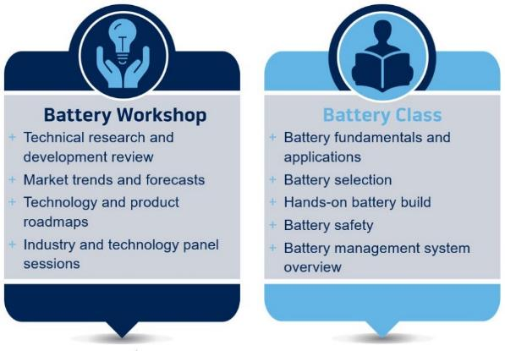
Experience the Power
Keynote Speaker
John Kelly
September 30-October 3, 2024
Glendalough Conference Center DoubleTree
Springfield, MO

Slide 19
Thank You.

