Slide 1
High Energy Li-Ion Pouch Cells with Reduced Flammability Electrolyte Additive
Owen Crowther
4 June 2024

Slide 2
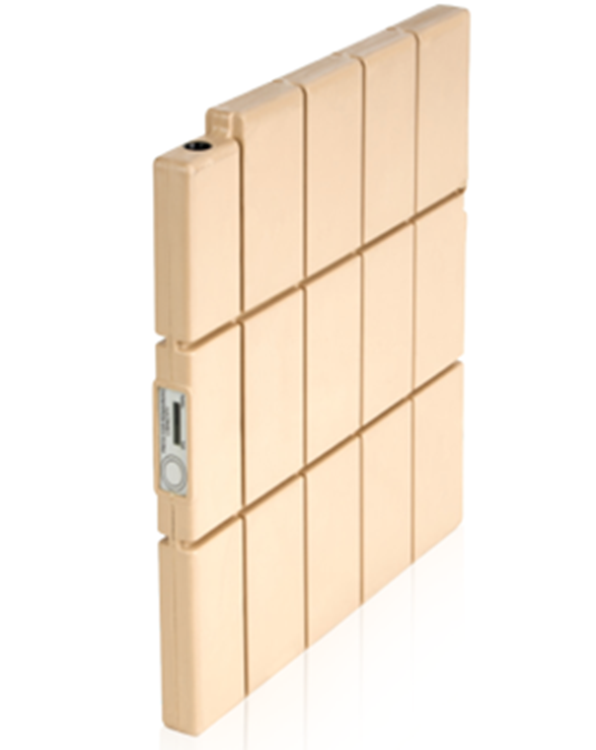
Overview
EaglePicher pouch cell overview
2.3Ah SLC-202 Li-ion Pouch Cell
    24 SLC-202 in SLB-101 Conformal Wearable Battery
13Ah SLC-203 Li-ion Pouch Cell
    8 SLC-203 in BB-2590
Reduced flammability (RF) electrolyte development: US Patent 11,050,284B
RF electrolyte compatibility in SLC-202 cell
Summary

Slide 3
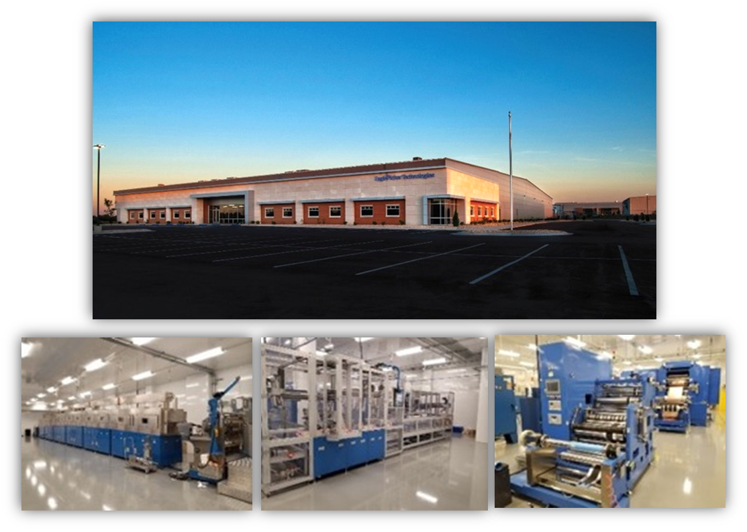
Domestic Li-Ion Cell Production at EaglePicher Technologies
Title III LIMA Program
Joplin, MO Crossroads Facility
Developed to manufacture lithium-ion for military applications (LIMA) under the Title III program
Phase II award for establishing a domestic and commercially viable production capability for Li-Ion batteries essential for national defense
Expanded capability to advance Li-ion technology to production level environment (MRL 8)
3CPM production rate for two sizes of cell
To support a wide range of applications: aircraft, UAVs, tactical vehicles, robotics, unattended sensors and submersibles

Slide 4
High Energy and High Power Li-ion Cell Development
High Energy Density Chemistry
  Incorporate Silicon-based anode
  Incorporate High specific capacity cathode (High Nickel content)
High Power Li-ion Cell
  Advance Anode design to provide high power capability with high energy density
  Matching cathode design is important due to overall cell energy and configuration
Stability and Safety
  Suppression of cell swelling
  Thermal management at high C-rate (or power discharge)
  Improved safety for high energy
Silicon Anode development enables high energy and power Li-ion cell

Slide 5
SLC-202 2.3Ah Li-ion Pouch

Slide 6
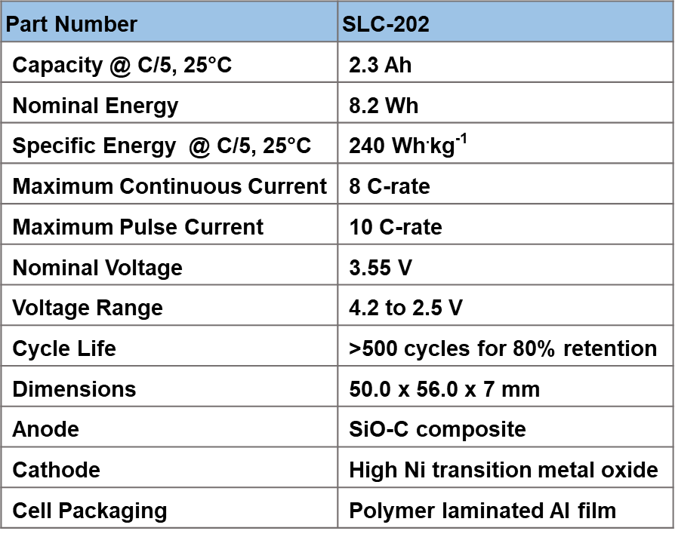
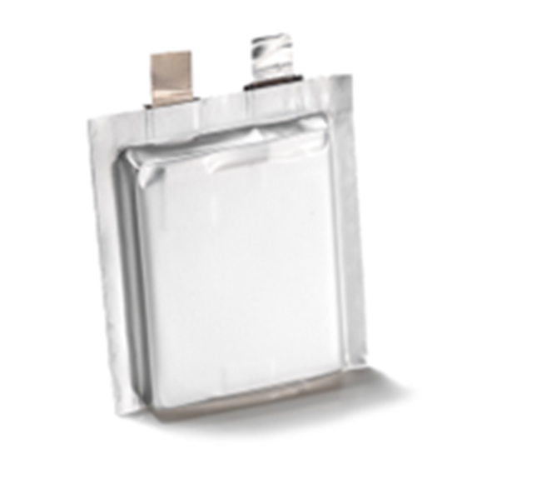
SLC-202: High Energy Li-ion Cell with High-Rate Capability
2.3Ah SLC-202 with Silicon Anode Technology

Slide 7
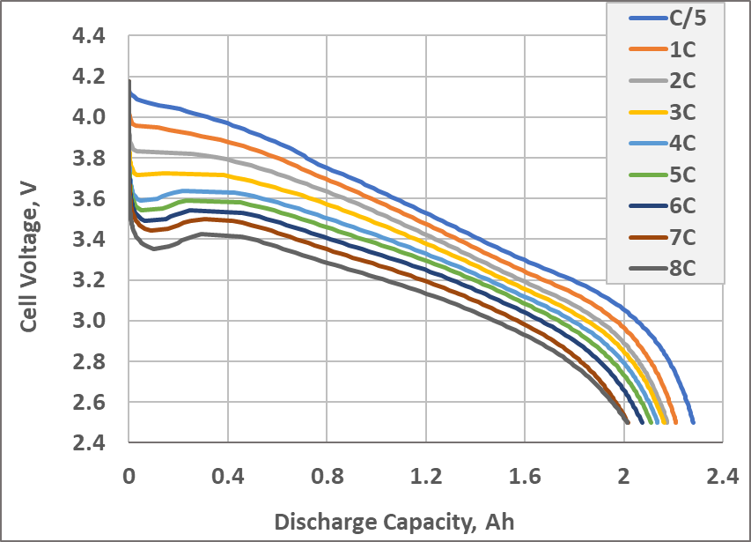
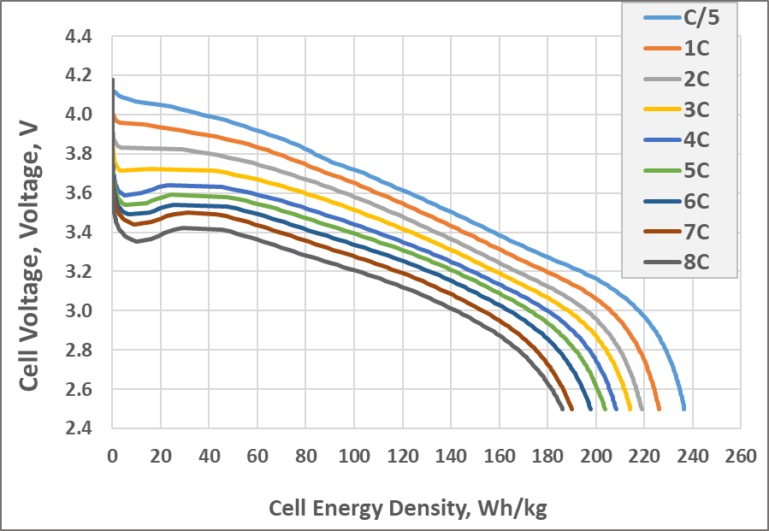
Room Temperature Rate Capability
Discharge Capacity at various C-rates
Specific Energy at various C-rates
80 % of nominal energy at 8C-rate discharge

Slide 8
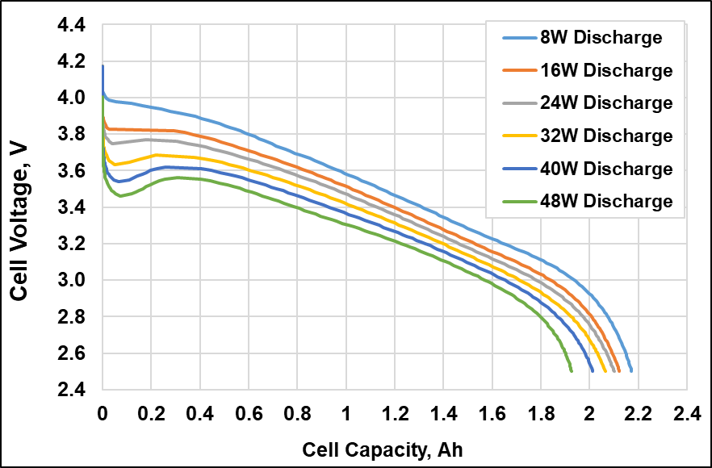
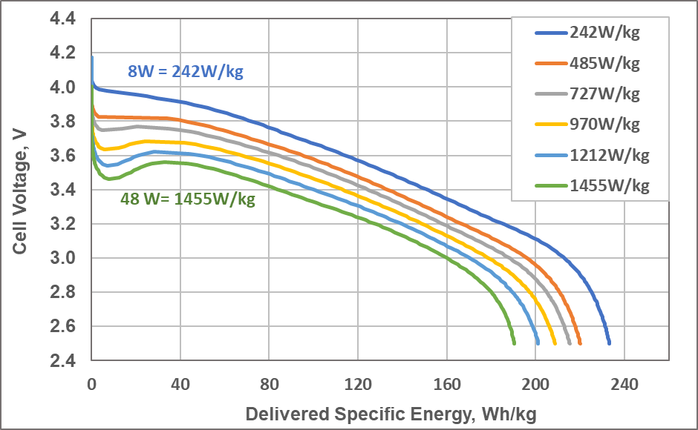
Room Temperature Power Capability
Capacity for Constant Power Discharge
Specific Energy for Constant Power Discharge
80% of nominal energy delivered for 1455 W/kg power discharge

Slide 9
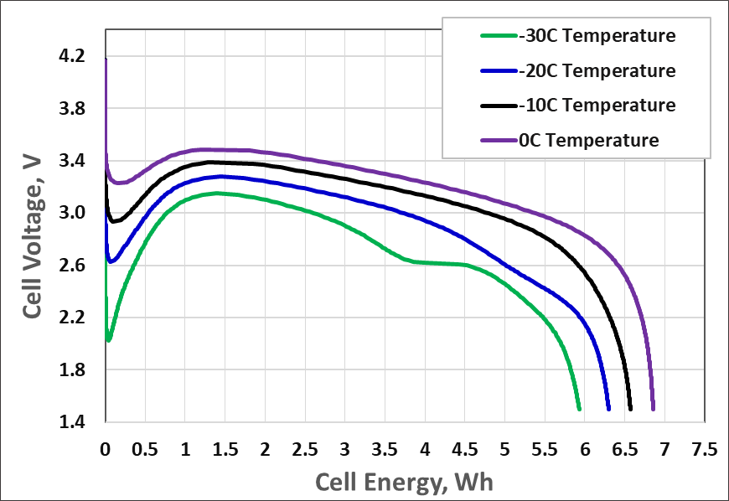
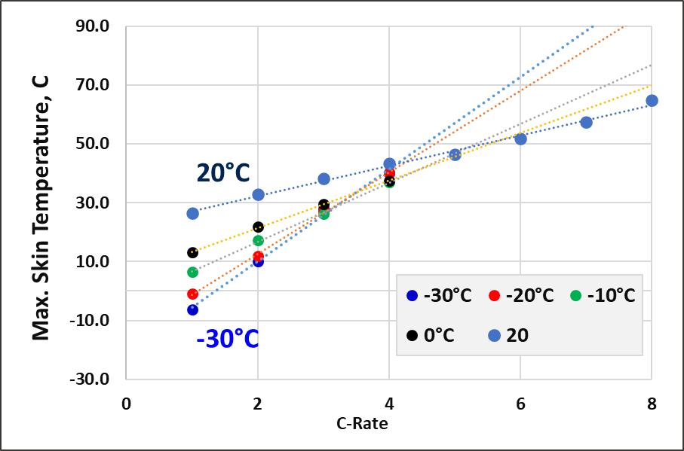
Low Temperature Performance of SLC-202
4C Discharge at Cold Temperatures
Max Cell Skin Temperature Discharge
70% of nominal cell energy delivered at 4C and -30˚C

Slide 10
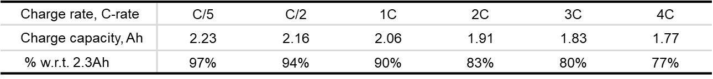
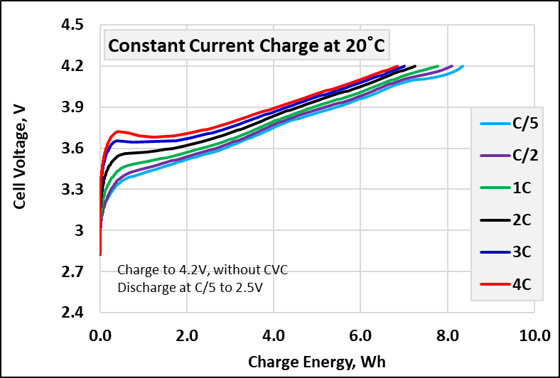
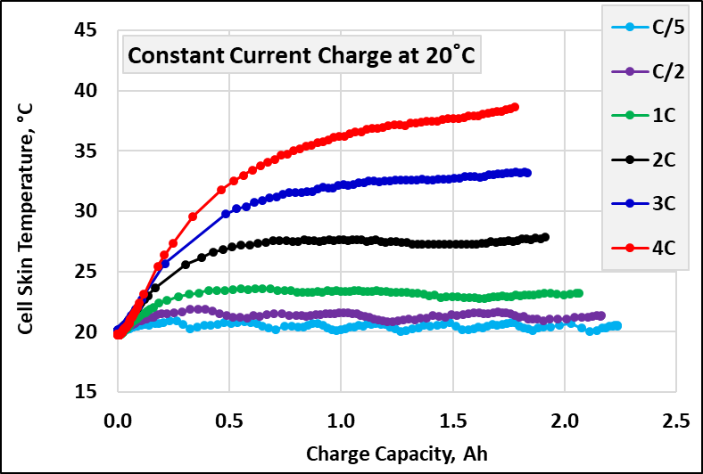
Fast Charging Capability
77% of nominal capacity delivered after 12-minute charge with no clamp

Slide 11
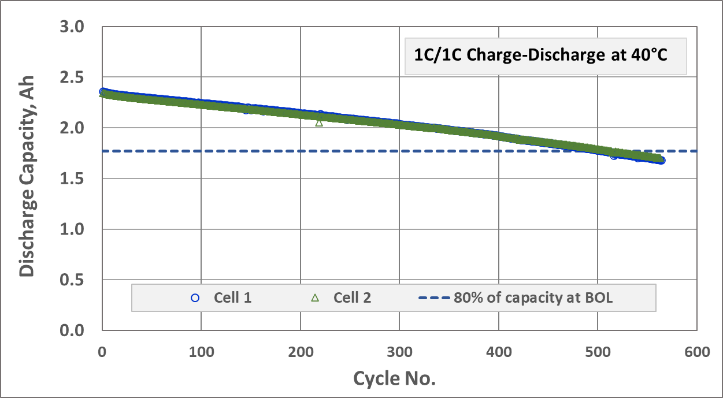
SLC-202 Cell Cycling Performance at 40˚C
80% retention for ≥500 cycles

Slide 12
SLC-203 13Ah Li-ion Pouch

Slide 13
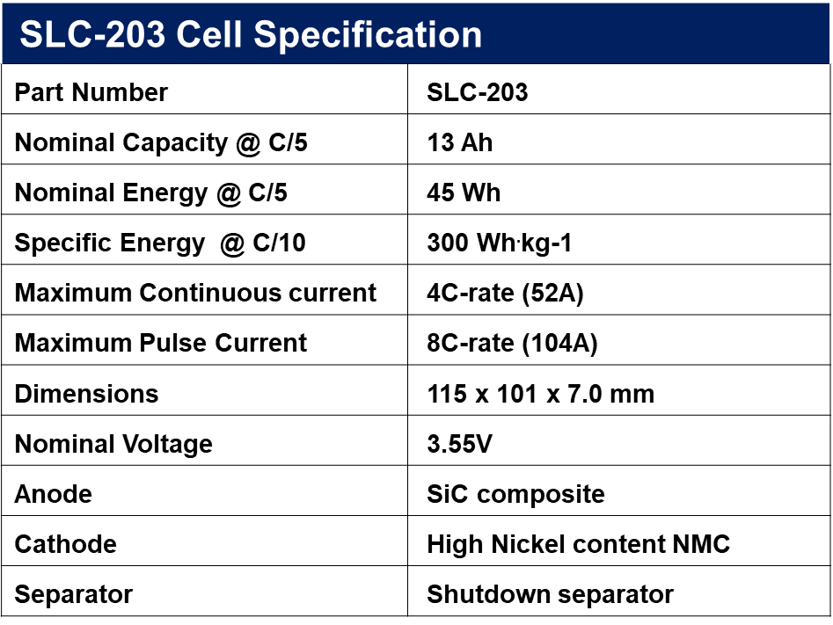
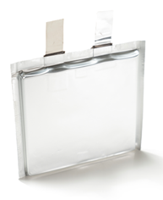
SLC203: 13Ah High Energy and Power Li-Ion Pouch Cell
300 Wh kg⁻¹ and 4C continuous rate capability

Slide 14
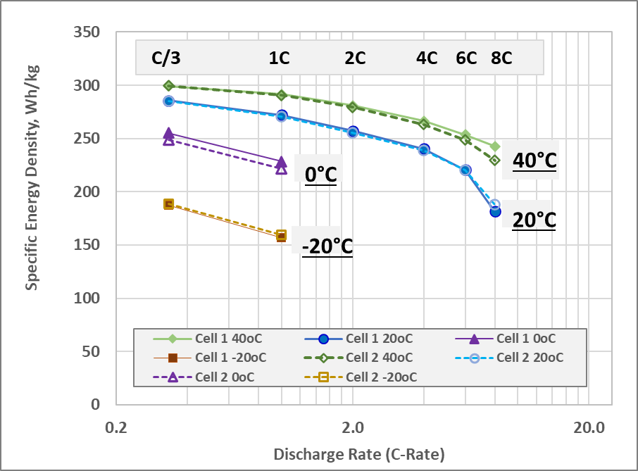
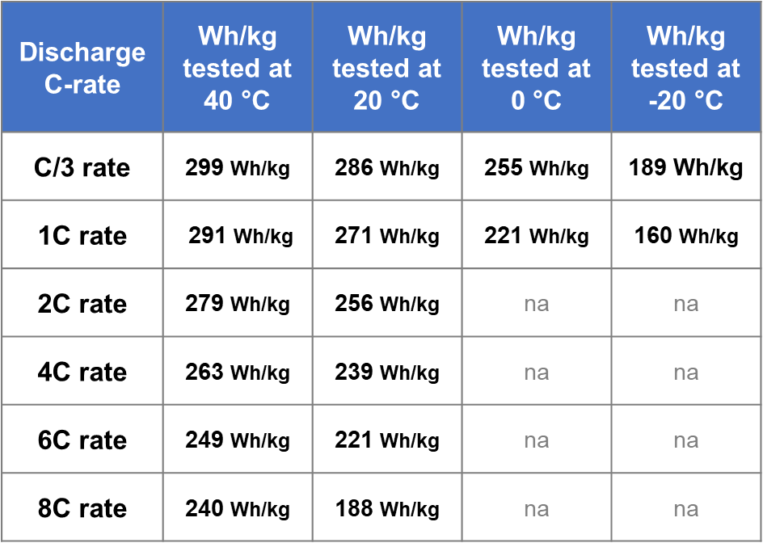
Rate Capability at Various Temperatures
SLC-203 operates over a wide temperature range

Slide 15
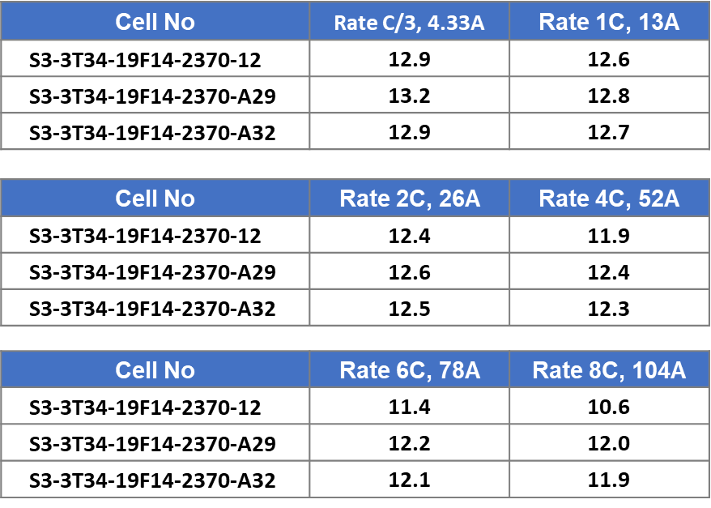
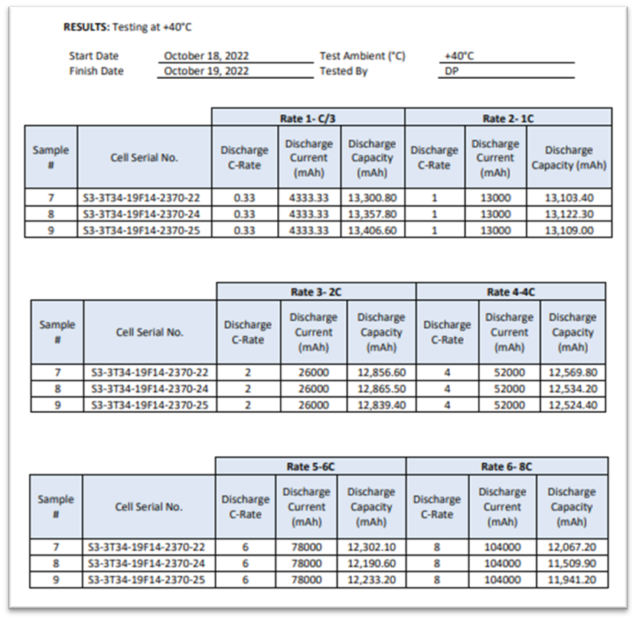
Cell Performance Confirmation (3rd Party Test Results)
Internal Test Results at 40 ˚C
3rd Party Test Results
90% of initial capacity at 8C

Slide 16
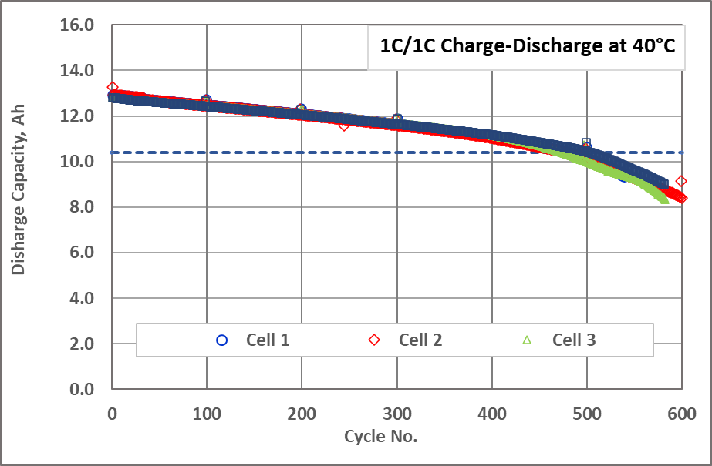
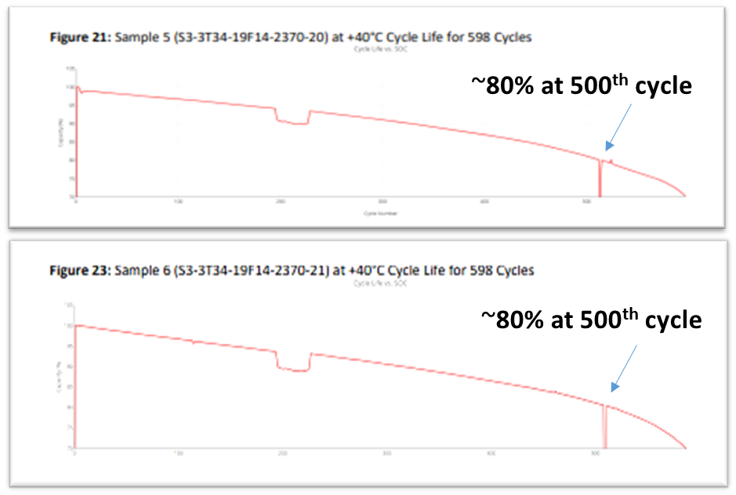
Cell Cycling at 40˚C
Internal Test Results at 40 ˚C
3rd Party Test Results
3rd party testing confirmed ≥500 cycles to 80% initial capacity

Slide 17
Reduced Flammability (RF) Electrolyte Development

Slide 18
Concepts to Improve Safety at Cell Level
Material selection with improved thermal and voltage stability
Cell safety components (PTC, CID, etc.)
Vent design
Reducing Joule (I²R) heating
Electrolyte optimization
  Low vapor pressure solvents
  Wide voltage stability range
  SEI stabilizing co-solvents and additives
  Flame retardant additives
EaglePicher designed an electrolyte with reduced flammability (RF)
Safer electrolytes often suffer from poor rate and cold performance

Slide 19
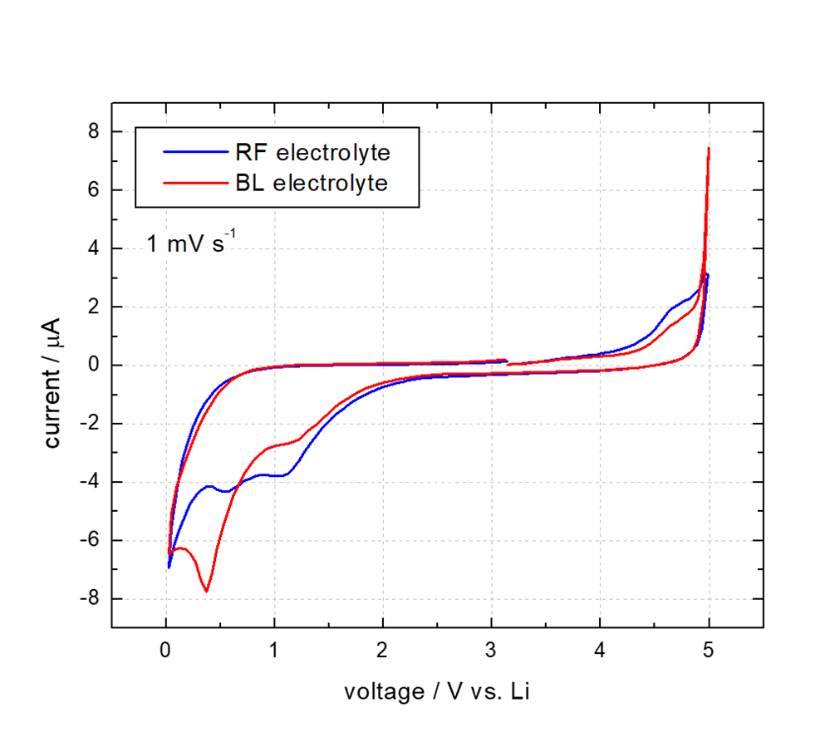
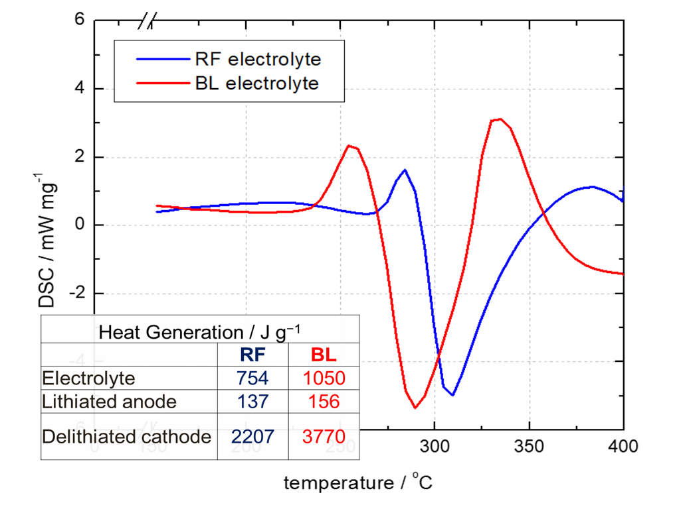
Voltage Window and Thermal Stability of RF Electrolyte
Improved thermal stability with similar electrochemical stability

Slide 20
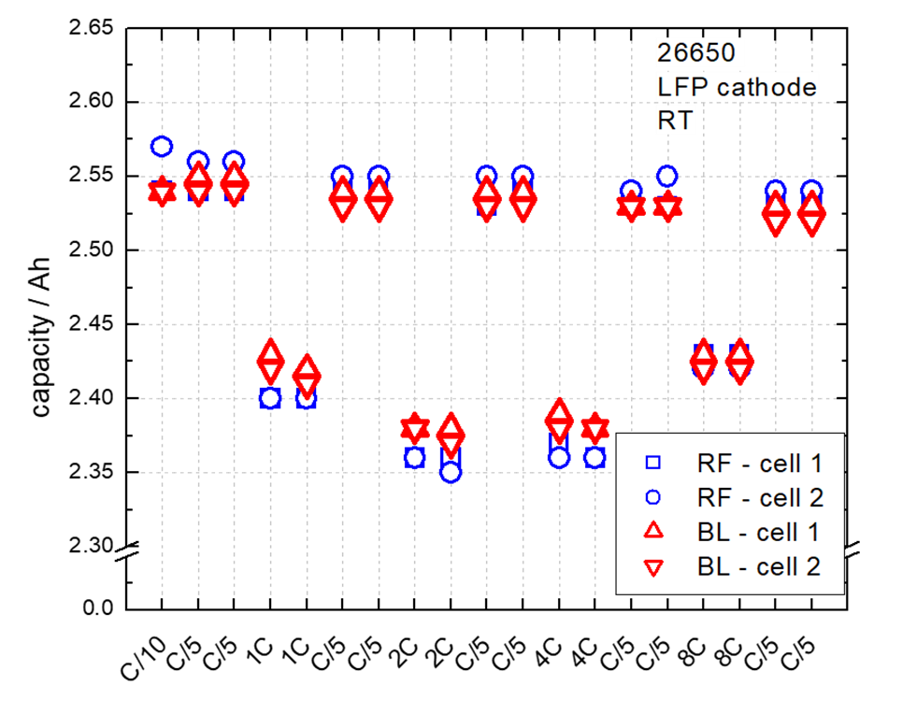
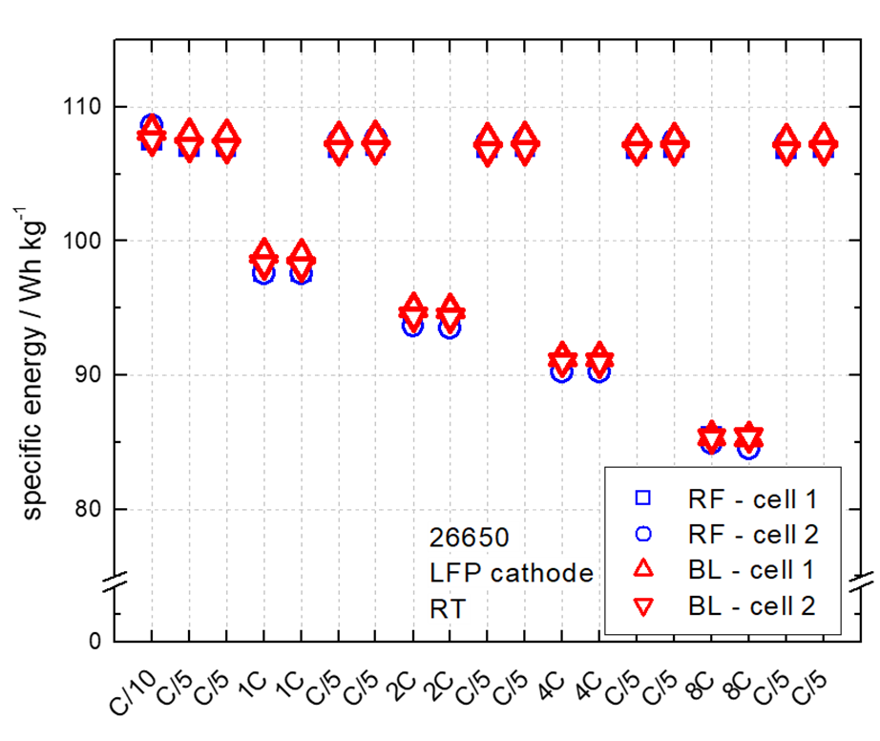
Rate Capability of RF Electrolyte in LFP 26650s
RF electrolyte demonstrates the same performance to 8C rate

Slide 21
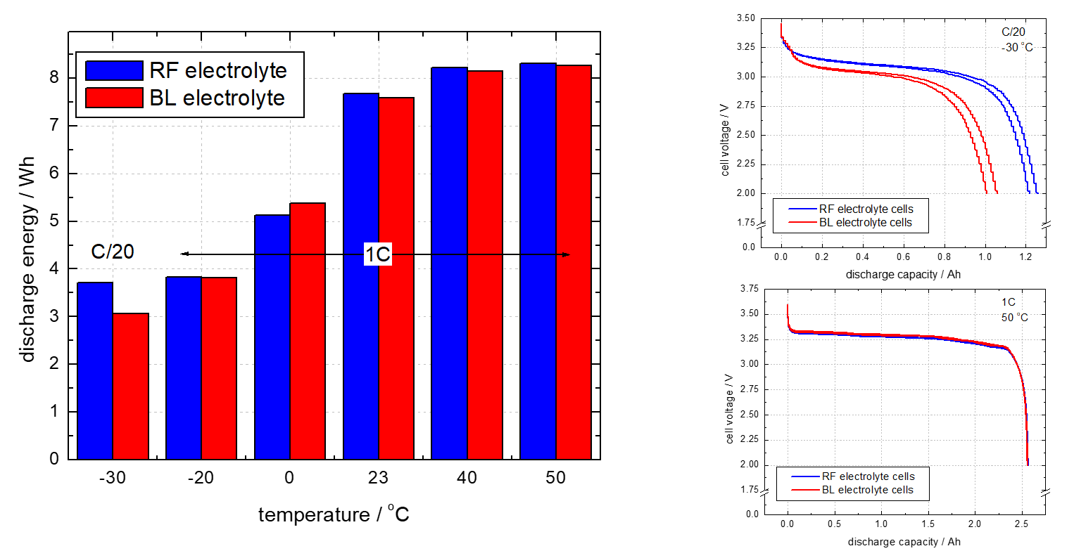
Wide Temperature Range of RF Electrolyte
RF electrolyte performs better at −30°C and similar from −20 to 50 °C

Slide 22
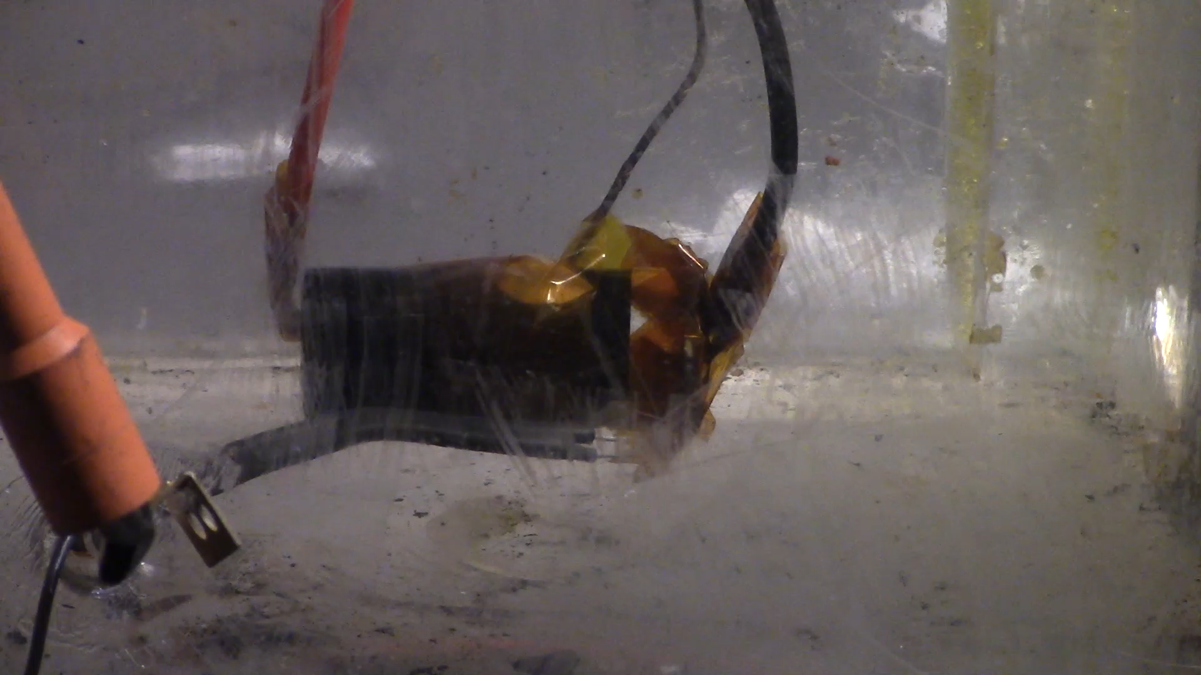
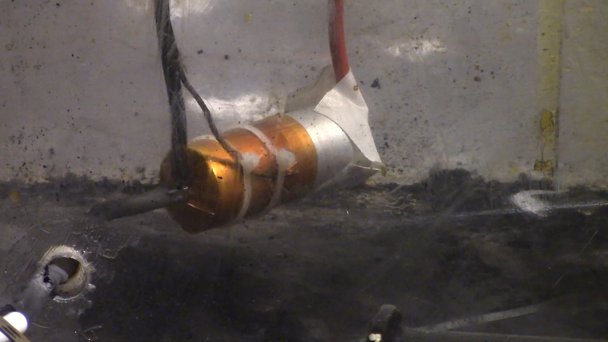
LFP 26650 Overcharge in Presence of a Spark Emitter
BL↑
RF↓
No fire in cell with RF electrolyte

Slide 23
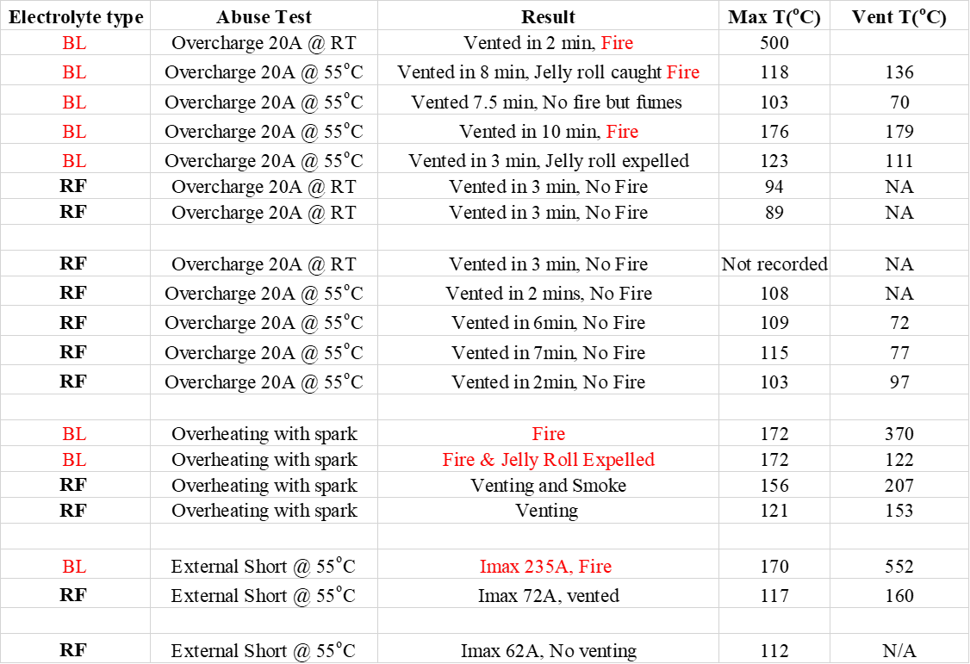
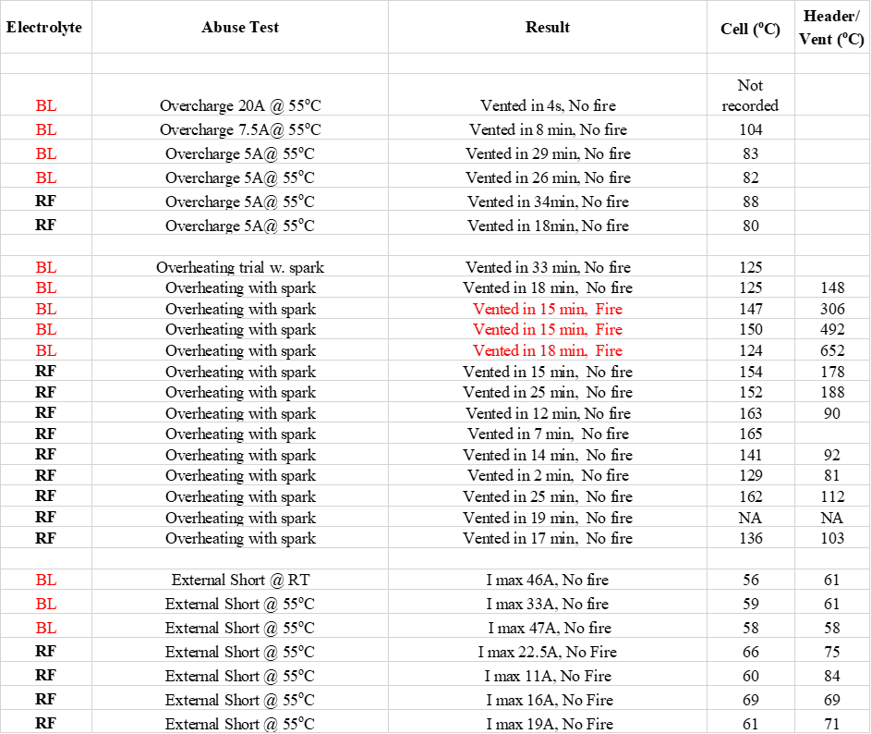
Cell Safety Test Summary
LFP 26650
NCM111 18650
No fire for any cell using RF electrolyte in any of the above tests

Slide 24
Performance of SLC-202 with RF Electrolyte

Slide 25
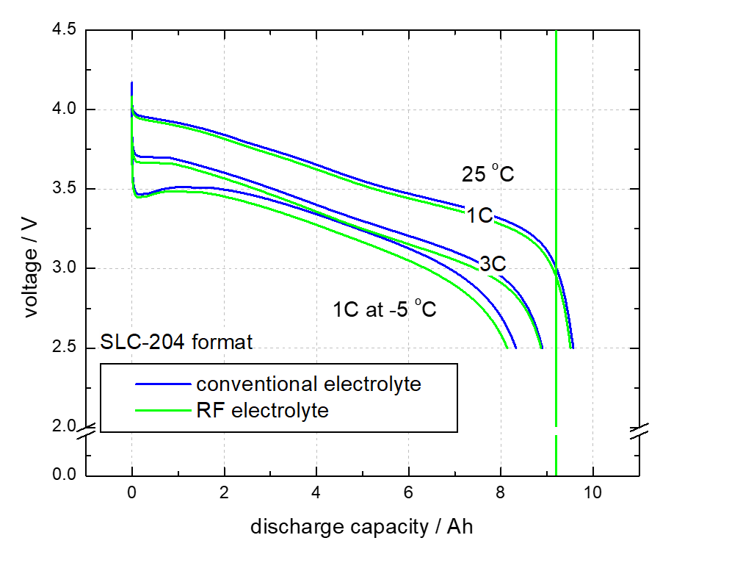
High-Rate and Cold Performance for UUV Application
Slight voltage effect of RF electrolyte

Slide 26
Rate Capability of SLC-202 with RF electrolyte
Similar rate capability to 3C

Slide 27
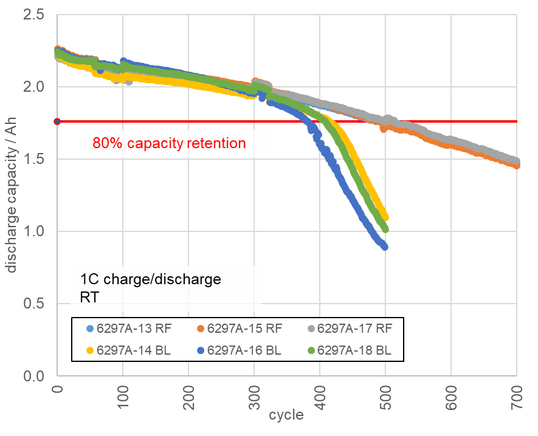
Room Temperature Cycle Life for SLC-202 with RF electrolyte
RF electrolyte improves RT cycle life by 20%

Slide 28
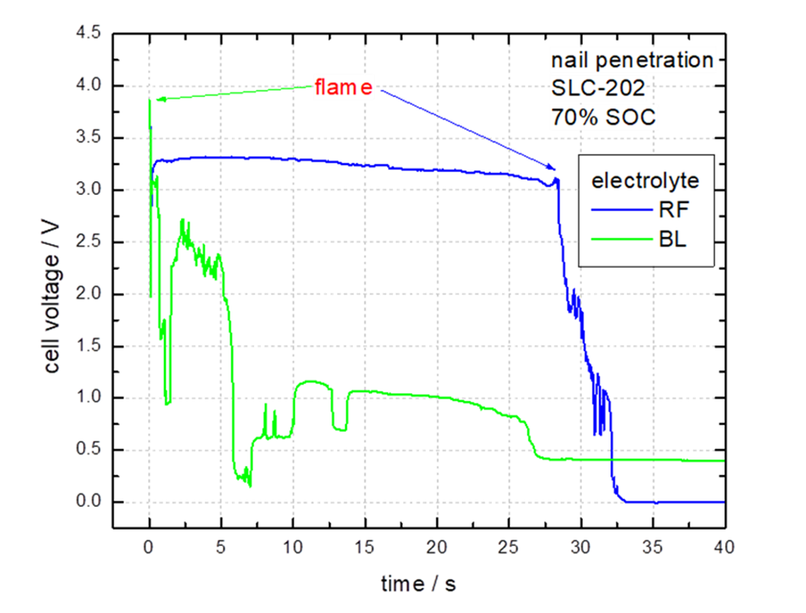
70% SOC Nail Penetration of SLC-202
RF electrolyte delays thermal runaway by ~30s

Slide 29
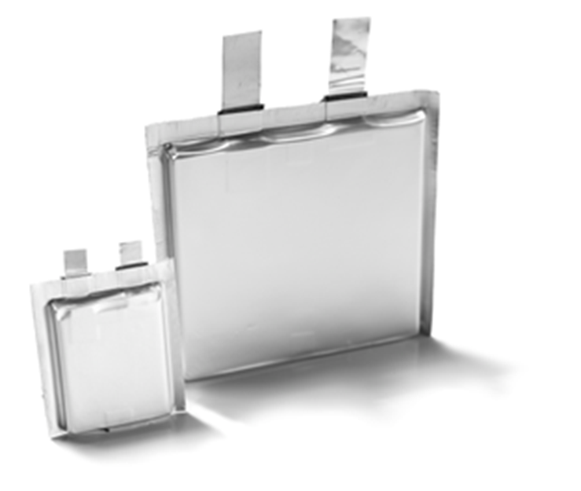
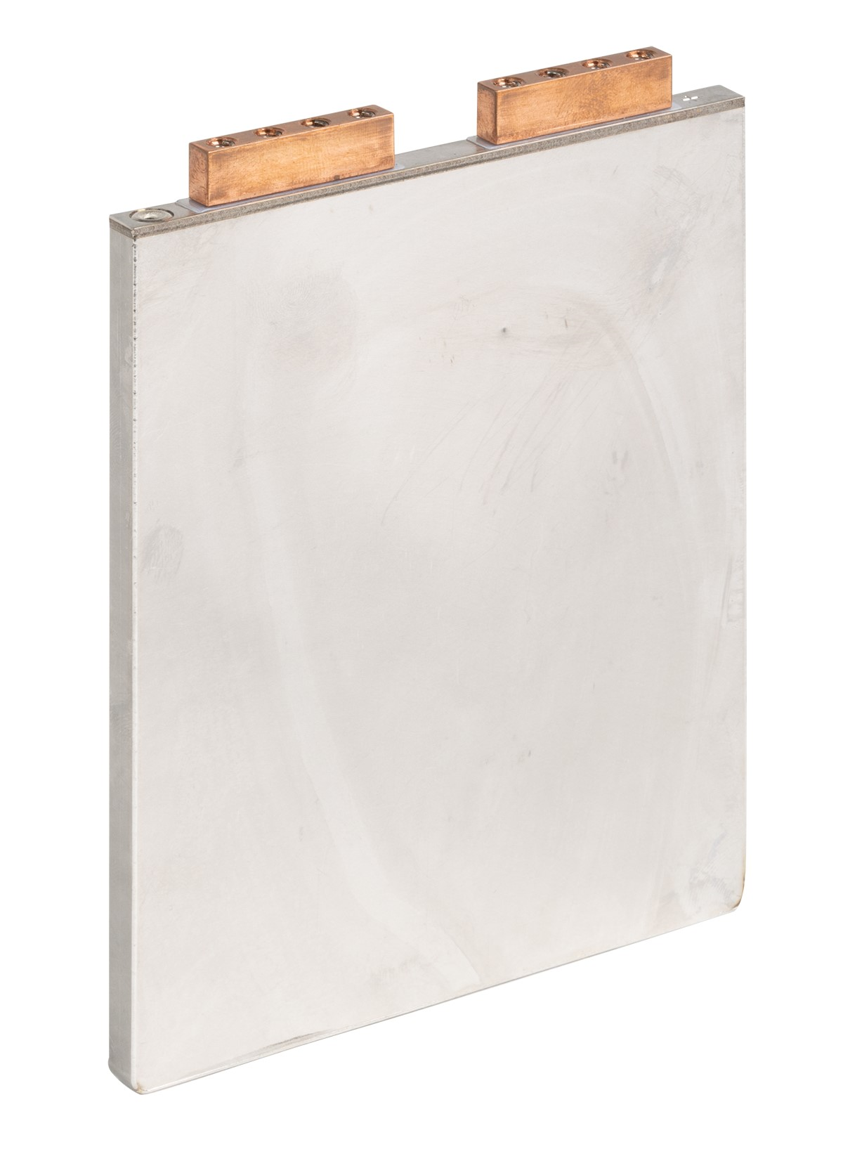
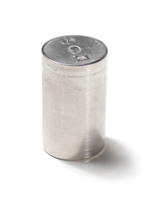
Applications
UAV
eVTOL
Aviation
UUV
Portable power
RF electrolyte can be used in various chemistries/form factors

Slide 30
Summary
EaglePicher is developing high energy pouch cells that also deliver high power
Silicon composite anode enables the high energy and power combination
SLC-202 is a 2.3Ah cell capable of 8C continuous discharge
SLC-203 is a 13Ah cell that delivers 300 Wh kg⁻¹ nominally
SLC-203 delivers 260 Wh kg⁻¹ when discharged at a 4C (52A) rate
RF electrolyte is compatible with the SLC-202/203 chemistry
RF electrolyte improves cell safety and cycle life
EaglePicher Technologies continues to focus on improving battery safety via cell and packaging technologies

Slide 31



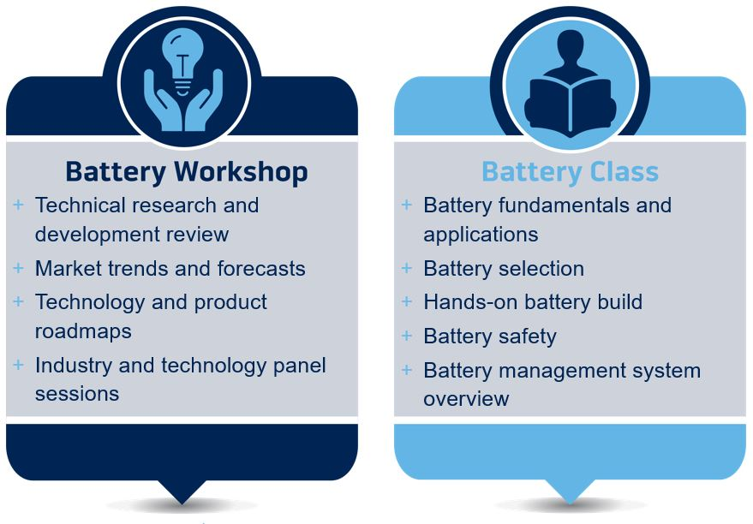
Experience the Power
Keynote Speaker
John Kelly
September 30-October 3, 2024
Glendalough Conference Center DoubleTree
Springfield, MO

