Slide 1
High energy and power density batteries
with silicon anode materials
Ionel Stefan
CTO, Amprius Technologies
DPEC, June 4th, 2024

Slide 2
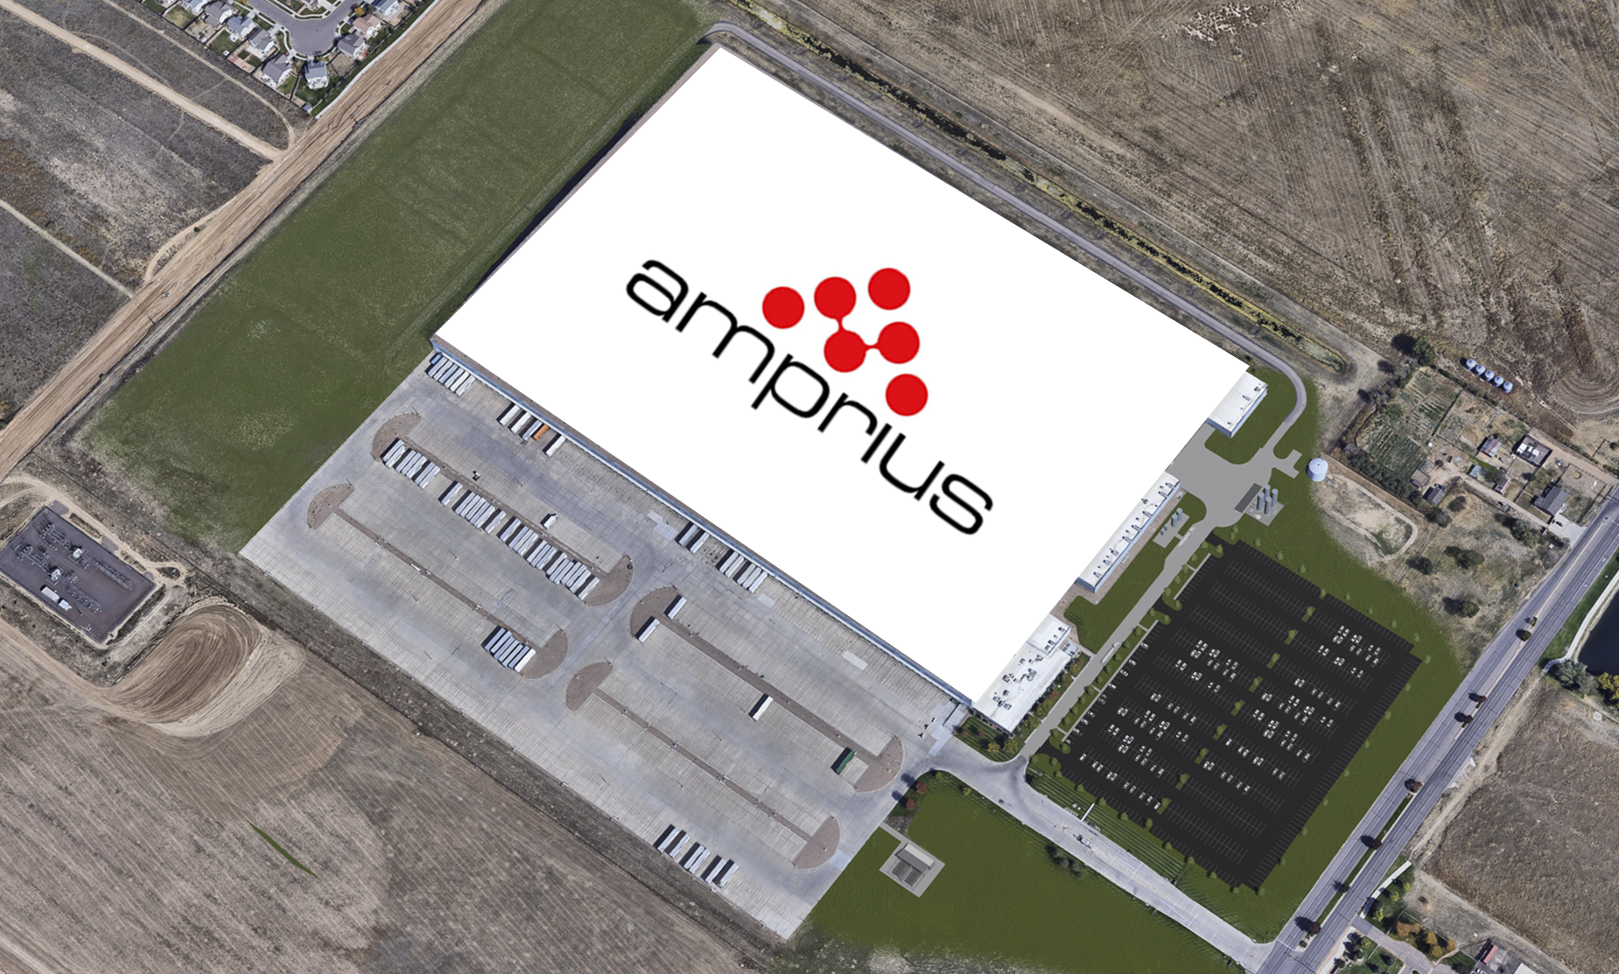
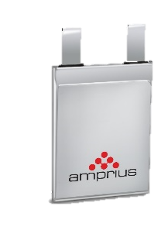

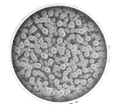
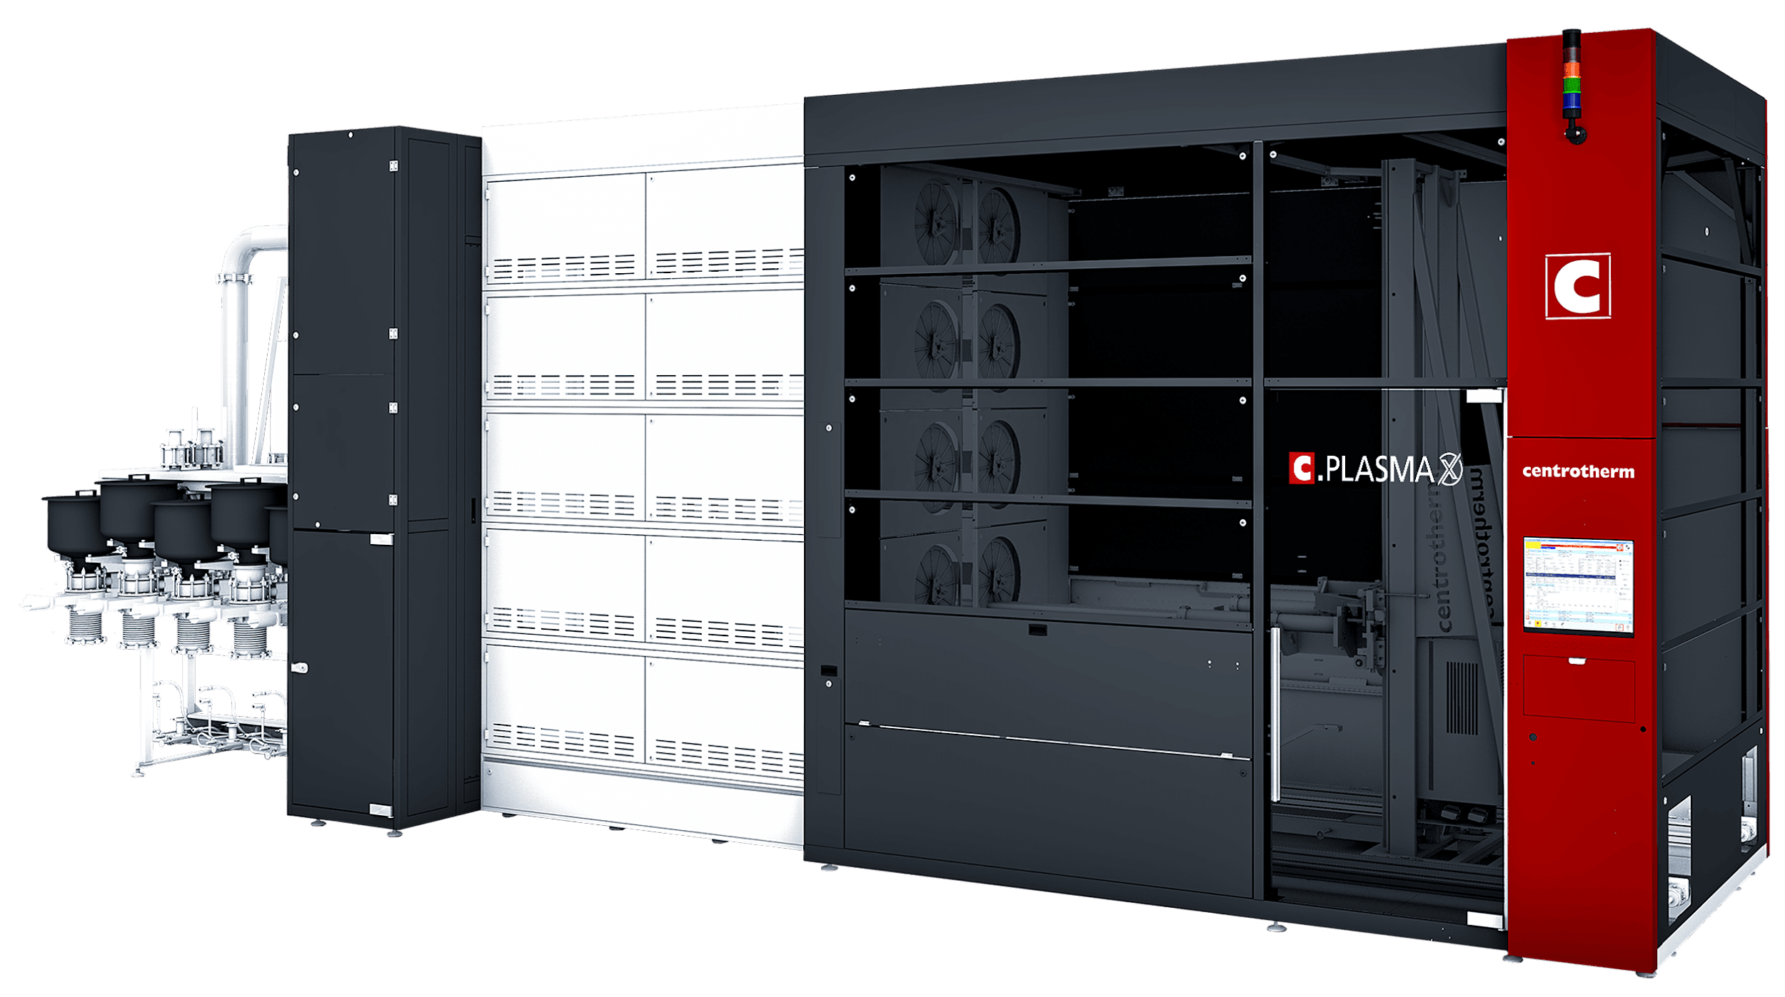
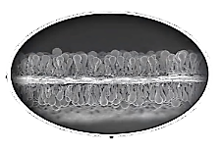
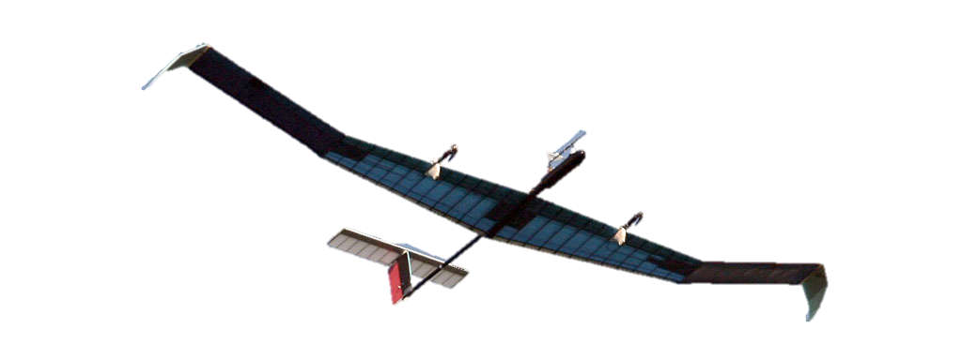
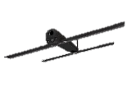
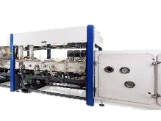

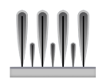
AMPRIUS – THE SILICON PIONEER
A History of Innovation and Achievements
Gigafactory in Brighton Colorado
2024
500 Wh/kg platform validated
MWh Scale Expansion Achieved
2023
IPO- AMPX is traded on NYSE
4000 W/kg High Power Density Commercial Product
2022
GWh Scale Project Development Initiated
2021
450 Wh/kg Commercial Product
Customer Orders
& Commercial
Sales
kWh Scale
Manufacturing
2018
Extreme Fast Charge Commercial Product (0-80% in 6 minutes)
Founded in 2008
Fully Operational
in 2010
Silicon Nanowire Design Finalized
2016
2014
400 Wh/kg Commercial Product
2008
Notes:
Amprius technologies was born out of a concept that came from Stanford University in 2008. Since then, we’ve been able to transform a concept or an idea into a reality.
In 2018, after 10 years of stealth mode, Amprius was able to achieve a commercial level of rigor and start shipping cells to support our customer’s products.
We took another step forward in 2021 and started to grow our cell production even further with the GWh scale project development initiated.
That project was further supported by the major milestone of Amprius becoming a publicly traded company in 2022, which has given us the means to start our planned Gigafactory in 2025.

Slide 3
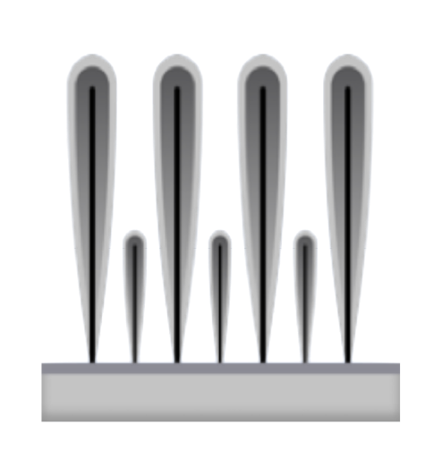
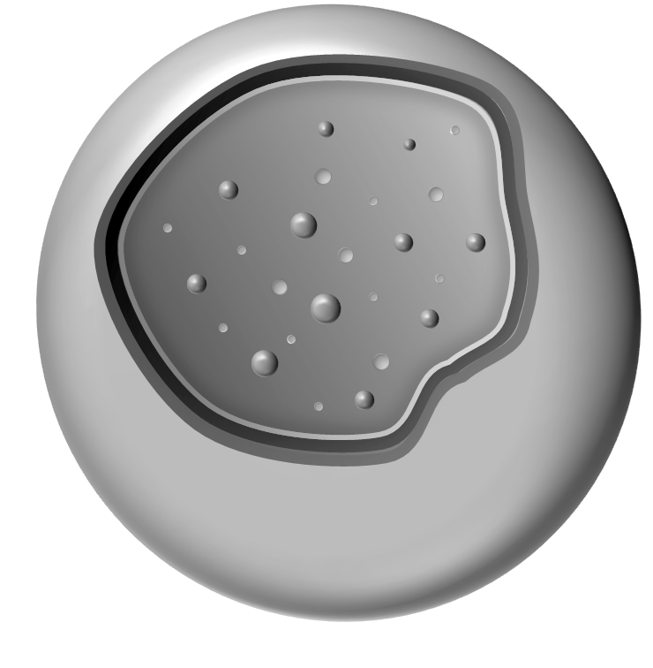
AMPRIUS SILICON ANODE STRUCTURES
Commercial Anode Platforms
SiMaxx™
SiCore™
100% Silicon Anode Technology
Silicon Oxide Anode Technology
Silicon Surface Coating
Fast Ion Conductor
Silicon Coating
Highly Conductive Carbon Layer
Silicon Nanowire Template
Structure Stablization Layer
Substrate
Ultra-fine Silicon Nanostructure

Slide 4
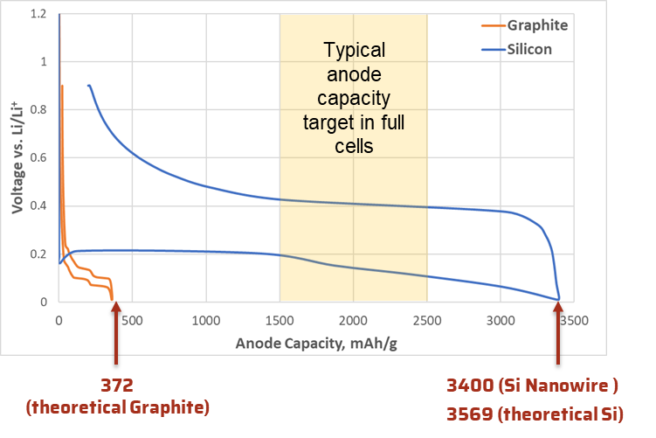
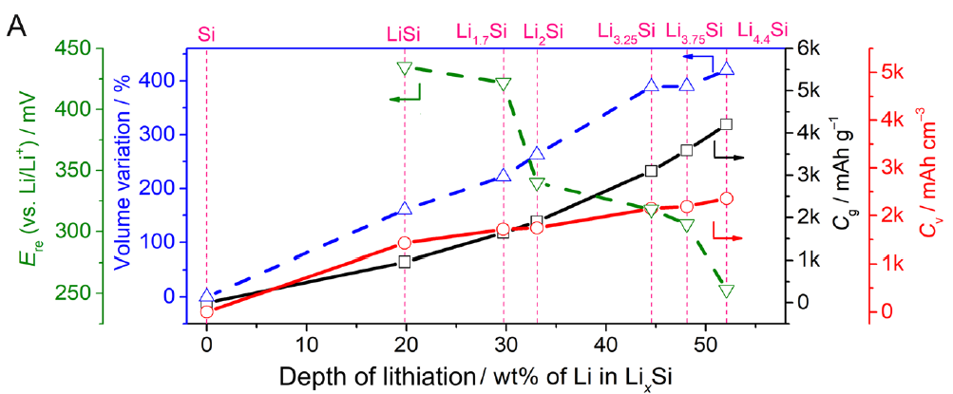
SIMAXX – HIGHEST LITHIUM STORAGE CAPACITY
Amprius silicon has near-theoretical capacity for a silicon anode
LiSi Li_{1.7}Si Li₂Si Li_{3.25}Si
*Amprius Data
Eshetu, G. G. et al. Nat. Commun. 12, 5459 (2021).
High first cycle efficiency due to low surface area (typically 94%)
Multiple cell designs (loading, capacity utilization, N/P ratio) are possible with silicon materials

Slide 5
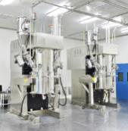
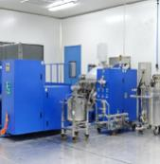
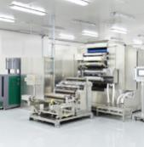
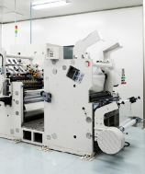
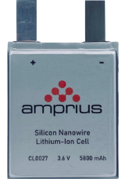
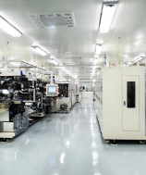
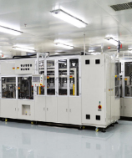
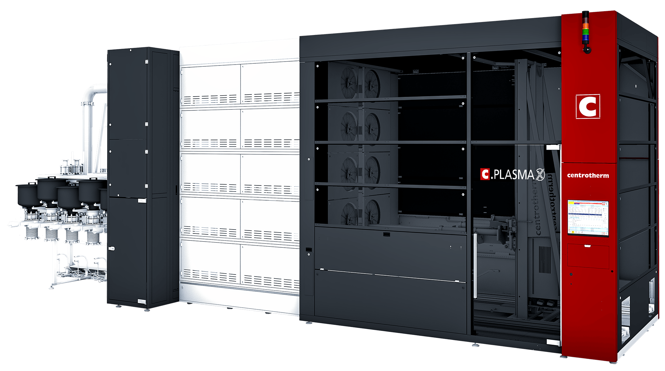
manufacturing
How Does Amprius Achieve Scale?
Battery-cell manufacturing is fully derivative of standard production methods
Cathode and assembly processes are standard
Replace conventional graphite anode with Amprius silicon anode
Standard Battery Cathode
standard Battery
Manufacturing Line
Silicon Anode
Manufacturing Line
Standard Battery Assembly
Mixing
Coating
Calendaring
Slitting
AMPRIUS Silicon Anode
Stacking
Formation

Slide 6
Battery Requirements for Electric Flight

Slide 7
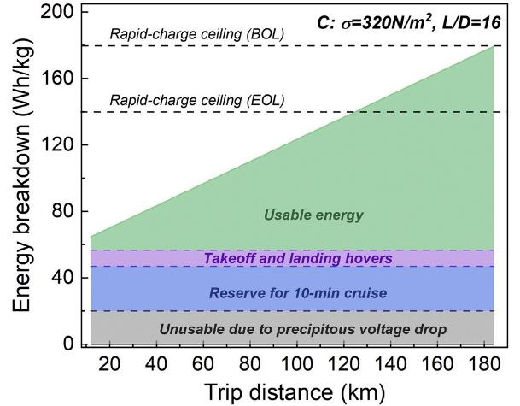
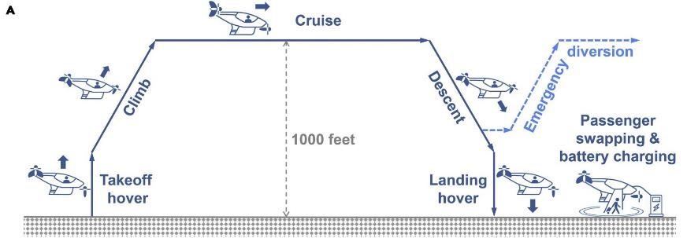
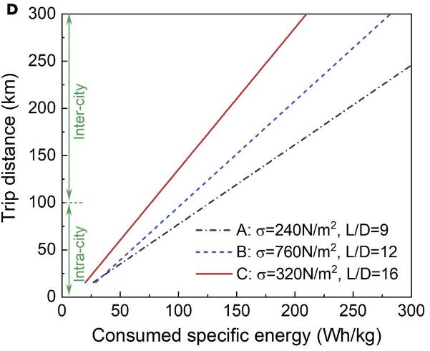
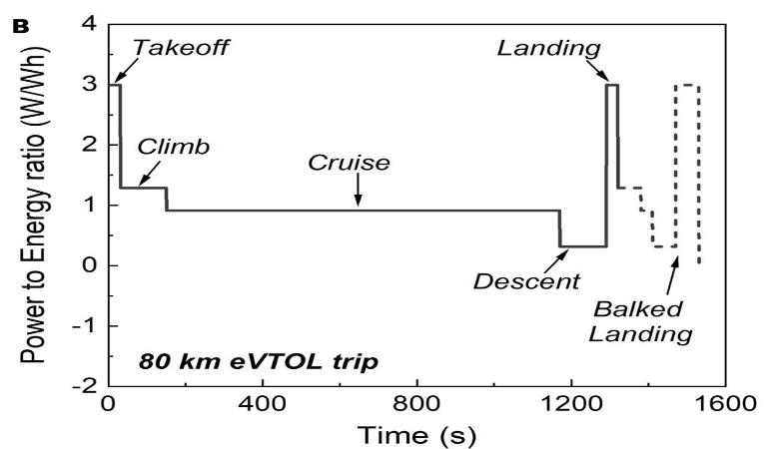
ENABLING ELECTRIC FLIGHT
eVTOL Flight Components
Joule 5, 1644–1659, July 21, 2021
Notes:
eVTOL sector, where charging times and power availability for landing are critical components of the business case
eVTOL charging times should be as short as possible to maximize the number of flights
Battery technology impacts the development of eVTOL profoundly, as it affects the flight range, carrying capacity, charging time, and operating costs

Slide 8
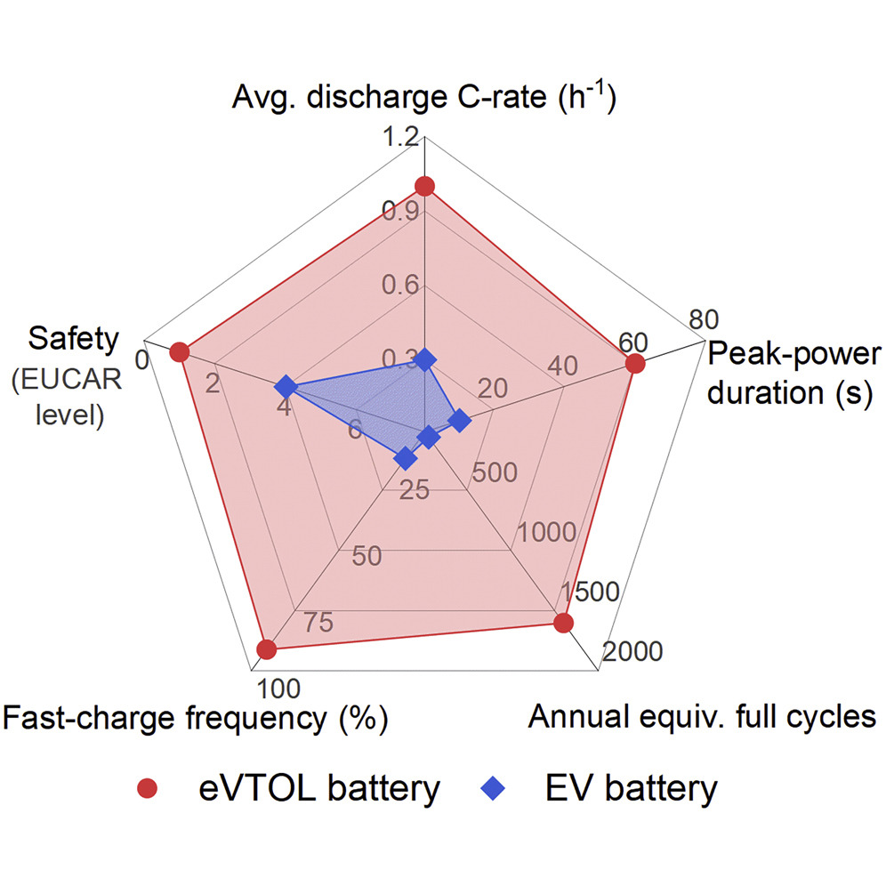
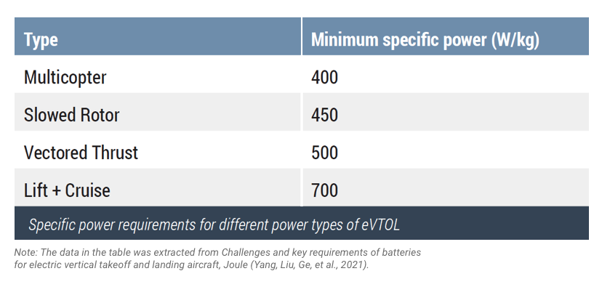
ENABLING ELECTRIC FLIGHT
Battery Requirements
US Department of Energy (DOE) target is to charge 180 Wh/kg energy in 10 min without appreciable degradation
Objective to have a 5C discharge rate with specific power of 2.5 kW/kg for eVTOLs by 2040
While at the same time offer good cycle life under high charge-discharge current

Slide 9
Amprius batteries and applications

Slide 10
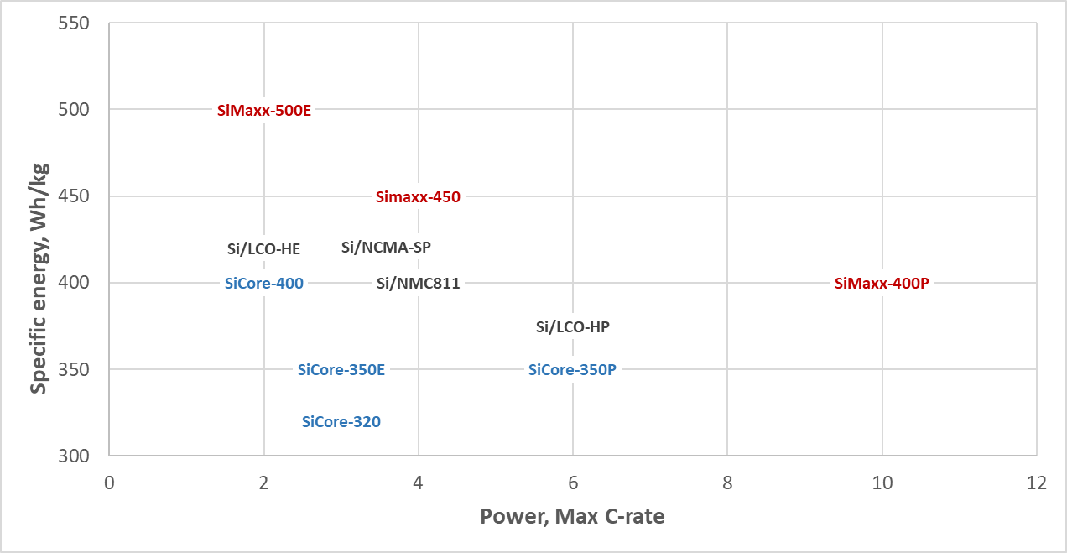
CURRENT AMPRIUS BATTERY OFFERINGS
New SiMaxx products in 2023
Legacy products on order
New SiCore products in 2023
Long cycle life

Slide 11
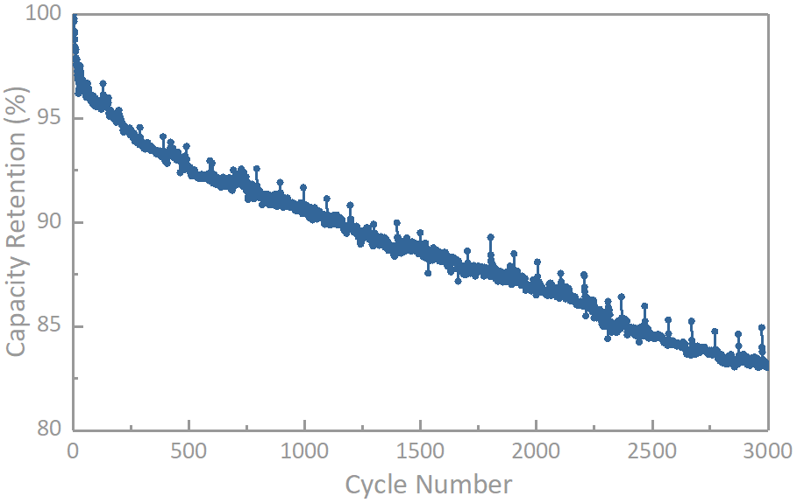
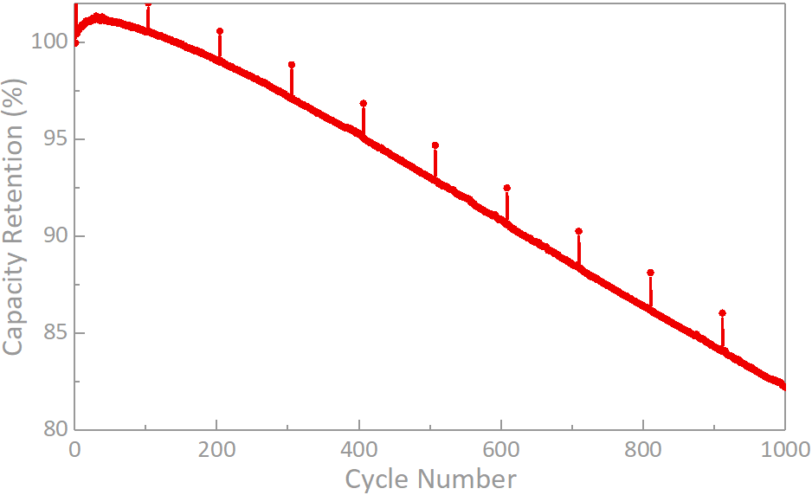
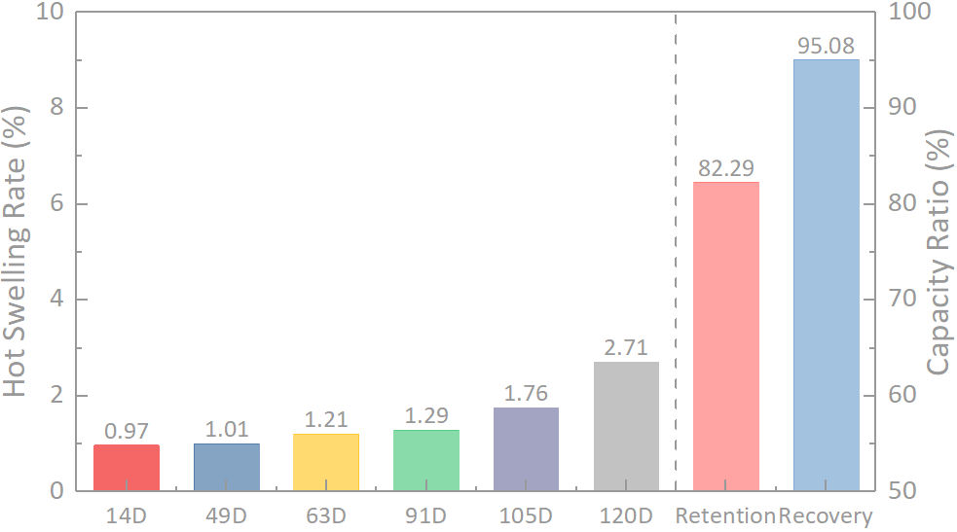
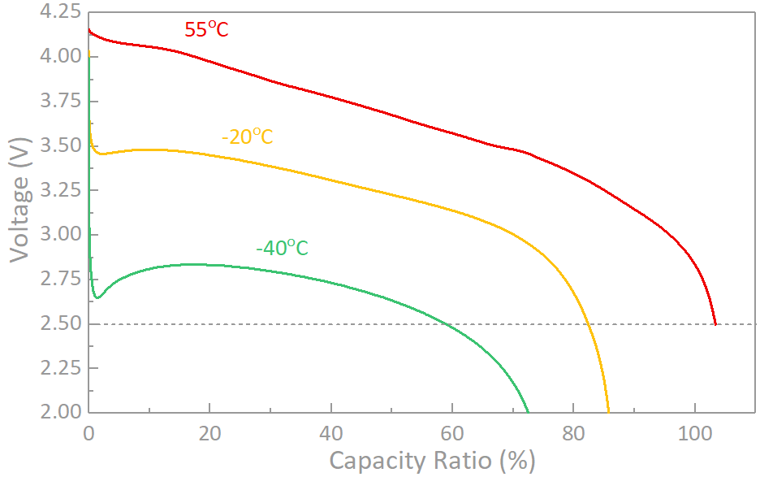
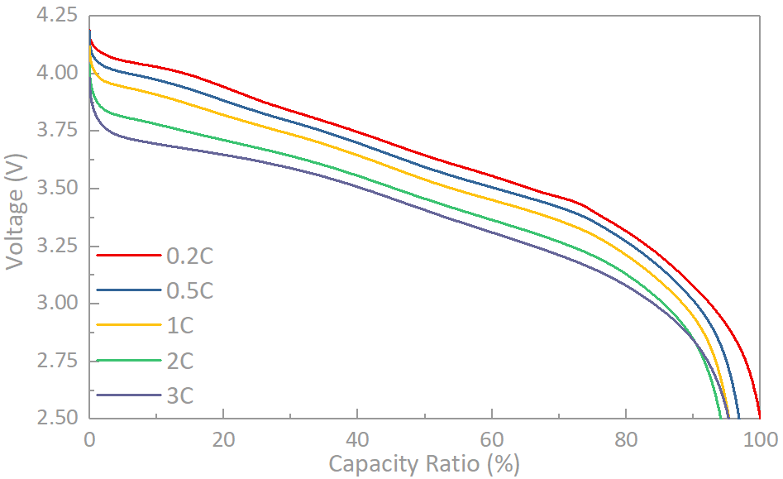
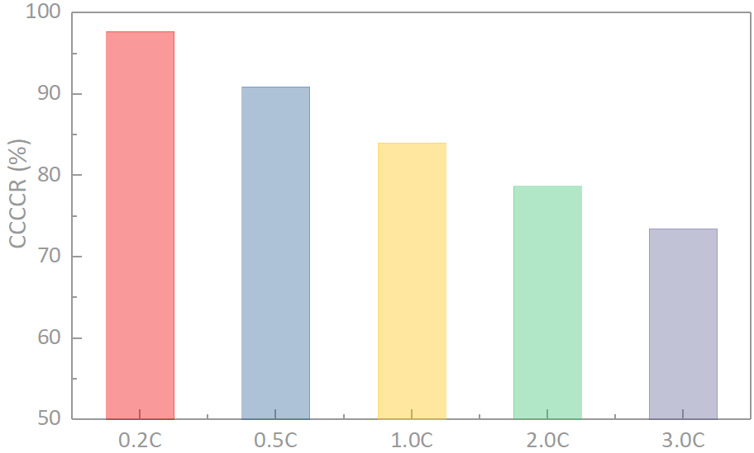
SA04 - SICORE 320WH/KG LONG CYCLE LIFE CELL SYSTEM
EV, micromobility, long endurance drones
RT Cycle Performance
45ºC Cycle Performance
60ºC Storage
4.2-2.5V (100%DOD)
+1C/-1C Cycles
4.2-3.0V (87%DOD)
+1C/-1C Cycles
HT&LT Discharge
Rate Discharge
Rate Charge
R(DC_{55℃}/DC_{25℃}) | R(DC_{-40℃}/DC_{25℃})
103.4% | 72.5%
 | 3.0C/0.2C
Ratio (%) | 95.3%
 | 0.2C | 3.0C
CCCCR (%) | 97.7 | 73.4

Slide 12
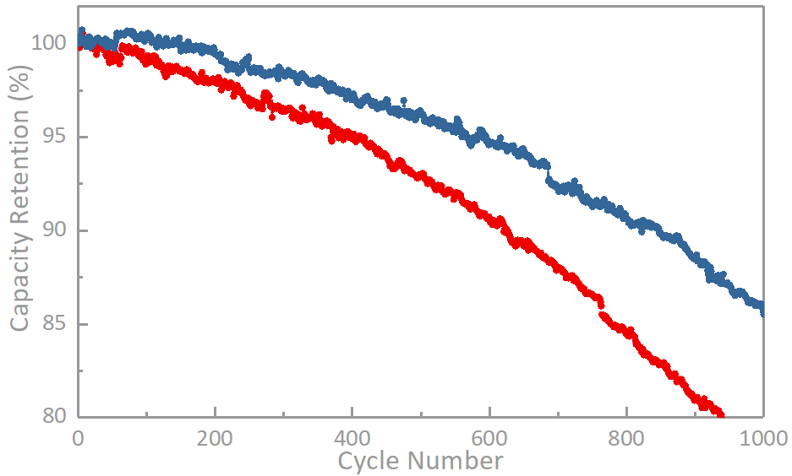
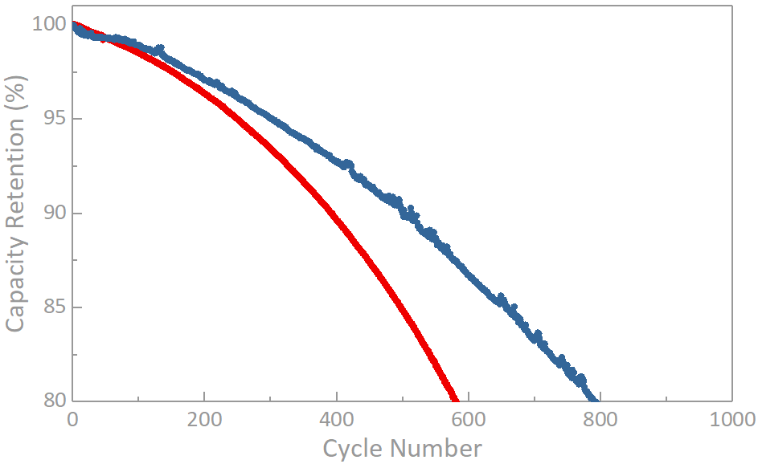
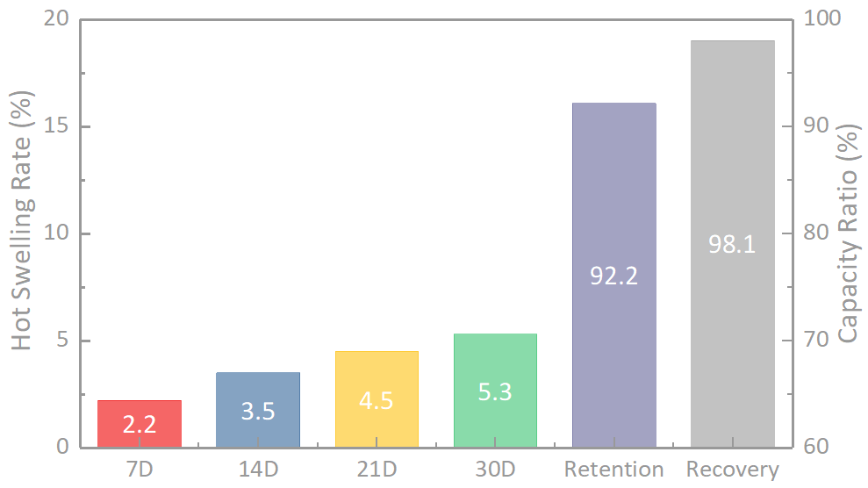
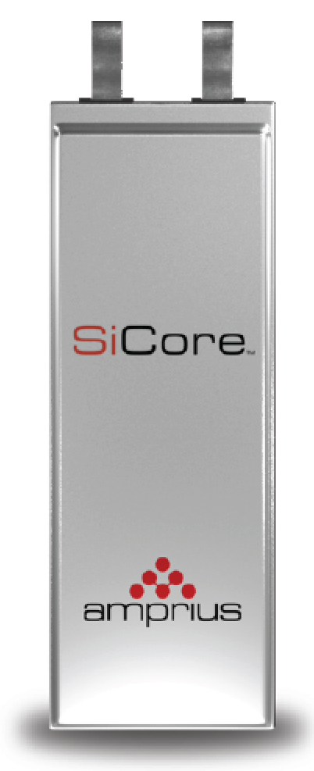
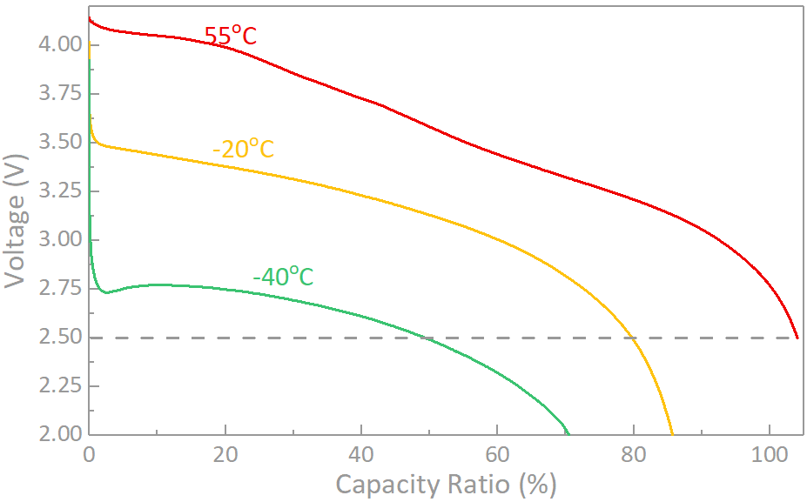
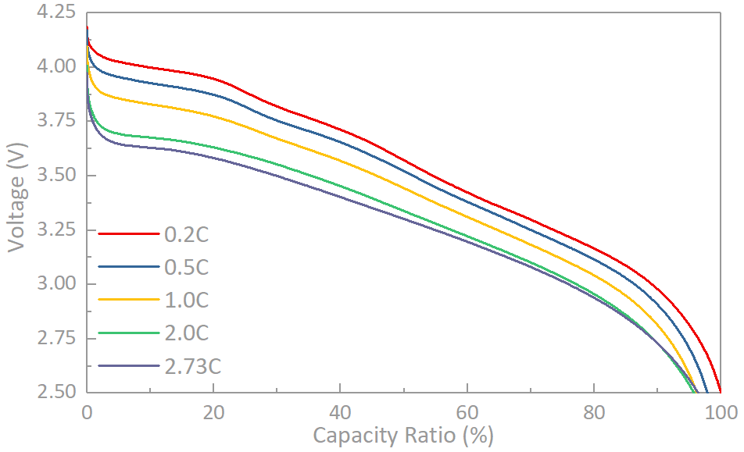
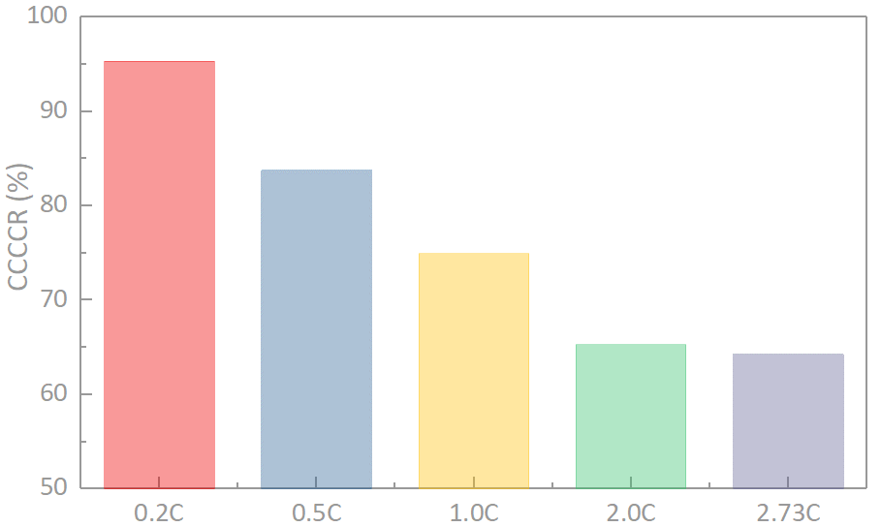
SA02 - SICORE 350WH/KG BALANCED PERFORMANCE SYSTEM
Balanced power, energy, cycle life – one of the best sellers
RT Cycle Performance
45ºC Cycle Performance
60ºC Storage For 30 Days
4.15-2.8V(90%DOD)
+1C/-1C
4.15-2.8V(90%DOD)
+1C/-1C
4.2-2.5V (100%DOD)
+1C/-1C
4.2-2.5V(100%DOD)
+1.0C/-1.0C
HLT Discharge Performance
Rate Discharge Performance
Rate Charge Performance
R(DC_{55℃}/DC_{25℃}) | R(DC_{-40℃}/DC_{25℃})
104.0% | 70.5%
 | 2.73C/0.2C
Ratio (%) | 96.4%
 | 0.2C | 2.73C
CCCCR (%) | 95.3 | 64.3

Slide 13
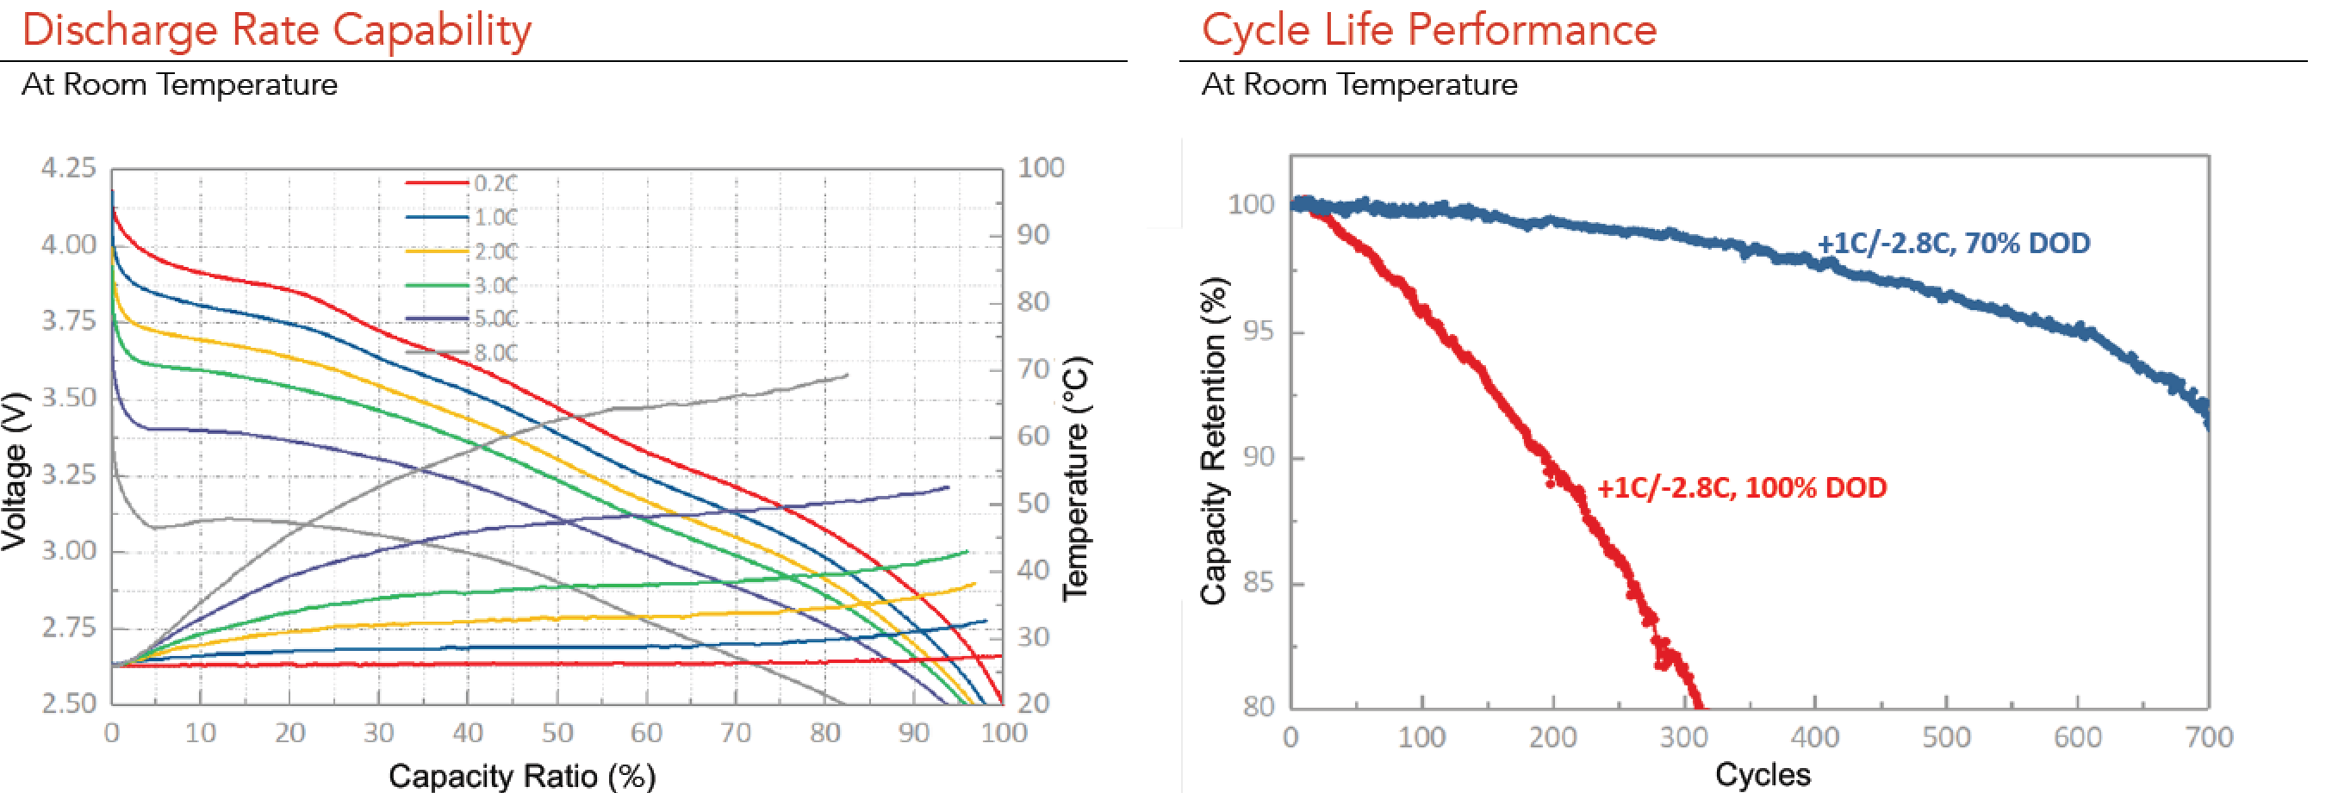
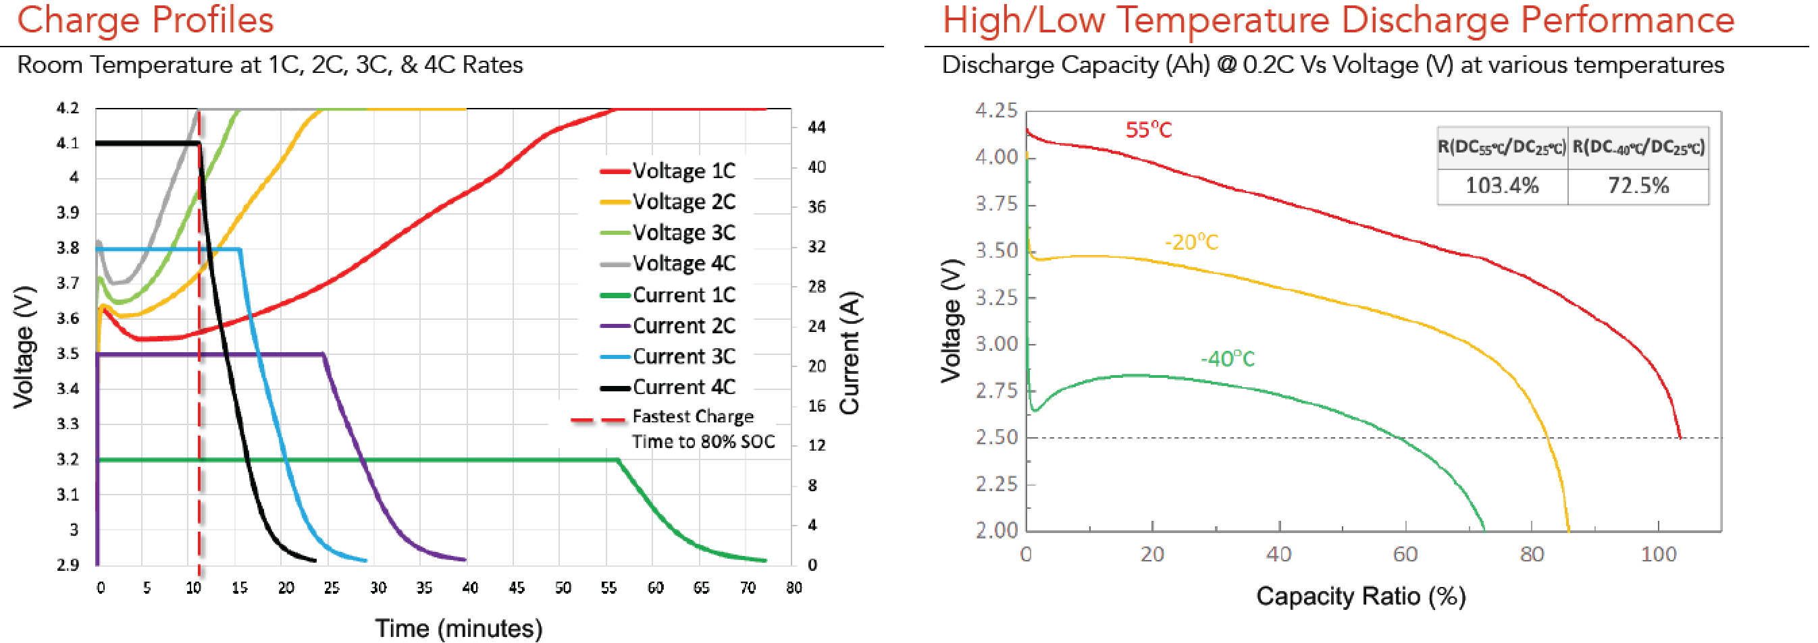
SA08 - SICORE 350WH/KG HIGH POWER SYSTEM
Best for high power drones and eVTOL, up to 8C discharge rate
Full discharge in 8 minutes
Full charge in 12 minutes

Slide 14
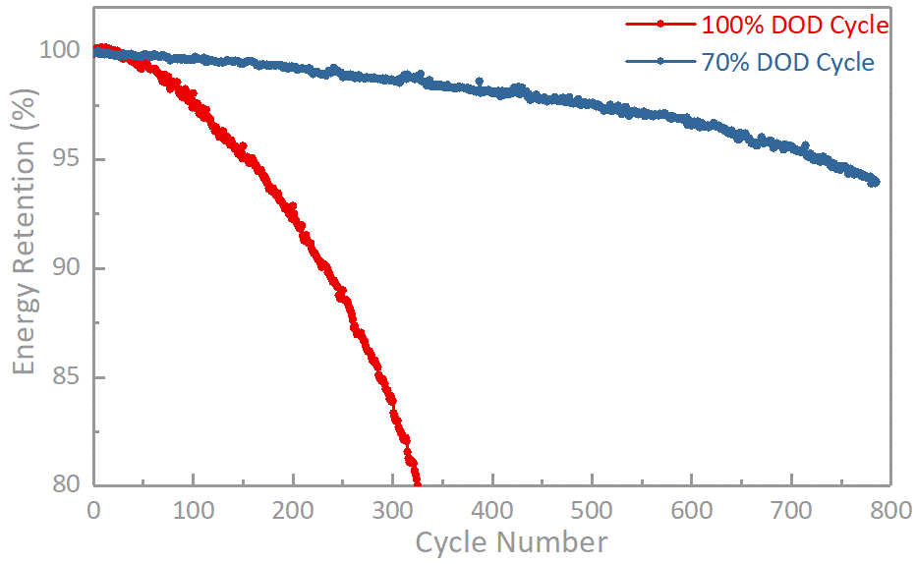
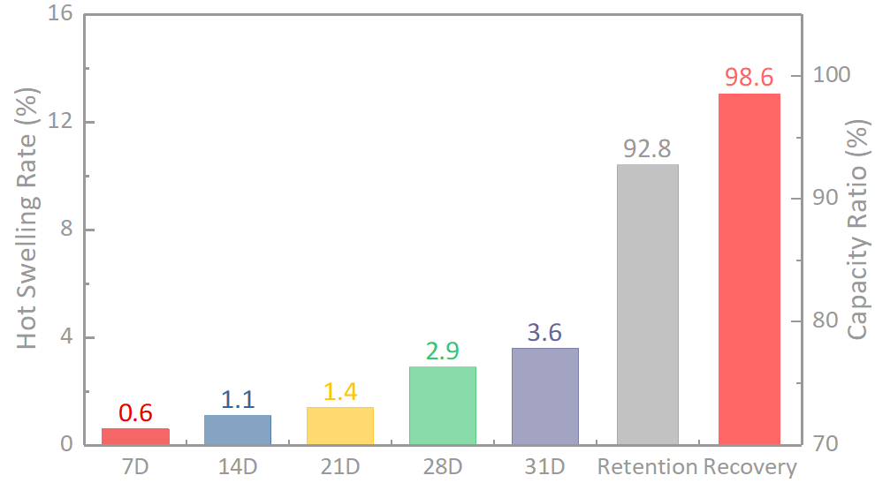
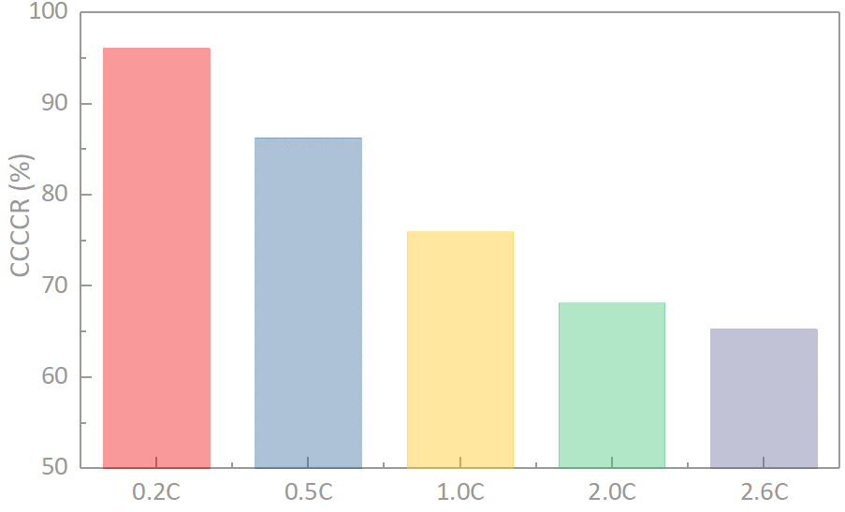
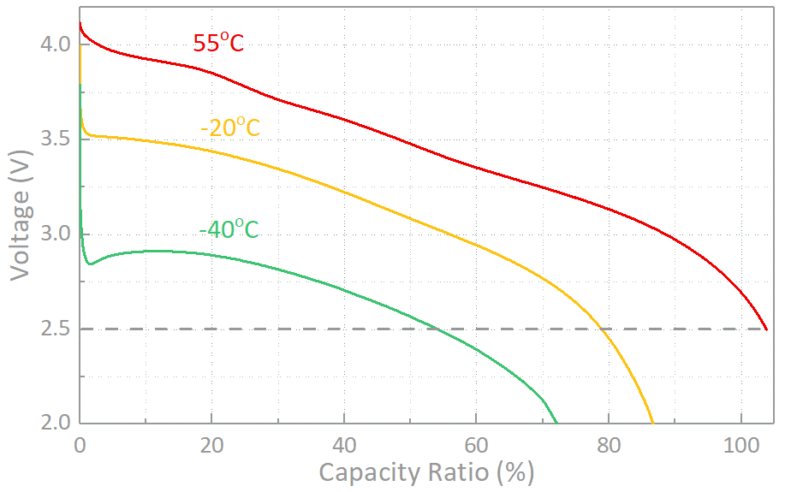
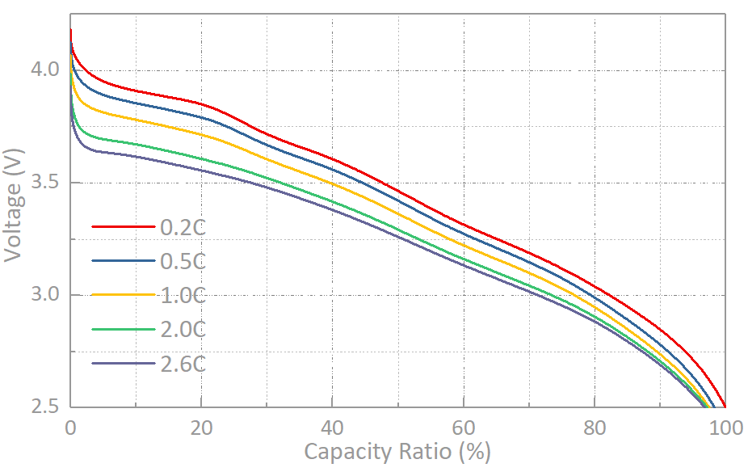
SA03 - SICORE 400WH/KG HIGH ENERGY DENSITY
Highest silicon content for high energy density
RT Cycle Performance
60ºC Storage For 30 Days
Rate Charge
 | 0.2C | 2.6C
CCCCR (%) | 96.0 | 64.9
HLT Discharge
Rate Discharge
R(DC_{55℃}/DC_{25℃}) | R(DC_{-40℃}/DC_{25℃})
104.0% | 71.8%
 | 2.6C/0.2C
Ratio (%) | 96.5%
The only cell in the world that could cycle well at 100%DOD and without clamping, given >400Wh/Kg energy density.

Slide 15
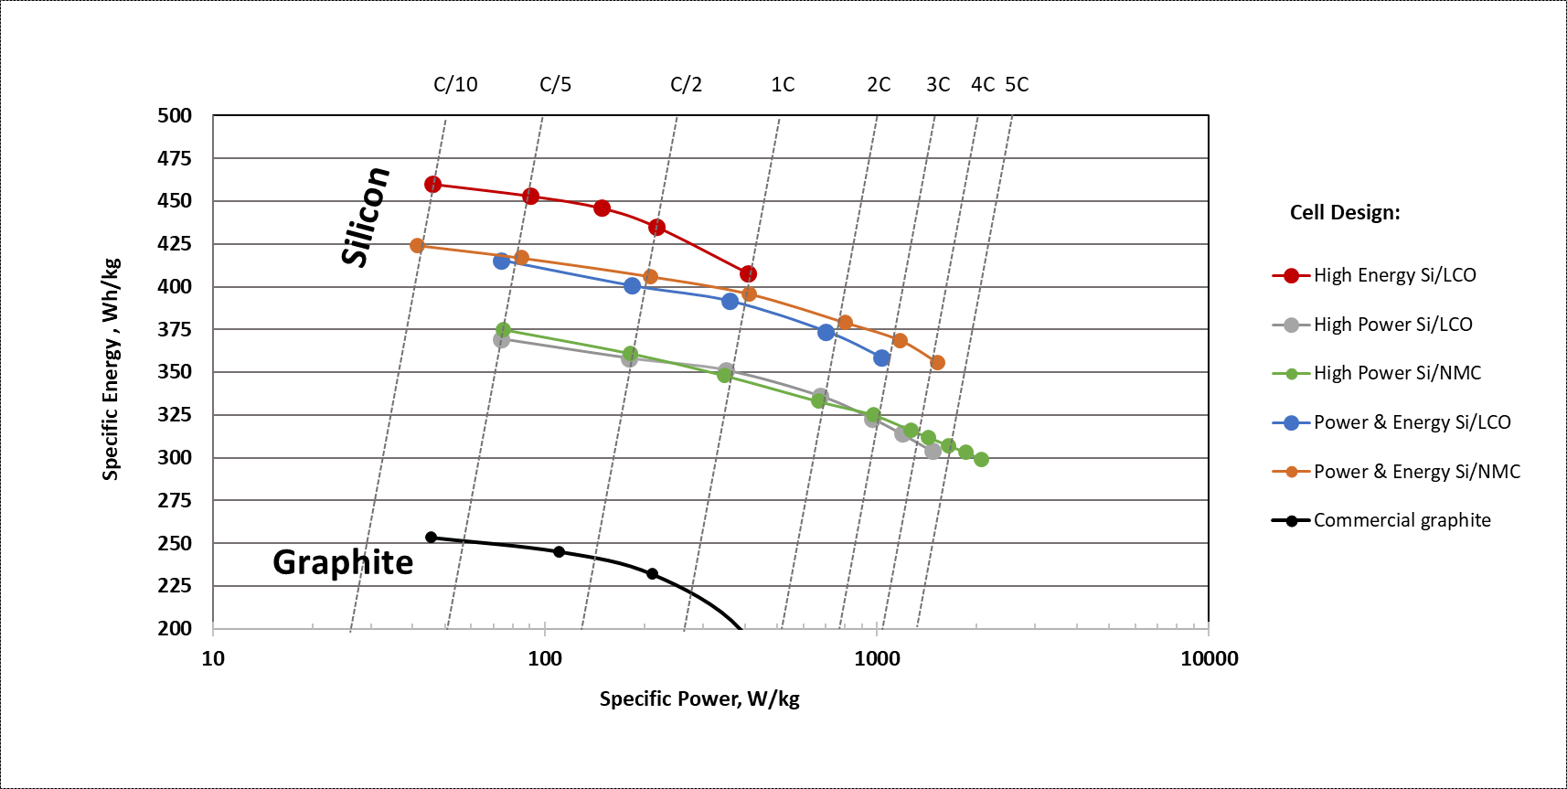
SIMAXX PLATFORMS - High Energy and Power density PRODUCTS WITH PURE SI
Minimal trade off between specific energy and specific power
Silicon Nanowire Power & Energy platforms
ENERGY
POWER

Slide 16
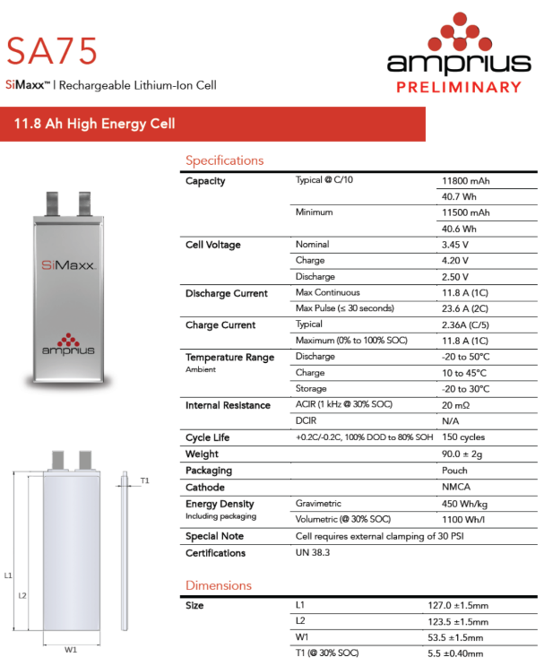


SIMAXX - 450 Wh/kg PRODUCTS RELEASED IN 2023
UN38.3 Certified; Designed for long endurance drone platforms
KEY TAKEAWAYS
Potential for 6 months of operation
400 Wh/kg at 2C discharge
Optimization of electrolyte formulation and amount & full electrical and safety evaluation underway for future product release
At least six months of operation in Stratosphere
> 3C discharge rate capability
Up to 1C charge rate

Slide 17


SIMAXX PLATFORMS - High Energy and Power density PRODUCTS WITH PURE SI
New energy cell design: 500 Wh/kg cells
Silicon Nanowire Power & Energy platforms
ENERGY
POWER

Slide 18









SIMAXX - 500 Wh/kg WITH 100% SILICON
External Validation of Early Prototypes by 3rd Party
Industry Leading
500 Wh/kg Battery
        Unprecedented Energy Density
        Unparalleled Run Time
Typical 18650 Cell vs. Amprius 500Wh/kg Cell
Same Weight | 2X the Capacity

Slide 19



SIMAXX - 500 Wh/kg WITH 100% SILICON
Products under development
400 Wh/kg at 2C discharge
KEY TAKEAWAYS
Potential for 6 months of operation in Stratosphere
400 Wh/kg at 2C discharge
Optimization of electrolyte formulation and amount & full electrical and safety evaluation underway for future product release
Continuous cycling at C/10 rate for >150 cycles,
100% DOD
Notes:
Since that announcement, our 500 wh/kg cell has cycled over 100 cycles and continuing.
Even at a 2C discharge, the energy density is still 400 Wh/kg.
There is still some work that needs to be done before it is fully commercially released, but that is well underway.

Slide 20


SIMAXX PLATFORMS - High Energy and Power density PRODUCTS WITH PURE SI
New power cell design: 400 Wh/kg with 4000 W/kg power density
Silicon Nanowire Power & Energy platforms
ENERGY
4 kW/kg
POWER

Slide 21

HIGH POWER CELL DEVELOPMENT
Improved electrode structures and compositions
Si Cell Specifications:
Rated Capacity: 10 Ah at C/5 rate
Rated Energy: 34.2 Wh at C/5 rate
Vmin₀ = Vmin_{op} = 2.5V
Vmax₁₀₀ = Vmax_{op} = 4.25V
Vmax_{Pulse} = 4.35V
Vmin_{Pulse} = 2.25V
ACIR < 7 mOhms
Cell weight = 86 g
Cell size = 5.6x54x135mm
Max Discharge Rate = 3C
~400 Wh/kg
~880 Wh/L

Slide 22



SIMAXX - EXTREME FAST CHARGING, HIGH POWER AND HIGH ENERGY- ALL IN ONE CELL
Ultra High-Power, High-Energy Cell Platform
Power Density vs DoD%
Amprius Silicon Anode System vs. Commercial Graphite Anode System
Gravimetric Energy Density vs. Power Density
Amprius Silicon Anode System vs. Commercial Graphite Anode System
KEY TAKEAWAYS
This power-and-energy platform is used in long endurance drones and eVTOL applications where target endurance exceeds one hour
Matched with a high-power, thin cathode, the cells still have over 350 Wh/kg specific energy and can support 3000 W/kg continuously
Ideal for applications that require very high specific power and typically doubles the running times compared to graphite cells
+1C/-1C cycling at Room Temperature
Full depth of discharge

Slide 23




XFC CAPABILITY OF EVTOL POWER CELLS
Enable Extreme Fast Charge (XFC)
< 6 min
to 80% charged
80% Charged
in < 6min
Time | SOC
5 min | 78%
6 min | 85%
7 min | 90%
18 min | 100%
Fast charging capability is essential to maximizing UAM uptime to drive profitability of the business model

Slide 24

CALENDAR Life (Ongoing)
10Ah Si cell – storage at full charge
>95% energy recovery at all temperatures

Slide 25



Temperature performance
10Ah Si/NCMA cell
~82% at -20°C, exceeds the 70% goal

Slide 26


NEW FORMAT - SICORE CYLINDRICAL CELL
4Ah capacity
RT Cycle Performance
Discharge Rate Performance
300 Wh/kg, 830 Wh/L
1C charge capable
Drop-in replacement in most existing batteries used in defense applications
UN 38.3, IEC 62133, UL1642, PSE certified

Slide 27



AMPRIUS INITIAL Target Markets
Electric Flight Applications Enabled by Amprius’ Batteries
 | Unmanned Aerial Systems (Drones) | High Altitude Pseudo Satellites | Air Transportation
Product
Application | Recon Drone | Stratospheric Satellite | eVTOL⁽¹⁾
Amprius Product | Balanced Energy/Power | High Energy | High Power
Performance Specification | 1.4 Ah, 390 Wh/kg at C/5 | 5.8 Ah, 450 Wh/kg at C/10 | 15+ Ah, 380+ Wh/kg at C/5 with 6C long pulse
End User Benefit | Very long endurance and increased capacity with no increase in weight or volume | Ultra long sustained flight at high altitude with max payload | eVTOL with extreme-fast charge and greatly extended service radius
  Actively sampling with OEMs and continuing to pursue joint development agreements.

Slide 28
Thank you !
Amprius Technologies
1180 Page Ave.
Fremont, CA 94538 USA
Tel.: 800-425-8803
Email: ir@amprius.com
Gateway Investor Relations
Tel: (949) 574-3860
Amprius wishes to acknowledge the support received from
US Army, DOE, USABC, NASA, and ONR

