Slide 1

Dry Processed, Layered, Flexible Lithium-Ion Manufacturing Process
Mike Eskra
Eskra Technical Products, Inc.
Saukville, WI
Mike Eskra 262 707-5855

Slide 2

Dry Processed, Layered, Flexible Lithium-Ion Manufacturing Process
Introduction
Originally Developed Under BATTNET
Five US Patents Issued +
Totally Dry Solvent Free PVDF Process
Layered Electrodes Building Thickness
Tailored Densities and Particle Sizes Enhance Performance of Electrodes
Solid State Electrolyte Capabilities

Slide 3

ETP Solvent-Free Electrode Fabrication
Original Motivation: Adaptable Process for Making Batteries in Variable Lot Sizes and Variable Designs
DOD Customers Were Having Difficulty Acquiring Such Batteries
  Traditional Solvent-Casting Impractical, Especially in Larger-Scale “Gigafactories,” From Foreign Producers
Was to Have Quick Changeover, Variable Electrode Size and Capacities

Slide 4

Unexpected Benefits
Much Lower Cost (Capital, Energy, Dry Room Requirements, Labor)
Compatible with Manufacturing Cells with Solid Electrolytes
Improved Electrode Structure; Ability to Tune Structure to Application Needs
  More Ideal Distribution of Polymer Binder
  Non-Uniform Electrode Structures
Ability to Spray Separator Layer, Eliminating Requirement for Discrete Separator in Cell

Slide 5
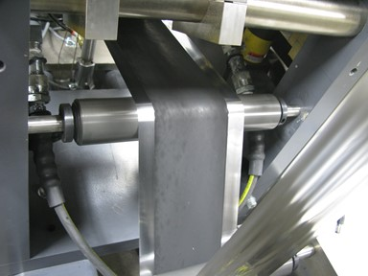
Basis of ETP Dry Process
10-60 kV
Electrode Materials in Powder Form Suspended in a Fluidized Bed (Active Materials, Polymer Binder, Additives)
Particles Charged Electrostatically
Particles Sprayed Onto Heated, Grounded Metal Foil
Green Electrode Heated, Calendered, and Cut to Size
Loose
Electrode/
Separator
Material
Compacted
Electrode/
Separator
Material
Fluidized Particles
Heat

Slide 6
Dry Processed, Layered, Flexible Lithium-Ion Manufacturing Process
BATTNET Pre-Commercial Pilot

Slide 7
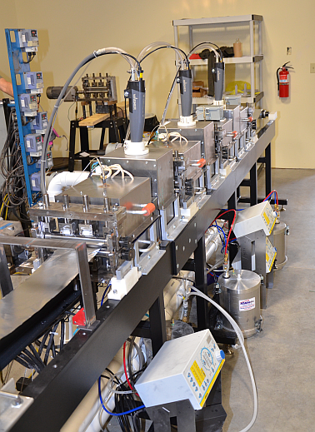
Dry Processed, Layered, Flexible Lithium-Ion Manufacturing Process
Original Lab Line Concept

Slide 8
Spray vs Solvent Cast
Spray Does Not Leave A Fines or Polymer Layer
Spray Allows Better Dispersed Polymer That Does Not Enter Pores of the Electrode Active Material
PVDF Can Be Placed Where it Does The Most Good and Lowered Where IT Is Not Needed
Electrode Can Immediately Be Used
No Solvent Or Drying.

Slide 9
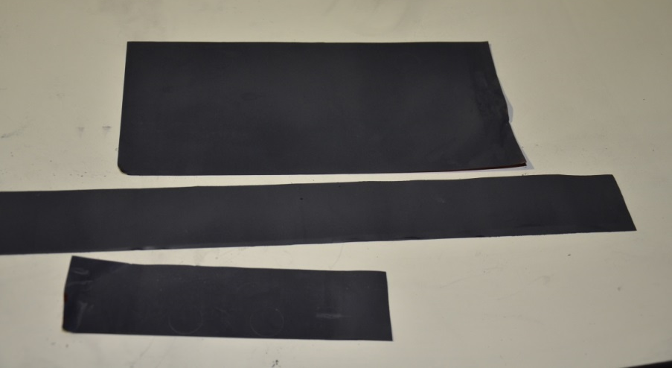
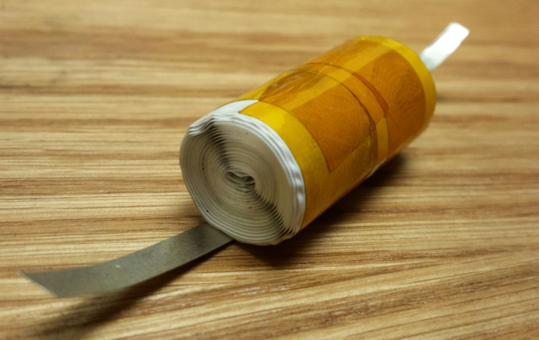
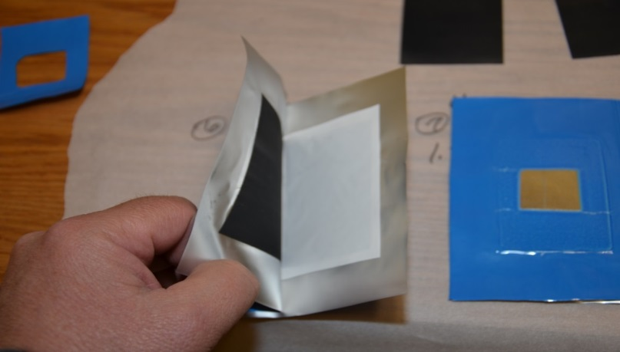
ETP Dry Processed Electrodes Before Manufacturing Into…..
Cylindrical Cells and
Pouch Cells for testing

Slide 10
Layered Electrode Concept
Deposition of Multiple Electrode Layers with Differing Compositions, Porosities
This Can Result in More Optimum Placement of Conductive Carbon, Porosity to Reduce Resistances, Especially at High Rates (i.e. Reduce Choke Points for Ionic, Electronic Current Density Through Electrode Thickness)
Impractical with Other Dry Processes

Slide 11
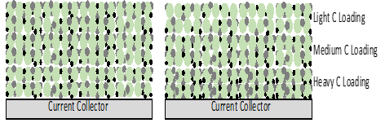
Dry Processed, Layered, Flexible Lithium-Ion Manufacturing Process
-Changing Particle Size, Loadings and Conductive Additives Throughout the
Layered Electrode Could Provide Improved Performance
-Changes in Porosity, Binder Levels Could Improve Active Material
Adherence and Power

Slide 12
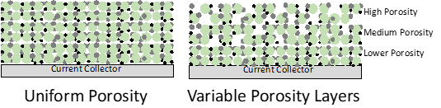
Porous Structure for Power

Slide 13

Ceramic Separator
Ceramic Powders and Polymer Powders Mixed
Sprayed Onto Surface of Existing Electrode
Heated and Calendered
Advantages
  No Separator Alignment Problems
  Reduce Polymer Amounts
  Much Greater Safety
  Lower Cost
Multilayer Separator

Slide 14
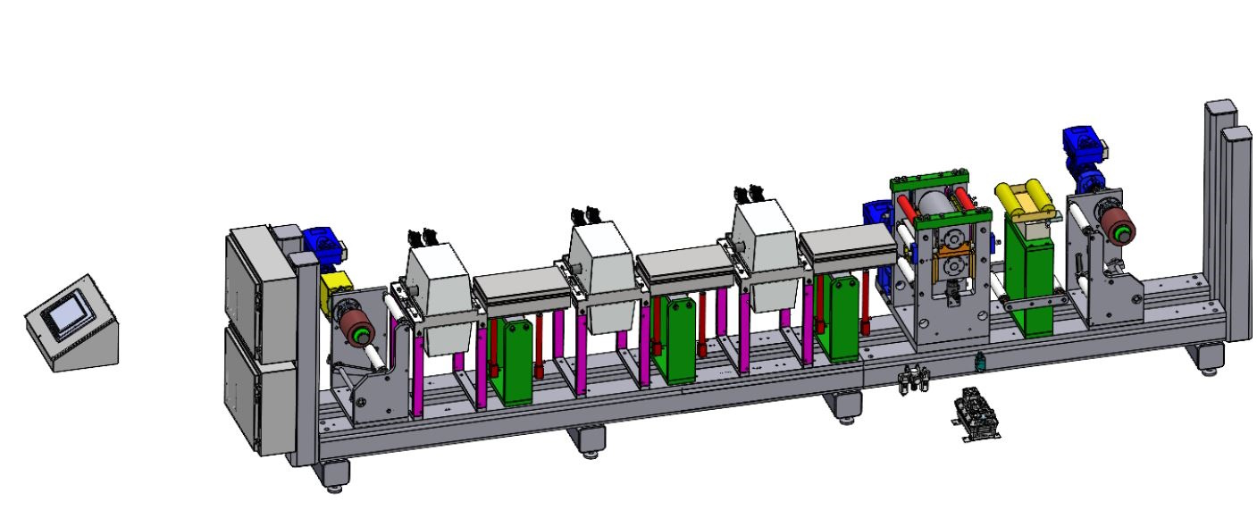

Pilot Line 1um Control Automated
$1.8 to 2M

Slide 15
Conclusions
Cost and time advantages of the use of the dry fabrication process developed by ETP are well-established.
Significant performance advantages, which can be achieved by applying multiple electrode layers with different properties
Depositing a ceramic-polymer separator on the surface of electrodes greatly improves electrode alignment and safety.
It is widely believed that solid electrolyte cells cannot be made effectively when a solvent-casting manufacturing approach is used to make electrodes.
The use of the ETP dry process avoids the problems of using a solvent-based process, which include a residual and resistive film that remains on the surface of the solid electrolyte.

