Slide 1
Glatfelter Generation II Separator
DPEC Dave Rittenhouse
June 5, 2024

Slide 3
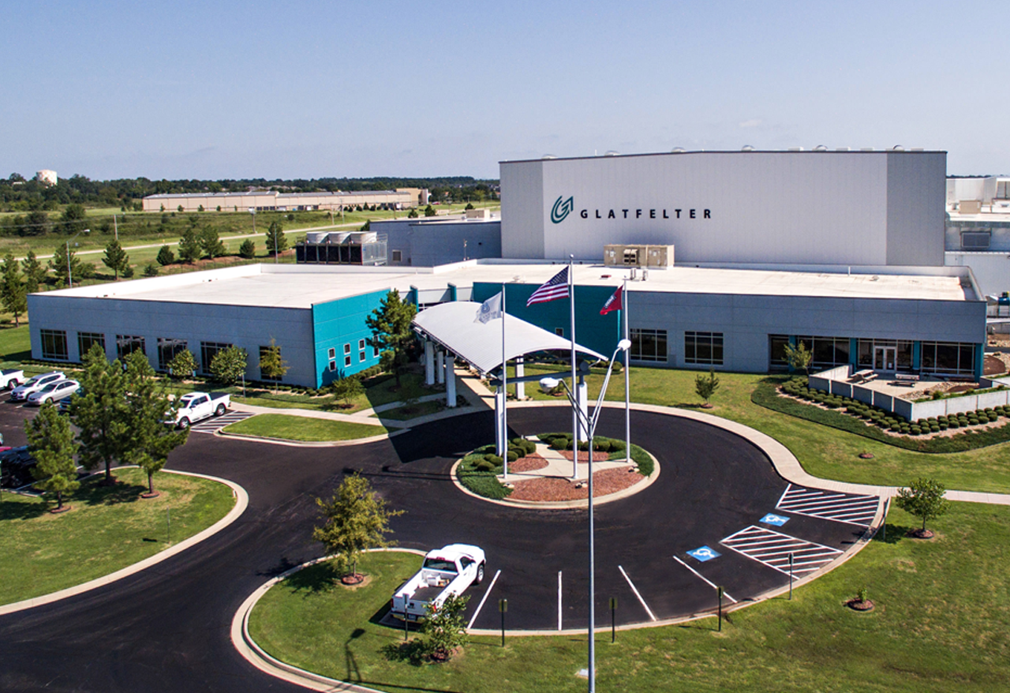
GLATFELTER
AT A GLANCE
Founded in 1864
$
Sales: $1.5 billion
Employees worldwide: 3,300
16 Manufacturing Facilities: U.S. - Germany - Canada United Kingdom - France Philippines - Spain
Glatfelter Company Snapshot 2023
Notes:
Update Numbers

Slide 5
Old Hickory Advanced Battery Technology Center

Slide 6
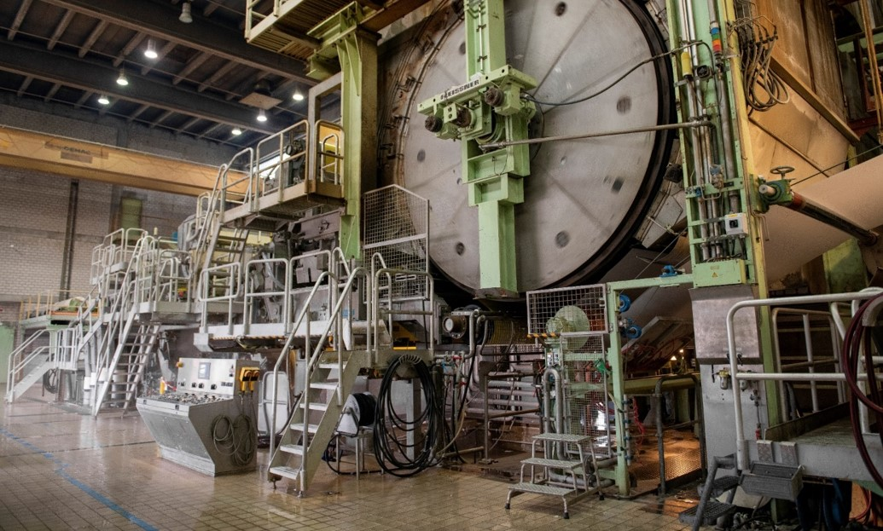
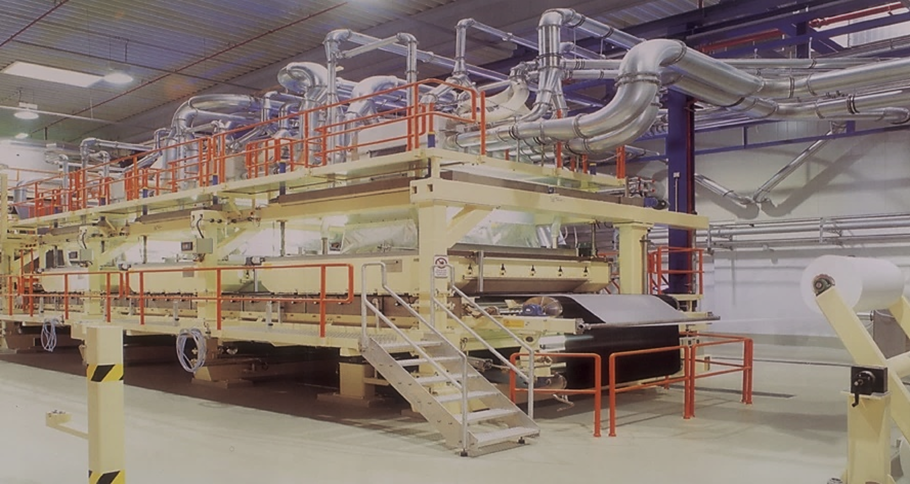
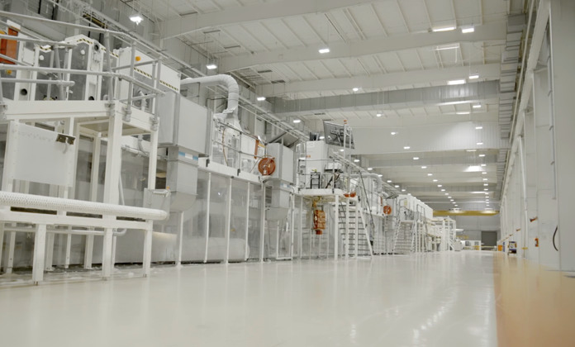
Nonwoven Web forming technologies used by Glatfelter
Inclined Wire-Wet laid Nonwovens
Air Laid
Spun lace-Hydroentangled
Largest capacity of Inclined wire machines-10
Largest producer of Airlaid materials

Slide 7
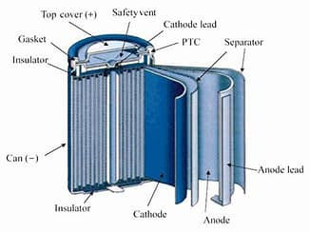
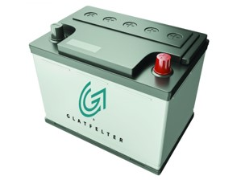
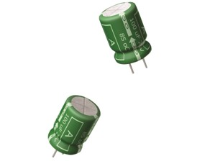
Three Pillars of Glatfelter’s Electrical Business
Lead-Acid Batteries
Capacitors
Lithium-Ion Separators
Leading supplier of Pasting Paper world wide
Retention Mats for EFBs
Kraft Capacitor Tissue
Aluminum Electrolytic Capacitors
Invested in DreamWeaver on 3-14-2014
Manufacturing Licensee
Wet laid paper making process
Fibers dispersed in water
Single layer, comprised of nano and micro fibers
Sought to advance separator technology

Slide 8
Objectives of Generation II Separator
Fast Charging Thin Safety Versatile Secure Economic | Increased charge rates without loss of capacity or cycle life Increased energy density, reduced weight/size Low thermal shrinkage with optional high-temperature variants Platform technology can readily be tuned to diverse applications US sourced technologies, materials and manufacture Margin compression impacting EV industry, savings needed

Slide 9
Properties of Generation II vs. existing separators
Uniform highly tortuous fibrous structure
High porosity => high ionic conductivity
Through pore structure, no tortuosity of stretched films
Poor wicking properties

Slide 10
Properties of Gen II vs Dry Process Separator
Property | Unit |  | GS12 | GS15 | GS22 | PP Dry Process
Nominal Thickness | μm |  | 12 | 15 | 22 | 25
Basis Weight | g/m² |  | 6 | 8 | 12 | -
Thermal Shrinkage (120°C for 1hr) | % | MD | 2% | 1% | 3% | 14%
 |  | TD | 2% | 2% | 2% | 0%
Air Permeability | mL/sec |  | 1,420 | 320 | 149 | 11
 | s/100mL |  | 6 | 9 | 16 | 200
Porosity | % |  | 54 | 58 | 59 | 55

Slide 11
Wettability and Capillary Action
12 gsm Gen II after 1 minute
- ~0.25 ml of LiPF6 1M EC/DMC -
25um PP Dry Process after 1 minute
- ~0.25 ml of LiPF6 1M EC/DMC -

Slide 12
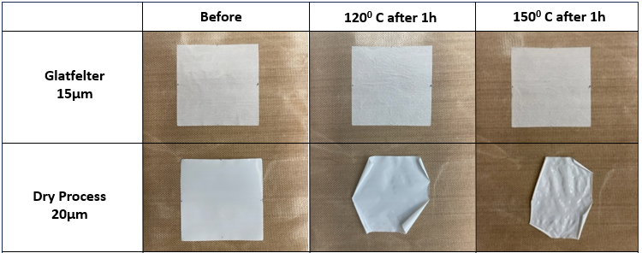
Shrinkage Testing
~1% Shrinkage in TD and ~5% in MD
~2% Shrinkage in TD and ~28% in MD

Slide 13
Cycle Life of Gen II vs. Dry Process Separator
Description | Ch. ID | # | Cycles | Capacity Ret.% | Loss/cycle % | Start Cap. | End. Cap. | DCIR
15um | 16-3-1 | 11 | 532 | 94.3 | 0.0107 | 1694.80 | 1598.40 | 65
22um | 16-2-3 | 21 | 508 | 93.5 | 0.0127 | 1710.20 | 1599.70 | 71
Celgard 2500 | 15-8-6 | 35 | 468 | 94.6 | 0.0115 | 1670.90 | 1581.20 | 61
Celgard 1611 | 15-7-2 | 28 | 467 | 93.2 | 0.0146 | 1695.60 | 1579.90 | 58

Slide 14
Cycle Life of Gen II vs. Dry Process Separator
Changed from C/3 to 1C
Description | Ch. ID | # | Cycles | Capacity Ret.% | Loss/cycle | Start Cap. | End. Cap. | DCIR
15um | 16-5-3 | 9 | 756 | 92.5 | 0.01 | 1610 | 1489 | 62
22um | 16-2-1 | 19 | 749 | 89.4 | 0.0141 | 1695 | 1516 | 71
Celgard 2500 | 15-8-3 | 32 | 698 | 88.2 | 0.0168 | 1680 | 1483 | 61
Celgard 1611 | 15-7-1 | 27 | 698 | 90.4 | 0.0137 | 1693 | 1531 | 58

Slide 15
Cycle Life of Gen II vs. Dry Process Separator
Description | Ch. ID | # | Cycles | Capacity Ret.% | Loss/cycle % | Start Cap. | End. Cap. | DCIR
15um | 86-3-6 | 7 | 755 | 94.3 | 0.0076 | 1652 | 1565 | 58
22um | - | - | - | - | - | - | - | -
Celgard 2500 | 86-4-5 | 31 | 699 | 90.9 | 0.013 | 1672 | 1520.00 | 65
Celgard 1611 | 86-3-5 | 26 | 694 | 83.5 | 0.0238 | 1701 | 1420.90 | 61

Slide 16
Rate Capability vs. Dry Process Separator

Slide 17
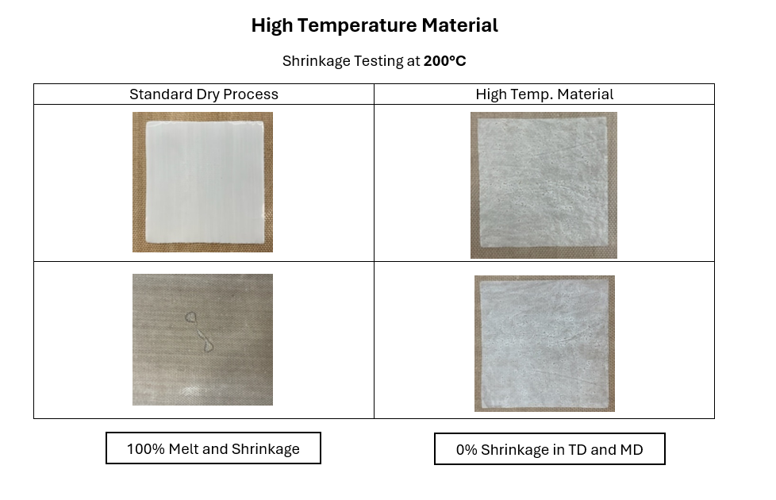
Developments
Working with different materials to increase safety for extreme temperature conditions.
Ability to use non-standard materials is beneficial for applications beyond typical lithium-ion battery applications.

Slide 18
Developments
Adjustable pore size & porosity to match performance in end-use-
Rate vs. Self-discharge
Surface functionalization to enable better wet out by organic electrolytes
High viscosity FR electrolytes
Reserve battery application requiring excellent wicking
Wet-out in aqueous electrolyte systems
Dendrite Suppression
Electrochemical technology
Nanoparticle technology for advanced lithium battery designs prone to dendrite formation, eg. Li-Metal
Coatings
Extreme temperature resistance
Adhesive layer
Extended Cell Life– HF Scaveging technology

Slide 19
Commercial Status
Have been making highly reproducible separator for 3 years on semi-production equipment
Engagements with many customers
MIL: High-Rate applications-UAVs, DEWs, & Safety-CWBs
High-Energy materials, enables high charge & discharge rates, Si, Li-Metal
Emerging chemistries: Zn, Al-Ion, Si, Li-Metal anodes
Have inventory of 12, 15, and 22 um for sampling.
Can quickly scale to full-scale production

Slide 20
Business Strategy
Approaching battery market the same way that Glatfelter uses with its other businesses:
Closely engage with customers to understand their needs and tailor a solution to meet their needs.
We can produce sample-to-commercial quantities
The details of each project are unique

Slide 21
Summary of Gen II Separator
High porosity enables fast charging & discharging (Achieving 4C rates).
Currently determining max discharge capabilities in High power applications.
Cell performance is comparable to commercial high power dry process separator.
Base product stable to 120°C (vs. 90°C for stretched films).
Higher temperature versions under development.
Platform versatility and robustness enabling:
Thickness range of 12 =>175 u
Compatibility with organic and aqueous electrolyte systems
Extensive IP portfolio
U. S. based supply chain provides security and jobs, availability of developmental and scale-up quantities.
Platform offers economic advantages vs. available separators

Slide 22
Thank you for your time.
Dave.Rittenhouse@Glatfelter.Com
404-372-5082

