Slide 1
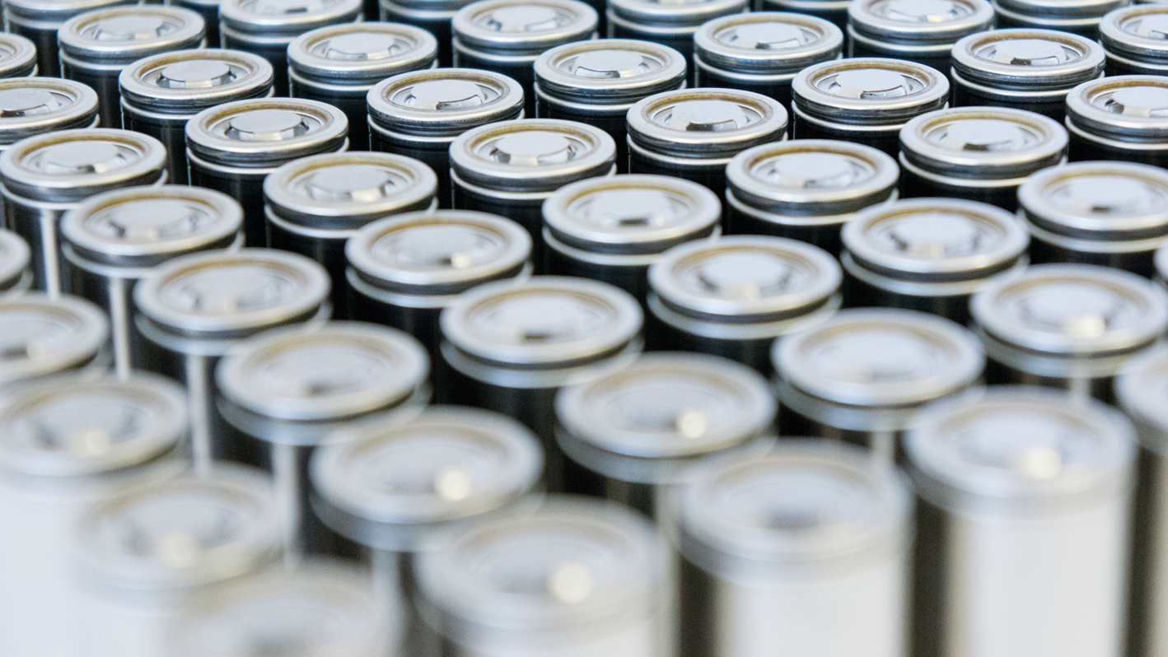
Better Domestically Sourced Batteries for Better Products
Deryck Robinson, Director of Sales
Forge Battery Incorporated
www.forgebattery.com

Slide 2
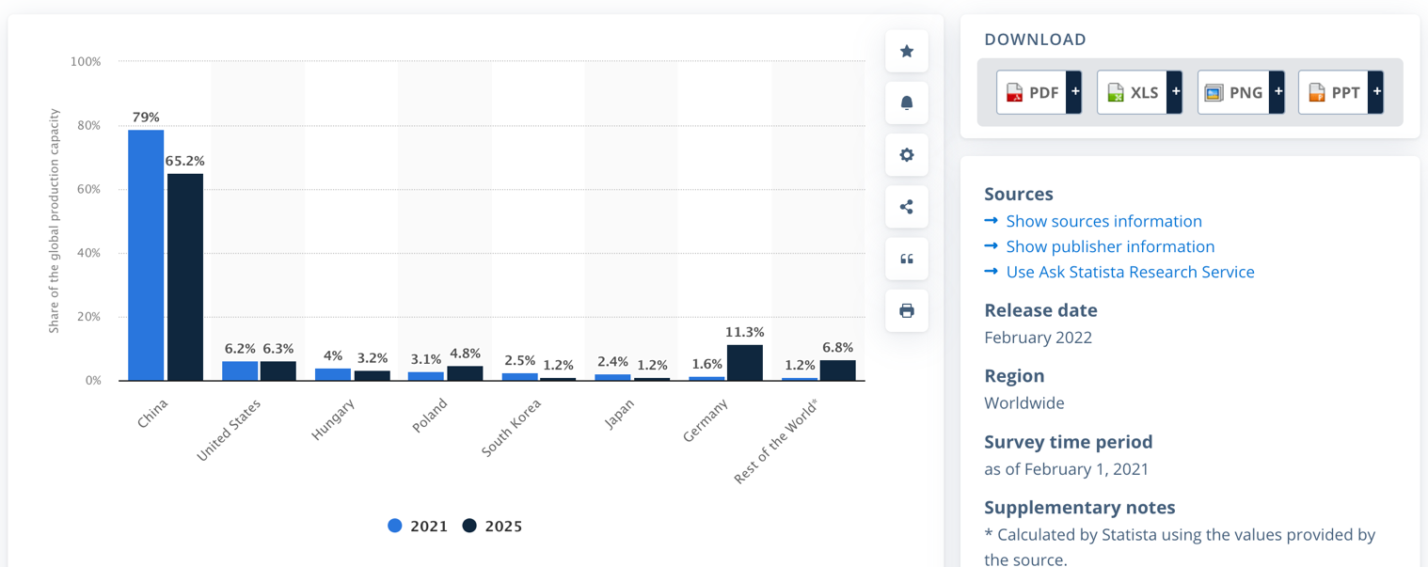
The Problem: China Dominates Li+ Production and material resources.
China controls the largest global capacity share: >75% of cell production, >70% of processed energy material production, and >60% of energy materials purification and refinement.
Demand for Li-ion batteries growing rapidly.
U.S. based companies continue to lead innovation of next gen battery technologies.
U.S. industry currently captures <30% of the economic value of each battery in the U.S. Market
China-based companies capture
90% of the economic value of each lithium battery cell consumed in China.
Sources: Li-Bridge, Building a Robust and Resilient U.S. Lithium Supply Chain.
Sources: Benchmark minerals; Statista; CNN Business; all data is estimated

Slide 3
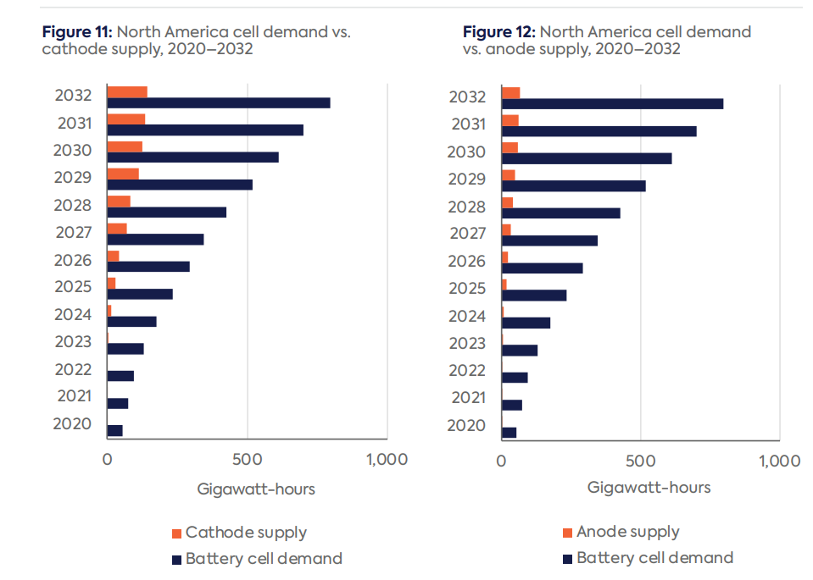
The Problem: US Supply Chain Vulnerability
Battery demand in U.S to grow to over 800 GWh by 2032.
Battery cell supply projected to meet demands
Shortages of anode and cathode materials represent a major bottleneck for domestic supply.
U.S. is projected to be highly import dependent on a supply chain that is easily disrupted.

Slide 4
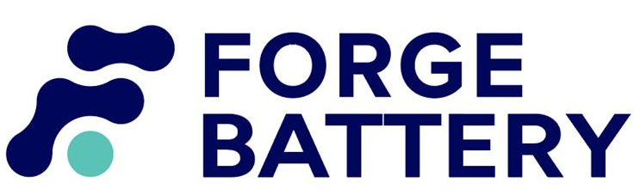
Building a robust and sustainable lithium battery manufacturing base in the United States requires addressing several challenges.
Main Challenges:
Insufficient Return on Investment on Long-Term Projects.
Scale-up is requires capital intensive investment and requires a longer-term view from investors.
Tax incentives to persuade investors to focus on long-term return?
Lengthy and uncertain timelines to secure permits and project approval…and electricity!
Unpredictable permitting and approvals limits potential investment in projects across the lithium battery supply chain. Delays can range from six months (manufacturing) up to decades (for mining).
Lack of Access to Critical Minerals and Raw and Processed Energy Materials.
U.S. Government intervention is necessary to level the playing field.
Insufficient benefits for customers to “buy local” and pay more for U.S.-made products.
Incentives required for OEM’s and end customers to purchase U.S. Made and U.S. supplied cells.
Sources: Li-Bridge, Building a Robust and Resilient U.S. Lithium Supply Chain.

Slide 5
Partial Solutions
Improve investment attractiveness of U.S.-based lithium battery technology and material production through expanded and better designed supply and demand-side incentives. (Capex, Production, R&D, Demand, etc…)
“Investment incentives should be allocated to favor the localization of production facilities, R&D and engineering staff in the United States, regardless of the ownership of the entity receiving the incentive.”
Help U.S. companies secure access to critical raw minerals and processed energy materials (virgin and recycled, domestic- and foreign-sourced).
Government has a key role to play in several areas, particularly in reducing regulatory complexity, forging international partnerships, and supporting innovation.
Sources: Li-Bridge, Building a Robust and Resilient U.S. Lithium Supply Chain.

Slide 6
The good news, it can be done.

Slide 7
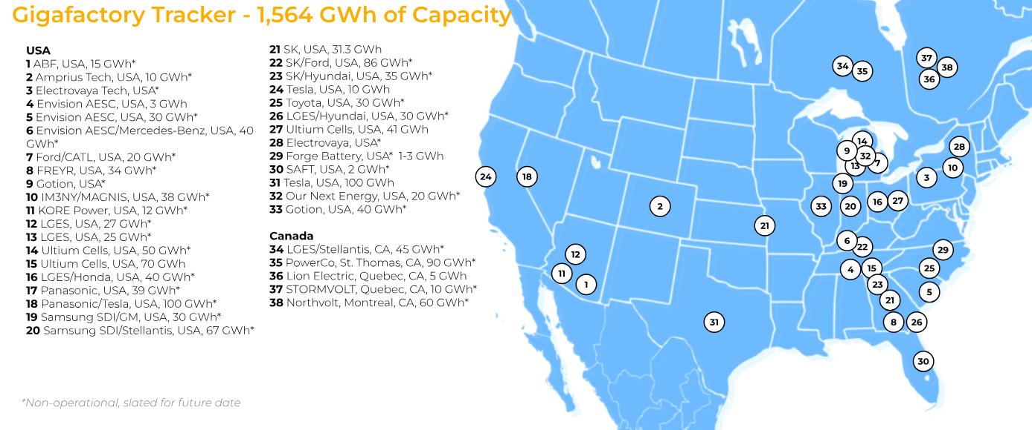
Better Batteries, Made in the U.S., By a U.S. Corporation
The U.S. has seen an influx of battery manufacturing announcements in recent years, with an estimated 1,564 GWh of capacity planned.
Of that planned capacity, roughly 14 percent (213 GWh) will be owned and operated by U.S. corporations^{.1}
Where are their materials sourced?
1. Volta Foundation – Battery Report 2023.

Slide 8
U.S. Corporations
Location
Location
Thornton, CO
Morrisville, N.C.
Facility
Facility
70,000 sq/ft
277,000 sq/ft
Production Capacity
Production Capacity
Giga-Scale production
20 tons/day
Mwh Scale Prototype line
Products
Atomic Armor works by shielding materials from detrimental surface reactions via an ultrathin, ultra uniform, and highly robust shell
Products
High-performance 21700 and
18650 Li-ion cells
Job Creation
Job Creation
Over 100 jobs and growing.
Creation of over 300 local jobs.

Slide 9
Forge Battery Mission- U.S. Focused Supply Chain
Forge Battery intends to be a leading domestic battery supplier with a U.S.-focused supply chain.
Benefits of U.S.-Produced & Sourced Batteries: It takes a village!
Further bolster the domestic battery ecosystem and reduce reliance of foreign suppliers.
Extraction > Chemical Processing > Cathode/Anode Production > Cell Manufacturing
Lower cell cost ($/kWh) for domestically produced cells as result of U.S innovation with majority U.S.-supplied materials.
Next-gen battery technology development.
Customs, taxes, shipping time & cost.
Gov’t incentives
Local job creation.
Vocational training.
Control Technician, Maintenance Planner, Process Engineering Lead, Quality Supervisor
Recycling

Slide 10
Supply Chain U.S.-Focused Supply Chain
Made in USA
U.S. Content Target in 2027: 100%
10-years of supplier validation
Component | Primary Sources | Target Source
Cathode | U.S. | U.S.
Graphite | U.S. | U.S.
Silicon Material | U.S. | U.S.
Binders | KR | U.S.
Foils | KR | U.S.
Conductive Additives | U.S. | U.S.
Separator | U.S. | U.S.
Exterior | U.S. | U.S.
Electrolyte | U.S. | U.S.
Acquisition of Forge Battery cells support IRA $10/kWh credit for pack manufacturers
Proprietary & Confidential

Slide 11
Gen 1.1 Cylindrical Specs
Product Details
18650
 | Energy | Power
Cell | FB1844-V11 | FB1830-V11
Chemistry | NMC811 and Synthetic Graphite + SiC | NMC811 and Synthetic Graphite + SiC
Capacity | 4.0Ah (3.9Ah Min) Charge: 0.1C, 4.35V, .05C cut off @ RT Discharge: 0.1C, 2.5V cut off @ RT | 3.0 Ah (2.9Ah Min) Charge: 0.1C, 4.2V, .05C cut off @ RT Discharge: 0.1C, 2.5V cut off @ RT
Voltage Range | 2.5-4.35V | 2.5-4.2V
Nominal Voltage | 3.41V | 3.52V
Energy | 13.1 Wh | 10.4 Wh
Weight/Volume | 43.8g (.01654L) | 42g (.01654L)
Energy Density | 301 Wh/kg (794 Wh/L) | 250 Wh/kg (628 Wh/L)
Cycle Life | 500 Cycles to 80% SOH | 1000 Cycles to 80% SOH
 | Energy | Power
Cell | FB2156-V11 | FB2146-V11
Chemistry | NMC811 and Synthetic Graphite + SiC | NMC811 and Synthetic Graphite + SiC
Capacity | 5.6Ah (5.4Ah Min) Charge: 0.1C, 4.35V, .05C cut off @ RT Discharge: 0.1C, 2.5V cut off @ RT | 4.6Ah (4.4Ah Min) Charge: 0.1C, 4.2V, .05C cut off @ RT Discharge: 0.1C, 2.5V cut off @ RT
Voltage Range | 2.5-4.35V | 2.5-4.2V
Nominal Voltage | 3.46V | 3.54V
Energy | 18.4 Wh | 15.4 Wh
Weight/Volume | 63.5g (.02425L) | 60.3g (.02425L)
Energy Density | 307 Wh/kg (804 Wh/L) at C/3 | 268 Wh/kg (667 Wh/L) at C/3
Cycle Life | 500 Cycles to 80% SOH | 1000 Cycles to 80% SOH
21700
Proprietary & Confidential
26
Note: 18650 and 21700 cells have nearly identical formulations

Slide 12
Performance Road Map
Cell Roadmap
Existing and emerging customer base
400
350
275
300
Wh/kg
2023
2024
2025
2026
Year
Gen | Wh/kg | Architecture | Formulation | Market Target | Market Outlet
1.0 | 275 | 21700, 18650 | NMC/G+Si | COTS | -
1.1 | 300 | 21700, 18650 | NMC/G+Si (more Si) | Niche, Niche EV | SPV
1.2 | 350+ | 21700, 46xx0, | NMC/100% Si | EV | JV
2.0 | 400+ | 46xxx, L. Prismatic | S/Li | EV, ESS | JV
Proprietary & Confidential
27

Slide 13
Summary
Benefits of Domestic Supply Chain
Job Creation
Forge Battery expects to employee at least 300 employees.
Forge Battery’s construction and ramp-up could support between 7-9x ancillary jobs per full time employee.
Vocational Training
The Company expects to work with local organizations and universities for job development programs to train future employees, which could be hired as soon as Q4 2024.
Decrease reliance on foreign suppliers
Multiply these benefits on downstream domestic material providers.
Domestic anode, cathode, electrolyte, etc…
U.S companies need to utilize domestic providers to promote growth and sustainability.
Funding, Grants & Incentives
IRA funding and grants are a tremendous help in moving things forward. More incentives are needed.
Has attracted many foreign manufacturers to create jobs in the U.S.
Allows U.S. based start ups to accelerate their time to market.
Need to streamline the process and make it easier and faster to apply for and receive the funding.
Many smaller organizations do not have the manpower or bandwidth to navigate the complex process of apply for funding.
Election year may impact access to these funds after 2024.
Commitment up and down the chain to source domestically.

Slide 14
Thank You!
Deryck Robinson
Director of Sales
678-654-5510
drobinson@forgebattery.com
Q&A
www.forgebattery.com

